Slide 1
Non-examples
(Coordinates to Graphs)
Each slide contains five “examples” of a mathematical property.
Some are correct examples, some are not.
Explain which examples are correct and why.
Explain which examples are incorrect and why.

Slide 2
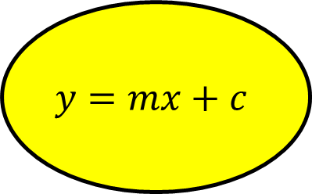
Go straight to…
Coordinates
Gradient
$$y=mx+c$$
Parallel lines
Perpendicular lines
Curves

Slide 3
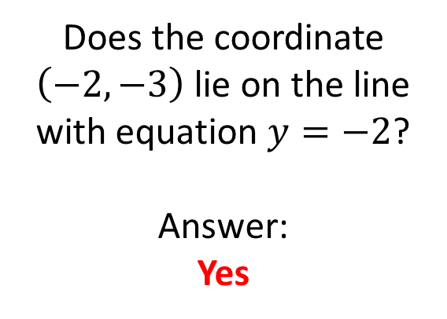
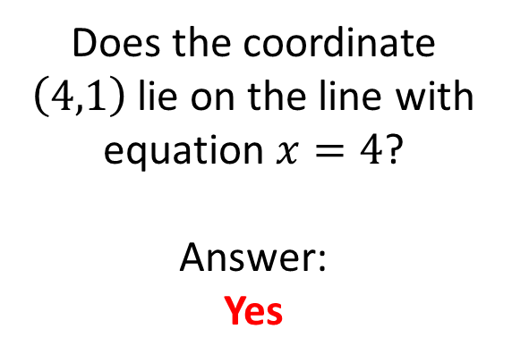
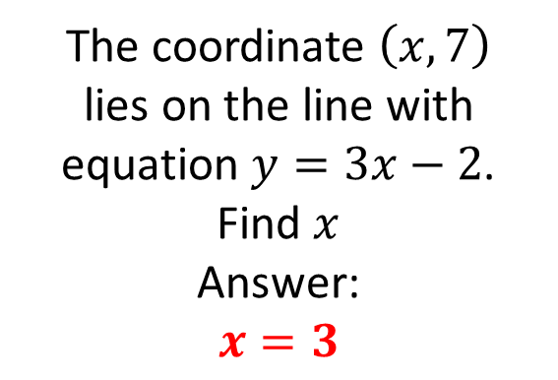
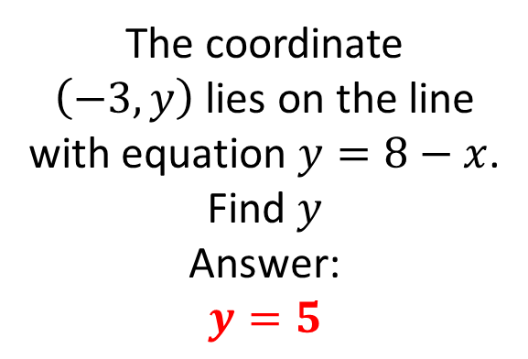
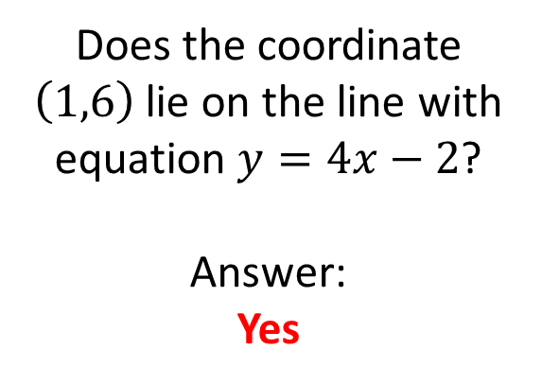
Mathematical Property:
Coordinates
A
B
Does the coordinate
$\left(4,1\right)$ lie on the line with equation $x=4$?
Answer:
Yes
Does the coordinate
$\left(−2,−3\right)$ lie on the line with equation $y=−2$?
Answer:
Yes
C
Does the coordinate
$\left(1,6\right)$ lie on the line with equation $y=4x−2$?
Answer:
Yes
D
E
The coordinate
$\left(−3,y\right)$ lies on the line with equation $y=8−x$.
Find $y$
Answer:
$$y=5$$
The coordinate $\left(x,7\right)$
lies on the line with equation $y=3x−2$.
Find $x$
Answer:
$$x=3$$

Slide 4
Mathematical Property:
Coordinates
Back to “Option” slide
A
B
Does the coordinate
$\left(4,1\right)$ lie on the line with equation $x=4$?
Answer:
Yes
Does the coordinate
$\left(−2,−3\right)$ lie on the line with equation $y=−2$?
Answer:
Yes
Answers
Correct
Incorrect
C
Does the coordinate
$\left(1,6\right)$ lie on the line with equation $y=4x−2$?
Answer:
Yes
Incorrect
D
E
The coordinate
$\left(−3,y\right)$ lies on the line with equation $y=8−x$.
Find $y$
Answer:
$$y=5$$
The coordinate $\left(x,7\right)$
lies on the line with equation $y=3x−2$.
Find $x$
Answer:
$$x=3$$
Incorrect
Correct

Slide 5
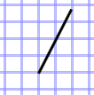
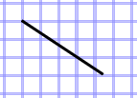
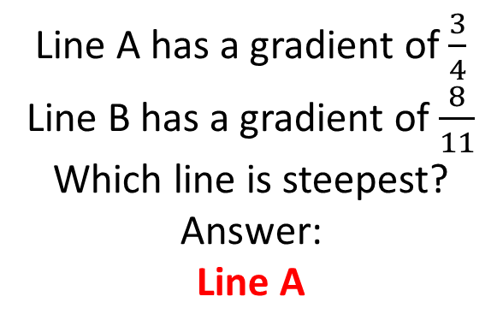
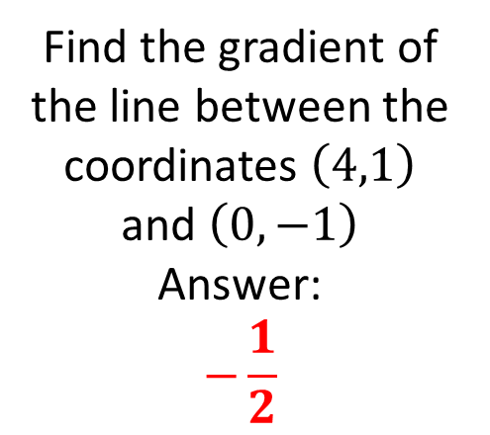
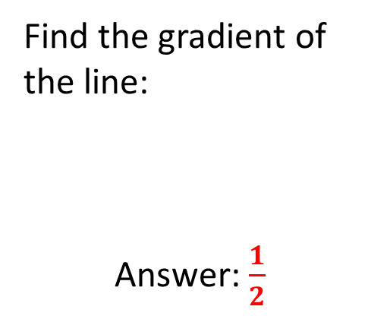
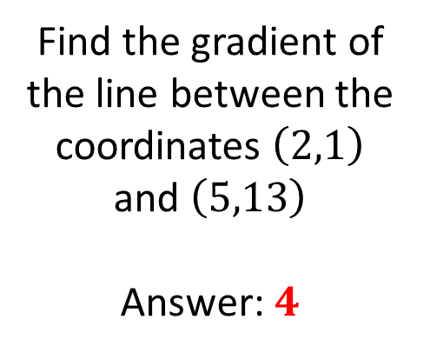

Mathematical Property:
Gradient
A
B
Find the gradient of the line:
Answer: $\frac{1}{2}$
Find the gradient of the line:
Answer: $\frac{2}{3}$
C
Find the gradient of the line between the coordinates $\left(2,1\right)$ and $\left(5,13\right)$
Answer: $4$
Find the gradient of the line between the coordinates $\left(4,1\right)$ and $\left(0,−1\right)$
Answer:
$$−\frac{1}{2}$$
E
D
Line A has a gradient of $\frac{3}{4}$
Line B has a gradient of $\frac{8}{11}$
Which line is steepest?
Answer:
Line A

Slide 6
Mathematical Property:
Gradient
Back to “Option” slide
A
B
Find the gradient of the line:
Answer: $\frac{1}{2}$
Find the gradient of the line:
Answer: $\frac{2}{3}$
Answers
Incorrect
Incorrect
C
Find the gradient of the line between the coordinates $\left(2,1\right)$ and $\left(5,13\right)$
Answer: $4$
Correct
Find the gradient of the line between the coordinates $\left(4,1\right)$ and $\left(0,−1\right)$
Answer:
$$−\frac{1}{2}$$
E
D
Line A has a gradient of $\frac{3}{4}$
Line B has a gradient of $\frac{8}{11}$
Which line is steepest?
Answer:
Line A
Incorrect
Correct

Slide 7
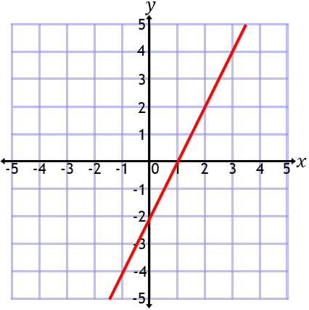
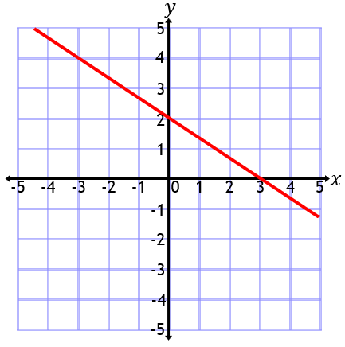
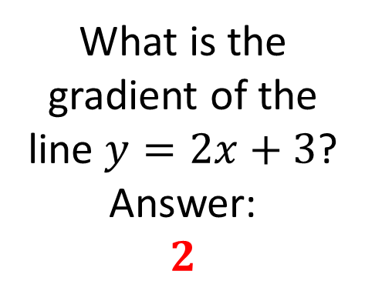
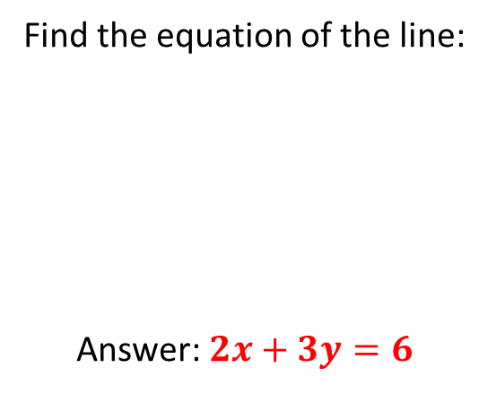

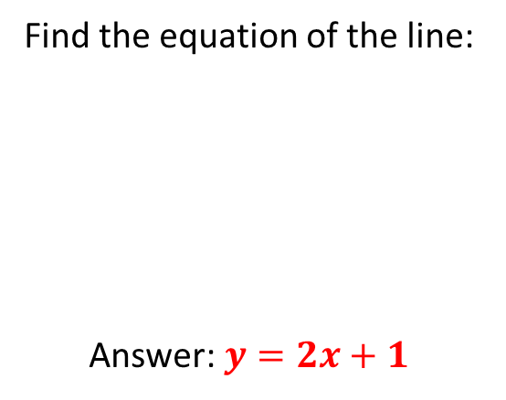
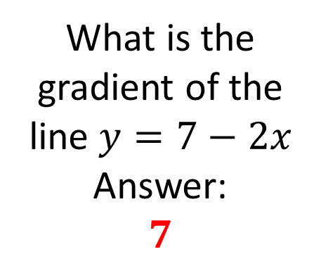
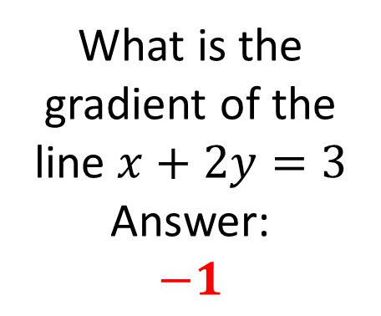
Mathematical Property:
$$y=mx+c$$
A
B
What is the gradient of the line $y=2x+3$?
Answer:
$$2$$
What is the gradient of the line $y=7−2x$
Answer:
$$7$$
C
What is the gradient of the line $x+2y=3$
Answer:
$$−1$$
D
E
Find the equation of the line:
Answer: $y=2x+1$
Find the equation of the line:
Answer: $2x+3y=6$

Slide 8
Mathematical Property:
$$y=mx+c$$
Back to “Option” slide
A
B
What is the gradient of the line $y=2x+3$?
Answer:
$$2$$
Answers
What is the gradient of the line $y=7−2x$
Answer:
$$7$$
Correct
Incorrect
C
What is the gradient of the line $x+2y=3$
Answer:
$$−1$$
Incorrect
D
E
Find the equation of the line:
Answer: $y=2x+1$
Find the equation of the line:
Answer: $2x+3y=6$
Incorrect
Correct

Slide 9
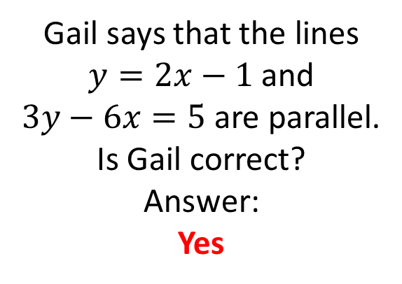
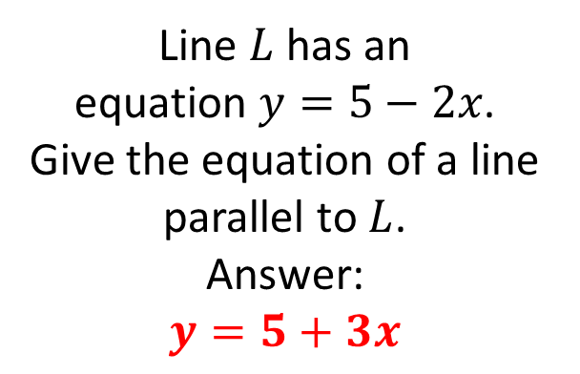
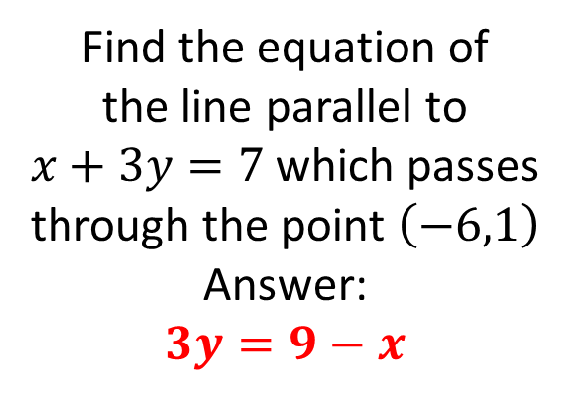
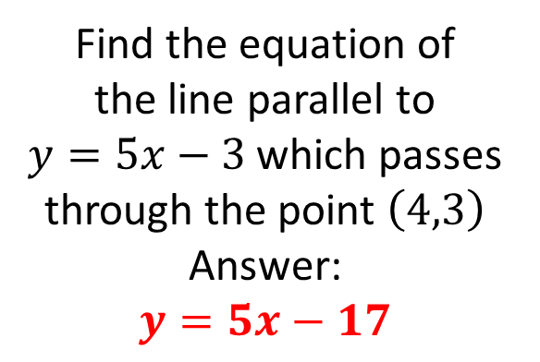
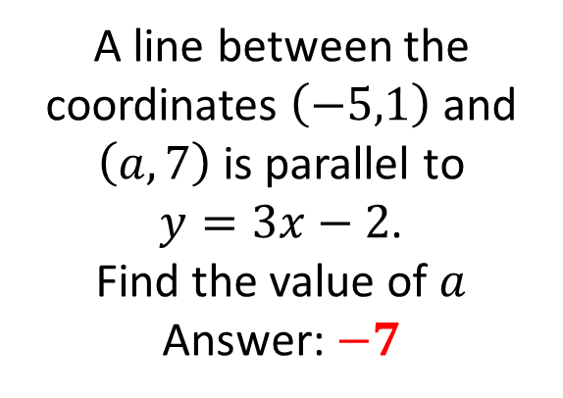
Mathematical Property:
Parallel lines
A
B
Line $L$ has an
equation $y=5−2x$.
Give the equation of a line parallel to $L$.
Answer:
$$y=5+3x$$
Gail says that the lines
$y=2x−1$ and
$3y−6x=5$ are parallel.
Is Gail correct?
Answer:
Yes
C
A line between the coordinates $\left(−5,1\right)$ and $\left(a,7\right)$ is parallel to
$y=3x−2$.
Find the value of $a$
Answer: $−7$
D
E
Find the equation of
the line parallel to
$y=5x−3$ which passes through the point $\left(4,3\right)$
Answer:
$$y=5x−17$$
Find the equation of
the line parallel to
$x+3y=7$ which passes through the point $\left(−6,1\right)$
Answer:
$$3y=9−x$$

Slide 10
Mathematical Property:
Parallel lines
Back to “Option” slide
A
B
Line $L$ has an
equation $y=5−2x$.
Give the equation of a line parallel to $L$.
Answer:
$$y=5+3x$$
Gail says that the lines
$y=2x−1$ and
$3y−6x=5$ are parallel.
Is Gail correct?
Answer:
Yes
Answers
Incorrect
Correct
C
A line between the coordinates $\left(−5,1\right)$ and $\left(a,7\right)$ is parallel to
$y=3x−2$.
Find the value of $a$
Answer: $−7$
Incorrect
D
E
Find the equation of
the line parallel to
$y=5x−3$ which passes through the point $\left(4,3\right)$
Answer:
$$y=5x−17$$
Find the equation of
the line parallel to
$x+3y=7$ which passes through the point $\left(−6,1\right)$
Answer:
$$3y=9−x$$
Correct
Incorrect

Slide 11
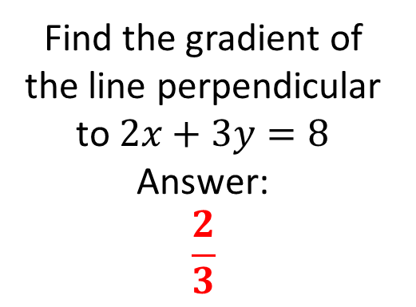
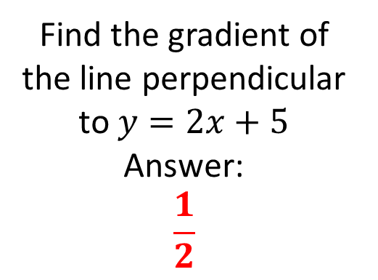
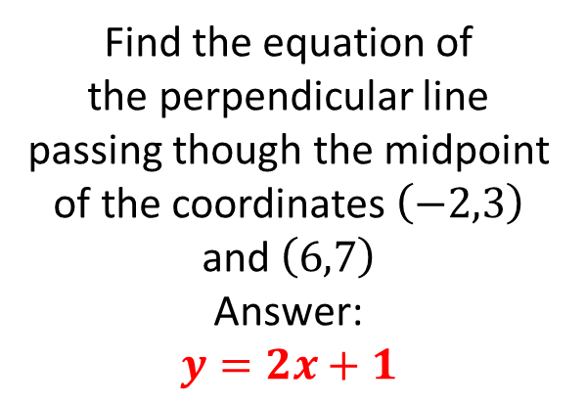
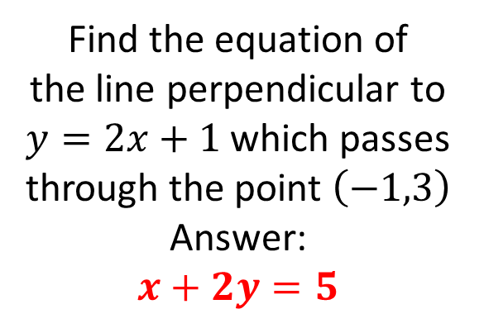
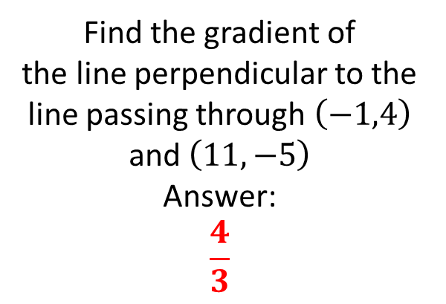
Mathematical Property:
Perpendicular lines
A
B
Find the gradient of the line perpendicular to $y=2x+5$
Answer:
$$\frac{1}{2}$$
Find the gradient of the line perpendicular to $2x+3y=8$
Answer:
$$\frac{2}{3}$$
C
Find the gradient of
the line perpendicular to the line passing through $\left(−1,4\right)$ and $\left(11,−5\right)$
Answer:
$$\frac{4}{3}$$
D
E
Find the equation of
the line perpendicular to
$y=2x+1$ which passes through the point $\left(−1,3\right)$
Answer:
$$x+2y=5$$
Find the equation of
the perpendicular line passing though the midpoint of the coordinates $\left(−2,3\right)$ and $\left(6,7\right)$
Answer:
$$y=2x+1$$

Slide 12
Mathematical Property:
Perpendicular lines
Back to “Option” slide
A
B
Find the gradient of the line perpendicular to $y=2x+5$
Answer:
$$\frac{1}{2}$$
Find the gradient of the line perpendicular to $2x+3y=8$
Answer:
$$\frac{2}{3}$$
Incorrect
Incorrect
C
Find the gradient of
the line perpendicular to the line passing through $\left(−1,4\right)$ and $\left(11,−5\right)$
Answer:
$$\frac{4}{3}$$
Correct
D
E
Find the equation of
the line perpendicular to
$y=2x+1$ which passes through the point $\left(−1,3\right)$
Answer:
$$x+2y=5$$
Find the equation of
the perpendicular line passing though the midpoint of the coordinates $\left(−2,3\right)$ and $\left(6,7\right)$
Answer:
$$y=2x+1$$
Correct
Incorrect
Answers

Slide 13
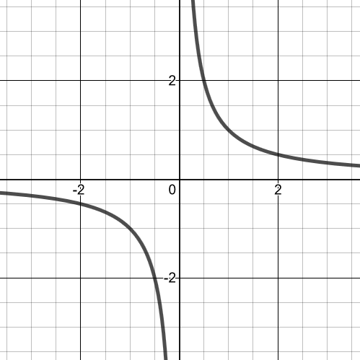
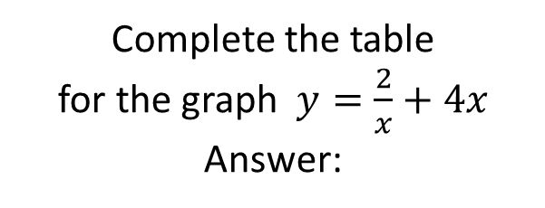
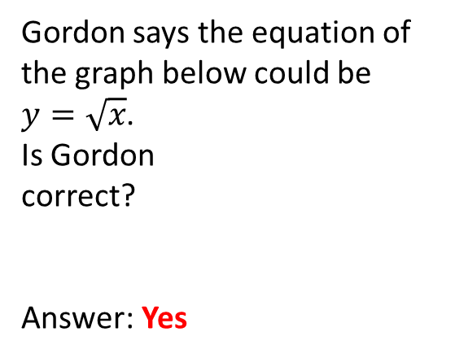
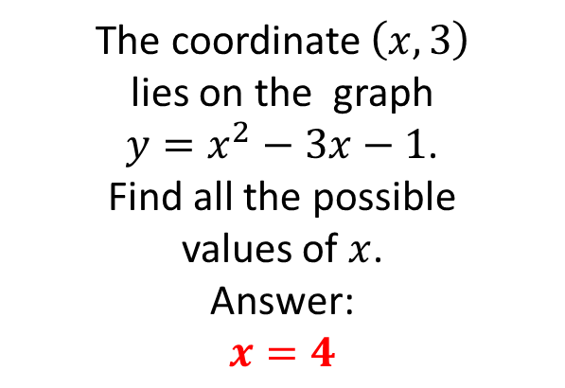
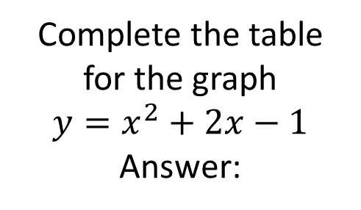
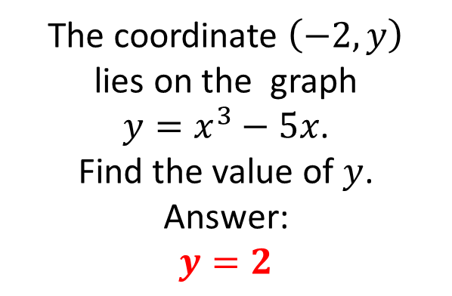
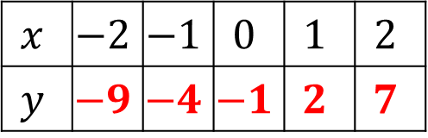
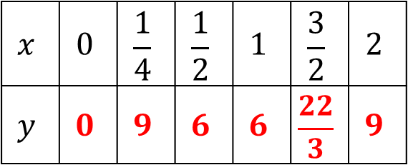
Mathematical Property:
Curves
A
Complete the table
for the graph
$$y=x^{2}+2x−1$$
Answer:
B
Gordon says the equation of the graph below could be
$y=\sqrt{x}$.
Is Gordon
correct?
Answer: Yes
C
$$x$$ | $$−2$$ | $$−1$$ | $$0$$ | $$1$$ | $$2$$
$$y$$ | $$−9$$ | $$−4$$ | $$−1$$ | $$2$$ | $$7$$
The coordinate $\left(−2,y\right)$
lies on the graph
$y=x^{3}−5x$.
Find the value of $y$.
Answer:
$$y=2$$
Complete the table
for the graph $y=\frac{2}{x}+4x$
Answer:
D
E
The coordinate $\left(x,3\right)$
lies on the graph
$y=x^{2}−3x−1$.
Find all the possible
values of $x$.
Answer:
$$x=4$$
$$x$$ | $$0$$ | $$\frac{1}{4}$$ | $$\frac{1}{2}$$ | $$1$$ | $$\frac{3}{2}$$ | $$2$$
$$y$$ | $$0$$ | $$9$$ | $$6$$ | $$6$$ | $$\frac{22}{3}$$ | $$9$$

Slide 14
Mathematical Property:
Curves
Back to “Option” slide
A
Complete the table
for the graph
$$y=x^{2}+2x−1$$
Answer:
B
Gordon says the equation of the graph below could be
$y=\sqrt{x}$.
Is Gordon
correct?
Answer: Yes
Incorrect
Incorrect
C
$$x$$ | $$−2$$ | $$−1$$ | $$0$$ | $$1$$ | $$2$$
$$y$$ | $$−9$$ | $$−4$$ | $$−1$$ | $$2$$ | $$7$$
The coordinate $\left(−2,y\right)$
lies on the graph
$y=x^{3}−5x$.
Find the value of $y$.
Answer:
$$y=2$$
Correct
Complete the table
for the graph $y=\frac{2}{x}+4x$
Answer:
D
E
The coordinate $\left(x,3\right)$
lies on the graph
$y=x^{2}−3x−1$.
Find all the possible
values of $x$.
Answer:
$$x=4$$
Incorrect
Incorrect
$$x$$ | $$0$$ | $$\frac{1}{4}$$ | $$\frac{1}{2}$$ | $$1$$ | $$\frac{3}{2}$$ | $$2$$
$$y$$ | $$0$$ | $$9$$ | $$6$$ | $$6$$ | $$\frac{22}{3}$$ | $$9$$
Answers

Slide 15
Mathematical Property: here
A
B
C
D
E

