Slide 1
Non-examples
(Ratio and Proportion)
Each slide contains five “examples” of a mathematical property.
Some are correct examples, some are not.
Explain which examples are correct and why.
Explain which examples are incorrect and why.

Slide 2
Go straight to…
Simplifying
Sharing in given ratio
Ratio problems
Worded proportion
Algebraic proportion

Slide 3
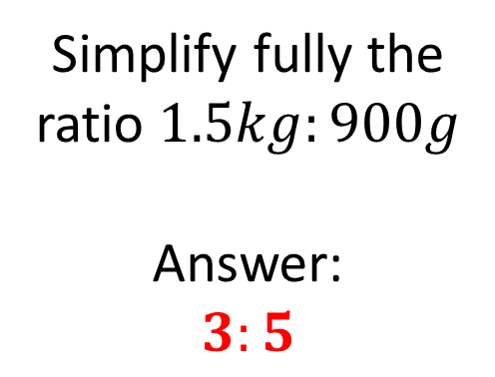
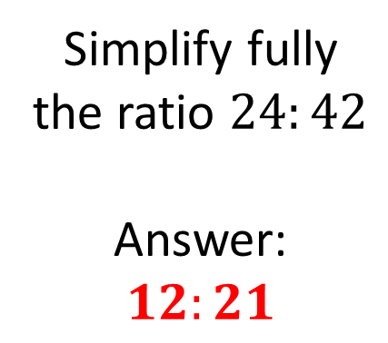
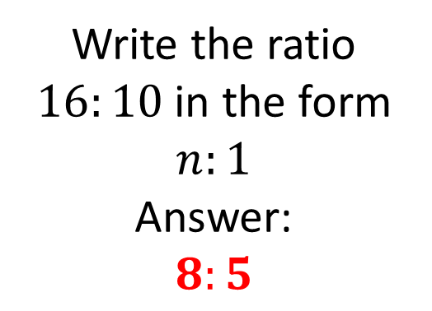
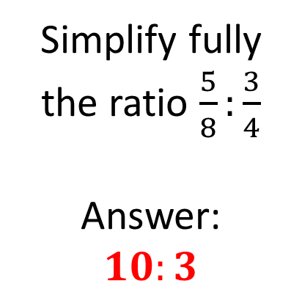
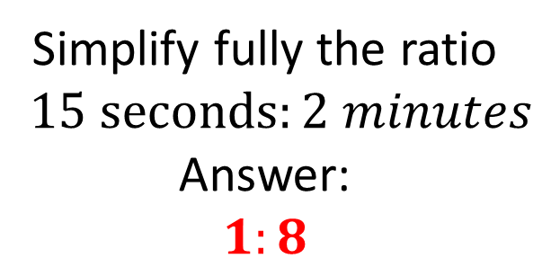
Mathematical Property:
Simplifying
A
B
Simplify fully the ratio $24:42$
Answer:
$$12:21$$
Write the ratio $16:10$ in the form $n:1$
Answer:
$$8:5$$
C
Simplify fully the ratio $\frac{5}{8}:\frac{3}{4}$
Answer:
$$10:3$$
D
E
Simplify fully the ratio $1.5kg:900g$
Answer:
$$3:5$$
Simplify fully the ratio $15 seconds:2 minutes$
Answer:
$$1:8$$

Slide 4
Mathematical Property:
Simplifying
Back to “Option” slide
A
B
Simplify fully the ratio $24:42$
Answer:
$$12:21$$
Write the ratio $16:10$ in the form $n:1$
Answer:
$$8:5$$
Answers
Incorrect
Incorrect
C
Simplify fully the ratio $\frac{5}{8}:\frac{3}{4}$
Answer:
$$10:3$$
Incorrect
D
E
Simplify fully the ratio $1.5kg:900g$
Answer:
$$3:5$$
Simplify fully the ratio $15 seconds:2 minutes$
Answer:
$$1:8$$
Incorrect
Correct

Slide 5
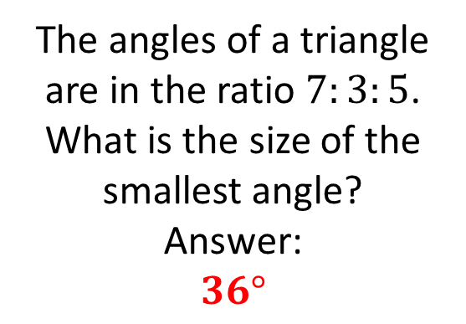
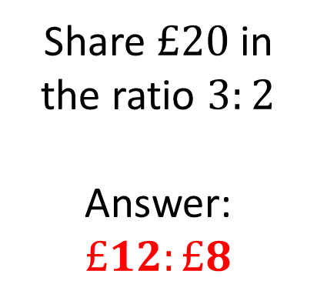
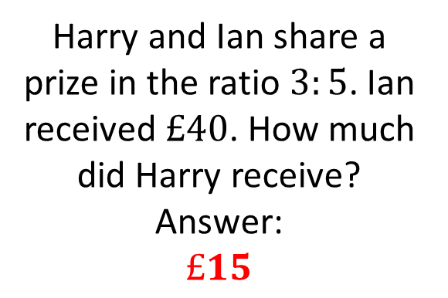
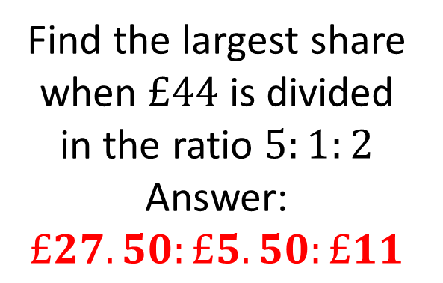
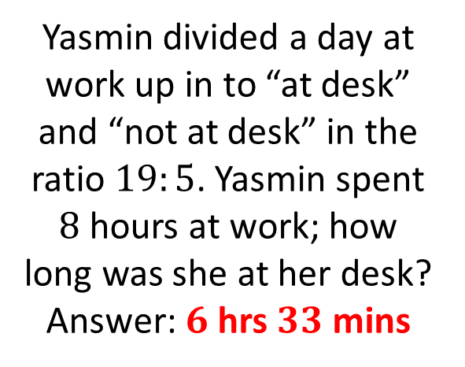
Mathematical Property:
Sharing in a given ratio
A
B
Share $£20$ in the ratio $3:2$
Answer:
$$£12:£8$$
Find the largest share when $£44$ is divided in the ratio $5:1:2$
Answer:
$$£27.50:£5.50:£11$$
C
Harry and Ian share a prize in the ratio $3:5$. Ian received $£40$. How much did Harry receive?
Answer:
$$£15$$
Yasmin divided a day at work up in to “at desk” and “not at desk” in the ratio $19:5$. Yasmin spent $8$ hours at work; how long was she at her desk?
Answer: $6$ hrs $33$ mins
D
E
The angles of a triangle are in the ratio $7:3:5$. What is the size of the smallest angle?
Answer:
$$36°$$

Slide 6
Mathematical Property:
Sharing in a given ratio
Back to “Option” slide
A
B
Share $£20$ in the ratio $3:2$
Answer:
$$£12:£8$$
Find the largest share when $£44$ is divided in the ratio $5:1:2$
Answer:
$$£27.50:£5.50:£11$$
Correct
Incorrect
C
Harry and Ian share a prize in the ratio $3:5$. Ian received $£40$. How much did Harry receive?
Answer:
$$£15$$
Incorrect
Yasmin divided a day at work up in to “at desk” and “not at desk” in the ratio $19:5$. Yasmin spent $8$ hours at work; how long was she at her desk?
Answer: $6$ hrs $33$ mins
D
E
The angles of a triangle are in the ratio $7:3:5$. What is the size of the smallest angle?
Answer:
$$36°$$
Correct
Incorrect
Answers

Slide 7
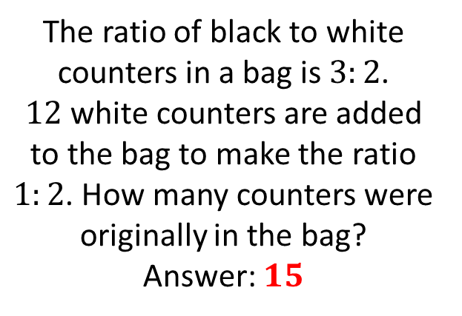
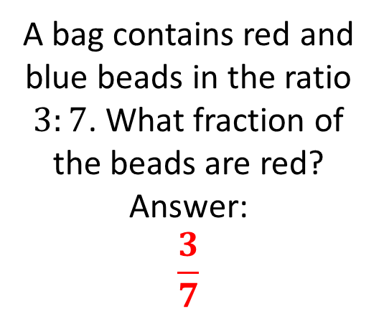
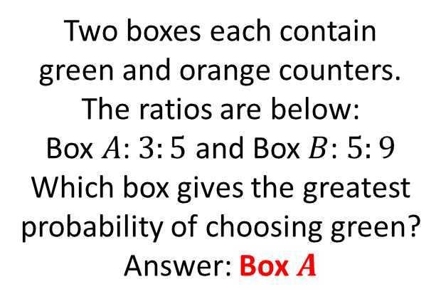
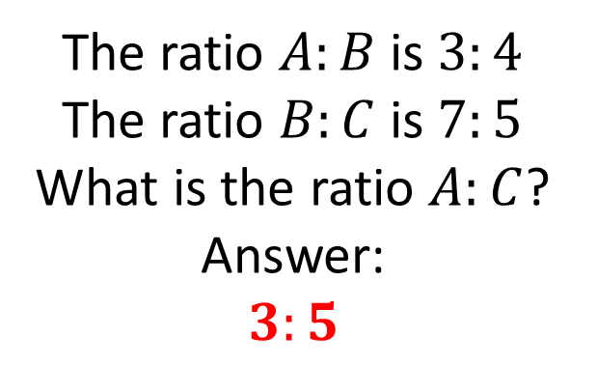
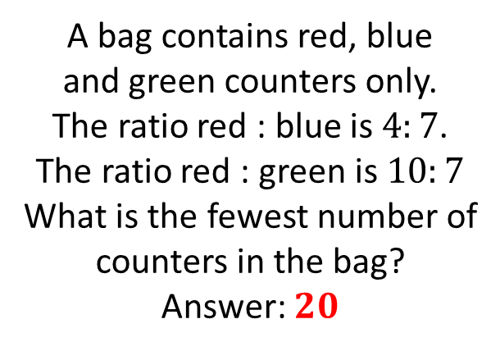
Mathematical Property:
Ratio problems
A bag contains red and blue beads in the ratio $3:7$. What fraction of the beads are red?
Answer:
$$\frac{3}{7}$$
A
B
Two boxes each contain
green and orange counters.
The ratios are below:
Box $A$: $3:5$ and Box $B$: $5:9$
Which box gives the greatest probability of choosing green?
Answer: Box $A$
C
The ratio $A:B$ is $3:4$
The ratio $B:C$ is $7:5$
What is the ratio $A:C$?
Answer:
$$3:5$$
D
E
The ratio of black to white counters in a bag is $3:2$.
$12$ white counters are added to the bag to make the ratio $1:2$. How many counters were originally in the bag?
Answer: $15$
A bag contains red, blue
and green counters only.
The ratio red : blue is $4:7$.
The ratio red : green is $10:7$
What is the fewest number of counters in the bag?
Answer: $20$

Slide 8
Mathematical Property:
Ratio problems
Back to “Option” slide
A bag contains red and blue beads in the ratio $3:7$. What fraction of the beads are red?
Answer:
$$\frac{3}{7}$$
A
B
Two boxes each contain
green and orange counters.
The ratios are below:
Box $A$: $3:5$ and Box $B$: $5:9$
Which box gives the greatest probability of choosing green?
Answer: Box $A$
Incorrect
Correct
C
The ratio $A:B$ is $3:4$
The ratio $B:C$ is $7:5$
What is the ratio $A:C$?
Answer:
$$3:5$$
Incorrect
D
E
The ratio of black to white counters in a bag is $3:2$.
$12$ white counters are added to the bag to make the ratio $1:2$. How many counters were originally in the bag?
Answer: $15$
A bag contains red, blue
and green counters only.
The ratio red : blue is $4:7$.
The ratio red : green is $10:7$
What is the fewest number of counters in the bag?
Answer: $20$
Correct
Incorrect
Answers

Slide 9
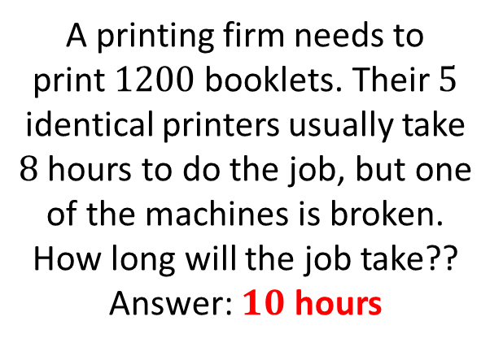
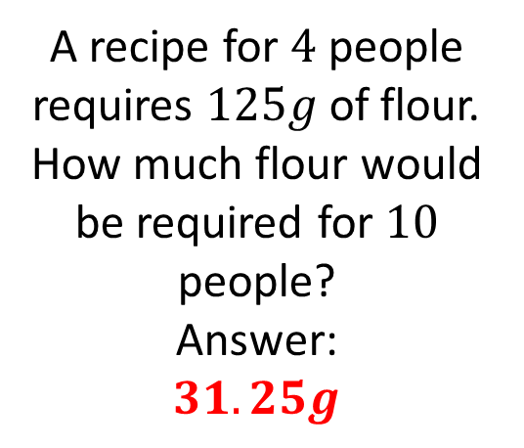
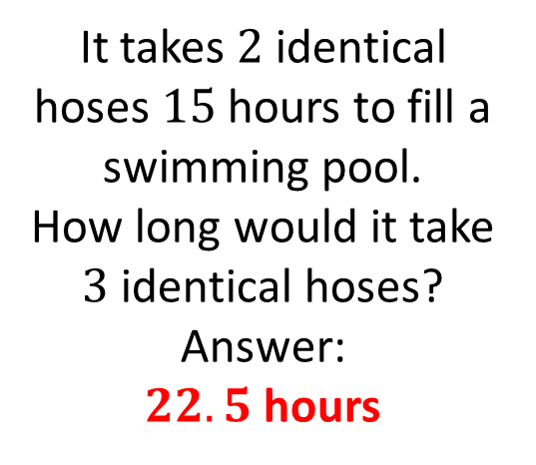
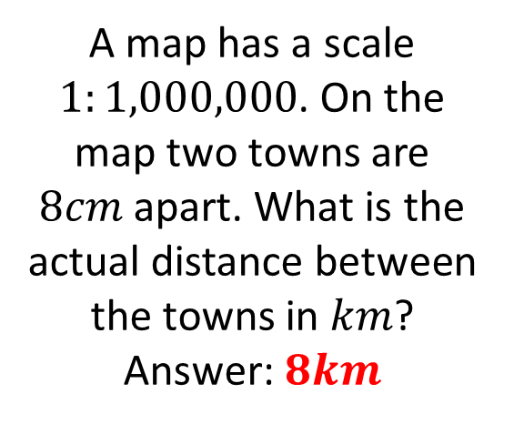
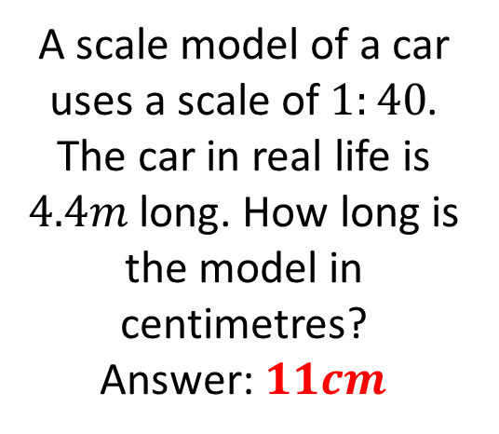
Mathematical Property:
Worded proportion
A recipe for $4$ people requires $125g$ of flour. How much flour would be required for $10$ people?
Answer:
$$31.25g$$
It takes $2$ identical hoses $15$ hours to fill a swimming pool.
How long would it take $3$ identical hoses?
Answer:
$22.5$ hours
A
B
A scale model of a car uses a scale of $1:40$. The car in real life is $4.4m$ long. How long is the model in centimetres?
Answer: $11cm$
C
A map has a scale $1:1,000,000$. On the map two towns are $8cm$ apart. What is the actual distance between the towns in $km$?
Answer: $8km$
D
E
A printing firm needs to
print $1200$ booklets. Their $5$ identical printers usually take $8$ hours to do the job, but one of the machines is broken. How long will the job take??
Answer: $10$ hours

Slide 10
Mathematical Property:
Worded proportion
Back to “Option” slide
A recipe for $4$ people requires $125g$ of flour. How much flour would be required for $10$ people?
Answer:
$$31.25g$$
It takes $2$ identical hoses $15$ hours to fill a swimming pool.
How long would it take $3$ identical hoses?
Answer:
$22.5$ hours
A
B
Incorrect
Incorrect
A scale model of a car uses a scale of $1:40$. The car in real life is $4.4m$ long. How long is the model in centimetres?
Answer: $11cm$
C
Correct
A map has a scale $1:1,000,000$. On the map two towns are $8cm$ apart. What is the actual distance between the towns in $km$?
Answer: $8km$
D
E
A printing firm needs to
print $1200$ booklets. Their $5$ identical printers usually take $8$ hours to do the job, but one of the machines is broken. How long will the job take??
Answer: $10$ hours
Correct
Incorrect
Answers

Slide 11
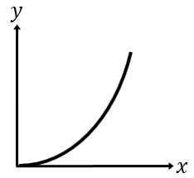
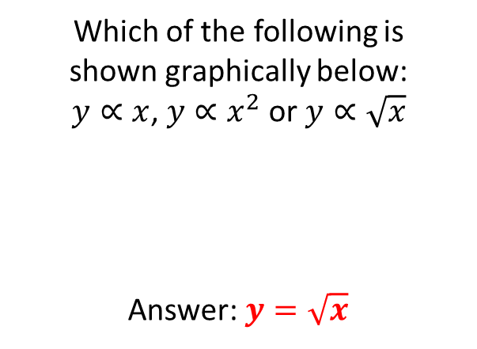
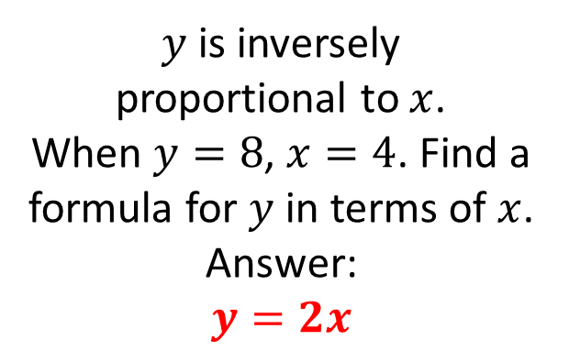
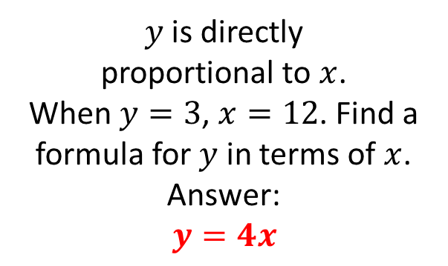
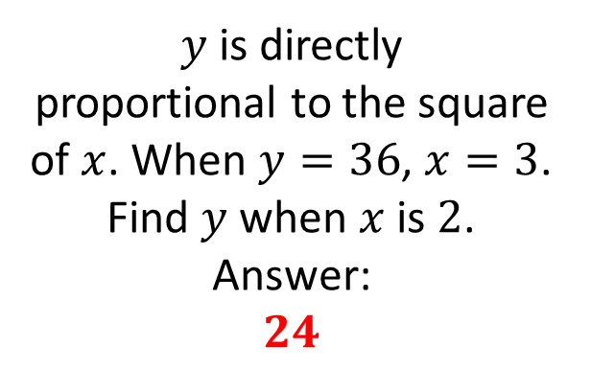
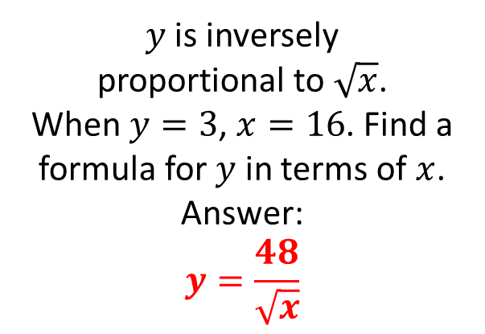
Mathematical Property:
Algebraic proportion
A
B
$y$ is inversely
proportional to $x$.
When $y=8$, $x=4$. Find a formula for $y$ in terms of $x$.
Answer:
$$y=2x$$
$y$ is directly
proportional to $x$.
When $y=3$, $x=12$. Find a formula for $y$ in terms of $x$.
Answer:
$$y=4x$$
C
$y$ is directly
proportional to the square of $x$. When $y=36$, $x=3$. Find $y$ when $x$ is $2$.
Answer:
$$24$$
D
E
$y$ is inversely
proportional to $\sqrt{x}$.
When $y=3$, $x=16$. Find a formula for $y$ in terms of $x$.
Answer:
$$y=\frac{48}{\sqrt{x}}$$
Which of the following is
shown graphically below:
$y∝x$, $y∝x^{2}$ or $y∝\sqrt{x}$
Answer: $y=\sqrt{x}$

Slide 12
Mathematical Property:
Algebraic proportion
Back to “Option” slide
A
B
$y$ is inversely
proportional to $x$.
When $y=8$, $x=4$. Find a formula for $y$ in terms of $x$.
Answer:
$$y=2x$$
$y$ is directly
proportional to $x$.
When $y=3$, $x=12$. Find a formula for $y$ in terms of $x$.
Answer:
$$y=4x$$
Incorrect
Incorrect
C
$y$ is directly
proportional to the square of $x$. When $y=36$, $x=3$. Find $y$ when $x$ is $2$.
Answer:
$$24$$
Incorrect
D
E
$y$ is inversely
proportional to $\sqrt{x}$.
When $y=3$, $x=16$. Find a formula for $y$ in terms of $x$.
Answer:
$$y=\frac{48}{\sqrt{x}}$$
Which of the following is
shown graphically below:
$y∝x$, $y∝x^{2}$ or $y∝\sqrt{x}$
Answer: $y=\sqrt{x}$
Incorrect
Incorrect
Answers

Slide 13
Mathematical Property: here
A
B
C
D
E

