Slide 1
Non-examples
(Pythagoras and Trigonometry)
Each slide contains five “examples” of a mathematical property.
Some are correct examples, some are not.
Explain which examples are correct and why.
Explain which examples are incorrect and why.

Slide 2
Go straight to…
Pythagoras
Trigonometry (sides)
Trigonometry (angles)
Right-angled or not?
Pythagoras & trigonometry in 3D
Trigonometry (exact values)
Trigonometry (area)
Trigonometry (Sine and Cosine rules)

Slide 3
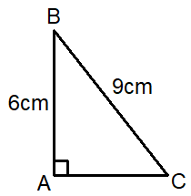
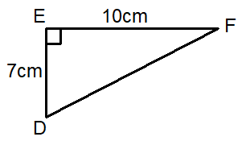
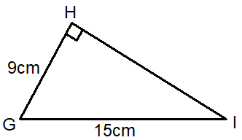
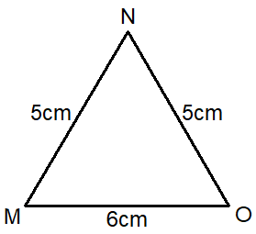
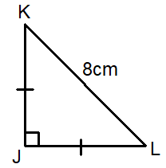
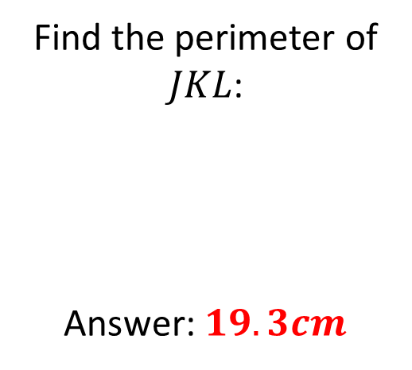
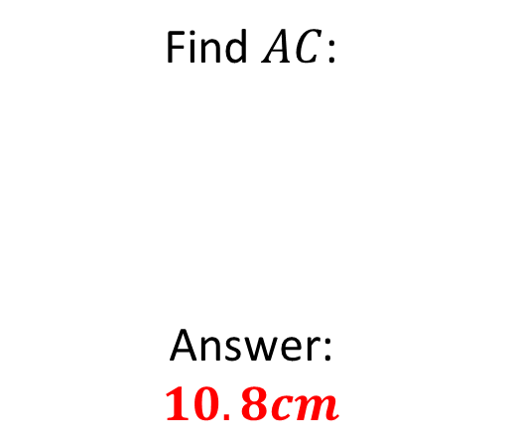
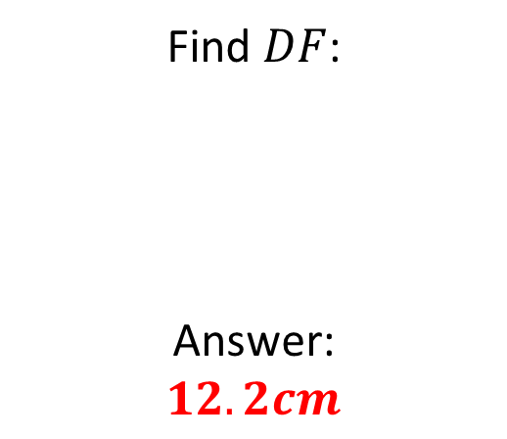
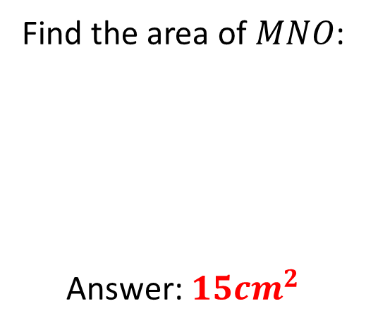
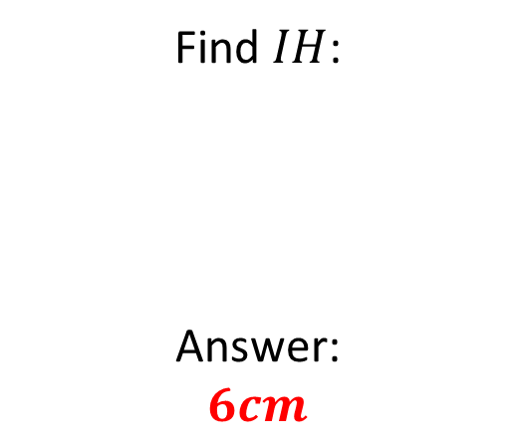
Mathematical Property:
Pythagoras
Find $AC$:
Answer:
$$10.8cm$$
Find $DF$:
Answer:
$$12.2cm$$
A
B
Find $IH$:
Answer:
$$6cm$$
C
Find the perimeter of $JKL$:
Answer: $19.3cm$
Find the area of $MNO$:
Answer: $15{cm}^{2}$
D
E

Slide 4
Mathematical Property:
Pythagoras
Back to “Option” slide
Find $AC$:
Answer:
$$10.8cm$$
Find $DF$:
Answer:
$$12.2cm$$
A
B
Answers
Incorrect
Correct
Find $IH$:
Answer:
$$6cm$$
C
Incorrect
Find the perimeter of $JKL$:
Answer: $19.3cm$
Find the area of $MNO$:
Answer: $15{cm}^{2}$
D
E
Correct
Incorrect

Slide 5
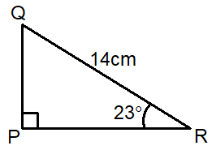
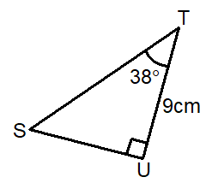
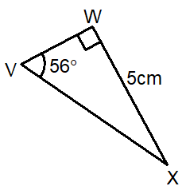
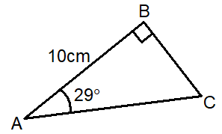
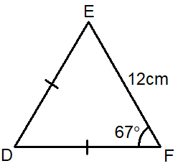
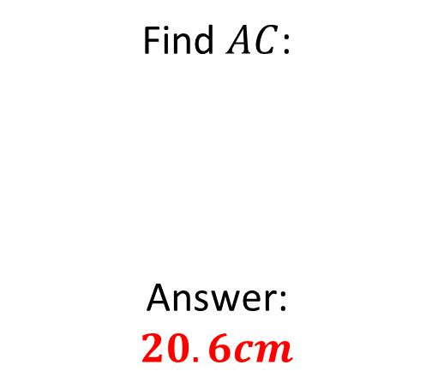
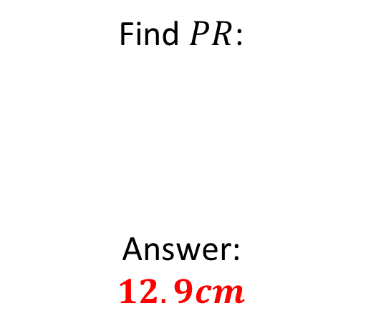
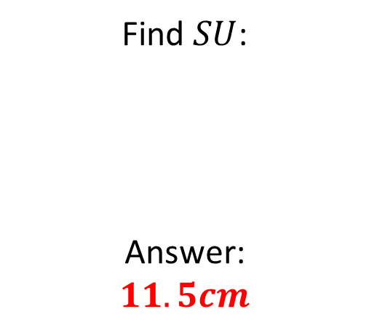
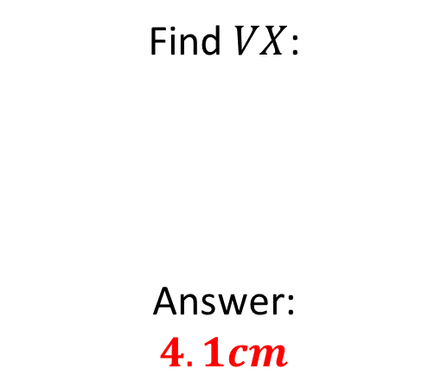
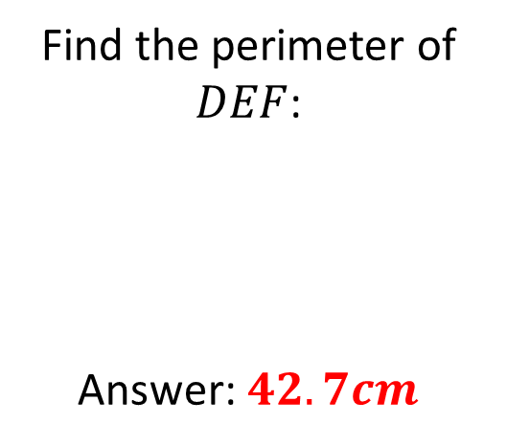
Mathematical Property:
Trigonometry
(sides)
Find $PR$:
Answer:
$$12.9cm$$
Find $SU$:
Answer:
$$11.5cm$$
A
B
Find $VX$:
Answer:
$$4.1cm$$
C
Find $AC$:
Answer:
$$20.6cm$$
Find the perimeter of $DEF$:
Answer: $42.7cm$
D
E

Slide 6
Mathematical Property:
Trigonometry
(sides)
Back to “Option” slide
Find $PR$:
Answer:
$$12.9cm$$
Find $SU$:
Answer:
$$11.5cm$$
A
B
Correct
Incorrect
Find $VX$:
Answer:
$$4.1cm$$
C
Incorrect
Find $AC$:
Answer:
$$20.6cm$$
Find the perimeter of $DEF$:
Answer: $42.7cm$
D
E
Incorrect
Correct
Answers

Slide 7
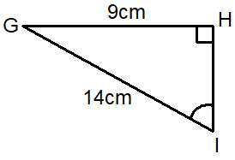
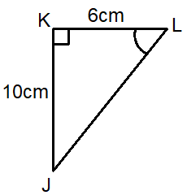
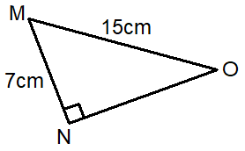
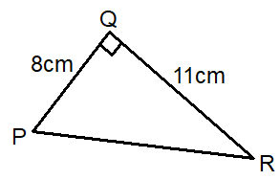
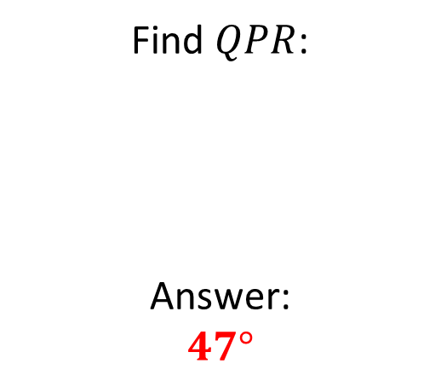
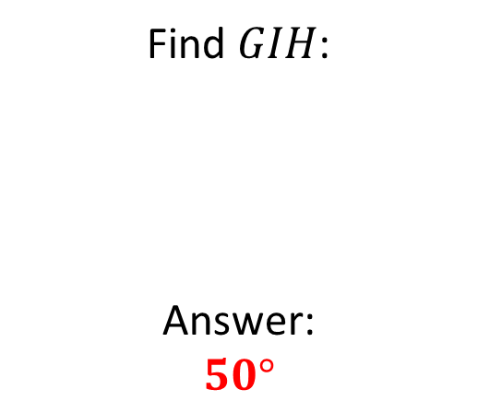
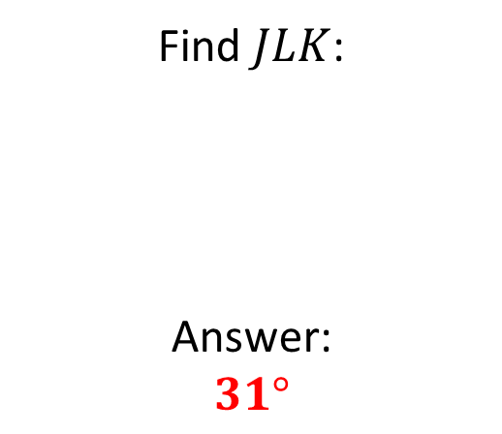
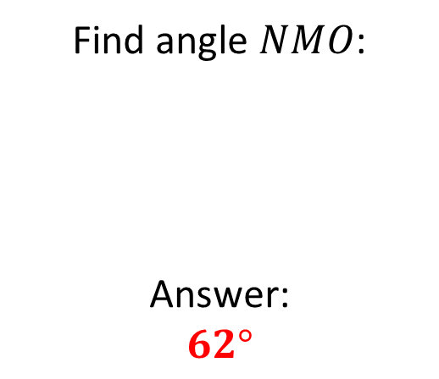
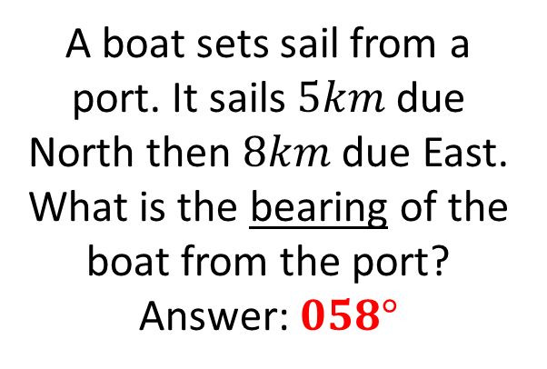
Mathematical Property:
Trigonometry
(angles)
Find $GIH$:
Answer:
$$50°$$
Find $JLK$:
Answer:
$$31°$$
A
B
Find angle $NMO$:
Answer:
$$62°$$
C
Find $QPR$:
Answer:
$$47°$$
E
D
A boat sets sail from a port. It sails $5km$ due North then $8km$ due East. What is the bearing of the boat from the port?
Answer: $058°$

Slide 8
Mathematical Property:
Trigonometry
(angles)
Back to “Option” slide
Find $GIH$:
Answer:
$$50°$$
Find $JLK$:
Answer:
$$31°$$
A
B
Incorrect
Incorrect
Find angle $NMO$:
Answer:
$$62°$$
C
Correct
Find $QPR$:
Answer:
$$47°$$
E
D
A boat sets sail from a port. It sails $5km$ due North then $8km$ due East. What is the bearing of the boat from the port?
Answer: $058°$
Incorrect
Correct
Answers

Slide 9
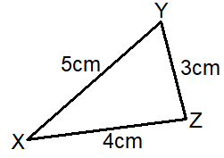
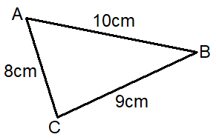
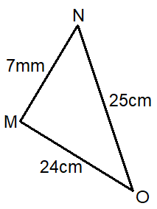
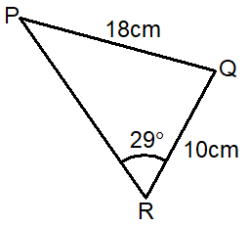
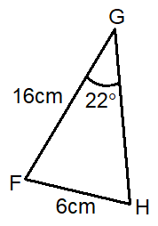
Mathematical Property:
Right-angled or not?
A
B
C
D
E

Slide 10
Mathematical Property:
Right-angled or not?
Back to “Option” slide
A
B
Yes!
No!
C
No!
D
E
No!
Yes!
Answers

Slide 11
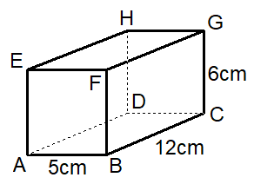
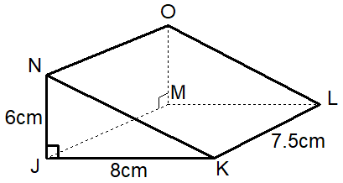
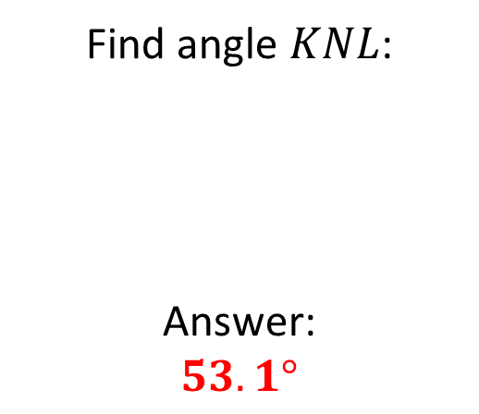
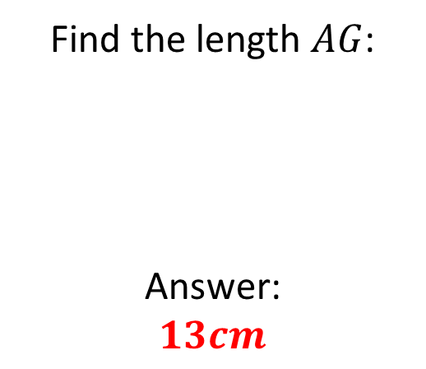

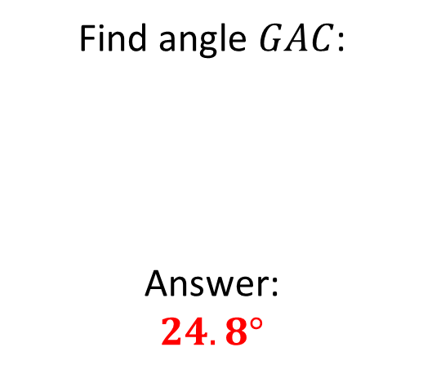
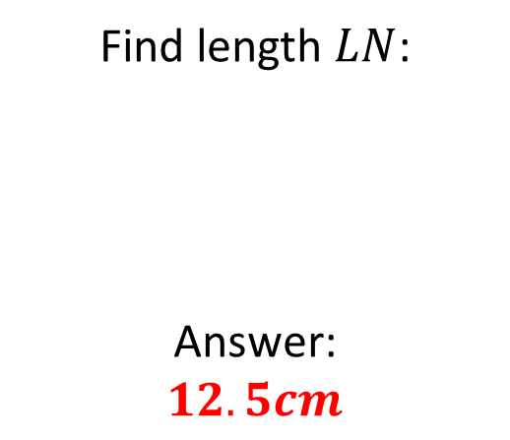
Mathematical Property:
Pythagoras & trigonometry in 3D
Find the length $AG$:
Answer:
$$13cm$$
Find angle $GAC$:
Answer:
$$24.8°$$
A
B
Find length $LN$:
Answer:
$$12.5cm$$
C
Find angle $KNL$:
Answer:
$$53.1°$$
Find angle $JLN$:
Answer:
$$2.9°$$
D
E

Slide 12
Mathematical Property:
Pythagoras & trigonometry in 3D
Back to “Option” slide
Find the length $AG$:
Answer:
$$13cm$$
Find angle $GAC$:
Answer:
$$24.8°$$
A
B
Incorrect
Correct
Find length $LN$:
Answer:
$$12.5cm$$
C
Correct
Find angle $KNL$:
Answer:
$$53.1°$$
Find angle $JLN$:
Answer:
$$2.9°$$
D
E
Incorrect
Incorrect
Answers

Slide 13
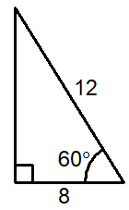
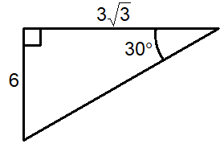
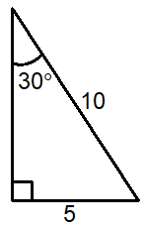
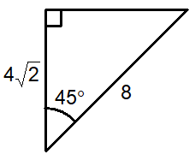
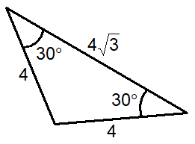
Mathematical Property:
Trigonometry
(exact values); correct or not?
A
B
C
D
E

Slide 14
Mathematical Property:
Trigonometry
(exact values); correct or not?
Back to “Option” slide
A
B
Incorrect
Incorrect
C
Correct
D
E
Correct
Correct
Answers

Slide 15
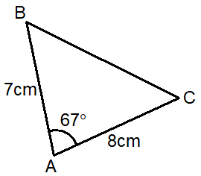
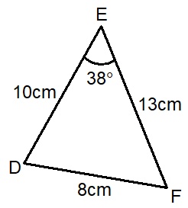
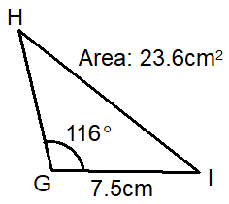
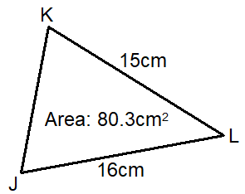
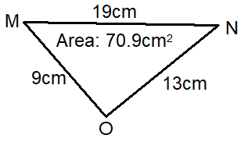





Mathematical Property:
Trigonometry
(area)
Find the area of $ABC$:
Answer: $51.5{cm}^{2}$
Find the area of $DEF$:
Answer: $49.3{cm}^{2}$
A
B
Find the length $GH$:
Answer: $3.5cm$
C
Find the angle $JLK$:
Answer: $0.7°$
Find the angle $OMN$:
Answer: $35°$
D
E

Slide 16
Mathematical Property:
Trigonometry
(area)
Back to “Option” slide
Find the area of $ABC$:
Answer: $51.5{cm}^{2}$
Find the area of $DEF$:
Answer: $49.3{cm}^{2}$
A
B
Incorrect
Incorrect
Find the length $GH$:
Answer: $3.5cm$
C
Incorrect
Find the angle $JLK$:
Answer: $0.7°$
Find the angle $OMN$:
Answer: $35°$
D
E
Incorrect
Incorrect
Answers

Slide 17









Mathematical Property:
Trigonometry
(Sine and Cosine
Rules)
Find $QR$:
Answer: $60.9cm$
Find $ST$:
Answer: $13.3cm$
A
B
Find the angle $WXV$:
Answer: $74.4°$
C
Find $AB$:
Answer: $12.2cm$
E
D
Ship A sails from a port on a bearing of $063°$ for $13km$.
Ship B sails from the same port on a bearing of $141°$ for $7km$.
Calculate the distance between the two ships.
Answer: $19km$

Slide 18
Mathematical Property:
Trigonometry
(Sine and Cosine
Rules)
Back to “Option” slide
Find $QR$:
Answer: $60.9cm$
Find $ST$:
Answer: $13.3cm$
A
B
Incorrect
Incorrect
Find the angle $WXV$:
Answer: $74.4°$
C
Incorrect
Find $AB$:
Answer: $12.2cm$
E
D
Ship A sails from a port on a bearing of $063°$ for $13km$.
Ship B sails from the same port on a bearing of $141°$ for $7km$.
Calculate the distance between the two ships.
Answer: $19km$
Correct
Incorrect
Answers

Slide 19
Mathematical Property: here
A
B
C
D
E

