Slide 1
Non-examples
(Solving Equations)
Each slide contains five “examples” of a mathematical property.
Some are correct examples, some are not.
Explain which examples are correct and why.
Explain which examples are incorrect and why.

Slide 2
Go straight to…
One-step
Two-step
Brackets
Variables on both sides
Fractions
Simultaneous
Quadratics 1
Quadratics 2

Slide 3
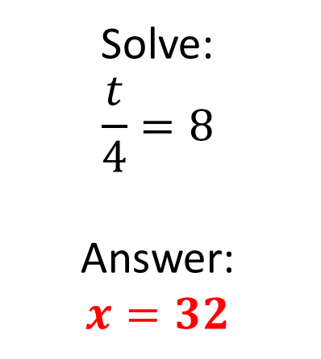
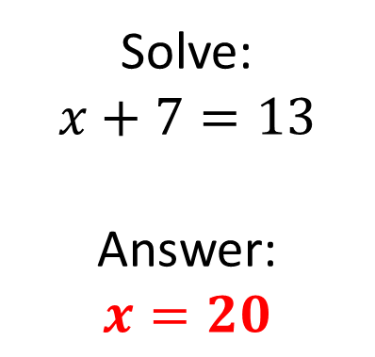
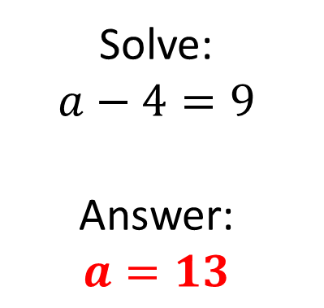
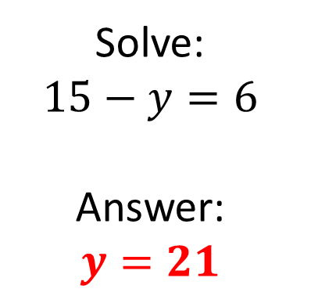
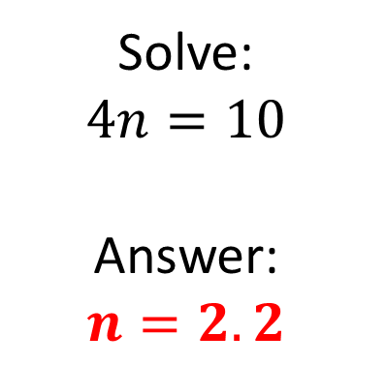
Mathematical Property:
One step
A
B
Solve:
$$x+7=13$$
Answer:
$$x=20$$
Solve:
$$a−4=9$$
Answer:
$$a=13$$
C
Solve:
$$15−y=6$$
Answer:
$$y=21$$
Solve:
$$\frac{t}{4}=8$$
Answer:
$$x=32$$
D
E
Solve:
$$4n=10$$
Answer:
$$n=2.2$$

Slide 4
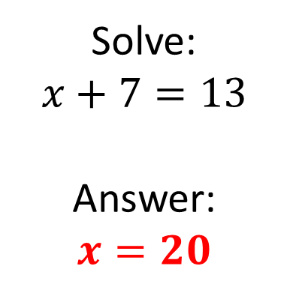
Mathematical Property:
One step
Back to “Option” slide
A
B
Solve:
$$x+7=13$$
Answer:
$$x=20$$
Answers
Solve:
$$a−4=9$$
Answer:
$$a=13$$
Incorrect
Correct
C
Solve:
$$15−y=6$$
Answer:
$$y=21$$
Incorrect
Solve:
$$\frac{t}{4}=8$$
Answer:
$$x=32$$
D
E
Solve:
$$4n=10$$
Answer:
$$n=2.2$$
Incorrect
Correct

Slide 5
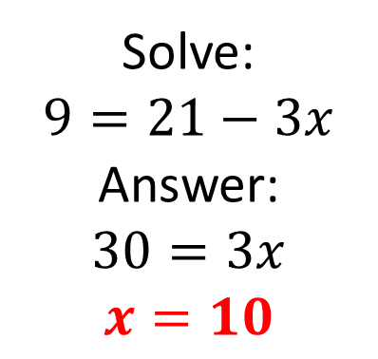
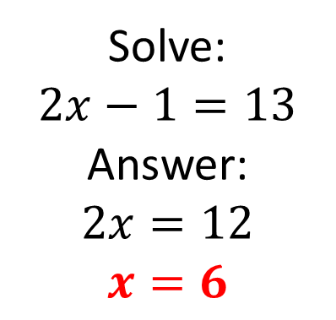
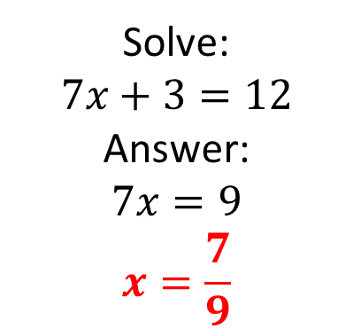
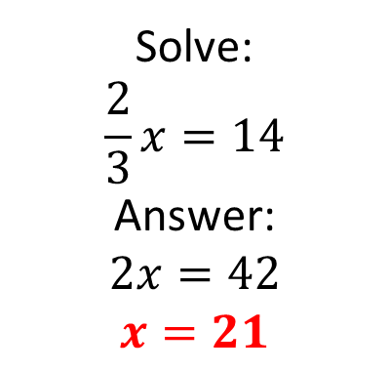
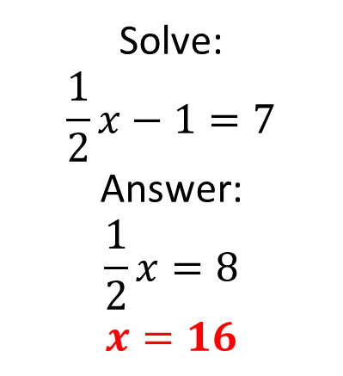
Mathematical Property:
Two step
A
Solve:
$$\frac{1}{2}x−1=7$$
Answer:
$$\frac{1}{2}x=8$$
$$x=16$$
B
Solve:
$$2x−1=13$$
Answer:
$$2x=12$$
$$x=6$$
C
Solve:
$$9=21−3x$$
Answer:
$$30=3x$$
$$x=10$$
D
E
Solve:
$$\frac{2}{3}x=14$$
Answer:
$$2x=42$$
$$x=21$$
Solve:
$$7x+3=12$$
Answer:
$$7x=9$$
$$x=\frac{7}{9}$$

Slide 6
Mathematical Property:
Two step
Back to “Option” slide
A
Solve:
$$\frac{1}{2}x−1=7$$
Answer:
$$\frac{1}{2}x=8$$
$$x=16$$
B
Solve:
$$2x−1=13$$
Answer:
$$2x=12$$
$$x=6$$
Answers
Incorrect
Correct
C
Solve:
$$9=21−3x$$
Answer:
$$30=3x$$
$$x=10$$
Incorrect
D
E
Solve:
$$\frac{2}{3}x=14$$
Answer:
$$2x=42$$
$$x=21$$
Solve:
$$7x+3=12$$
Answer:
$$7x=9$$
$$x=\frac{7}{9}$$
Correct
Incorrect

Slide 7
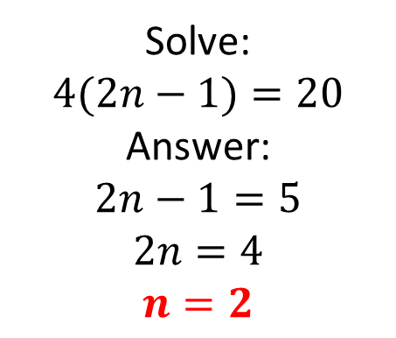
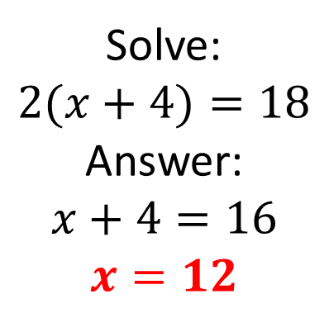
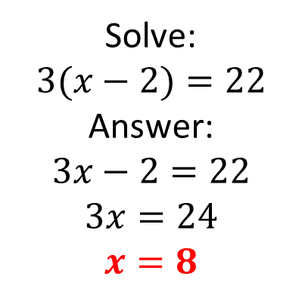
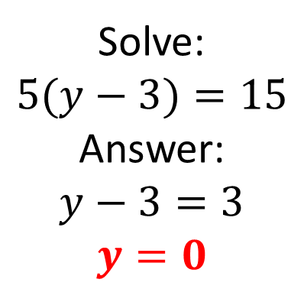
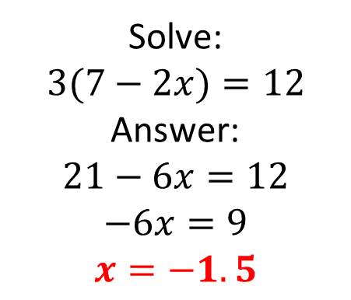
Mathematical Property:
Brackets
A
B
Solve:
$$2(x+4)=18$$
Answer:
$$x+4=16$$
$$x=12$$
Solve:
$$3(x−2)=22$$
Answer:
$$3x−2=22$$
$$3x=24$$
$$x=8$$
C
Solve:
$$5(y−3)=15$$
Answer:
$$y−3=3$$
$$y=0$$
D
E
Solve:
$$4(2n−1)=20$$
Answer:
$$2n−1=5$$
$$2n=4$$
$$n=2$$
Solve:
$$3(7−2x)=12$$
Answer:
$$21−6x=12$$
$$−6x=9$$
$$x=−1.5$$

Slide 8
Mathematical Property:
Brackets
Back to “Option” slide
A
B
Solve:
$$2(x+4)=18$$
Answer:
$$x+4=16$$
$$x=12$$
Solve:
$$3(x−2)=22$$
Answer:
$$3x−2=22$$
$$3x=24$$
$$x=8$$
Answers
Incorrect
Incorrect
C
Solve:
$$5(y−3)=15$$
Answer:
$$y−3=3$$
$$y=0$$
Incorrect
D
E
Solve:
$$4(2n−1)=20$$
Answer:
$$2n−1=5$$
$$2n=4$$
$$n=2$$
Solve:
$$3(7−2x)=12$$
Answer:
$$21−6x=12$$
$$−6x=9$$
$$x=−1.5$$
Incorrect
Incorrect

Slide 9
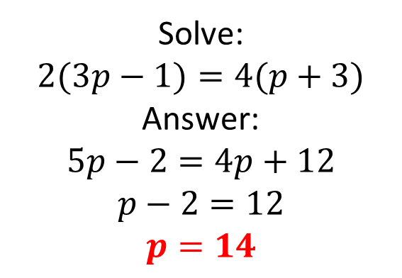
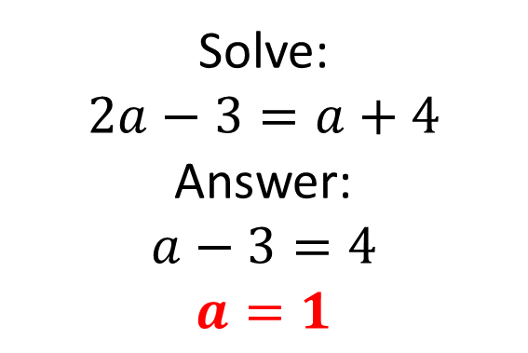
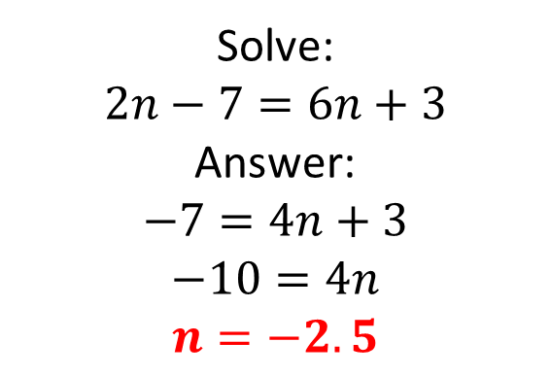
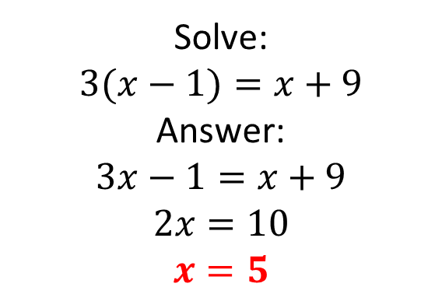
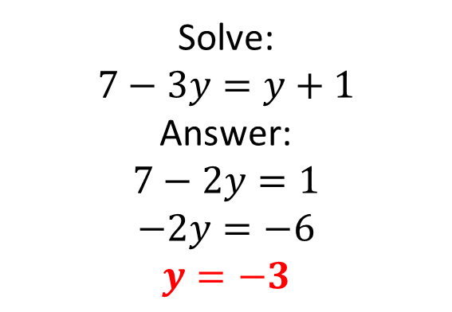
Mathematical Property:
Variables on both sides
A
B
Solve:
$$2a−3=a+4$$
Answer:
$$a−3=4$$
$$a=1$$
Solve:
$$2n−7=6n+3$$
Answer:
$$−7=4n+3$$
$$−10=4n$$
$$n=−2.5$$
C
Solve:
$$3(x−1)=x+9$$
Answer:
$$3x−1=x+9$$
$$2x=10$$
$$x=5$$
D
E
Solve:
$$7−3y=y+1$$
Answer:
$$7−2y=1$$
$$−2y=−6$$
$$y=−3$$
Solve:
$$2(3p−1)=4(p+3)$$
Answer:
$$5p−2=4p+12$$
$$p−2=12$$
$$p=14$$

Slide 10
Mathematical Property:
Variable on both sides
Back to “Option” slide
A
B
Solve:
$$2a−3=a+4$$
Answer:
$$a−3=4$$
$$a=1$$
Solve:
$$2n−7=6n+3$$
Answer:
$$−7=4n+3$$
$$−10=4n$$
$$n=−2.5$$
Incorrect
Correct
C
Solve:
$$3(x−1)=x+9$$
Answer:
$$3x−1=x+9$$
$$2x=10$$
$$x=5$$
Incorrect
D
E
Solve:
$$7−3y=y+1$$
Answer:
$$7−2y=1$$
$$−2y=−6$$
$$y=−3$$
Solve:
$$2(3p−1)=4(p+3)$$
Answer:
$$5p−2=4p+12$$
$$p−2=12$$
$$p=14$$
Incorrect
Incorrect
Answers

Slide 11
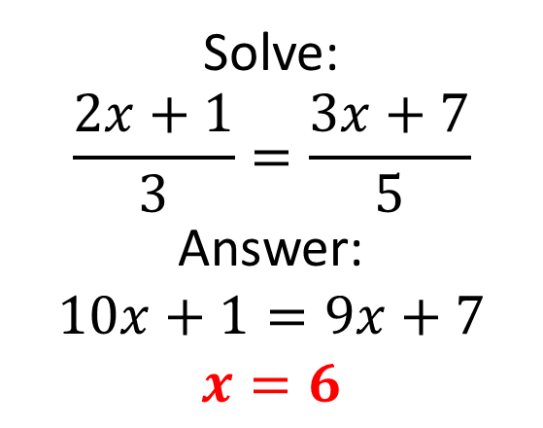
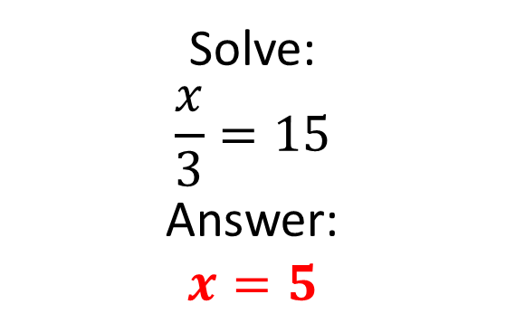
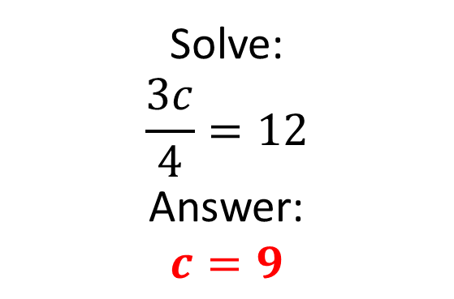
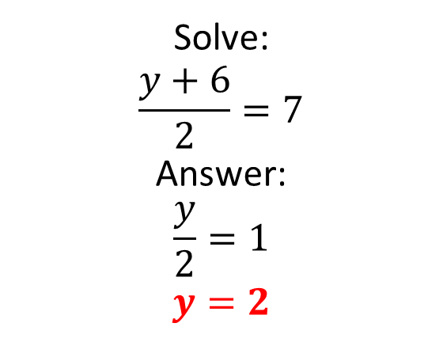
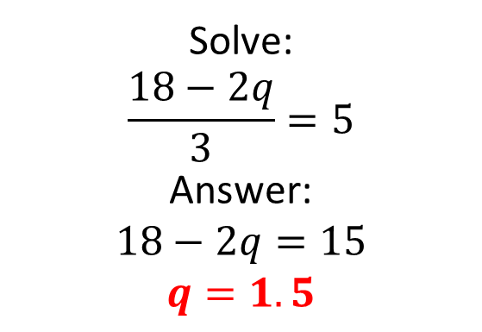
Mathematical Property:
Fractions
A
B
Solve:
$$\frac{x}{3}=15$$
Answer:
$$x=5$$
Solve:
$$\frac{3c}{4}=12$$
Answer:
$$c=9$$
C
Solve:
$$\frac{y+6}{2}=7$$
Answer:
$$\frac{y}{2}=1$$
$$y=2$$
Solve:
$$\frac{2x+1}{3}=\frac{3x+7}{5}$$
Answer:
$$10x+1=9x+7$$
$$x=6$$
D
E
Solve:
$$\frac{18−2q}{3}=5$$
Answer:
$$18−2q=15$$
$$q=1.5$$

Slide 12
Mathematical Property:
Fractions
Back to “Option” slide
A
B
Solve:
$$\frac{x}{3}=15$$
Answer:
$$x=5$$
Answers
Solve:
$$\frac{3c}{4}=12$$
Answer:
$$c=9$$
Incorrect
Incorrect
C
Solve:
$$\frac{y+6}{2}=7$$
Answer:
$$\frac{y}{2}=1$$
$$y=2$$
Incorrect
Solve:
$$\frac{2x+1}{3}=\frac{3x+7}{5}$$
Answer:
$$10x+1=9x+7$$
$$x=6$$
D
E
Solve:
$$\frac{18−2q}{3}=5$$
Answer:
$$18−2q=15$$
$$q=1.5$$
Correct
Incorrect

Slide 13
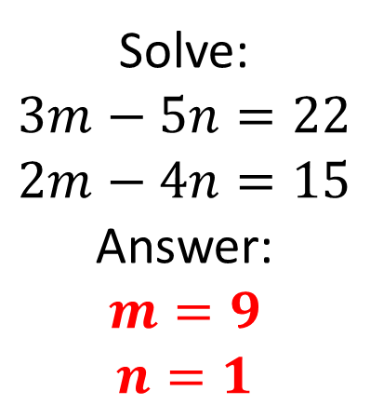
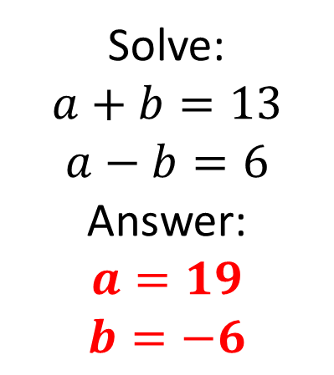
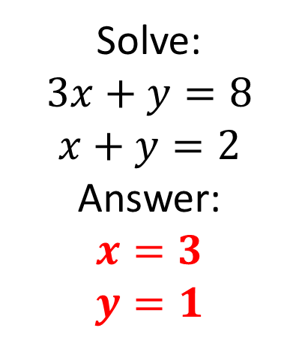
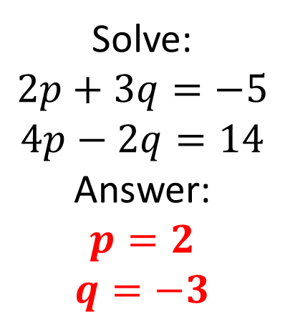
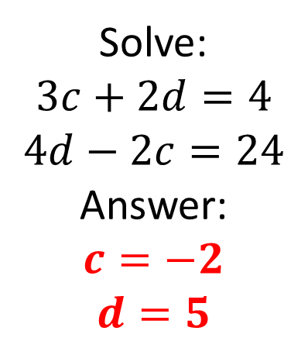
Mathematical Property:
Simultaneous
Equations
Solve:
$$a+b=13$$
$$a−b=6$$
Answer:
$$a=19$$
$$b=−6$$
Solve:
$$3x+y=8$$
$$x+y=2$$
Answer:
$$x=3$$
$$y=1$$
A
B
Solve:
$$2p+3q=−5$$
$$4p−2q=14$$
Answer:
$$p=2$$
$$q=−3$$
C
Solve:
$$3m−5n=22$$
$$2m−4n=15$$
Answer:
$$m=9$$
$$n=1$$
Solve:
$$3c+2d=4$$
$$4d−2c=24$$
Answer:
$$c=−2$$
$$d=5$$
D
E

Slide 14
Mathematical Property:
Simultaneous
Equations
Back to “Option” slide
Solve:
$$a+b=13$$
$$a−b=6$$
Answer:
$$a=19$$
$$b=−6$$
Solve:
$$3x+y=8$$
$$x+y=2$$
Answer:
$$x=3$$
$$y=1$$
A
B
Incorrect
Incorrect
Solve:
$$2p+3q=−5$$
$$4p−2q=14$$
Answer:
$$p=2$$
$$q=−3$$
C
Correct
Solve:
$$3m−5n=22$$
$$2m−4n=15$$
Answer:
$$m=9$$
$$n=1$$
Solve:
$$3c+2d=4$$
$$4d−2c=24$$
Answer:
$$c=−2$$
$$d=5$$
D
E
Incorrect
Correct
Answers

Slide 15
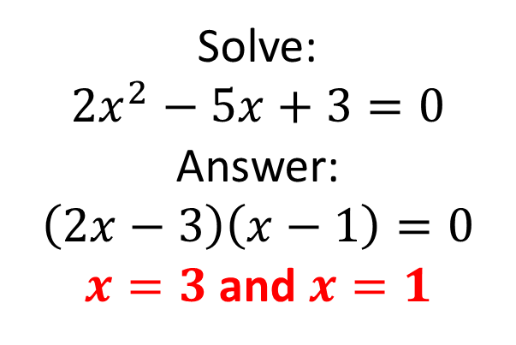
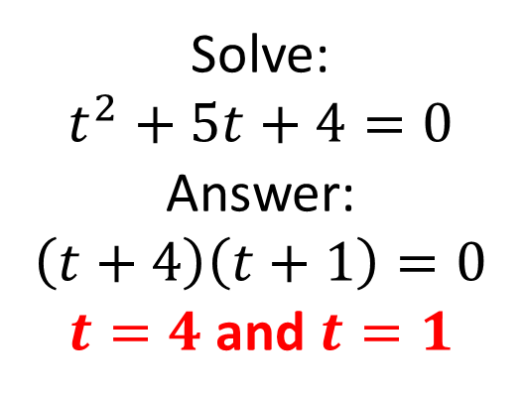
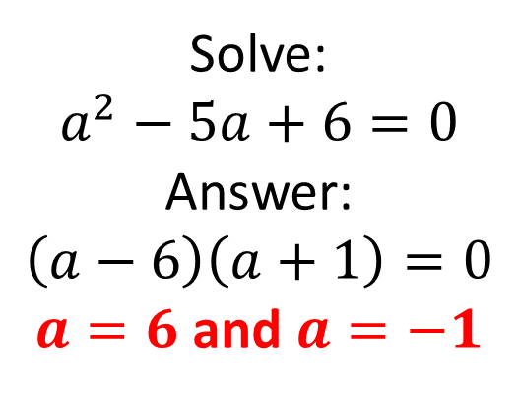
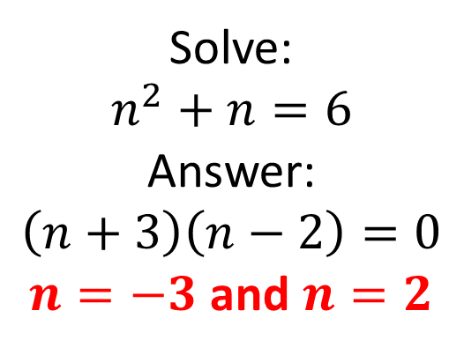
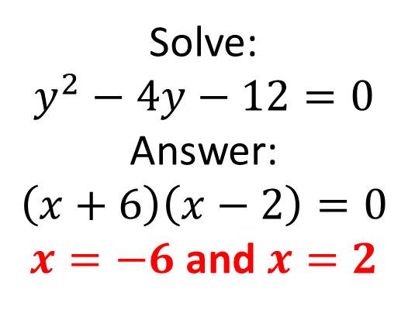
Mathematical Property:
Quadratics 1
A
B
Solve:
$$t^{2}+5t+4=0$$
Answer:
$$\left(t+4\right)\left(t+1\right)=0$$
$t=4$ and $t=1$
Solve:
$$a^{2}−5a+6=0$$
Answer:
$$\left(a−6\right)\left(a+1\right)=0$$
$a=6$ and $a=−1$
C
Solve:
$$y^{2}−4y−12=0$$
Answer:
$$\left(x+6\right)\left(x−2\right)=0$$
$x=−6$ and $x=2$
D
E
Solve:
$$n^{2}+n=6$$
Answer:
$$\left(n+3\right)\left(n−2\right)=0$$
$n=−3$ and $n=2$
Solve:
$$2x^{2}−5x+3=0$$
Answer:
$$\left(2x−3\right)\left(x−1\right)=0$$
$x=3$ and $x=1$

Slide 16
Mathematical Property:
Quadratics 1
Back to “Option” slide
A
B
Solve:
$$t^{2}+5t+4=0$$
Answer:
$$\left(t+4\right)\left(t+1\right)=0$$
$t=4$ and $t=1$
Answers
Solve:
$$a^{2}−5a+6=0$$
Answer:
$$\left(a−6\right)\left(a+1\right)=0$$
$a=6$ and $a=−1$
Incorrect
Incorrect
C
Solve:
$$y^{2}−4y−12=0$$
Answer:
$$\left(x+6\right)\left(x−2\right)=0$$
$x=−6$ and $x=2$
Incorrect
D
E
Solve:
$$n^{2}+n=6$$
Answer:
$$\left(n+3\right)\left(n−2\right)=0$$
$n=−3$ and $n=2$
Solve:
$$2x^{2}−5x+3=0$$
Answer:
$$\left(2x−3\right)\left(x−1\right)=0$$
$x=3$ and $x=1$
Correct
Incorrect

Slide 17
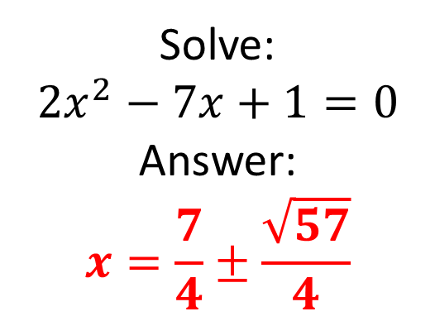
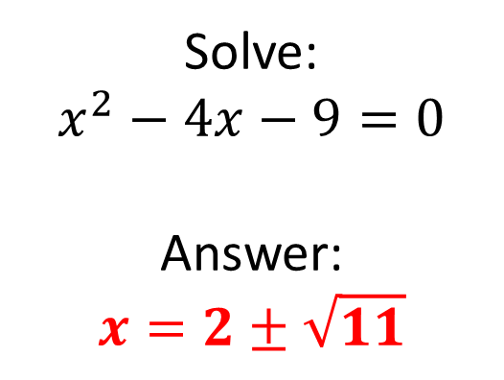
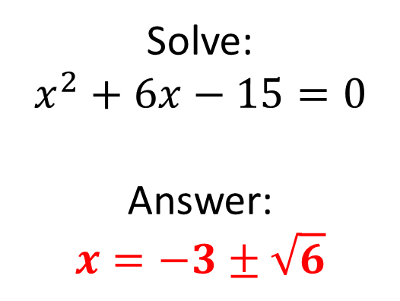
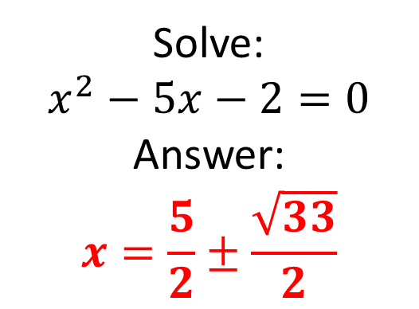
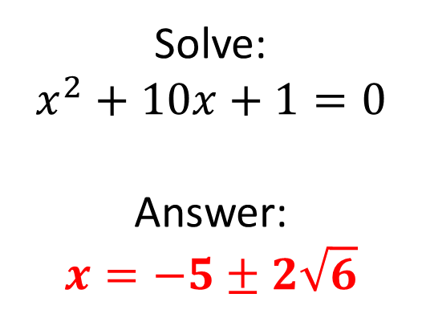
Mathematical Property:
Quadratics 2
A
B
Solve:
$$x^{2}−4x−9=0$$
Answer:
$$x=2±\sqrt{11}$$
Solve:
$$x^{2}+6x−15=0$$
Answer:
$$x=−3±\sqrt{6}$$
C
Solve:
$$x^{2}+10x+1=0$$
Answer:
$$x=−5±2\sqrt{6}$$
D
E
Solve:
$$x^{2}−5x−2=0$$
Answer:
$$x=\frac{5}{2}±\frac{\sqrt{33}}{2}$$
Solve:
$$2x^{2}−7x+1=0$$
Answer:
$$x=\frac{7}{4}±\frac{\sqrt{57}}{4}$$

Slide 18
Mathematical Property:
Quadratics 2
Back to “Option” slide
A
B
Solve:
$$x^{2}−4x−9=0$$
Answer:
$$x=2±\sqrt{11}$$
Solve:
$$x^{2}+6x−15=0$$
Answer:
$$x=−3±\sqrt{6}$$
Answers
Incorrect
Incorrect
C
Solve:
$$x^{2}+10x+1=0$$
Answer:
$$x=−5±2\sqrt{6}$$
Correct
D
E
Solve:
$$x^{2}−5x−2=0$$
Answer:
$$x=\frac{5}{2}±\frac{\sqrt{33}}{2}$$
Solve:
$$2x^{2}−7x+1=0$$
Answer:
$$x=\frac{7}{4}±\frac{\sqrt{57}}{4}$$
Correct
Incorrect

Slide 19
Mathematical Property: here
A
B
C
D
E

