Slide 1
Non-examples
(Expressions and Formulae)
Each slide contains five “examples” of a mathematical property.
Some are correct examples, some are not.
Explain which examples are correct and why.
Explain which examples are incorrect and why.

Slide 2
Go straight to…
Simplifying expressions
Substitution
Expanding a bracket
Factorising
Expanding and factorising quadratics
Rearranging formulae
Algebraic fractions

Slide 3
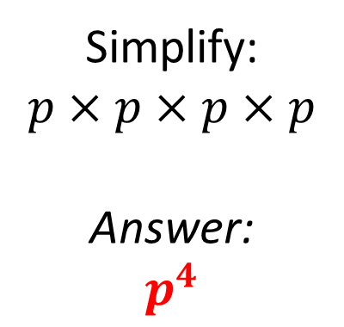
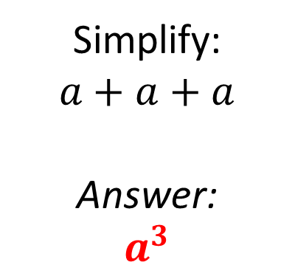
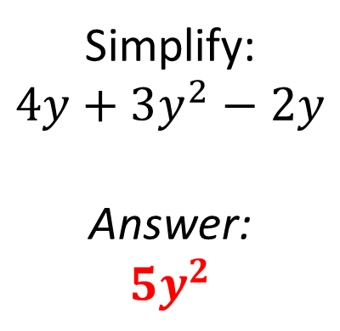
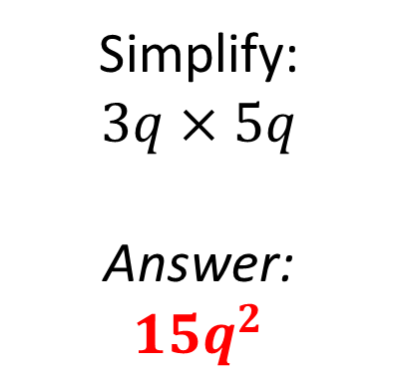
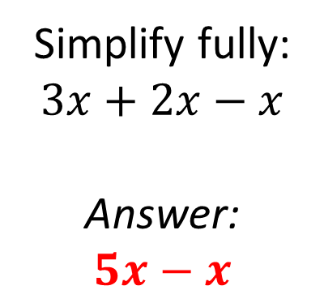
Mathematical Property:
Simplifying expressions
A
B
Simplify:
$$a+a+a$$
Answer:
$$a^{3}$$
Simplify fully:
$$3x+2x−x$$
Answer:
$$5x−x$$
C
Simplify:
$$p×p×p×p$$
Answer:
$$p^{4}$$
D
E
Simplify:
$$3q×5q$$
Answer:
$${15q}^{2}$$
Simplify:
$$4y+3y^{2}−2y$$
Answer:
$${5y}^{2}$$

Slide 4
Mathematical Property:
Simplifying expressions
Back to “Option” slide
A
B
Simplify:
$$a+a+a$$
Answer:
$$a^{3}$$
Simplify fully:
$$3x+2x−x$$
Answer:
$$5x−x$$
Incorrect
Incorrect
C
Simplify:
$$p×p×p×p$$
Answer:
$$p^{4}$$
Correct
D
E
Simplify:
$$3q×5q$$
Answer:
$${15q}^{2}$$
Simplify:
$$4y+3y^{2}−2y$$
Answer:
$${5y}^{2}$$
Correct
Incorrect
Answers

Slide 5
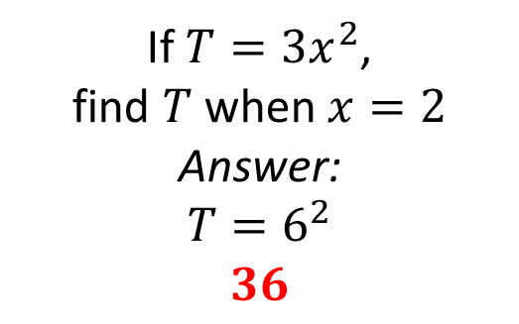
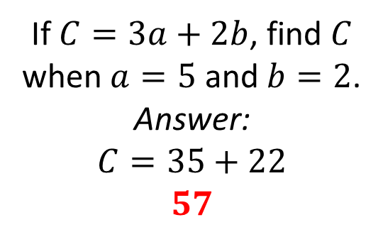
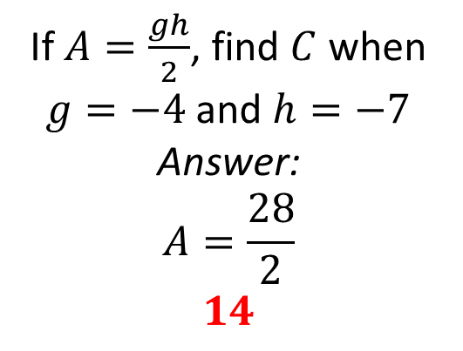
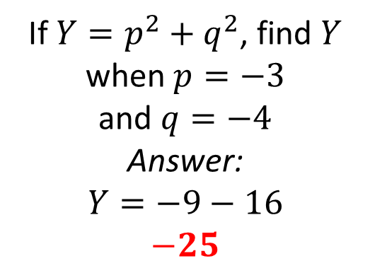

Mathematical Property:
Substitution
A
B
If $C=3a+2b$, find $C$ when $a=5$ and $b=2$.
Answer:
$$C=35+22$$
$$57$$
If $T=3x^{2}$,
find $T$ when $x=2$
Answer:
$$T=6^{2}$$
$$36$$
C
If $P=5m−2n$, find $P$ when $m=3$
and $n=−4$
Answer:
$$P=15+8$$
$$23$$
D
E
If $Y=p^{2}+q^{2}$, find $Y$ when $p=−3$
and $q=−4$
Answer:
$$Y=−9−16$$
$$−25$$
If $A=\frac{gh}{2}$, find $C$ when $g=−4$ and $h=−7$
Answer:
$$A=\frac{28}{2}$$
$$14$$

Slide 6


Mathematical Property:
Substitution
Back to “Option” slide
A
B
If $C=3a+2b$, find $C$ when $a=5$ and $b=2$.
Answer:
$$C=35+22$$
$$57$$
Answers
If $T=3x^{2}$,
find $T$ when $x=2$
Answer:
$$T=6^{2}$$
$$36$$
Incorrect
Incorrect
C
If $P=5m−2n$, find $P$ when $m=3$
and $n=−4$
Answer:
$$P=15+8$$
$$23$$
Correct
D
E
If $Y=p^{2}+q^{2}$, find $Y$ when $p=−3$
and $q=−4$
Answer:
$$Y=−9−16$$
$$−25$$
If $A=\frac{gh}{2}$, find $C$ when $g=−4$ and $h=−7$
Answer:
$$A=\frac{28}{2}$$
$$14$$
Incorrect
Correct

Slide 7
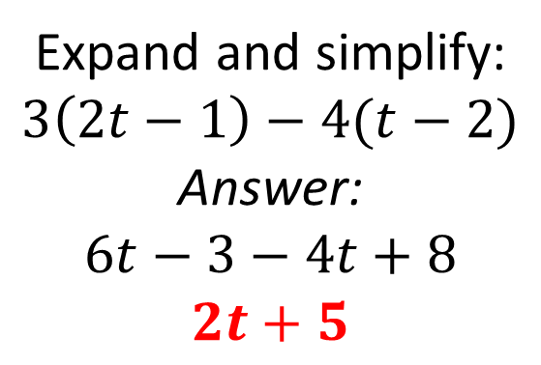
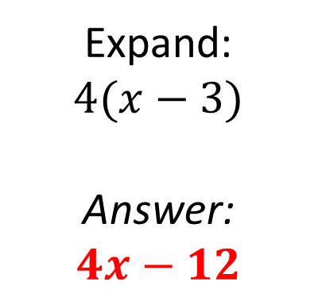
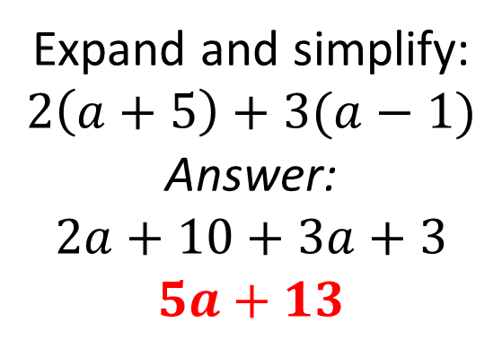
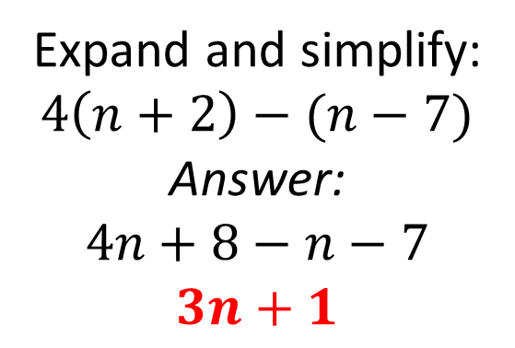
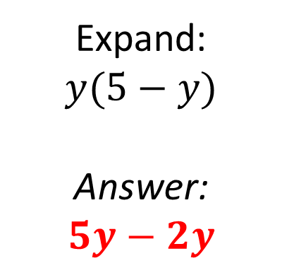
Mathematical Property:
Expanding a bracket
A
B
Expand:
$$4(x−3)$$
Answer:
$$4x−12$$
Expand:
$$y(5−y)$$
Answer:
$$5y−2y$$
C
Expand and simplify:
$$2\left(a+5\right)+3(a−1)$$
Answer:
$$2a+10+3a+3$$
$$5a+13$$
D
E
Expand and simplify:
$$4\left(n+2\right)−(n−7)$$
Answer:
$$4n+8−n−7$$
$$3n+1$$
Expand and simplify:
$$3\left(2t−1\right)−4(t−2)$$
Answer:
$$6t−3−4t+8$$
$$2t+5$$

Slide 8

Mathematical Property:
Expanding a bracket
Back to “Option” slide
A
B
Expand:
$$4(x−3)$$
Answer:
$$4x−12$$
Expand:
$$y(5−y)$$
Answer:
$$5y−2y$$
Correct
Incorrect
C
Expand and simplify:
$$2\left(a+5\right)+3(a−1)$$
Answer:
$$2a+10+3a+3$$
$$5a+13$$
Incorrect
D
E
Expand and simplify:
$$4\left(n+2\right)−(n−7)$$
Answer:
$$4n+8−n−7$$
$$3n+1$$
Expand and simplify:
$$3\left(2t−1\right)−4(t−2)$$
Answer:
$$6t−3−4t+8$$
$$2t+5$$
Incorrect
Correct
Answers

Slide 9
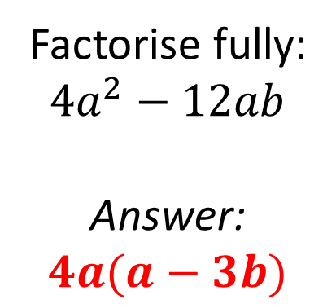
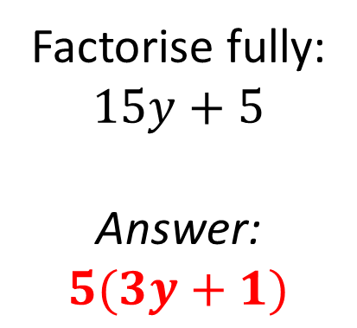
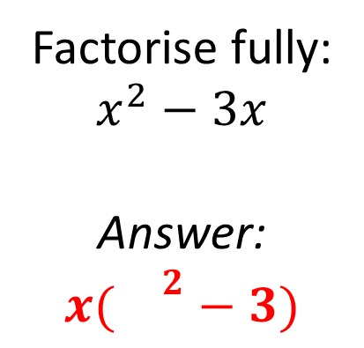
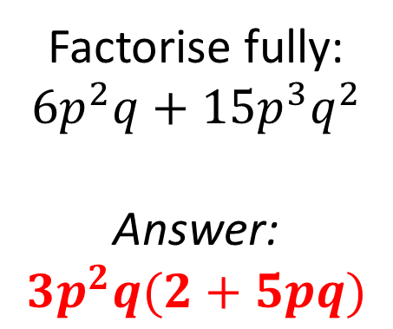
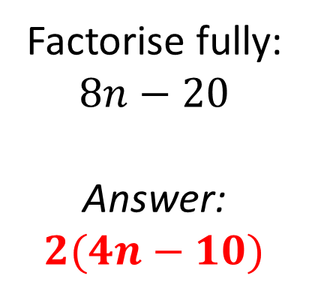
Mathematical Property:
Factorising
A
B
Factorise fully:
$$15y+5$$
Answer:
$$5(3y+1)$$
Factorise fully:
$$x^{2}−3x$$
Answer:
$$x({}^{2}−3)$$
C
Factorise fully:
$$8n−20$$
Answer:
$$2(4n−10)$$
D
E
Factorise fully:
$$4a^{2}−12ab$$
Answer:
$$4a(a−3b)$$
Factorise fully:
$$6p^{2}q+15p^{3}q^{2}$$
Answer:
$$3p^{2}q(2+5pq)$$

Slide 10
Mathematical Property:
Factorising
Back to “Option” slide
A
B
Factorise fully:
$$15y+5$$
Answer:
$$5(3y+1)$$
Answers
Factorise fully:
$$x^{2}−3x$$
Answer:
$$x({}^{2}−3)$$
Correct
Incorrect
C
Factorise fully:
$$8n−20$$
Answer:
$$2(4n−10)$$
Incorrect
D
E
Factorise fully:
$$4a^{2}−12ab$$
Answer:
$$4a(a−3b)$$
Factorise fully:
$$6p^{2}q+15p^{3}q^{2}$$
Answer:
$$3p^{2}q(2+5pq)$$
Correct
Correct

Slide 11
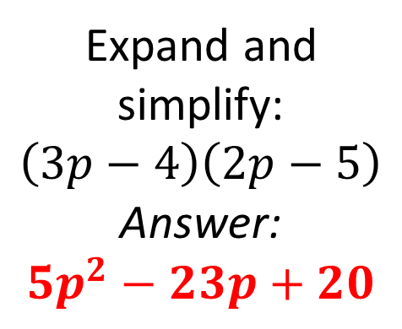
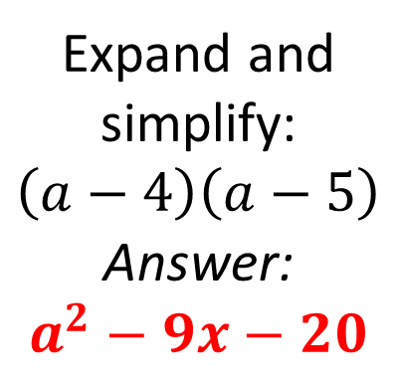
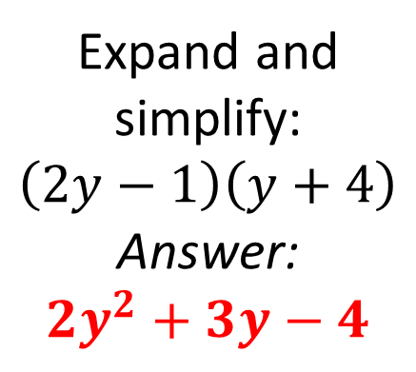
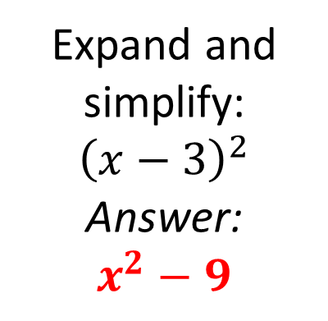
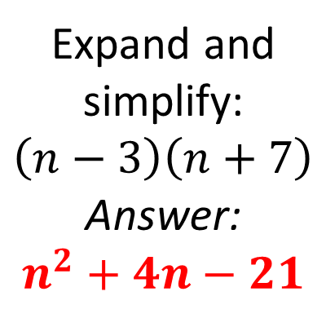
Mathematical Property:
Expanding and factorising quadratics
A
B
Expand and simplify:
$$\left(a−4\right)\left(a−5\right)$$
Answer:
$$a^{2}−9x−20$$
Expand and simplify:
$$\left(n−3\right)\left(n+7\right)$$
Answer:
$$n^{2}+4n−21$$
C
Expand and simplify:
$${\left(x−3\right)}^{2}$$
Answer:
$$x^{2}−9$$
D
E
Expand and simplify:
$$\left(2y−1\right)\left(y+4\right)$$
Answer:
$$2y^{2}+3y−4$$
Expand and simplify:
$$\left(3p−4\right)\left(2p−5\right)$$
Answer:
$$5p^{2}−23p+20$$

Slide 12
Mathematical Property:
Expanding and factorising quadratics
Back to “Option” slide
A
B
Expand and simplify:
$$\left(a−4\right)\left(a−5\right)$$
Answer:
$$a^{2}−9x−20$$
Expand and simplify:
$$\left(n−3\right)\left(n+7\right)$$
Answer:
$$n^{2}+4n−21$$
Incorrect
Correct
C
Expand and simplify:
$${\left(x−3\right)}^{2}$$
Answer:
$$x^{2}−9$$
Incorrect
D
E
Expand and simplify:
$$\left(2y−1\right)\left(y+4\right)$$
Answer:
$$2y^{2}+3y−4$$
Expand and simplify:
$$\left(3p−4\right)\left(2p−5\right)$$
Answer:
$$5p^{2}−23p+20$$
Incorrect
Incorrect
Answers

Slide 13
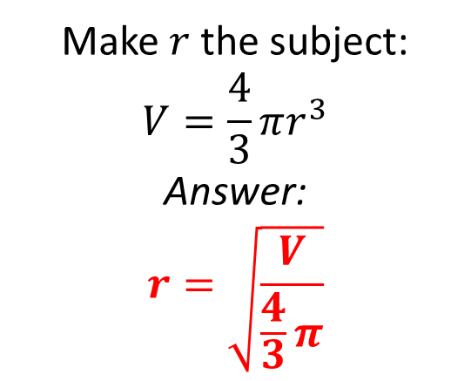
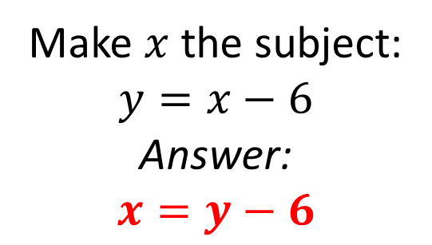
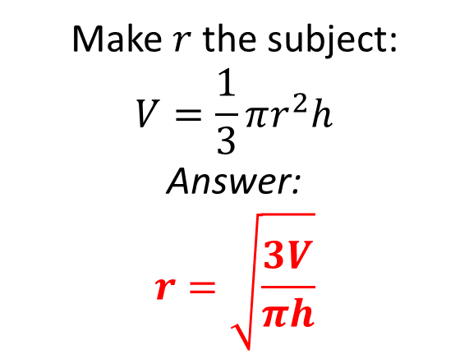
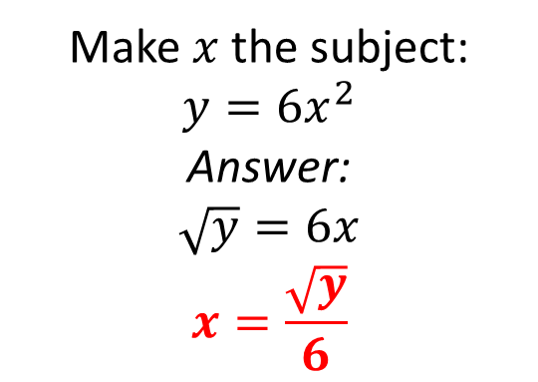
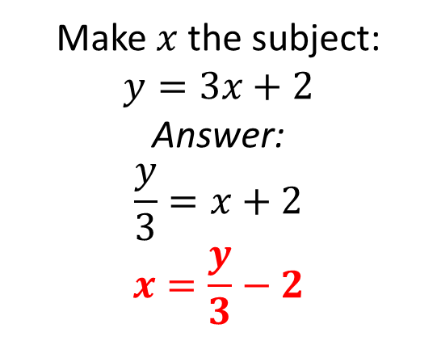
Mathematical Property:
Rearranging formulae
A
B
Make $x$ the subject:
$$y=3x+2$$
Answer:
$$\frac{y}{3}=x+2$$
$$x=\frac{y}{3}−2$$
Make $x$ the subject:
$$y=x−6$$
Answer:
$$x=y−6$$
C
Make $x$ the subject:
$$y=6x^{2}$$
Answer:
$$\sqrt{y}=6x$$
$$x=\frac{\sqrt{y}}{6}$$
Make $r$ the subject:
$$V=\frac{1}{3}πr^{2}h$$
Answer:
$$r=\sqrt{\frac{3V}{πh}}$$
Make $r$ the subject:
$$V=\frac{4}{3}πr^{3}$$
Answer:
$$r=\sqrt{\frac{V}{\frac{4}{3}π}}$$
D
E

Slide 14
Mathematical Property:
Rearranging formulae
Back to “Option” slide
A
B
Make $x$ the subject:
$$y=3x+2$$
Answer:
$$\frac{y}{3}=x+2$$
$$x=\frac{y}{3}−2$$
Make $x$ the subject:
$$y=x−6$$
Answer:
$$x=y−6$$
Incorrect
Incorrect
C
Make $x$ the subject:
$$y=6x^{2}$$
Answer:
$$\sqrt{y}=6x$$
$$x=\frac{\sqrt{y}}{6}$$
Incorrect
Make $r$ the subject:
$$V=\frac{1}{3}πr^{2}h$$
Answer:
$$r=\sqrt{\frac{3V}{πh}}$$
Make $r$ the subject:
$$V=\frac{4}{3}πr^{3}$$
Answer:
$$r=\sqrt{\frac{V}{\frac{4}{3}π}}$$
D
E
Correct
Incorrect
Answers

Slide 15
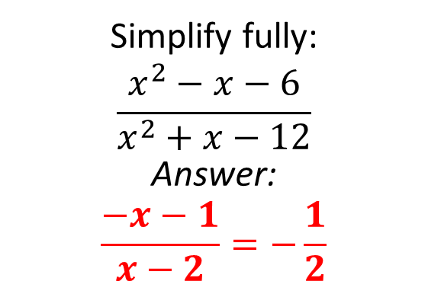
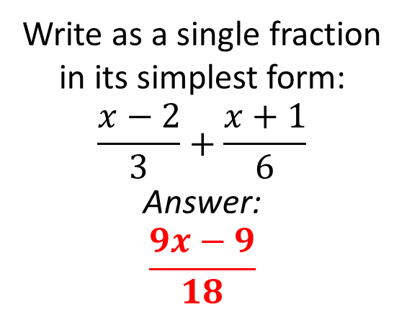
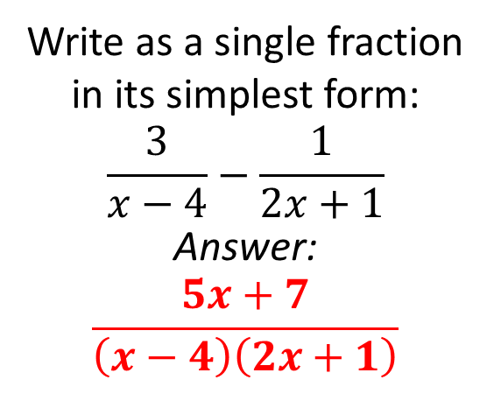
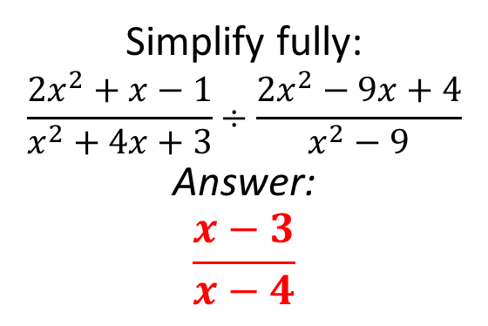
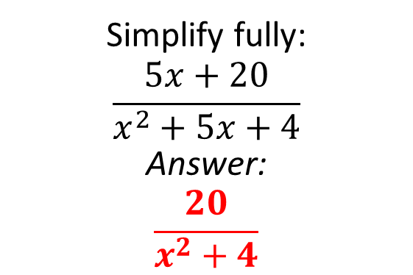
Mathematical Property:
Algebraic fractions
Write as a single fraction in its simplest form:
$$\frac{x−2}{3}+\frac{x+1}{6}$$
Answer:
$$\frac{9x−9}{18}$$
A
B
Simplify fully:
$$\frac{5x+20}{x^{2}+5x+4}$$
Answer:
$$\frac{20}{x^{2}+4}$$
Write as a single fraction in its simplest form:
$$\frac{3}{x−4}−\frac{1}{2x+1}$$
Answer:
$$\frac{5x+7}{\left(x−4\right)\left(2x+1\right)}$$
C
D
E
Simplify fully:
$$\frac{x^{2}−x−6}{x^{2}+x−12}$$
Answer:
$$\frac{−x−1}{x−2}=−\frac{1}{2}$$
Simplify fully:
$$\frac{2x^{2}+x−1}{x^{2}+4x+3}÷\frac{2x^{2}−9x+4}{x^{2}−9}$$
Answer:
$$\frac{x−3}{x−4}$$

Slide 16
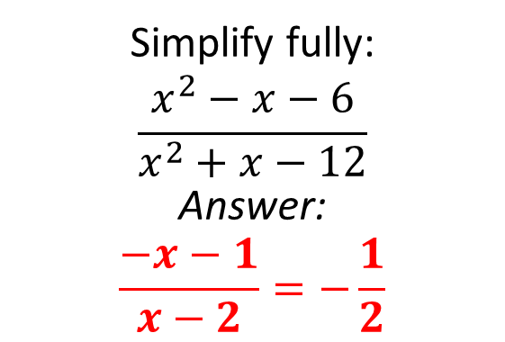
Mathematical Property:
Algebraic fractions
Back to “Option” slide
Write as a single fraction in its simplest form:
$$\frac{x−2}{3}+\frac{x+1}{6}$$
Answer:
$$\frac{9x−9}{18}$$
A
B
Simplify fully:
$$\frac{5x+20}{x^{2}+5x+4}$$
Answer:
$$\frac{20}{x^{2}+4}$$
Incorrect
Incorrect
Write as a single fraction in its simplest form:
$$\frac{3}{x−4}−\frac{1}{2x+1}$$
Answer:
$$\frac{5x+7}{\left(x−4\right)\left(2x+1\right)}$$
C
Correct
D
E
Simplify fully:
$$\frac{x^{2}−x−6}{x^{2}+x−12}$$
Answer:
$$\frac{−x−1}{x−2}=−\frac{1}{2}$$
Simplify fully:
$$\frac{2x^{2}+x−1}{x^{2}+4x+3}÷\frac{2x^{2}−9x+4}{x^{2}−9}$$
Answer:
$$\frac{x−3}{x−4}$$
Incorrect
Correct
Answers

Slide 17
Mathematical Property: here
A
B
C
D
E

