Slide 1
Non-examples (Shapes)
Each slide contains five “examples” of a mathematical property.
Some are correct examples, some are not.
Explain which examples are correct and why.
Explain which examples are incorrect and why.

Slide 2
Go straight to…
Shapes
Triangles
Angles on a line
Quadrilaterals
Parallel lines
Polygons
Circle theorems 1
Circle theorems 2

Slide 3
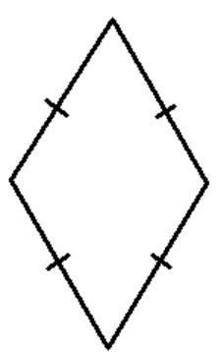
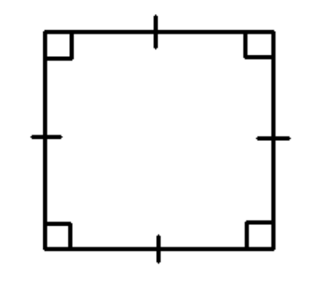
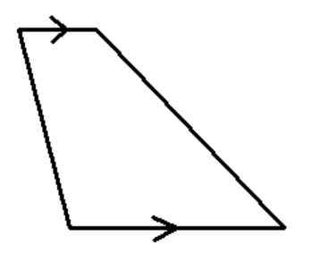
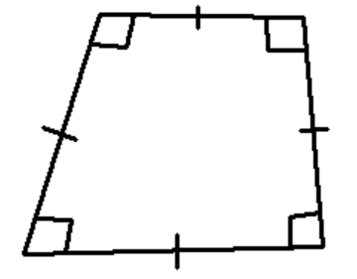
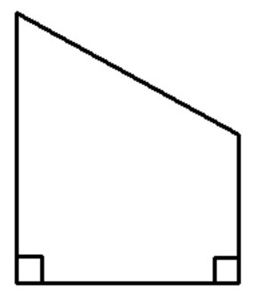
Mathematical Property:
Shapes
A
B
C
This is a rectangle
This is a diamond
D
E
This is a parallelogram
This is a square
This is a trapezium

Slide 4
Mathematical Property:
Shapes
Back to “Option” slide
A
B
Answers
Correct
Incorrect
C
This is a rectangle
This is a diamond
Incorrect
D
E
This is a parallelogram
Correct
Correct
This is a square
This is a trapezium

Slide 5
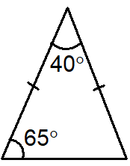
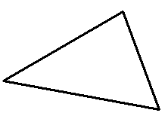
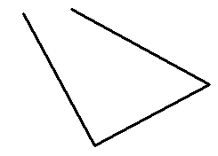
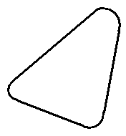
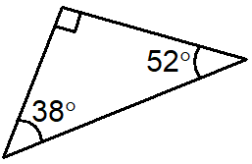
Mathematical Property:
Triangles
A
B
C
D
E

Slide 6
Mathematical Property:
Triangles
Back to “Option” slide
A
B
Answers
Correct
Incorrect
C
Incorrect
D
E
Correct
Incorrect

Slide 7
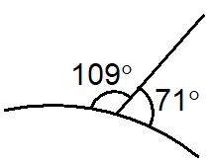
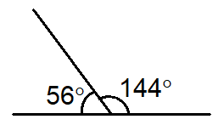
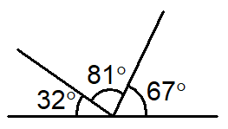
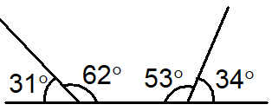
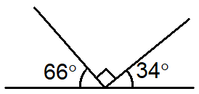
Mathematical Property:
Angles on a line
A
B
C
D
E

Slide 8
Mathematical Property:
Angles on a line
Back to “Option” slide
A
B
Answers
Incorrect
Incorrect
C
Correct
D
E
Incorrect
Incorrect

Slide 9
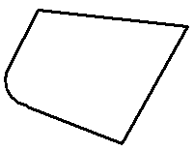
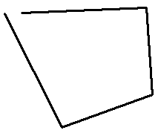
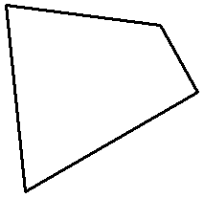
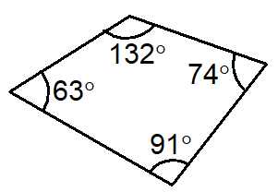
Mathematical Property:
Quadrilaterals
A
B
C
D
E
Two pairs of equal and parallel sides.
Two pairs of equal angles.

Slide 10
Mathematical Property:
Quadrilaterals
Back to “Option” slide
A
B
Answers
Incorrect
Incorrect
C
Correct
D
E
Two pairs of equal and parallel sides.
Two pairs of equal angles.
Correct
Correct

Slide 11
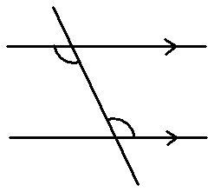
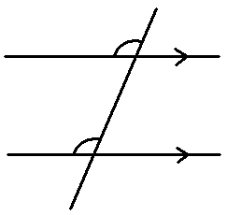
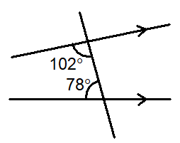
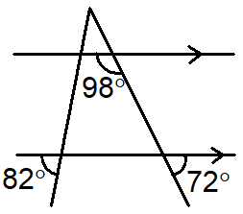
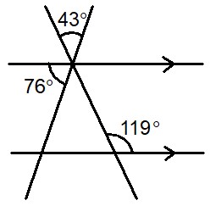
Mathematical Property:
Parallel lines
A Co-interior angles
B Corresponding angles
C
D
E

Slide 12
Mathematical Property:
Parallel lines
Back to “Option” slide
A Co-interior angles
B Corresponding angles
Answers
Incorrect
Correct
C
Correct
D
E
Incorrect
Correct

Slide 13
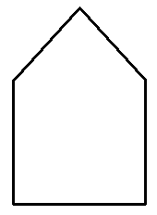
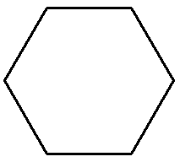
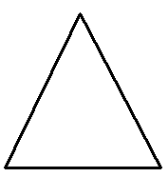
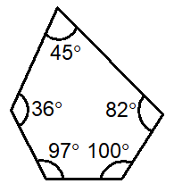
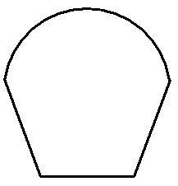
Mathematical Property:
Polygons
A
B
C
D
E

Slide 14
Mathematical Property:
Polygons
Back to “Option” slide
A
B
Answers
Correct
Correct
C
Correct
D
E
Incorrect
Incorrect

Slide 15
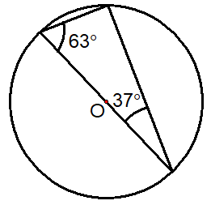
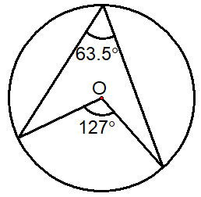
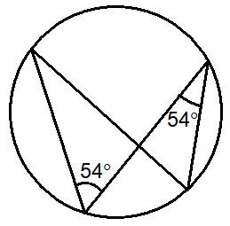
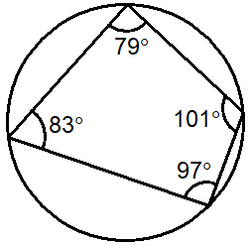
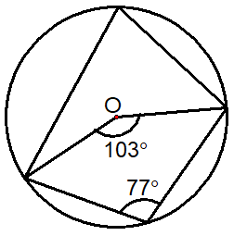
Mathematical Property:
Circle
Theorems 1
A
B
C
D
E

Slide 16
Mathematical Property:
Circle
Theorems 1
Back to “Option” slide
A
B
Incorrect
Correct
C
Incorrect
D
E
Incorrect
Incorrect
Answers

Slide 17
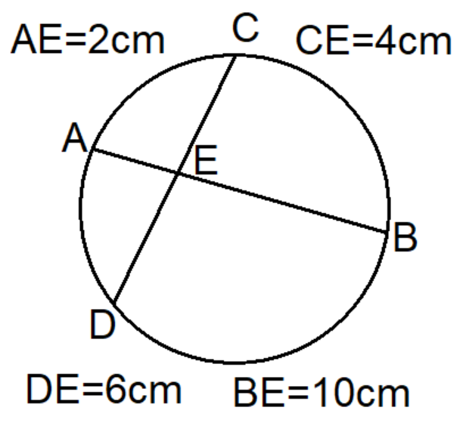
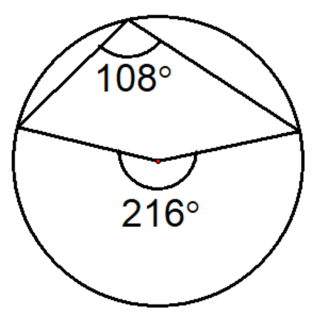
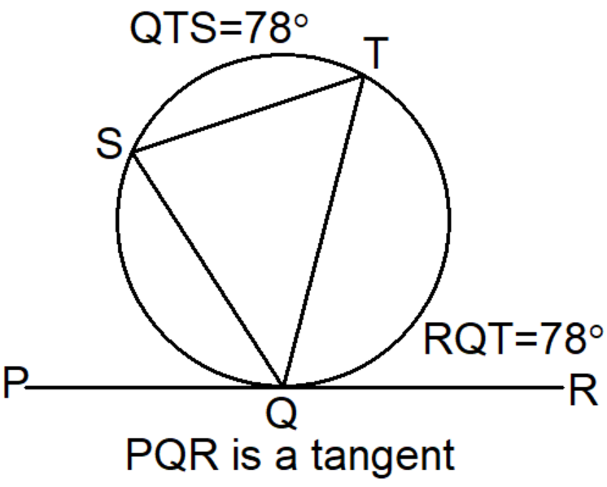
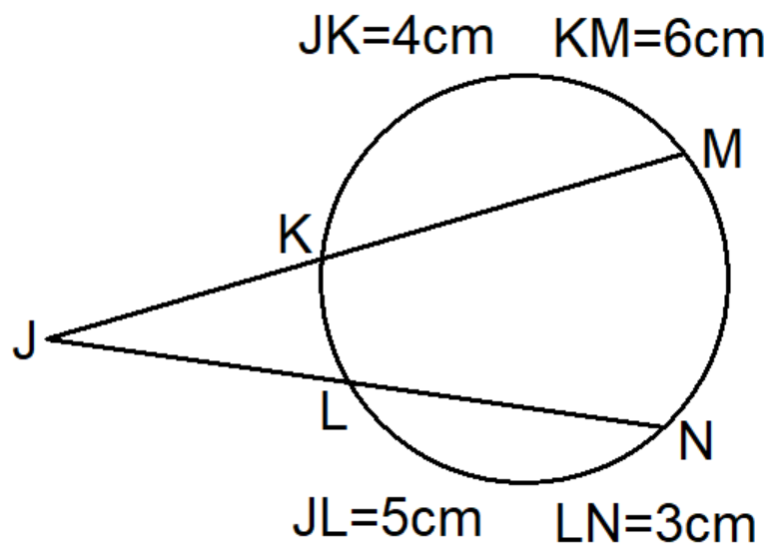
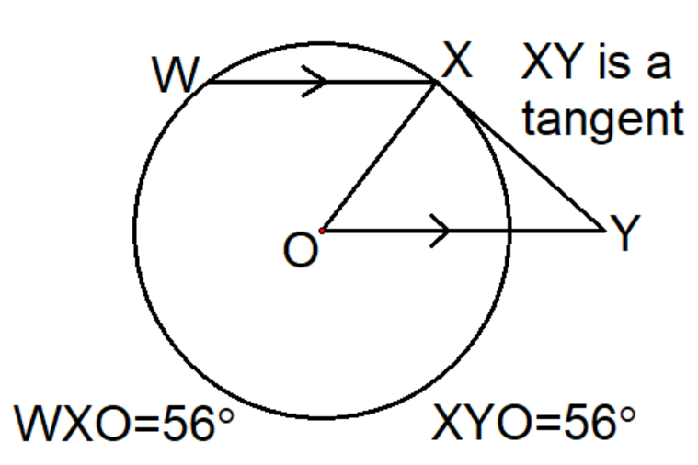
Mathematical Property:
Circle
Theorems 2
A
B
C
D
E

Slide 18
Mathematical Property:
Circle
Theorems 2
Back to “Option” slide
A
B
Incorrect
Correct
C
Incorrect
D
E
Correct
Incorrect
Answers

Slide 19
Mathematical Property:
Blank
A
B
C
D
E

