Slide 1
Bar Graphs
A series of problems…

Slide 2
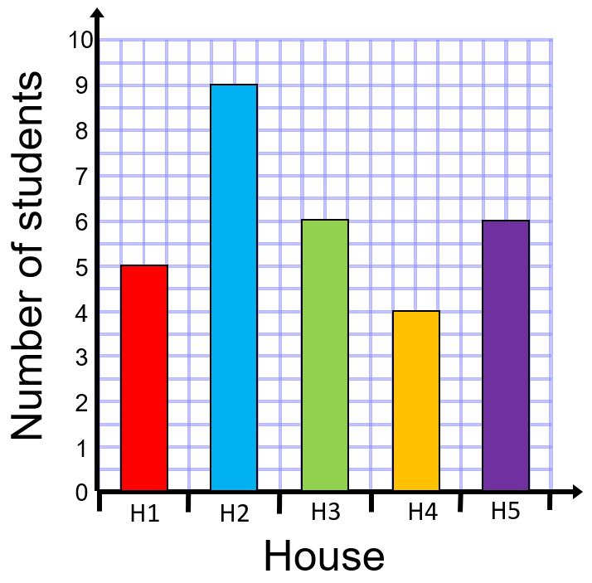
Answer the questions about the bar graph below:
Some pupils were asked which house they were a member of at school…
How many students asked were in House 5?
How many more students were in House 1 than House 4?
How many students were asked altogether?
Which is the modal House?

Slide 3



Answer the questions about the bar graph below:
Some pupils were asked which house they were a member of at school…
How many students asked were in House 5?
How many more students were in House 1 than House 4?
How many students were asked altogether?
Which is the modal House?
$$6$$
$$1$$
$$30$$
House 2

Slide 4
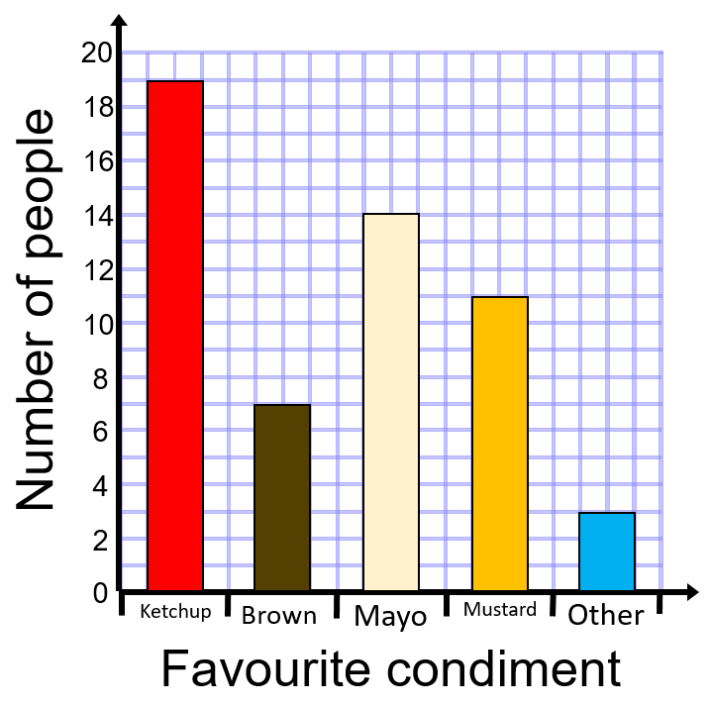
Write at least five questions using the bar chart on favourite condiments below:

Slide 5
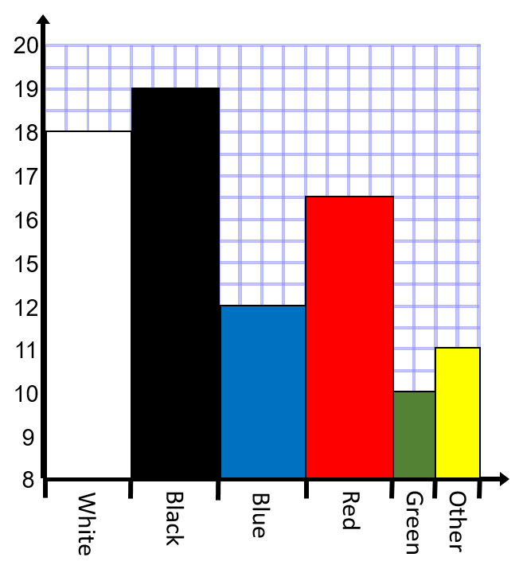
What is wrong with the bar chart below on the colours of cars in a car park?

Slide 6
What is wrong with the bar chart below on the colours of cars in a car park?
Scale doesn’t start at 0 and misses 13 and 14
No gaps between bars (discrete data)
Different widths of bar
You can’t have half a car!
No labels on either axis

Slide 7
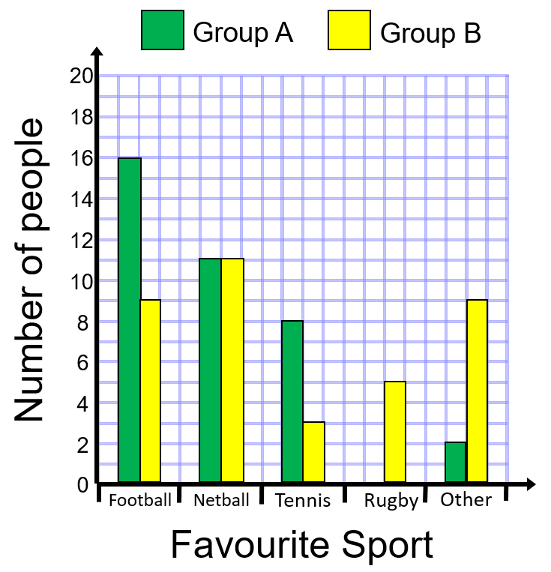
The comparative bar charts shows responses from two groups of people and their favourite sports:
How many more people in Group A than Group B like football?
Which sport was equally popular between the groups?
How many people like tennis?
Which group had more people?
Explain why there is only one bar for rugby.

Slide 8


The comparative bar charts shows responses from two groups of people and their favourite sports:
How many more people in Group A than Group B like football?
Which sport was equally popular between the groups?
How many people like tennis?
Which group had more people?
Explain why there is only one bar for rugby.
$$7$$
Netball
$$11$$
No-one in Group A likes rugby the best

Slide 9
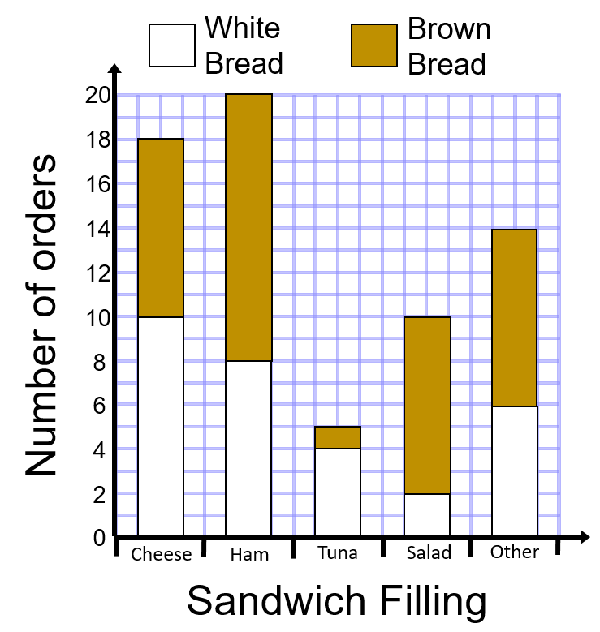
The composite bar chart shows the sandwich fillings and the type of bread ordered on one day
Which is the most popular sandwich filling?
How many people had a cheese sandwich in white bread?
How many people had a salad sandwich in brown bread?
Which was the most popular type of bread?

Slide 10


The composite bar chart shows the sandwich fillings and the type of bread ordered on one day
Which is the most popular sandwich filling?
How many people had a cheese sandwich in white bread?
How many people had a salad sandwich in brown bread?
Which was the most popular type of bread?
Ham
$$10$$
$$8$$
Brown (37 compared to 30 for white)

