Slide 1
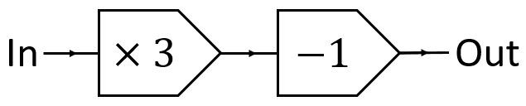
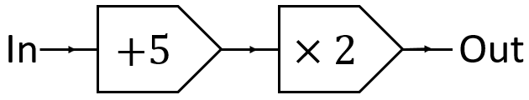
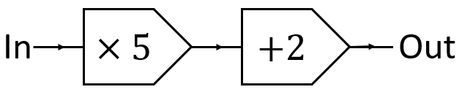
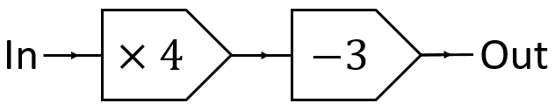
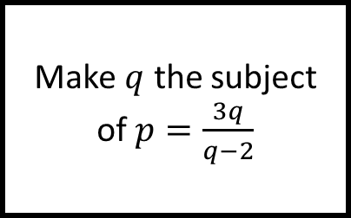
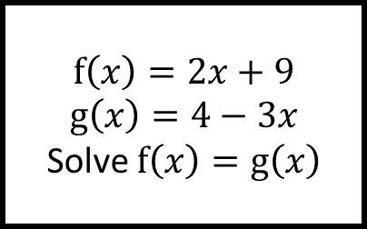
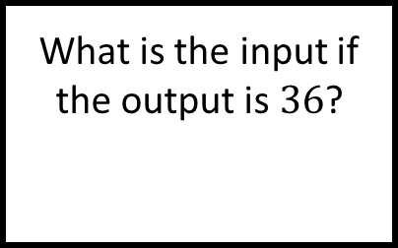
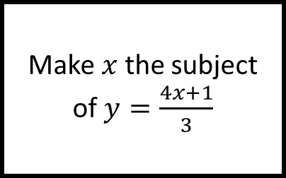
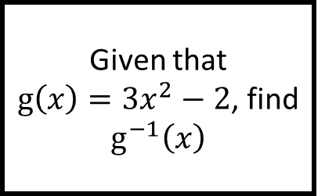
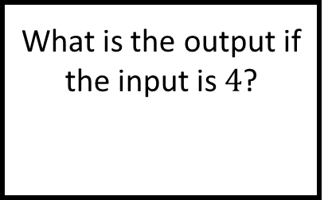
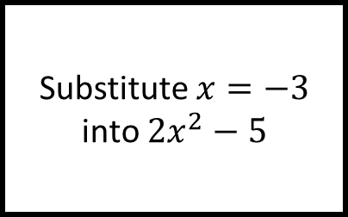
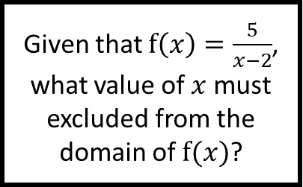
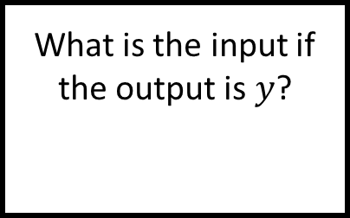
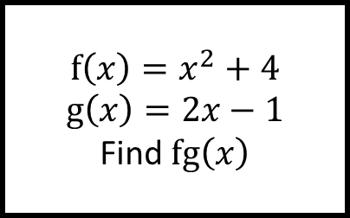
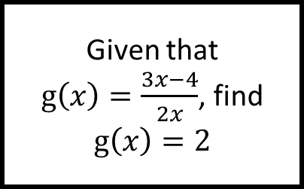
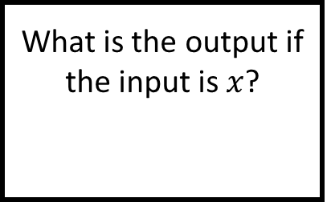
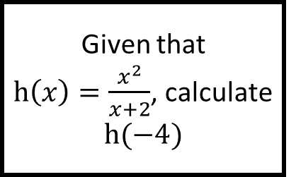
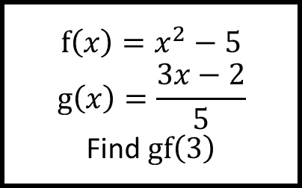
Building Blocks
$$f\left(x\right)=2x+9$$
$$g\left(x\right)=4−3x$$
Solve $f\left(x\right)=g\left(x\right)$
$$f\left(x\right)=x^{2}−5$$
$$g\left(x\right)=\frac{3x−2}{5}$$
Find $gf\left(3\right)$
$$f\left(x\right)=x^{2}+4$$
$$g\left(x\right)=2x−1$$
Find $fg\left(x\right)$
Given that
$h\left(x\right)=\frac{x^{2}}{x+2}$, calculate $h(−4)$
Given that
$g\left(x\right)=\frac{3x−4}{2x}$, find $g\left(x\right)=2$
Given that $f\left(x\right)=\frac{5}{x−2}$, what value of $x$ must excluded from the domain of $f(x)$?
Given that
$g\left(x\right)={3x}^{2}−2$, find $g^{−1}\left(x\right)$
Substitute $x=−3$ into $2x^{2}−5$
Make $x$ the subject of $y=\frac{4x+1}{3}$
Make $q$ the subject of $p=\frac{3q}{q−2}$
For Functions
What is the output if the input is $4$?
What is the input if the output is $36$?
What is the output if the input is $x$?
What is the input if the output is $y$?

Slide 2
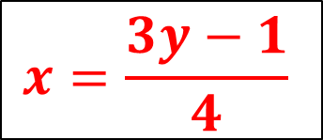

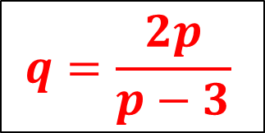
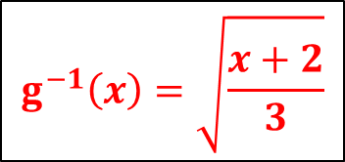




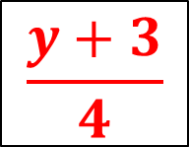
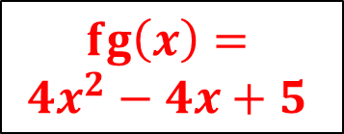




Building Blocks
$$f\left(x\right)=2x+9$$
$$g\left(x\right)=4−3x$$
Solve $f\left(x\right)=g\left(x\right)$
$$f\left(x\right)=x^{2}−5$$
$$g\left(x\right)=\frac{3x−2}{5}$$
Find $gf\left(3\right)$
$$f\left(x\right)=x^{2}+4$$
$$g\left(x\right)=2x−1$$
Find $fg\left(x\right)$
Answers
$$fg\left(x\right)=$$
$$4x^{2}−4x+5$$
$$x=−1$$
$$gf(3)=2$$
Given that
$h\left(x\right)=\frac{x^{2}}{x+2}$, calculate $h(−4)$
Given that
$g\left(x\right)=\frac{3x−4}{2x}$, find $g\left(x\right)=2$
Given that $f\left(x\right)=\frac{5}{x−2}$, what value of $x$ must excluded from the domain of $f(x)$?
Given that
$g\left(x\right)={3x}^{2}−2$, find $g^{−1}\left(x\right)$
$$g^{−1}\left(x\right)=\sqrt{\frac{x+2}{3}}$$
$$h\left(−4\right)=−8$$
$$x=−4$$
$$x=2$$
Substitute $x=−3$ into $2x^{2}−5$
Make $x$ the subject of $y=\frac{4x+1}{3}$
Make $q$ the subject of $p=\frac{3q}{q−2}$
For Functions
$$x=\frac{3y−1}{4}$$
$$q=\frac{2p}{p−3}$$
$$13$$
What is the output if the input is $4$?
What is the input if the output is $36$?
What is the output if the input is $x$?
What is the input if the output is $y$?
$$\frac{y+3}{4}$$
$$11$$
$$13$$
$$5x+2$$

