Slide 1

The answer is…
What was the question?
Christmas themed
What could be the questions?
Is your question the only possible question?

Slide 2
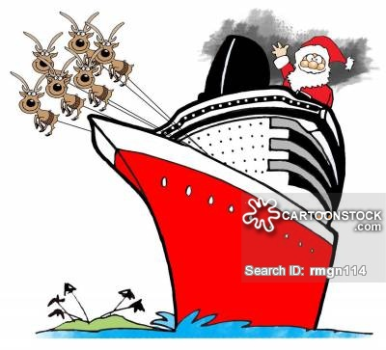
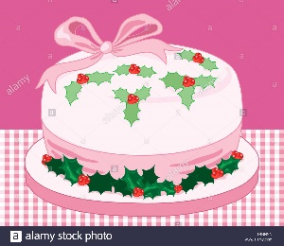
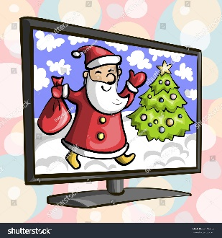
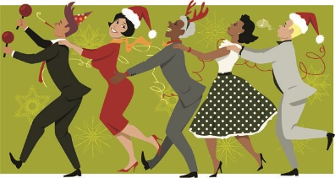
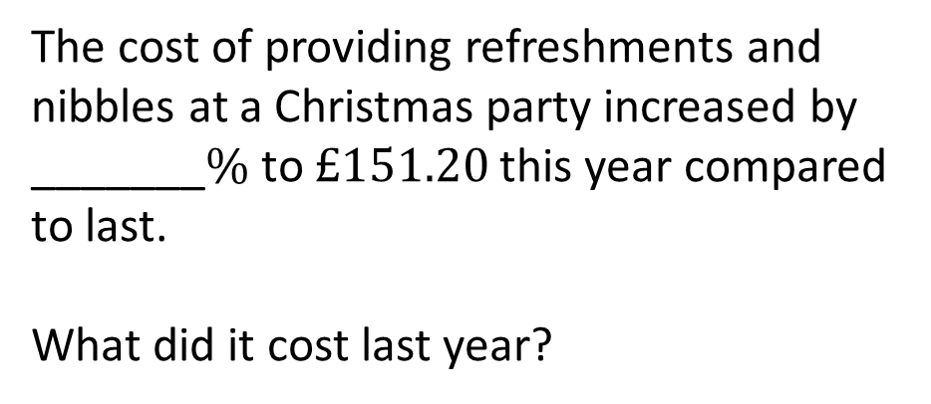
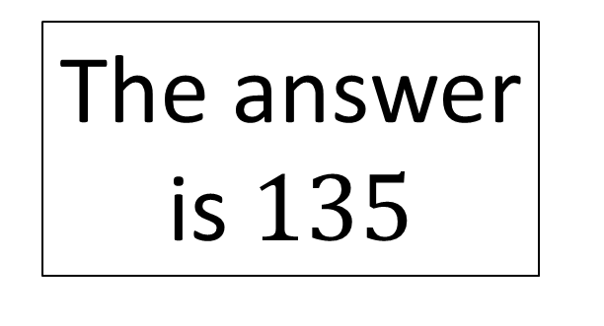
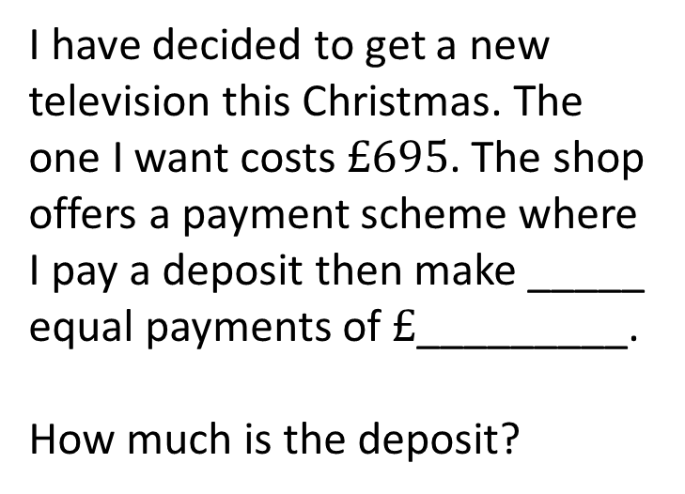
I have decided to make my Christmas cake in the shape of a regular ______________ this year.
How many degrees should each corner of my cake measure?
A Christmas cruise ship heads out of port in the direction ____________________.
What bearing is the ship sailing on?
The answer is $135$
I have decided to get a new television this Christmas. The one I want costs $£695$. The shop offers a payment scheme where I pay a deposit then make _____ equal payments of $£$_________.
How much is the deposit?
The cost of providing refreshments and nibbles at a Christmas party increased by _______$\%$ to $£151.20$ this year compared to last.
What did it cost last year?

Slide 3



I have decided to make my Christmas cake in the shape of a regular ______________ this year.
How many degrees should each corner of my cake measure?
A Christmas cruise ship heads out of port in the direction ____________________.
What bearing is the ship sailing on?
Octagon
South east
The answer is $135$
I have decided to get a new television this Christmas. The one I want costs $£695$. The shop offers a payment scheme where I pay a deposit then make _____ equal payments of $£$_________.
How much is the deposit?
The cost of providing refreshments and nibbles at a Christmas party increased by _______$\%$ to $£151.20$ this year compared to last.
What did it cost last year?
$$n$$
$$12$$
$$560÷n$$

Slide 4
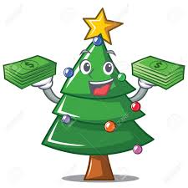
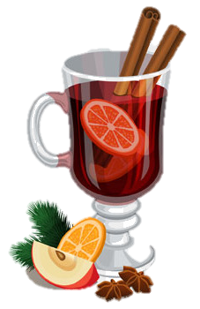
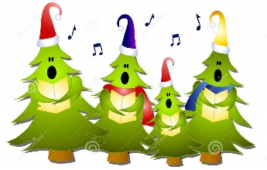
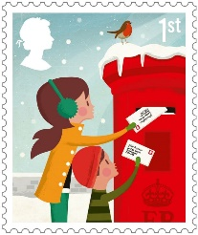
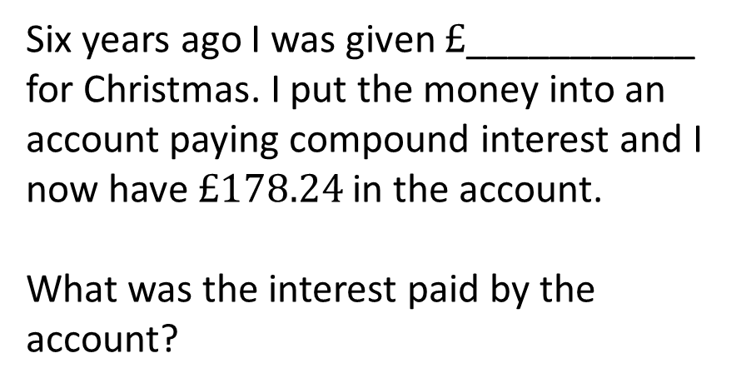
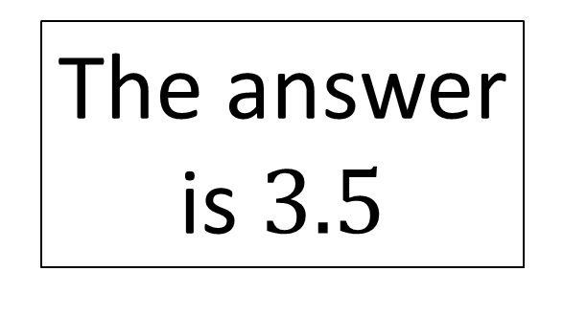
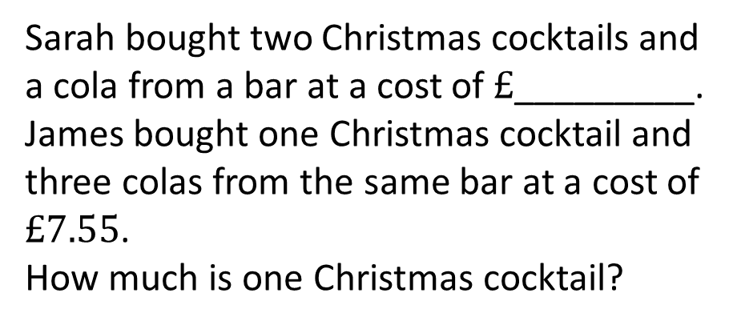
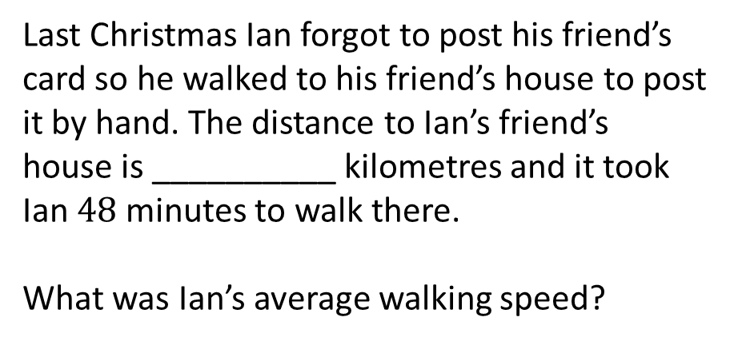
Six years ago I was given $£$___________ for Christmas. I put the money into an account paying compound interest and I now have $£178.24$ in the account.
What was the interest paid by the account?
Sarah bought two Christmas cocktails and a cola from a bar at a cost of $£$_________.
James bought one Christmas cocktail and three colas from the same bar at a cost of $£7.55$.
How much is one Christmas cocktail?
The answer is $3.5$
Last Christmas Ian forgot to post his friend’s card so he walked to his friend’s house to post it by hand. The distance to Ian’s friend’s house is __________ kilometres and it took Ian $48$ minutes to walk there.
What was Ian’s average walking speed?
Michael made a Christmas playlist. The playlist lasts __________ minutes in total and has _________ tracks on it.
What is the average length of each track on the playlist?

Slide 5





Six years ago I was given $£$___________ for Christmas. I put the money into an account paying compound interest and I now have $£178.24$ in the account.
What was the interest paid by the account?
Sarah bought two Christmas cocktails and a cola from a bar at a cost of $£$_________.
James bought one Christmas cocktail and three colas from the same bar at a cost of $£7.55$.
How much is one Christmas cocktail?
$$145$$
$$8.35$$
The answer is $3.5$
Last Christmas Ian forgot to post his friend’s card so he walked to his friend’s house to post it by hand. The distance to Ian’s friend’s house is __________ kilometres and it took Ian $48$ minutes to walk there.
What was Ian’s average walking speed?
Michael made a Christmas playlist. The playlist lasts __________ minutes in total and has _________ tracks on it.
What is the average length of each track on the playlist?
$$3.5n$$
$$2.8$$
$$n$$

Slide 6
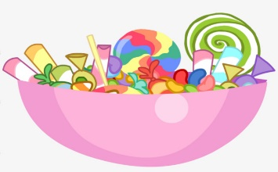
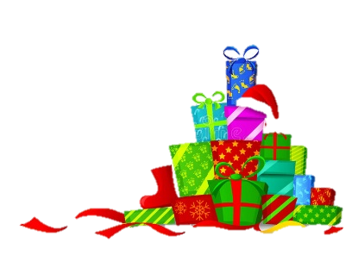
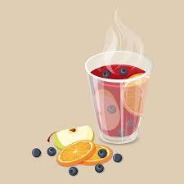
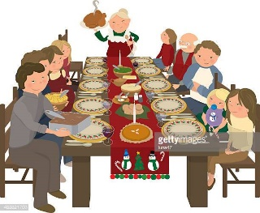
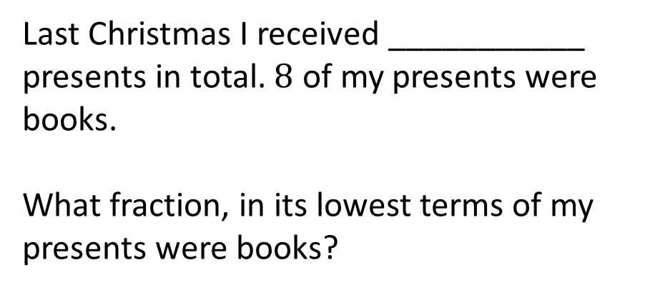
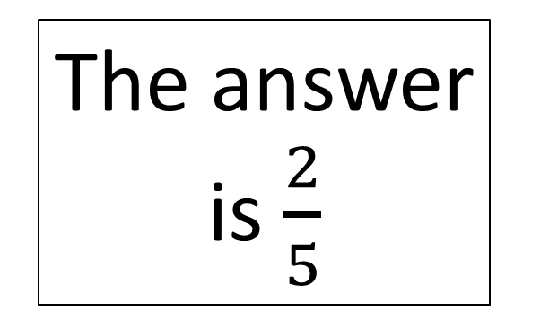
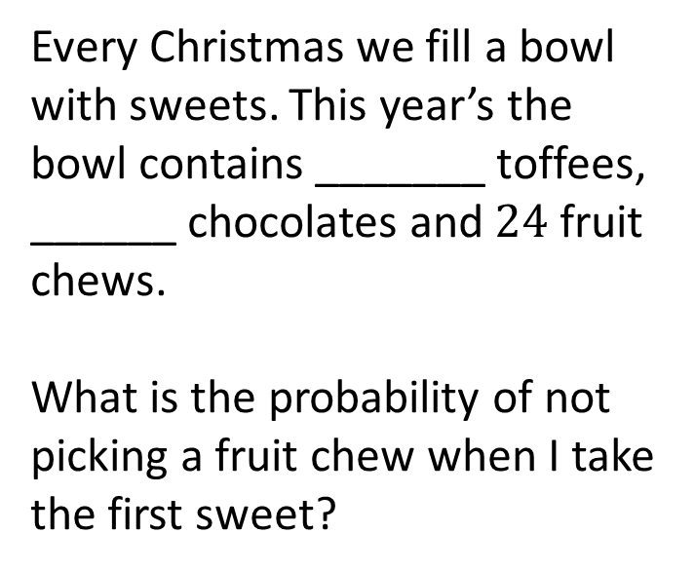
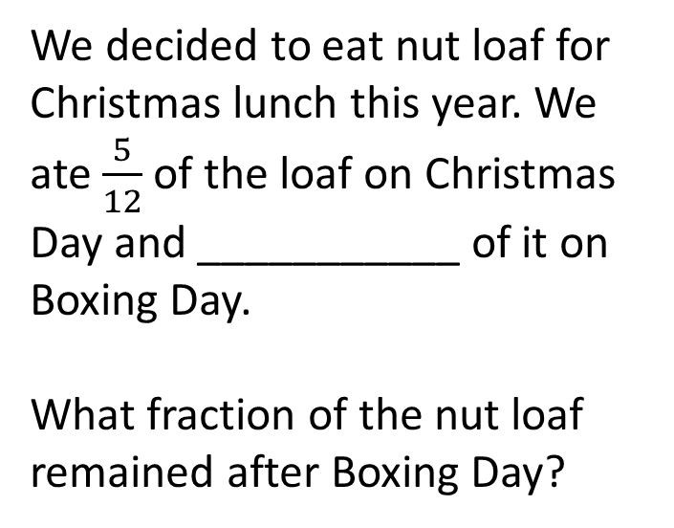
Every Christmas we fill a bowl with sweets. This year’s the bowl contains _______ toffees, ______ chocolates and $24$ fruit chews.
What is the probability of not picking a fruit chew when I take the first sweet?
Last Christmas I received ___________ presents in total. $8$ of my presents were books.
What fraction, in its lowest terms of my presents were books?
The answer is $\frac{2}{5}$
We decided to eat nut loaf for Christmas lunch this year. We ate $\frac{5}{12}$ of the loaf on Christmas Day and ___________ of it on Boxing Day.
What fraction of the nut loaf remained after Boxing Day?
I am making ______ litres of my traditional, non-alcoholic, Christmas punch. The recipe requires me to mix ________ millilitres of apple juice with ________ millilitres of cranberry juice and ________ millilitres of grapefruit juice.
What fraction of the punch is cranberry juice?

Slide 7

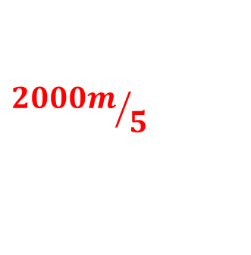


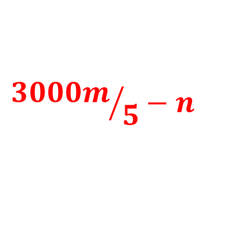



Every Christmas we fill a bowl with sweets. This year’s the bowl contains _______ toffees, ______ chocolates and $24$ fruit chews.
What is the probability of not picking a fruit chew when I take the first sweet?
Last Christmas I received ___________ presents in total. $8$ of my presents were books.
What fraction, in its lowest terms of my presents were books?
$$20$$
$$n$$
$$36−n$$
The answer is $\frac{2}{5}$
We decided to eat nut loaf for Christmas lunch this year. We ate $\frac{5}{12}$ of the loaf on Christmas Day and ___________ of it on Boxing Day.
What fraction of the nut loaf remained after Boxing Day?
I am making ______ litres of my traditional, non-alcoholic, Christmas punch. The recipe requires me to mix ________ millilitres of apple juice with ________ millilitres of cranberry juice and ________ millilitres of grapefruit juice.
What fraction of the punch is cranberry juice?
$$m$$
$$\frac{11}{60}$$
$$n$$
$${2000m}/5$$
$${3000m}/5−n$$

Slide 8
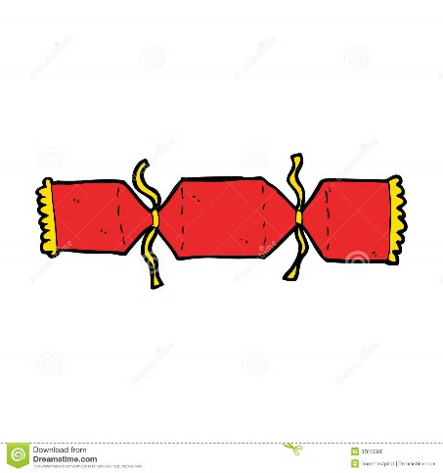
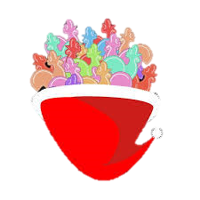
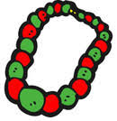
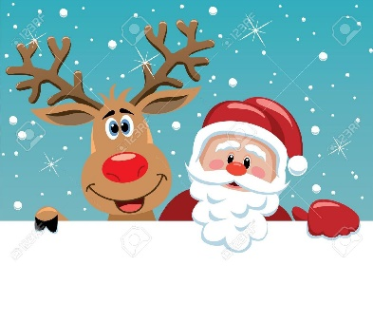
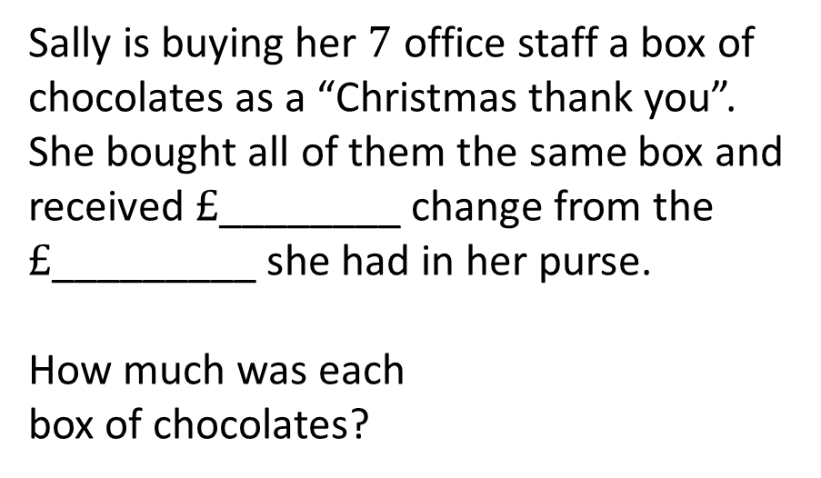
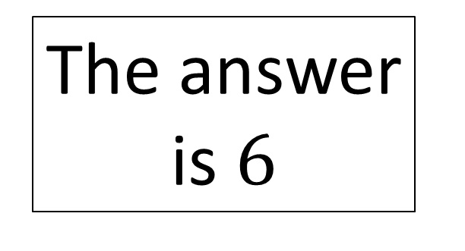
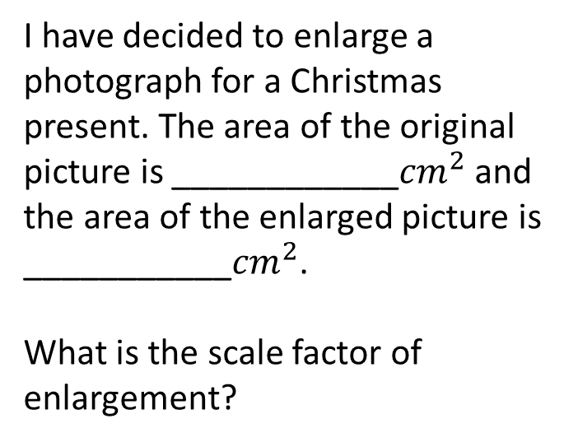
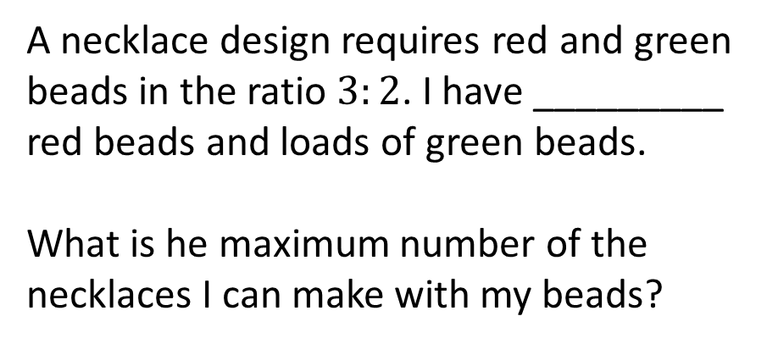
Sally is buying her $7$ office staff a box of chocolates as a “Christmas thank you”. She bought all of them the same box and received $£$________ change from the $£$_________ she had in her purse.
How much was each
box of chocolates?
Derek is organising a Christmas party and wants every person who attends to have a cracker to pull. Crackers come in boxes of _______ and there are _________ people attending the party.
How many boxes of crackers must Derek buy?
The answer is $6$
I have decided to enlarge a photograph for a Christmas present. The area of the original picture is ____________${cm}^{2}$ and the area of the enlarged picture is ___________${cm}^{2}$.
What is the scale factor of enlargement?
A necklace design requires red and green beads in the ratio $3:2$. I have _________ red beads and loads of green beads.
What is he maximum number of the necklaces I can make with my beads?

Slide 9







Sally is buying her $7$ office staff a box of chocolates as a “Christmas thank you”. She bought all of them the same box and received $£$________ change from the $£$_________ she had in her purse.
How much was each
box of chocolates?
Derek is organising a Christmas party and wants every person who attends to have a cracker to pull. Crackers come in boxes of _______ and there are _________ people attending the party.
How many boxes of crackers must Derek buy?
$$n$$
$$8$$
$$5n<x≤6n$$
$$50$$
Many answers including…
The answer is $6$
I have decided to enlarge a photograph for a Christmas present. The area of the original picture is ____________${cm}^{2}$ and the area of the enlarged picture is ___________${cm}^{2}$.
What is the scale factor of enlargement?
A necklace design requires red and green beads in the ratio $3:2$. I have _________ red beads and loads of green beads.
What is he maximum number of the necklaces I can make with my beads?
$$n$$
$$18≤n<24$$
$$36n$$

Slide 10
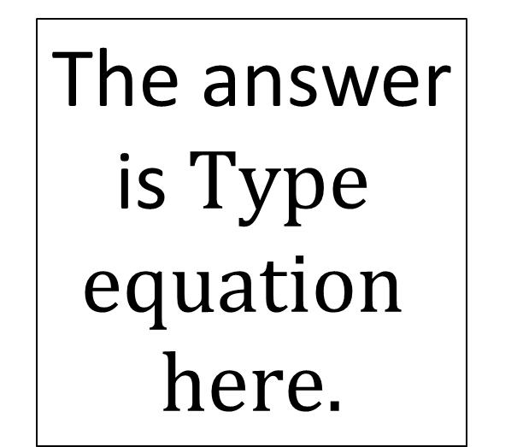
Type here
Type here
The answer is
Type here
Type here

