Slide 1

The answer is…
What was the question?
*Ratio and Proportion Edition*
What could be the questions?
Is your question the only possible question?

Slide 2
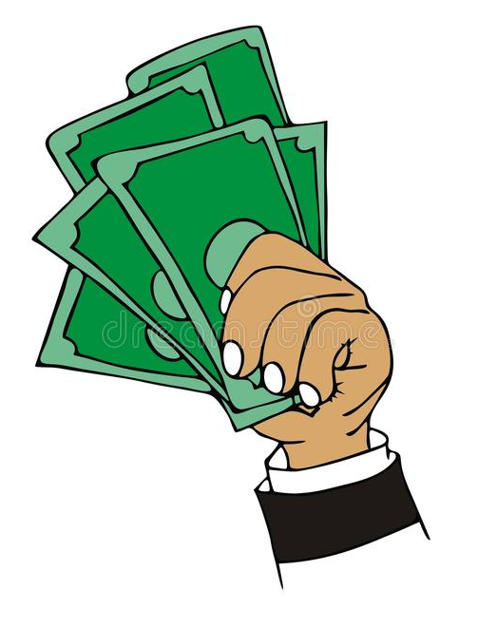
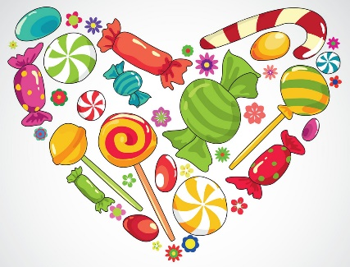
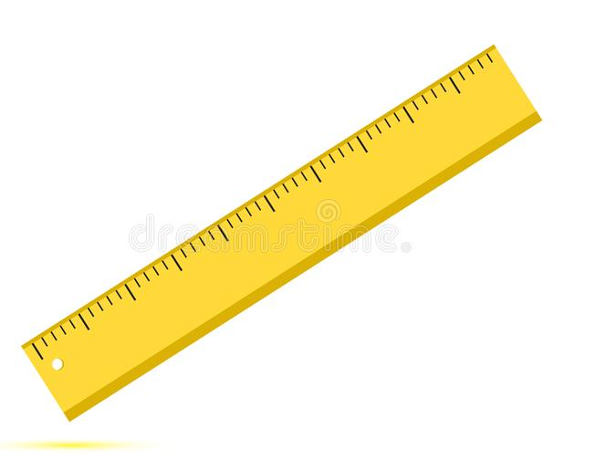

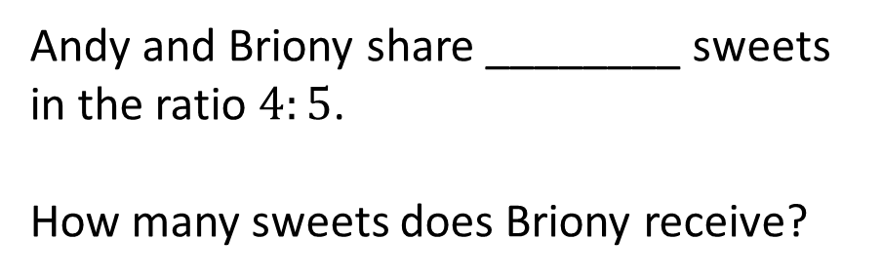
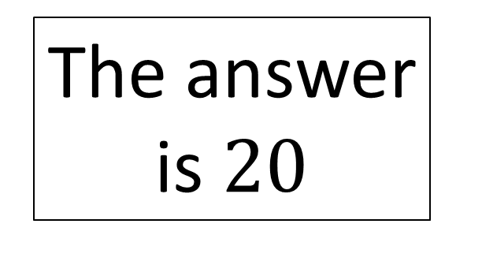
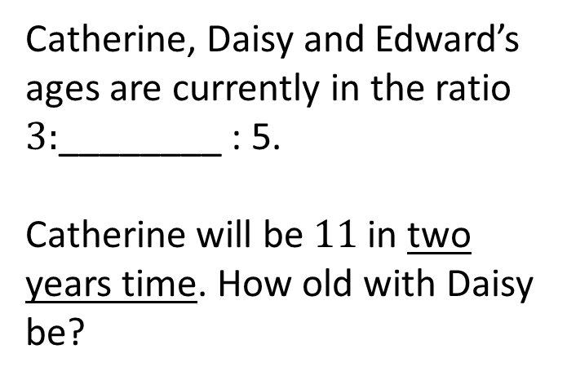
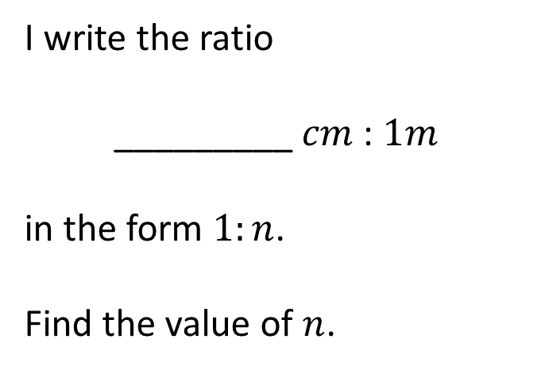
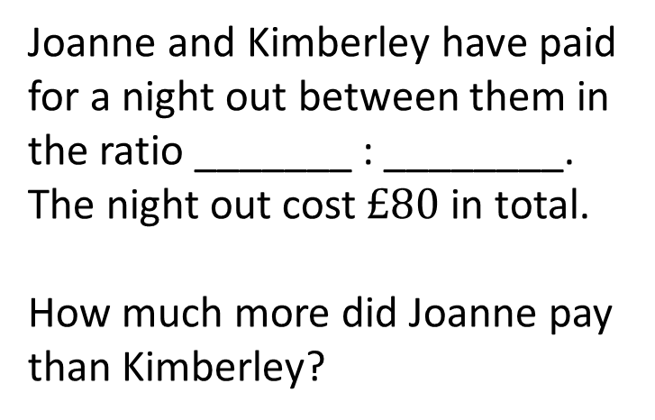
Andy and Briony share ________ sweets in the ratio $4:5$.
How many sweets does Briony receive?
Joanne and Kimberley have paid for a night out between them in the ratio _______ : ________. The night out cost $£80$ in total.
How much more did Joanne pay than Kimberley?
The answer is $20$
I write the ratio
_________ $cm$ : $1m$
in the form $1:n$.
Find the value of $n$.
Catherine, Daisy and Edward’s ages are currently in the ratio $3:$________ : 5.
Catherine will be $11$ in two years time. How old with Daisy be?

Slide 3





$$36$$
Joanne and Kimberley have paid for a night out between them in the ratio _______ : ________. The night out cost $£80$ in total.
How much more did Joanne pay than Kimberley?
Andy and Briony share ________ sweets in the ratio $4:5$.
How many sweets does Briony receive?
$$5$$
$$3$$
The answer is $20$
I write the ratio
_________ $cm$ : $1m$
in the form $1:n$.
Find the value of $n$.
Catherine, Daisy and Edward’s ages are currently in the ratio $3:$________ : 5.
Catherine will be $11$ in two years time. How old with Daisy be?
$$5$$
$$6$$

Slide 4

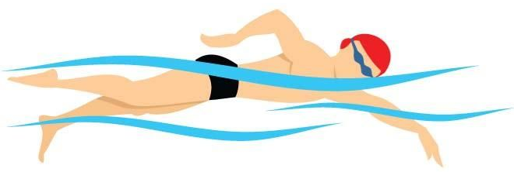

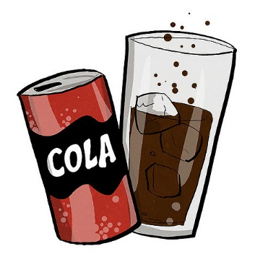
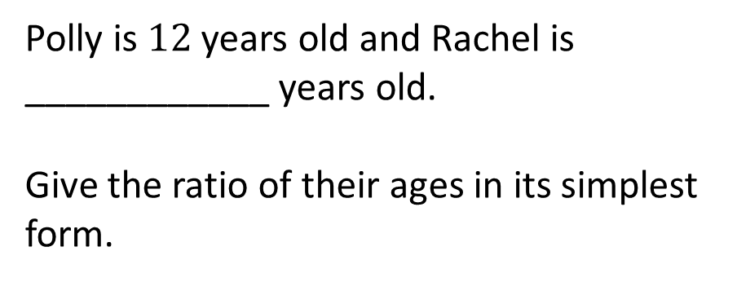
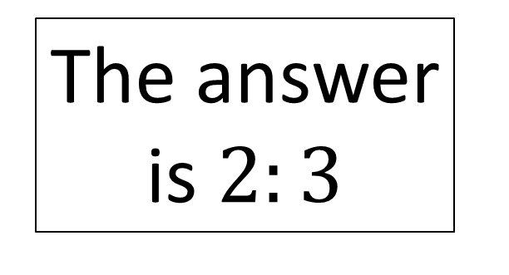
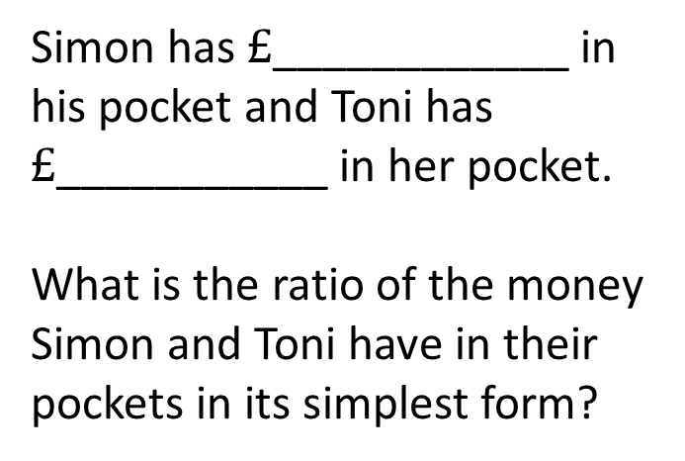
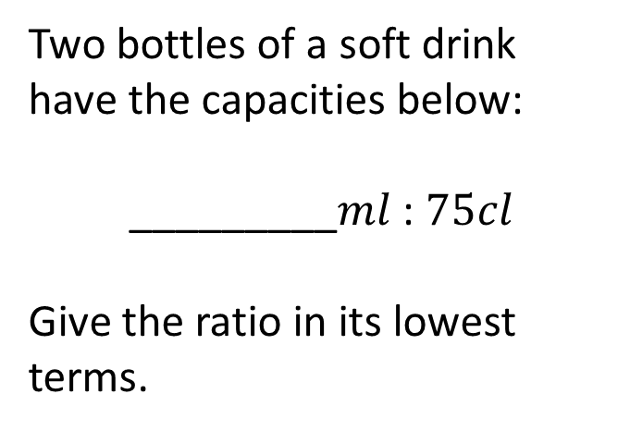
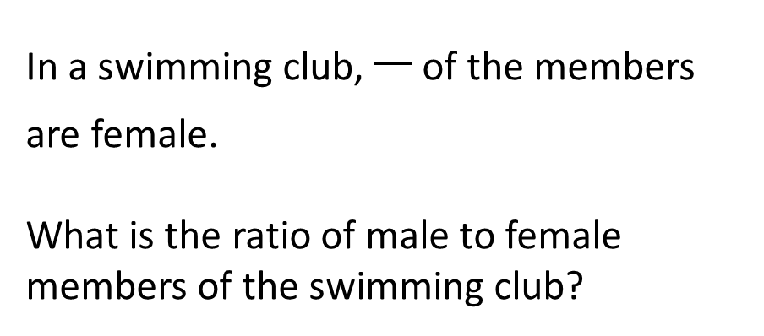
In a swimming club, of the members are female.
What is the ratio of male to female members of the swimming club?
Polly is $12$ years old and Rachel is ____________ years old.
Give the ratio of their ages in its simplest form.
The answer is $2:3$
Two bottles of a soft drink have the capacities below:
_________$ml$ : $75cl$
Give the ratio in its lowest terms.
Simon has $£$____________ in his pocket and Toni has $£$___________ in her pocket.
What is the ratio of the money Simon and Toni have in their pockets in its simplest form?

Slide 5





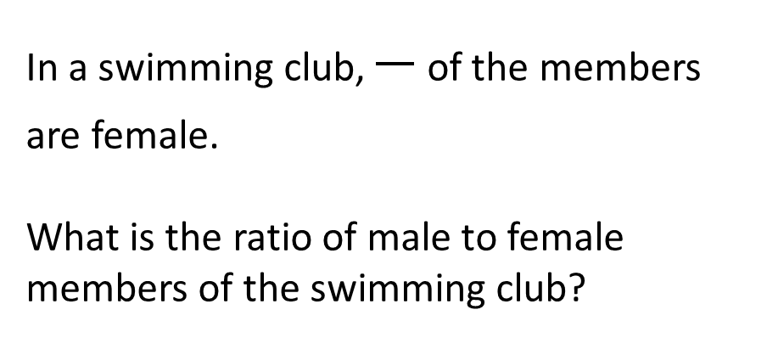

In a swimming club, of the members are female.
What is the ratio of male to female members of the swimming club?
$$3$$
Polly is $12$ years old and Rachel is ____________ years old.
Give the ratio of their ages in its simplest form.
$$18$$
$$5$$
The answer is $2:3$
$$2n$$
Two bottles of a soft drink have the capacities below:
_________$ml$ : $75cl$
Give the ratio in its lowest terms.
Simon has $£$____________ in his pocket and Toni has $£$___________ in her pocket.
What is the ratio of the money Simon and Toni have in their pockets in its simplest form?
$$3n$$
$$500$$

Slide 6
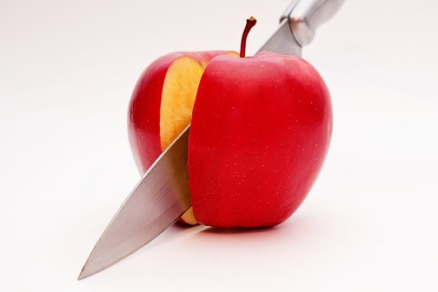
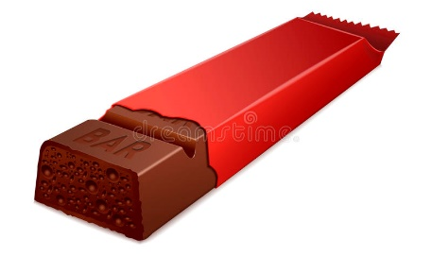


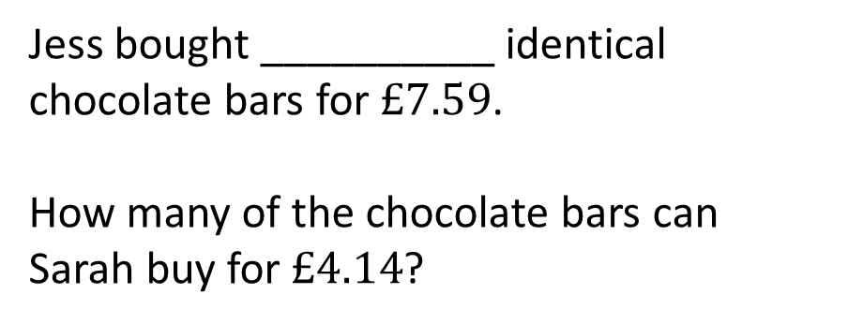
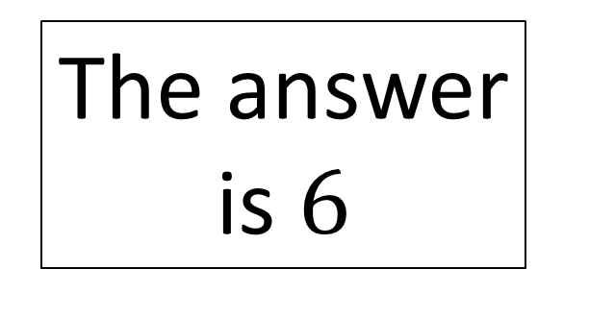
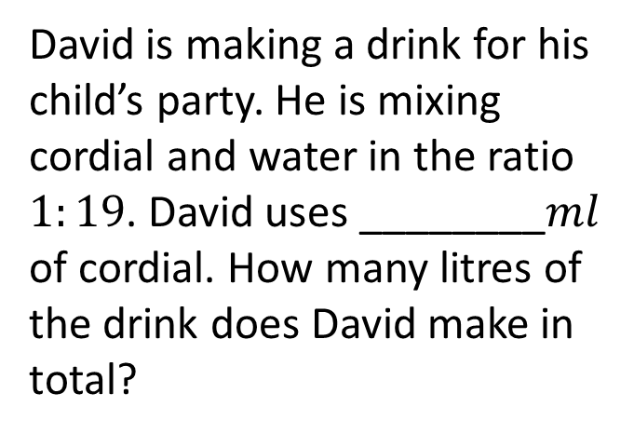
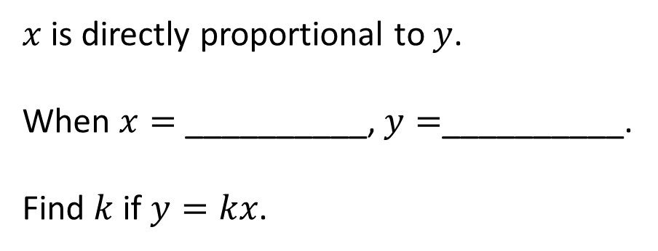
Jess bought __________ identical chocolate bars for $£7.59$.
How many of the chocolate bars can Sarah buy for $£4.14$?
$x$ is directly proportional to $y$.
When $x=$ __________, $y=$__________.
Find $k$ if $y=kx$.
The answer is $6$
It takes one hose ___________ minutes to fill a paddling pool.
How long will it take four hoses?
David is making a drink for his child’s party. He is mixing cordial and water in the ratio $1:19$. David uses ________$ml$ of cordial. How many litres of the drink does David make in total?

Slide 7





$$11$$
$x$ is directly proportional to $y$.
When $x=$ __________, $y=$__________.
Find $k$ if $y=kx$.
Jess bought __________ identical chocolate bars for $£7.59$.
How many of the chocolate bars can Sarah buy for $£4.14$?
$$n$$
$$6n$$
The answer is $6$
$$24$$
David is making a drink for his child’s party. He is mixing cordial and water in the ratio $1:19$. David uses ________$ml$ of cordial. How many litres of the drink does David make in total?
It takes one hose ___________ minutes to fill a paddling pool.
How long will it take four hoses?
$$300$$

Slide 8




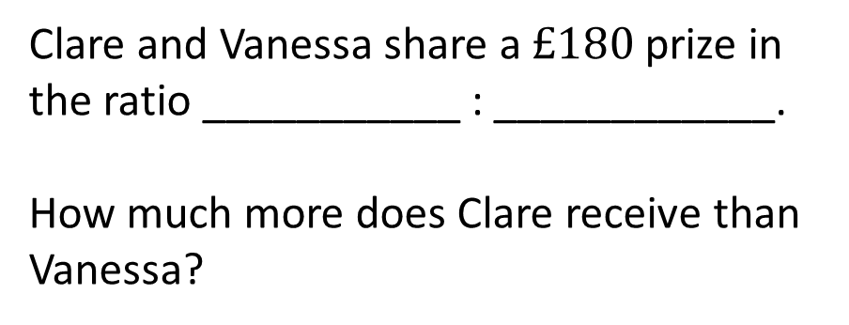
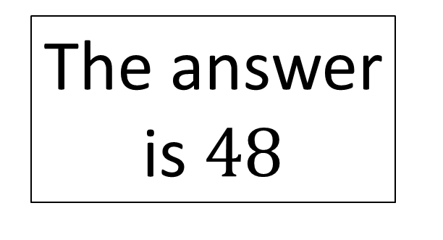
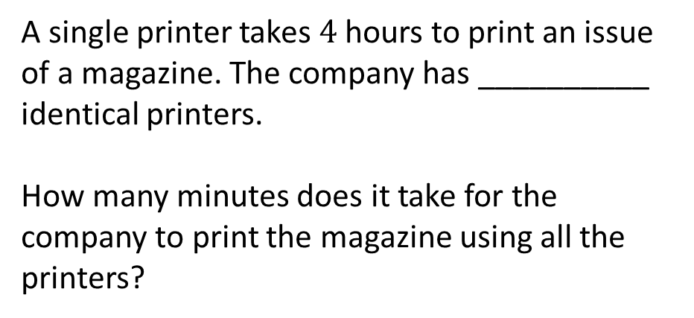
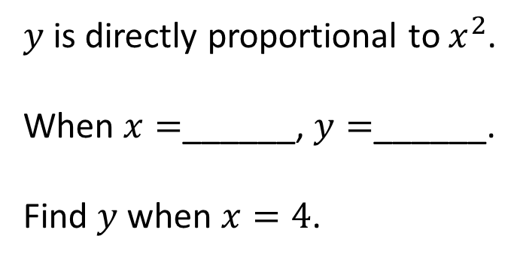
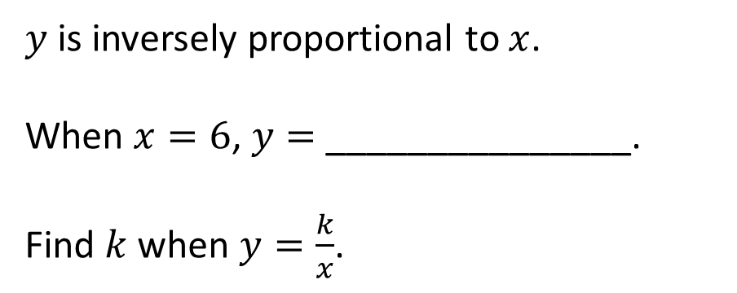
Clare and Vanessa share a $£180$ prize in the ratio ___________ : ____________.
How much more does Clare receive than Vanessa?
$y$ is inversely proportional to $x$.
When $x=6$, $y=$ _______________.
Find $k$ when $y=\frac{k}{x}$.
The answer is $48$
$y$ is directly proportional to $x^{2}$.
When $x=$______, $y=$______.
Find $y$ when $x=4$.
A single printer takes $4$ hours to print an issue of a magazine. The company has __________ identical printers.
How many minutes does it take for the company to print the magazine using all the printers?

Slide 9



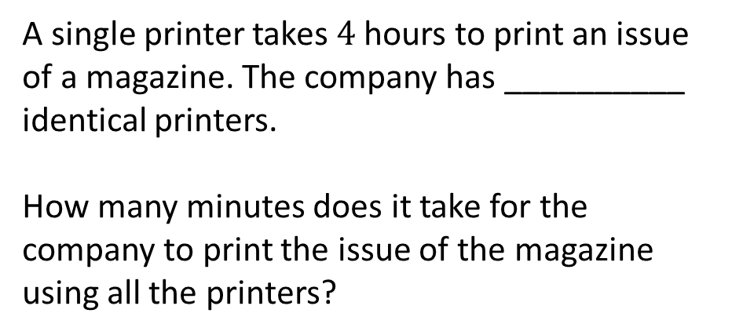



Clare and Vanessa share a $£180$ prize in the ratio ___________ : ____________.
How much more does Clare receive than Vanessa?
$y$ is inversely proportional to $x$.
When $x=6$, $y=$ _______________.
Find $k$ when $y=\frac{k}{x}$.
$$19$$
$$11$$
$$8$$
The answer is $48$
$y$ is directly proportional to $x^{2}$.
When $x=$______, $y=$______.
Find $y$ when $x=4$.
A single printer takes $4$ hours to print an issue of a magazine. The company has __________ identical printers.
How many minutes does it take for the company to print the issue of the magazine using all the printers?
$$n$$
$$3n^{2}$$
$$5$$

Slide 10
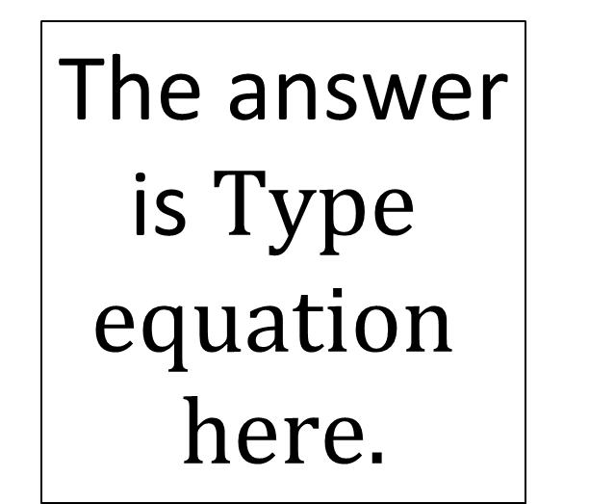
Type here
Type here
The answer is
Type here
Type here

