Slide 1

The answer is…
What was the question?
*Sets and Venn Diagrams Edition*
What could be the questions?
Is your question the only possible question?

Slide 2




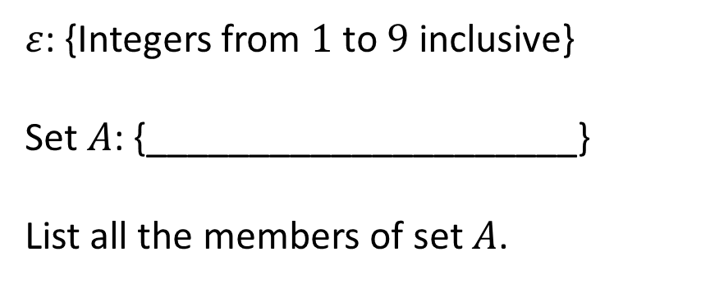
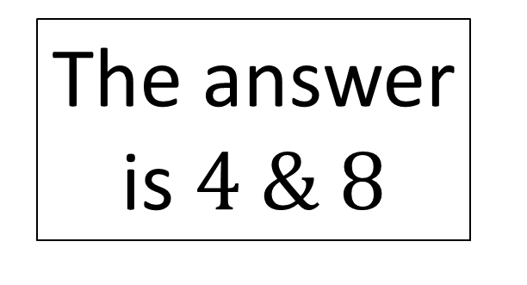
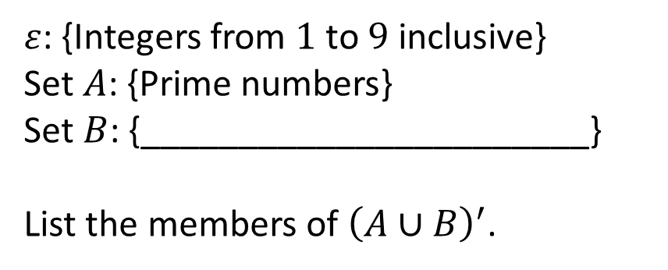
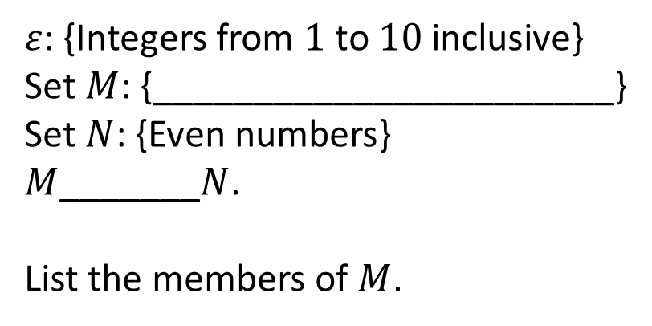
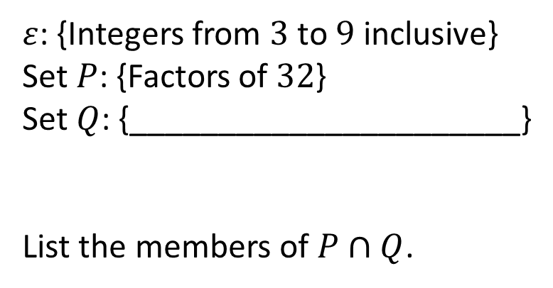
$ε$: {Integers from $1$ to $9$ inclusive}
Set $A$: {_____________________}
List all the members of set $A$.
$ε$: {Integers from $3$ to $9$ inclusive}
Set $P$: {Factors of $32$}
Set $Q$: {______________________}
List the members of $P∩Q$.
The answer is $4 \& 8$
$ε$: {Integers from $1$ to $10$ inclusive}
Set $M$: {_______________________}
Set $N$: {Even numbers}
$M$_______$N$.
List the members of $M$.
$ε$: {Integers from $1$ to $9$ inclusive}
Set $A$: {Prime numbers}
Set $B$: {_______________________}
List the members of ${\left(A∪B\right)}^{′}$.

Slide 3
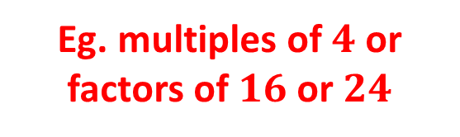
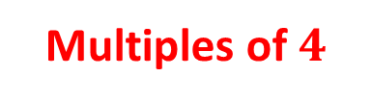
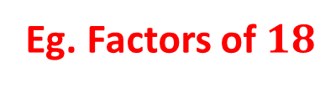

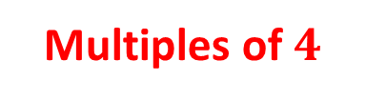
$ε$: {Integers from $1$ to $9$ inclusive}
Set $A$: {_____________________}
List all the members of set $A$.
$ε$: {Integers from $3$ to $9$ inclusive}
Set $P$: {Factors of $32$}
Set $Q$: {______________________}
List the members of $P∩Q$.
Multiples of $4$
Eg. multiples of $4$ or factors of $16$ or $24$
The answer is $4 \& 8$
$ε$: {Integers from $1$ to $10$ inclusive}
Set $M$: {_______________________}
Set $N$: {Even numbers}
$M$_______$N$.
List the members of $M$.
$ε$: {Integers from $1$ to $9$ inclusive}
Set $A$: {Prime numbers}
Set $B$: {_______________________}
List the members of ${\left(A∪B\right)}^{′}$.
Multiples of $4$
Eg. Factors of $18$
$$⊂$$

Slide 4







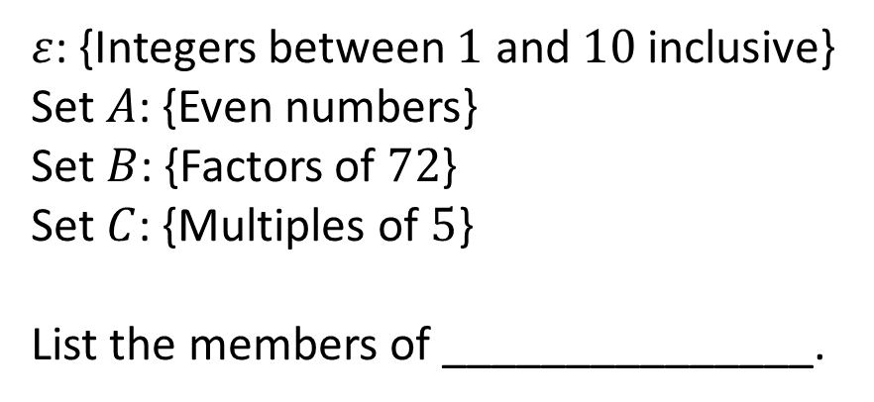



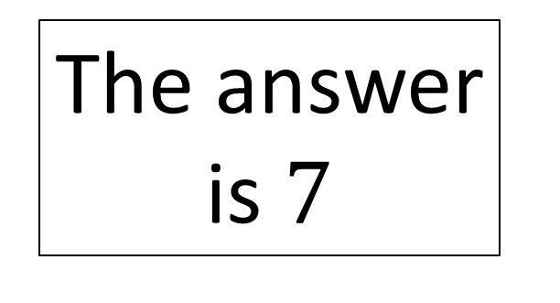



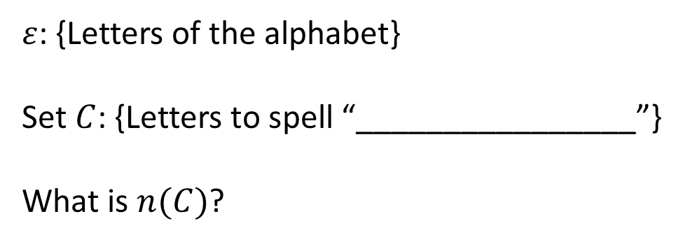

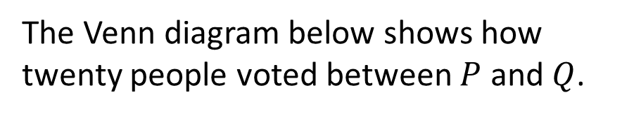

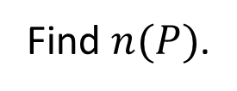



$ε$: {Letters of the alphabet}
Set $C$: {Letters to spell “________________”}
What is $n(C)$?
The Venn diagram below shows how twenty people voted between $P$ and $Q$.
$$ε$$
$$P$$
$$Q$$
____
____
____
$$5$$
The answer is $7$
Find $n(P)$.
The Venn diagram shows the number of people in each section.
$ε$: {Integers between $1$ and $10$ inclusive}
Set $A$: {Even numbers}
Set $B$: {Factors of $72$}
Set $C$: {Multiples of $5$}
List the members of _______________.
$$ε$$
$$M$$
$$L$$
$$N$$
$$4$$
$$1$$
$$2$$
$$7$$
$$3$$
Find
_______
$$6$$

Slide 5







$ε$: {Letters of the alphabet}
Set $C$: {Letters to spell “________________”}
What is $n(C)$?
The Venn diagram below shows how twenty people voted between $P$ and $Q$.
Any $7$ letter word
$$ε$$
$$P$$
$$Q$$
$$a$$
$$b$$
$$8$$
____
____
____
$$5$$
The answer is $7$
$a+b=7$
Find $n(P)$.
The Venn diagram shows the number of people in each section.
$ε$: {Integers between $1$ and $10$ inclusive}
Set $A$: {Even numbers}
Set $B$: {Factors of $72$}
Set $C$: {Multiples of $5$}
List the members of _______________.
$$ε$$
$$M$$
$$L$$
$$N$$
$$4$$
$$1$$
$$2$$
$$7$$
$$3$$
Find
_______
$${\left(A∪B∪C\right)}^{′}$$
$$6$$
$$n(M∩N)$$

Slide 6
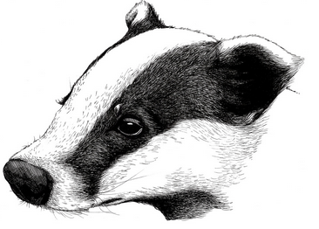

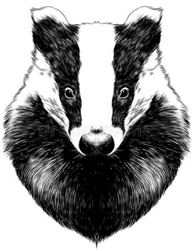


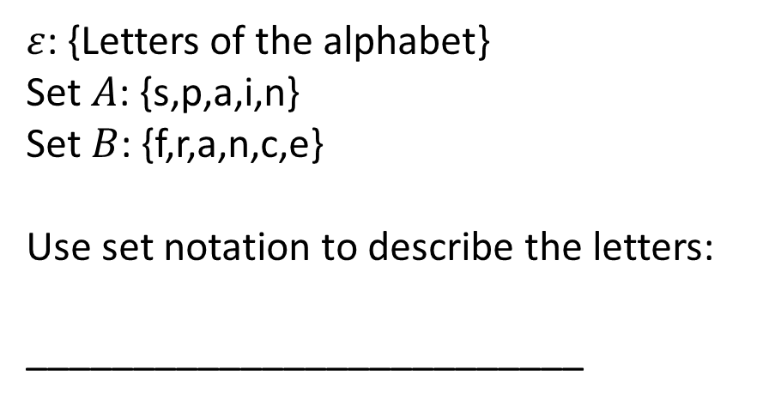
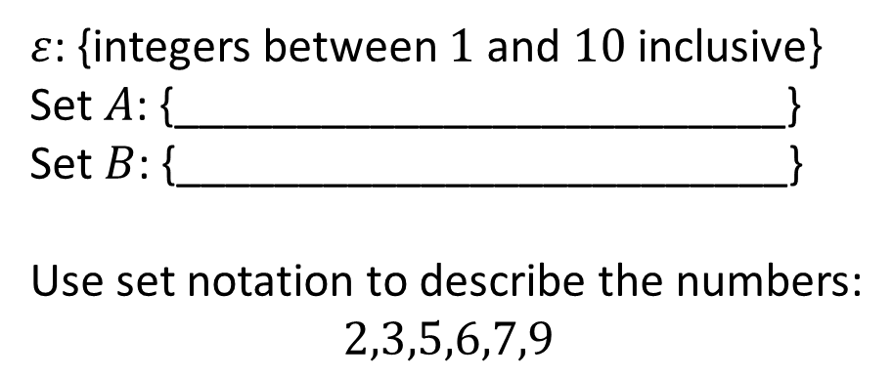
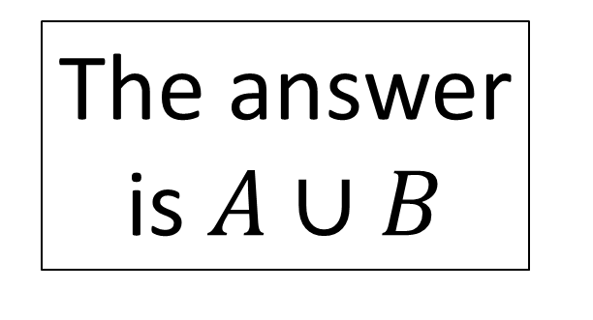






$ε$: {Letters of the alphabet}
Set $A$: {s,p,a,i,n}
Set $B$: {f,r,a,n,c,e}
Use set notation to describe the letters:
__________________________
Using set notation, describe the shaded area of the Venn diagram below:
$$ε$$
$$A$$
$$B$$
The answer is $A∪B$
Using set notation, describe the shaded area of the Venn diagram below:
$ε$: {integers between $1$ and $10$ inclusive}
Set $A$: {_________________________}
Set $B$: {_________________________}
Use set notation to describe the numbers:
$$2,3,5,6,7,9$$
$$ε$$
$$A$$
$$C$$
$$B$$

Slide 7




$ε$: {Letters of the alphabet}
Set $A$: {s,p,a,i,n}
Set $B$: {f,r,a,n,c,e}
Use set notation to describe the letters:
__________________________
Using set notation, describe the shaded area of the Venn diagram below:
$$ε$$
$$ε$$
$$A$$
$$B$$
$$A$$
$$B$$
a,c,e,f,i,n,p,r,s
The answer is $A∪B$
Using set notation, describe the shaded area of the Venn diagram below:
$ε$: {integers between $1$ and $10$ inclusive}
Set $A$: {_________________________}
Set $B$: {_________________________}
Use set notation to describe the numbers:
$$2,3,5,6,7,9$$
$$ε$$
Prime numbers
$$ε$$
$$A$$
$$A$$
$$C$$
$$C$$
Multiples of $3$
$$B$$
$$B$$

Slide 8


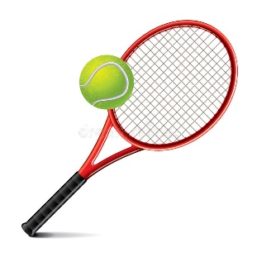




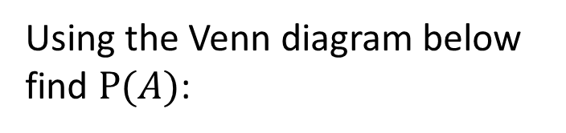



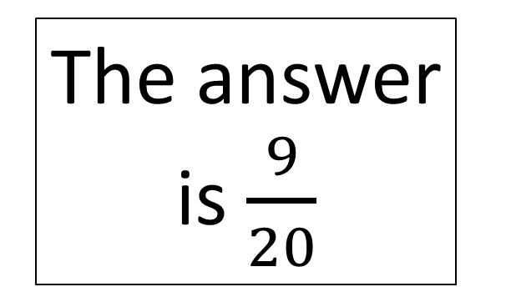






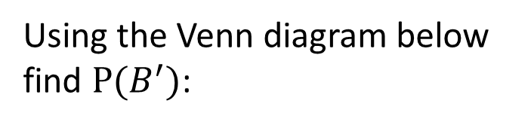

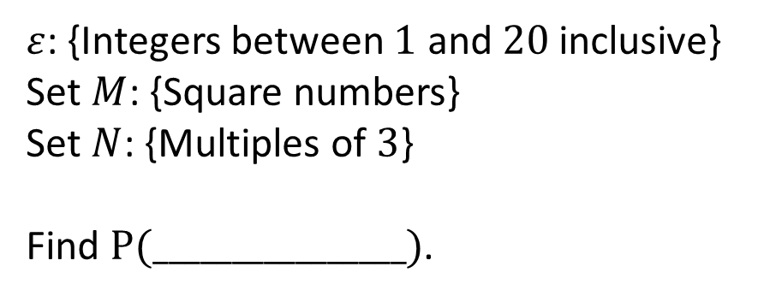


$ε$: {Integers between $1$ and $20$ inclusive}
Set $M$: {Square numbers}
Set $N$: {Multiples of $3$}
Find $P(________________)$.
Using the Venn diagram below find $P(A)$:
$$ε$$
$$A$$
$$B$$
$$7$$
___
$$5$$
The answer is $\frac{9}{20}$
___
Given that someone plays football, find the probability that they play Tennis as well.
Using the Venn diagram below find $P(B^{′})$:
$$ε$$
$$ε$$
Dance
Football
$$A$$
$$B$$
$$10$$
__
___
$$5$$
$$2$$
___
__
$$2$$
__
$$13$$
___
$$5$$
Tennis

Slide 9












$ε$: {Integers between $1$ and $20$ inclusive}
Set $M$: {Square numbers}
Set $N$: {Multiples of $3$}
Find $P(________________)$.
Using the Venn diagram below find $P(A)$:
$$ε$$
$$A$$
$$B$$
$$M∪N$$
$$7$$
$$2$$
$$5$$
___
$$6$$
The answer is $\frac{9}{20}$
___
Given that someone plays football, find the probability that they play Tennis as well.
Using the Venn diagram below find $P(B^{′})$:
$$a+b=9$$
$$c+d=11$$
$$ε$$
$$ε$$
Dance
Football
$$A$$
$$B$$
$$c$$
__
$$d$$
$$10$$
___
$$9$$
$$a$$
$$5$$
$$2$$
___
__
$$2$$
$$b$$
__
$$13$$
$$4$$
$$5$$
___
Tennis

Slide 10
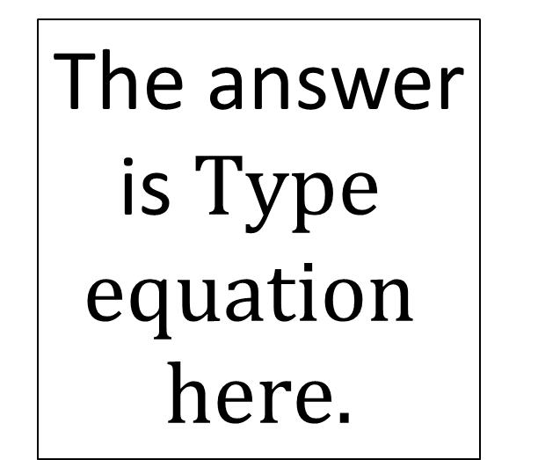
Type here
Type here
The answer is
Type here
Type here

