Slide 1

The answer is…
What was the question?
*Probability Special*
What could be the questions?
Is your question the only possible question?

Slide 2

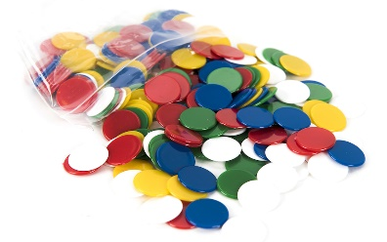
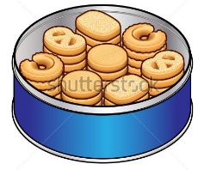
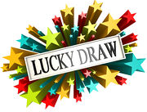
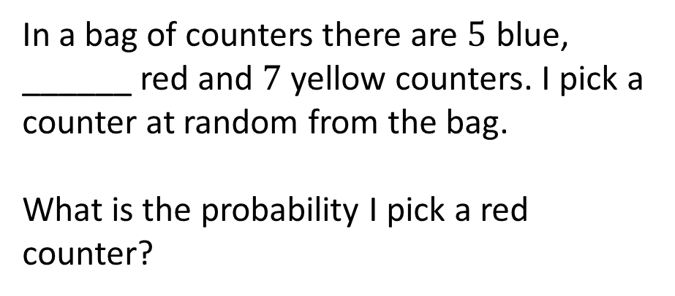
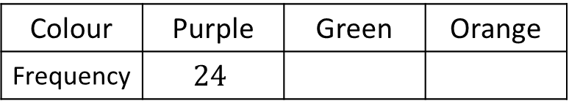
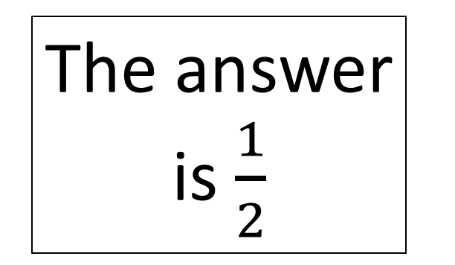
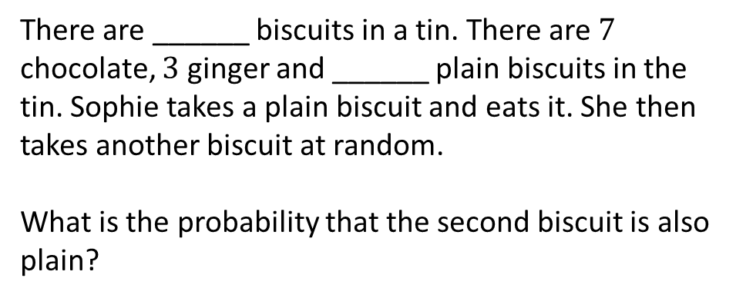
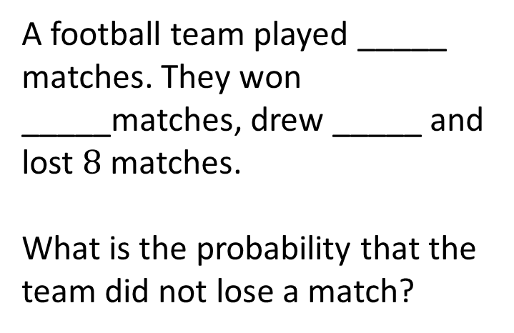
In a bag of counters there are $5$ blue, ______ red and $7$ yellow counters. I pick a counter at random from the bag.
What is the probability I pick a red counter?
A football team played _____ matches. They won _____matches, drew _____ and lost $8$ matches.
What is the probability that the team did not lose a match?
The answer is $\frac{1}{2}$
Below is a table showing the selections made by customers at a lucky dip:
What is the relative probability of the next person picking green?
There are ______ biscuits in a tin. There are $7$ chocolate, $3$ ginger and ______ plain biscuits in the tin. Sophie takes a plain biscuit and eats it. She then takes another biscuit at random.
What is the probability that the second biscuit is also plain?
Colour | Purple | Green | Orange
Frequency | $$24$$

Slide 3








In a bag of counters there are $5$ blue, ______ red and $7$ yellow counters. I pick a counter at random from the bag.
What is the probability I pick a red counter?
A football team played _____ matches. They won _____matches, drew _____ and lost $8$ matches.
What is the probability that the team did not lose a match?
$$16$$
$$12$$
$$n$$
$$8−n$$
The answer is $\frac{1}{2}$
Below is a table showing the selections made by customers at a lucky dip:
What is the relative probability of the next person picking green?
$$21$$
There are ______ biscuits in a tin. There are $7$ chocolate, $3$ ginger and ______ plain biscuits in the tin. Sophie takes a plain biscuit and eats it. She then takes another biscuit at random.
What is the probability that the second biscuit is also plain?
Colour | Purple | Green | Orange
Frequency | $$24$$
$$11$$
$$n+24$$
$$n$$

Slide 4
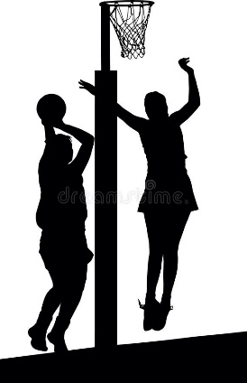
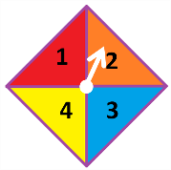
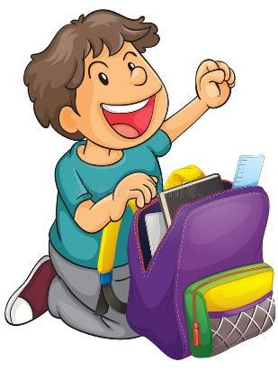
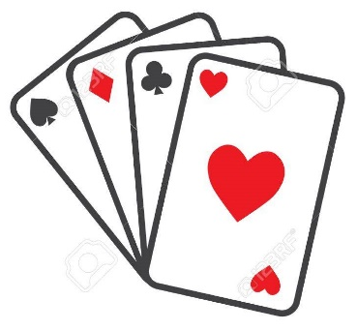
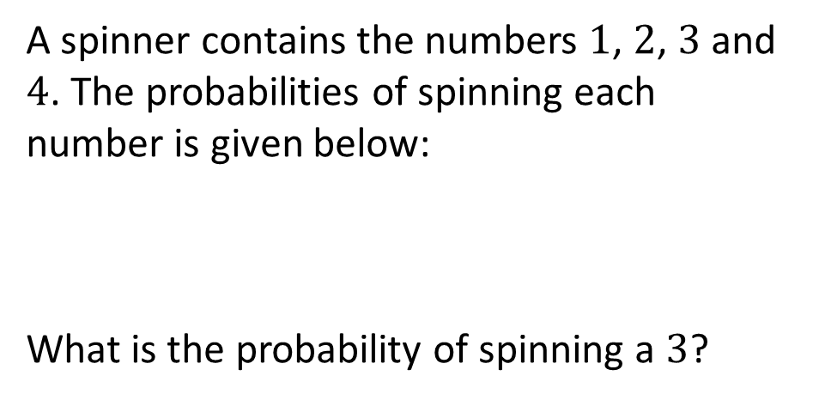
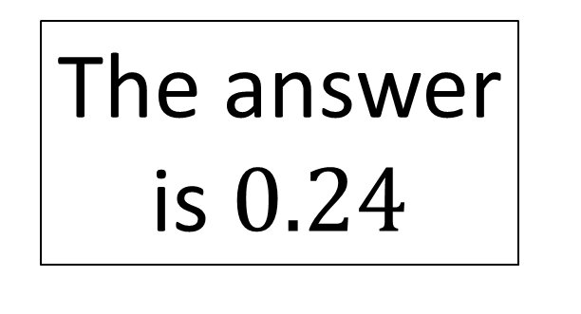
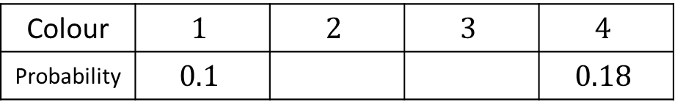
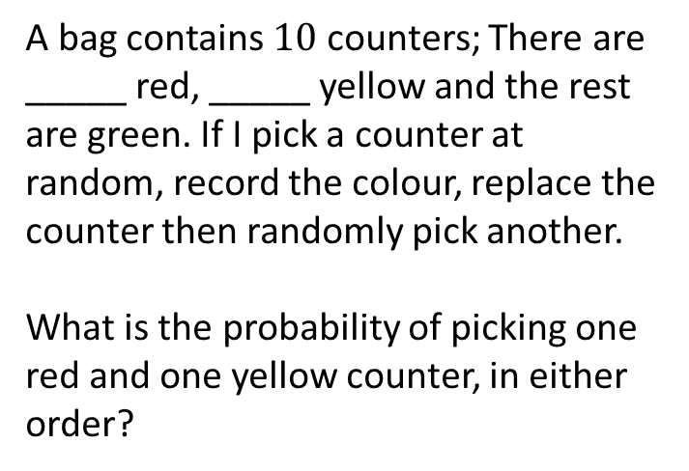
A spinner contains the numbers $1$, $2$, $3$ and $4$. The probabilities of spinning each number is given below:
What is the probability of spinning a $3$?
A netball match can either be won, drawn or lost. The probability that a netball team wins a match is _____; the probability that they draw a match is _____.
What is the probability that they lose the match?
Colour | $$1$$ | $$2$$ | $$3$$ | $$4$$
Probability | $$0.1$$ |  |  | $$0.18$$
The answer is $0.24$
In a card game you can either win or lose. The probability of Chloe winning a game of cards is _____.
Chloe plays two games of cards.
What is the probability that Chloe loses the first game but wins the second?
A bag contains $10$ counters; There are _____ red, _____ yellow and the rest are green. If I pick a counter at random, record the colour, replace the counter then randomly pick another.
What is the probability of picking one red and one yellow counter, in either order?

Slide 5







A spinner contains the numbers $1$, $2$, $3$ and $4$. The probabilities of spinning each number is given below:
What is the probability of spinning a $3$?
A netball match can either be won, drawn or lost. The probability that a netball team wins a match is _____; the probability that they draw a match is _____.
What is the probability that they lose the match?
Colour | $$1$$ | $$2$$ | $$3$$ | $$4$$
Probability | $$0.1$$ |  |  | $$0.18$$
$$n$$
$$0.48$$
$$0.76−n$$
The answer is $0.24$
In a card game you can either win or lose. The probability of Chloe winning a game of cards is _____.
Chloe plays two games of cards.
What is the probability that Chloe loses the first game but wins the second?
A bag contains $10$ counters; There are _____ red, _____ yellow and the rest are green. If I pick a counter at random, record the colour, replace the counter then randomly pick another.
What is the probability of picking one red and one yellow counter, in either order?
$$a$$
$$b$$
$0.4$ or $0.6$
$a$ and $b$ must multiply to make $12$

Slide 6
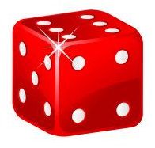
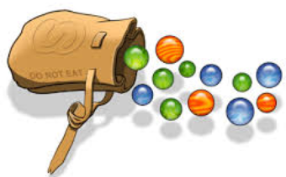

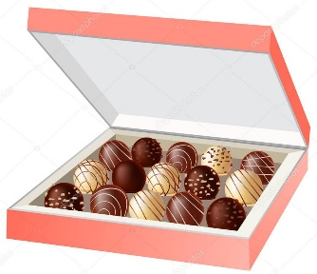
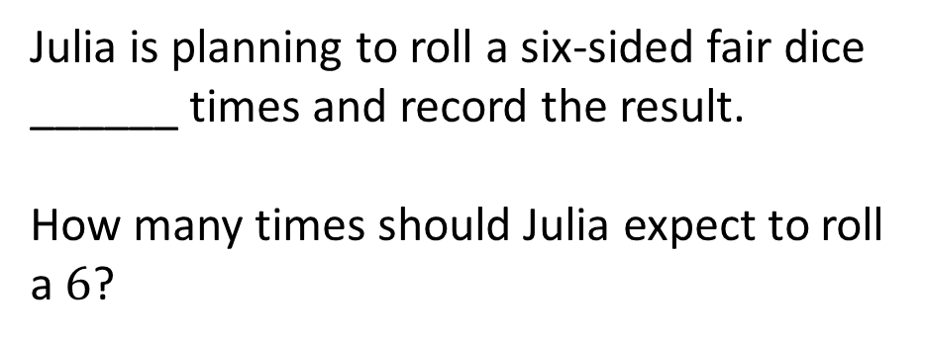
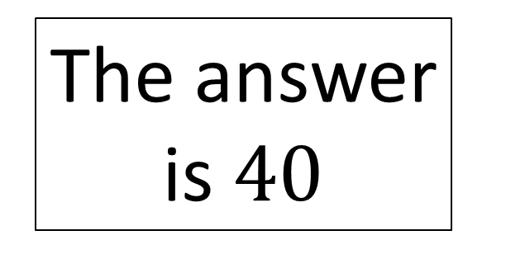
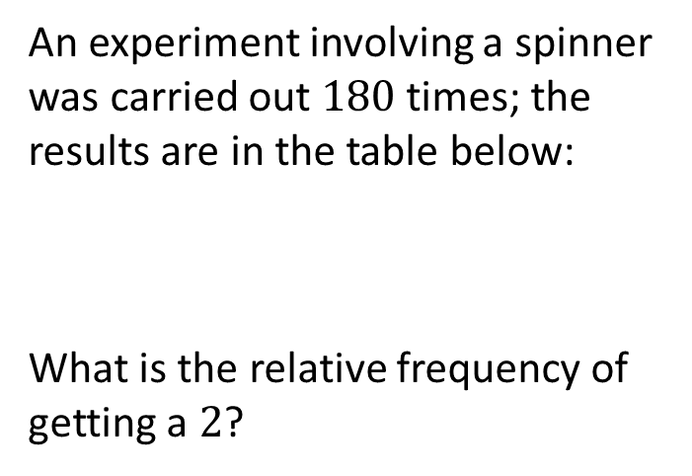
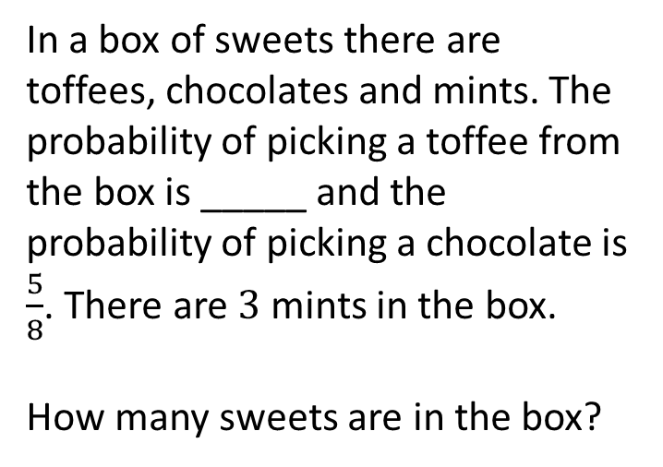
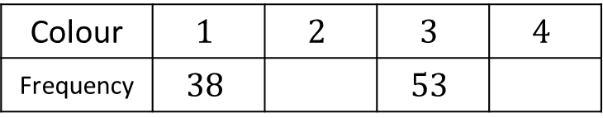
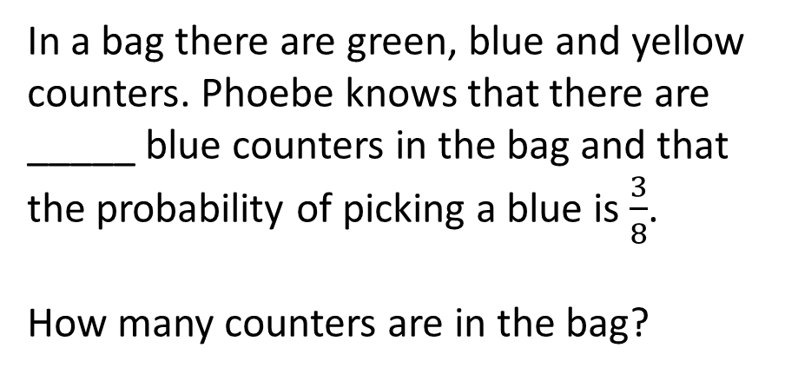
Julia is planning to roll a six-sided fair dice ______ times and record the result.
How many times should Julia expect to roll a $6$?
In a bag there are green, blue and yellow counters. Phoebe knows that there are _____ blue counters in the bag and that the probability of picking a blue is $\frac{3}{8}$.
How many counters are in the bag?
The answer is $40$
In a box of sweets there are toffees, chocolates and mints. The probability of picking a toffee from the box is _____ and the probability of picking a chocolate is $\frac{5}{8}$. There are $3$ mints in the box.
How many sweets are in the box?
An experiment involving a spinner was carried out $180$ times; the results are in the table below:
What is the relative frequency of getting a $2$?
Colour | $$1$$ | $$2$$ | $$3$$ | $$4$$
Frequency | $$38$$ |  | $$53$$

Slide 7

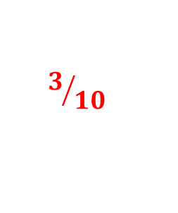


Julia is planning to roll a six-sided fair dice ______ times and record the result.
How many times should Julia expect to roll a $6$?
In a bag there are green, blue and yellow counters. Phoebe knows that there are _____ blue counters in the bag and that the probability of picking a blue is $\frac{3}{8}$.
How many counters are in the bag?
$$240$$
$$15$$
The answer is $40$
In a box of sweets there are toffees, chocolates and mints. The probability of picking a toffee from the box is _____ and the probability of picking a chocolate is $\frac{5}{8}$. There are $3$ mints in the box.
How many sweets are in the box?
An experiment involving a spinner was carried out $180$ times; the results are in the table below:
What is the relative frequency of getting a $2$?
$$3/{10}$$
Colour | $$1$$ | $$2$$ | $$3$$ | $$4$$
Frequency | $$38$$ |  | $$53$$
$$49$$

Slide 8
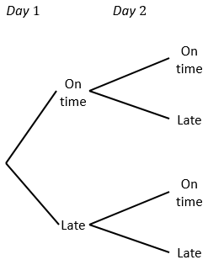
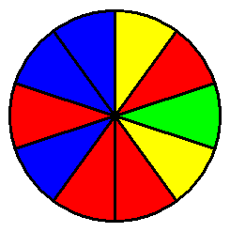
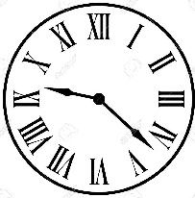

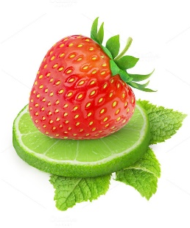
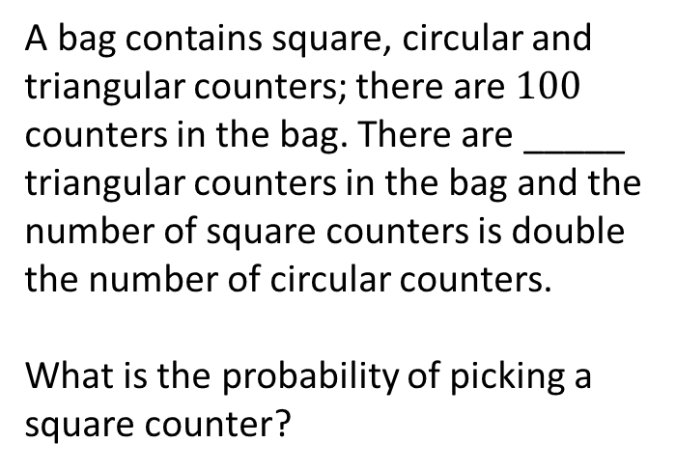
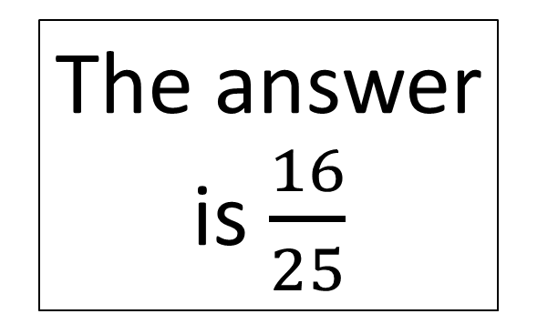
The wheel of fortune pictured offers a prize when it lands on _______________.
What is the probability that a player does not win in two spins?
The tree diagram shows the probability of Sally being late or on time for a meeting; the days are independent. Use the tree diagram to calculate the probability that Sally is on time on both days.
The answer is $\frac{16}{25}$
A bag contains square, circular and triangular counters; there are $100$ counters in the bag. There are _____ triangular counters in the bag and the number of square counters is double the number of circular counters.
What is the probability of picking a square counter?
There are two flavours of sweet left in a packet: strawberry and lime. There are _____ lime flavoured sweets and _____ sweets in total.
What is the probability of choosing a strawberry sweet at random?

Slide 9


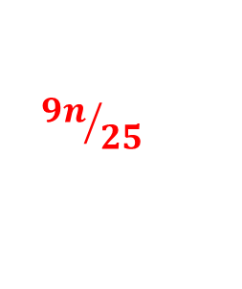



The wheel of fortune pictured offers a prize when it lands on _______________.
What is the probability that a player does not win in two spins?
The tree diagram shows the probability of Sally being late or on time for a meeting; the days are independent. Use the tree diagram to calculate the probability that Sally is on time on both days.
$$\frac{4}{5}$$
yellow
$$\frac{4}{5}$$
$$\frac{1}{5}$$
$$\frac{4}{5}$$
The answer is $\frac{16}{25}$
$$\frac{1}{5}$$
$$\frac{1}{5}$$
A bag contains square, circular and triangular counters; there are $100$ counters in the bag. There are _____ triangular counters in the bag and the number of square counters is double the number of circular counters.
What is the probability of picking a square counter?
There are two flavours of sweet left in a packet: strawberry and lime. There are _____ lime flavoured sweets and _____ sweets in total.
What is the probability of choosing a strawberry sweet at random?
$$4$$
$${9n}/{25}$$
$$n$$

Slide 10
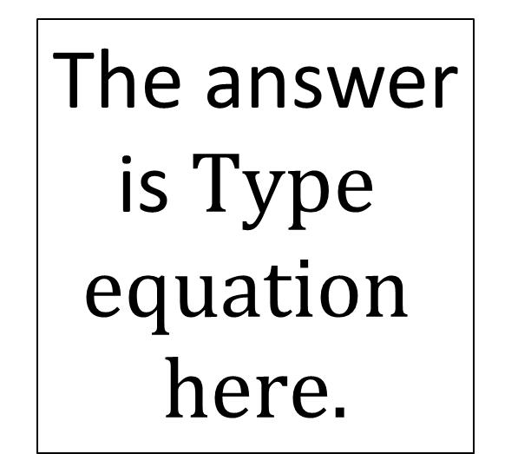
Type here
Type here
The answer is
Type here
Type here

