Slide 1
Sets and Venn Diagrams Matching
Match one group to the other.
There will be “spare” ones – what answers should be there?

Slide 2



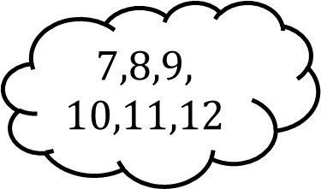
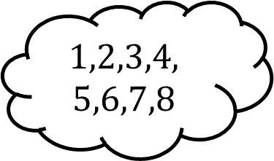

Matching 1
$ε$: $\left\{Integers from 1 to 12 inclusive\right\}$
Set $A$: $\left\{1,2,3,4,5,6\right\}$
Set $B$: $\left\{4,5,6,7,8\right\}$
$$A′$$
$$1,2,3,4,$$
$$5,6,7,8$$
$$A∩B$$
$$7,8,9,$$
$$10,11,12$$
$$A∪B$$

Slide 3
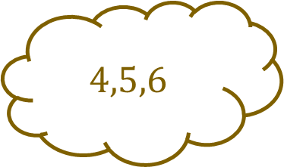
Matching 1 - Answers
$ε$: $\left\{Integers from 1 to 12 inclusive\right\}$
Set $A$: $\left\{1,2,3,4,5,6\right\}$
Set $B$: $\left\{4,5,6,7,8\right\}$
$$A′$$
$$1,2,3,4,$$
$$5,6,7,8$$
$$A∩B$$
$$7,8,9,$$
$$10,11,12$$
$$A∪B$$
$$4,5,6$$

Slide 4
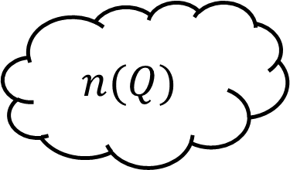

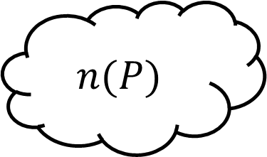


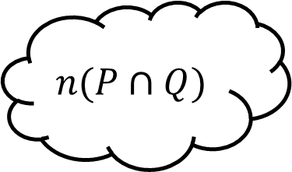
Matching 2
$ε$: $\left\{Integers from 1 to 12 inclusive\right\}$
Set $P$: $\left\{prime numbers\right\}$
Set $Q$: $\left\{factors of 12\right\}$
$$n(P)$$
$$5$$
$$n(Q)$$
$$6$$
$$n(P∩Q)$$

Slide 5

Matching 2 - Answers
$ε$: $\left\{Integers from 1 to 12 inclusive\right\}$
Set $P$: $\left\{prime numbers\right\}$
Set $Q$: $\left\{factors of 12\right\}$
$$n(P)$$
$$5$$
$$n(Q)$$
$$6$$
$$2$$
$$n(P∩Q)$$

Slide 6



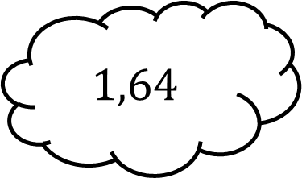
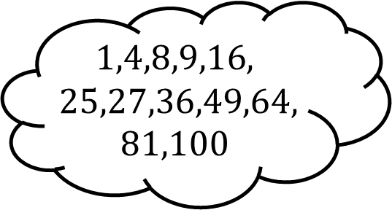
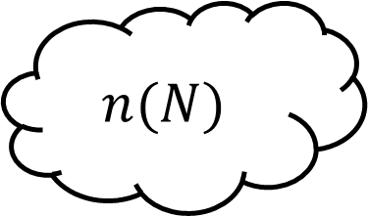
Matching 3
$ε$: $\left\{integers from 1 to 100 inclusive\right\}$
Set $M$: $\left\{square numbers\right\}$
Set $N$: $\left\{cube numbers\right\}$
$$M∩N$$
$$1,4,8,9,16,$$
$$25,27,36,49,64,$$
$$81,100$$
$$M∪N$$
$$1,64$$
$$n(N)$$

Slide 7

Matching 3 - Answers
$ε$: $\left\{integers from 1 to 100 inclusive\right\}$
Set $M$: $\left\{square numbers\right\}$
Set $N$: $\left\{cube numbers\right\}$
$$M∩N$$
$$1,4,8,9,16,$$
$$25,27,36,49,64,$$
$$81,100$$
$$M∪N$$
$$1,64$$
$$4$$
$$n(N)$$

Slide 8
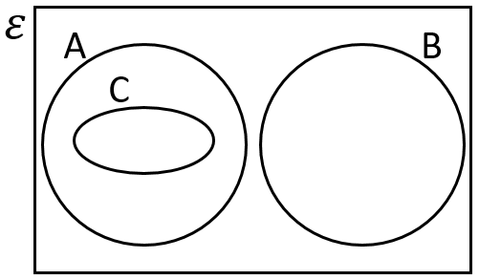
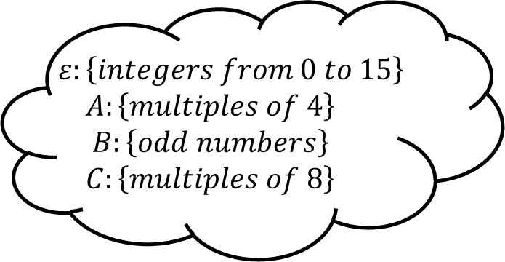
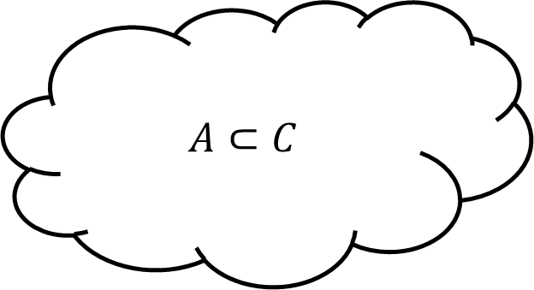
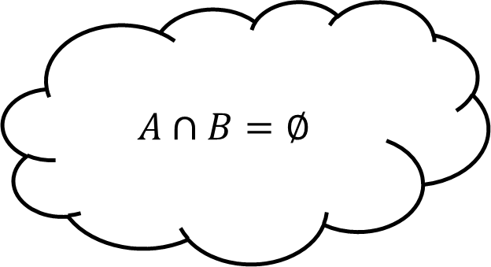

Matching 4
$$A⊂C$$
$$A∩B=∅$$
$$ε:\left\{integers from 0 to 15\right\}$$
$$A:\left\{multiples of 4\right\}$$
$$B:\left\{odd numbers\right\}$$
$$C:\left\{multiples of 8\right\}$$
$$2∈A$$

Slide 9



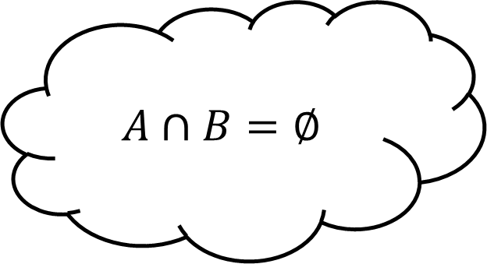

Matching 4 - Answers
$$A⊂C$$
$$A∩B=∅$$
$$C⊂A$$
$$ε:\left\{integers from 0 to 15\right\}$$
$$A:\left\{multiples of 4\right\}$$
$$B:\left\{odd numbers\right\}$$
$$C:\left\{multiples of 8\right\}$$
$$2∈A$$
$$2∉A$$

Slide 10
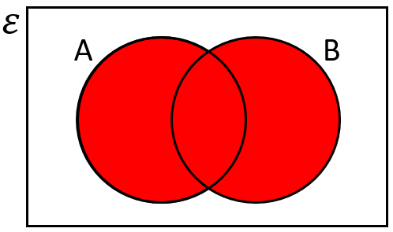
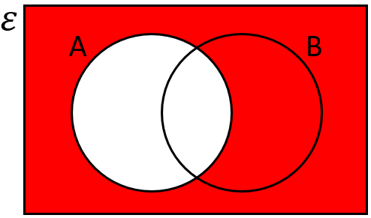
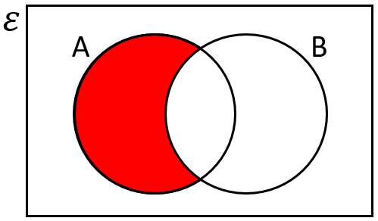

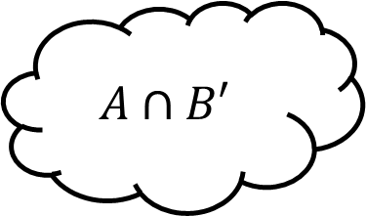
Matching 5
$$A∩B′$$
$$A∪B$$

Slide 11

Matching 5 - Answers
$$A∩B′$$
$$A∪B$$
$$A′$$

Slide 12
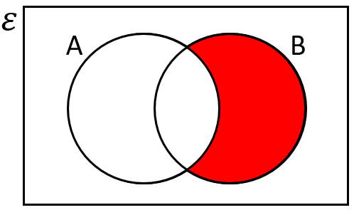
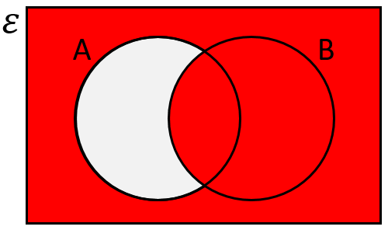
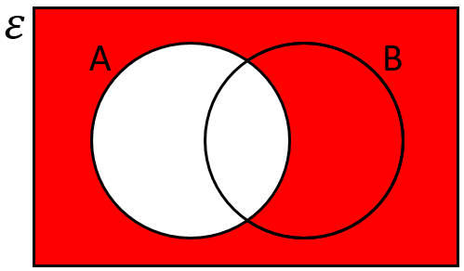


Matching 6
$$A′$$
$$A′∪B$$

Slide 13

Matching 6 - Answers
$$A′∩B$$
$$A′$$
$$A′∪B$$

Slide 14
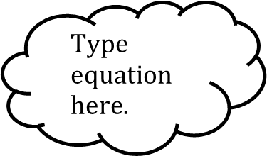

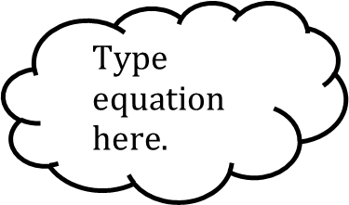
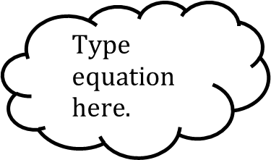
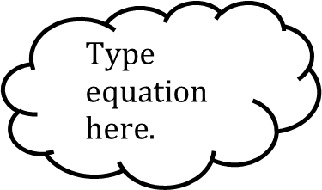
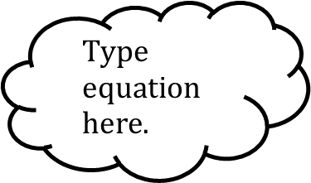
Matching n
$ε$:
Set $A$:
Set $B$:

Slide 15
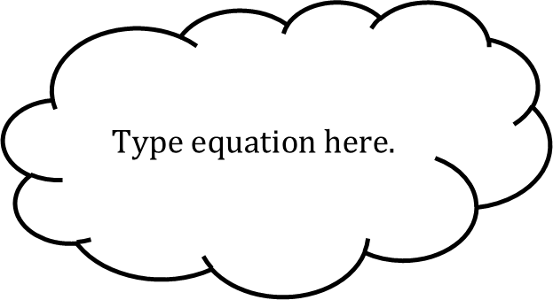
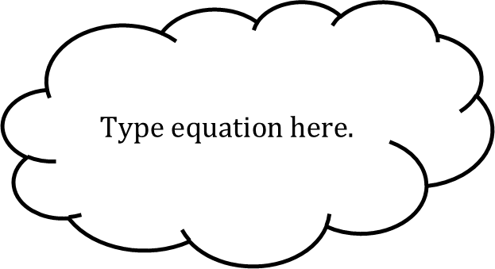
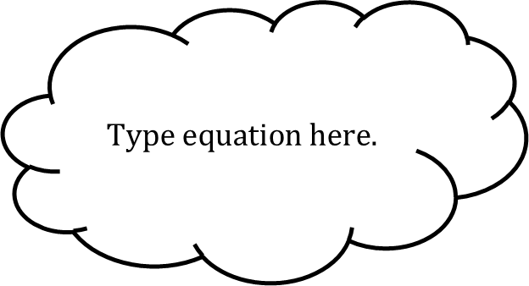
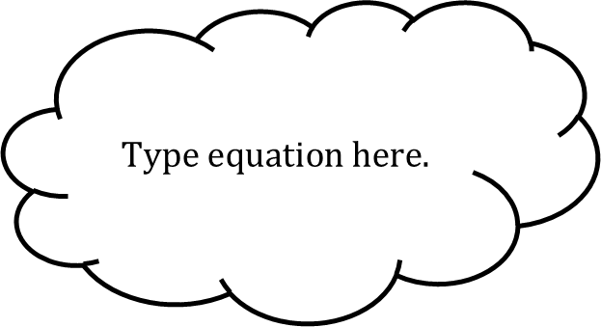
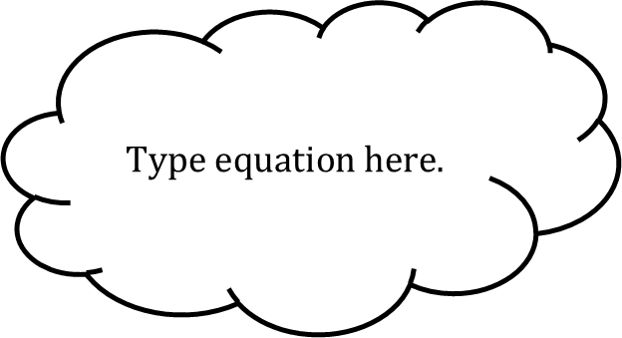
Matching n

