Slide 1
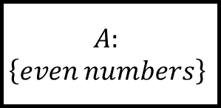
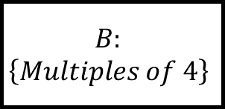

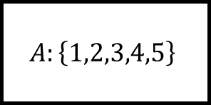
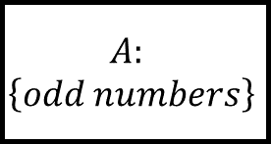
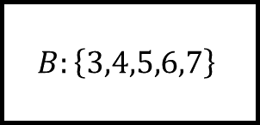


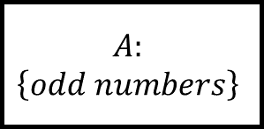
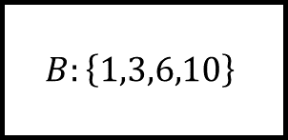
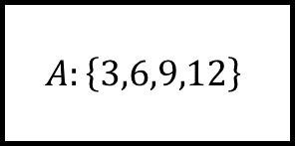

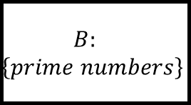
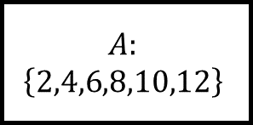
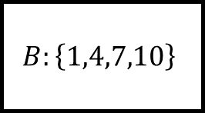
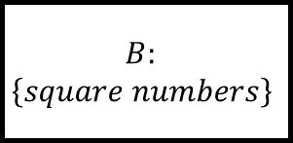

Sets and Venn Diagrams Spider 1
$$B:$$
$$\left\{square numbers\right\}$$
$$B:\left\{3,4,5,6,7\right\}$$
$$A:$$
$$\left\{odd numbers\right\}$$
$$A:\left\{1,2,3,4,5\right\}$$
$$ε:\{integers from 1 to 12 inclusive\}$$
$$ε:\{integers from 1 to 12 inclusive\}$$
$$A∩B$$
$$B:$$
$$\left\{prime numbers\right\}$$
$$A:$$
$$\left\{odd numbers\right\}$$
$$A:$$
$$\left\{2,4,6,8,10,12\right\}$$
$$B:\left\{1,4,7,10\right\}$$
$$ε:\{integers from 1 to 12 inclusive\}$$
$$A:$$
$$\left\{even numbers\right\}$$
$$A:\left\{3,6,9,12\right\}$$
$$ε:\{integers from 1 to 12 inclusive\}$$
$$B:$$
$$\left\{Multiples of 4\right\}$$
List the values asked for at the centre.
$$B:\left\{1,3,6,10\right\}$$

Slide 2
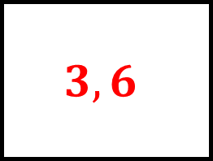
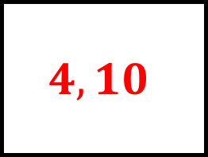
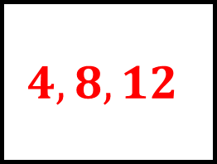
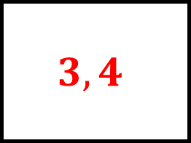
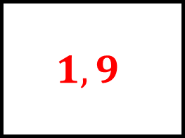
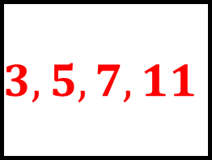
Sets and Venn Diagrams Spider 1 – Answers
$$1,9$$
$$3,4$$
$$B:$$
$$\left\{square numbers\right\}$$
$$B:\left\{3,4,5,6,7\right\}$$
$$A:$$
$$\left\{odd numbers\right\}$$
$$A:\left\{1,2,3,4,5\right\}$$
$$ε:\{integers from 1 to 12 inclusive\}$$
$$ε:\{integers from 1 to 12 inclusive\}$$
$$3,5,7,11$$
$$A∩B$$
$$4,10$$
$$B:$$
$$\left\{prime numbers\right\}$$
$$A:$$
$$\left\{odd numbers\right\}$$
$$A:$$
$$\left\{2,4,6,8,10,12\right\}$$
$$B:\left\{1,4,7,10\right\}$$
$$ε:\{integers from 1 to 12 inclusive\}$$
$$A:$$
$$\left\{even numbers\right\}$$
$$A:\left\{3,6,9,12\right\}$$
$$ε:\{integers from 1 to 12 inclusive\}$$
$$4,8,12$$
$$3,6$$
$$B:$$
$$\left\{Multiples of 4\right\}$$
List the values asked for at the centre.
$$B:\left\{1,3,6,10\right\}$$

Slide 3
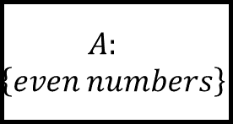

Sets and Venn Diagrams Spider 2
$$B:$$
$$\left\{square numbers\right\}$$
$$B:\left\{3,4,5,6,7\right\}$$
$$A:$$
$$\left\{odd numbers\right\}$$
$$A:\left\{1,2,3,4,5\right\}$$
$$ε:\{integers from 1 to 12 inclusive\}$$
$$ε:\{integers from 1 to 12 inclusive\}$$
$$A∪B$$
$$B:$$
$$\left\{prime numbers\right\}$$
$$A:$$
$$\left\{even numbers\right\}$$
$$A:$$
$$\left\{2,4,6,8,10,12\right\}$$
$$B:\left\{1,4,7,10\right\}$$
$$ε:\{integers from 1 to 12 inclusive\}$$
$$A:$$
$$\left\{even numbers\right\}$$
$$A:\left\{3,6,9,12\right\}$$
$$ε:\{integers from 1 to 12 inclusive\}$$
$$B:$$
$$\left\{Multiples of 4\right\}$$
List the values asked for at the centre.
$$B:\left\{1,3,6,10\right\}$$

Slide 4
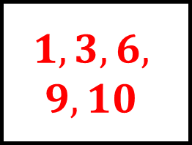
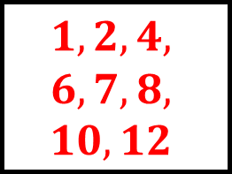
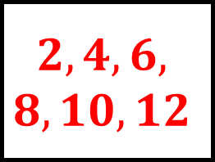
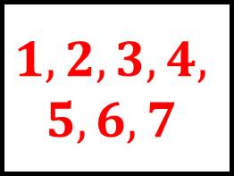
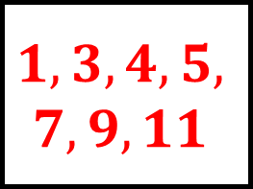
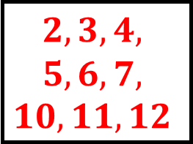
Sets and Venn Diagrams Spider 2 – Answers
$$1,3,4,5,$$
$$7,9,11$$
$$1,2,3,4,$$
$$5,6,7$$
$$B:$$
$$\left\{square numbers\right\}$$
$$B:\left\{3,4,5,6,7\right\}$$
$$A:$$
$$\left\{odd numbers\right\}$$
$$A:\left\{1,2,3,4,5\right\}$$
$$ε:\{integers from 1 to 12 inclusive\}$$
$$ε:\{integers from 1 to 12 inclusive\}$$
$$2,3,4,$$
$$5,6,7,$$
$$10,11,12$$
$$A∪B$$
$$1,2,4,$$
$$6,7,8,$$
$$10,12$$
$$B:$$
$$\left\{prime numbers\right\}$$
$$A:$$
$$\left\{even numbers\right\}$$
$$A:$$
$$\left\{2,4,6,8,10,12\right\}$$
$$B:\left\{1,4,7,10\right\}$$
$$ε:\{integers from 1 to 12 inclusive\}$$
$$A:$$
$$\left\{even numbers\right\}$$
$$A:\left\{3,6,9,12\right\}$$
$$ε:\{integers from 1 to 12 inclusive\}$$
$$2,4,6,$$
$$8,10,12$$
$$1,3,6,$$
$$9,10$$
$$B:$$
$$\left\{Multiples of 4\right\}$$
List the values asked for at the centre.
$$B:\left\{1,3,6,10\right\}$$

Slide 5
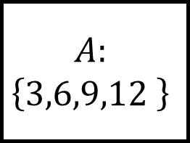
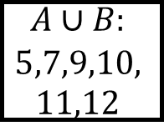
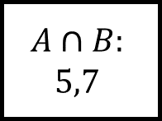
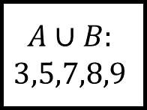
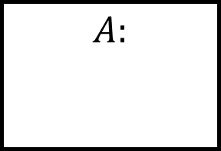
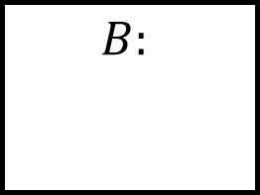
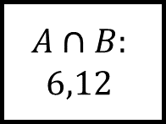
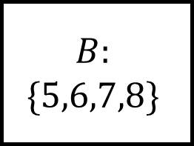
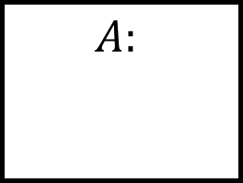
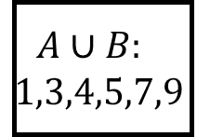
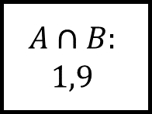
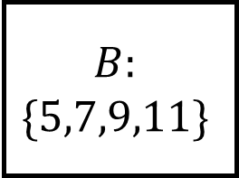
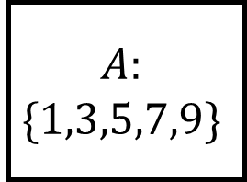
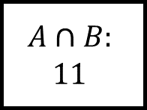
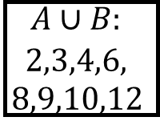
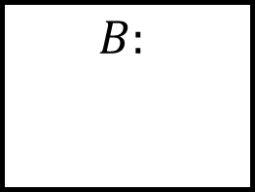
Sets and Venn Diagrams Spider 3
$$A:$$
$$A:$$
$$\left\{3,6,9,12 \right\}$$
$$A∪B:$$
$$5,7,9,10,$$
$$11,12$$
$$A∪B:$$
$$2,3,4,6,$$
$$8,9,10,12$$
$$A∩B:$$
$$11$$
$$A∩B:$$
$$6,12$$
$$B:$$
$$\{5,7,9,11\}$$
$$B:$$
Fill in the blanks…
$$B:$$
$$B:$$
$$\{5,6,7,8\}$$
$$A∩B:$$
$$1,9$$
$$A∩B:$$
$$5,7$$
$$A:$$
$$\{1,3,5,7,9\}$$
$$A:$$
$$A∪B:$$
$$1,3,4,5,7,9$$
$$A∪B:$$
$$3,5,7,8,9$$
Find the members of the two sets.

Slide 6
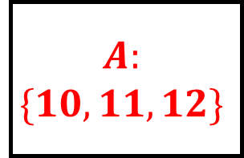
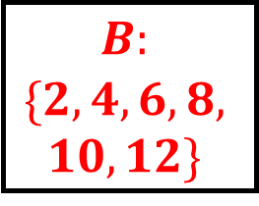
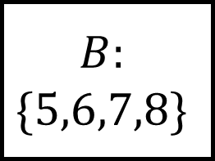
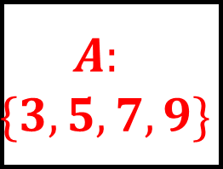
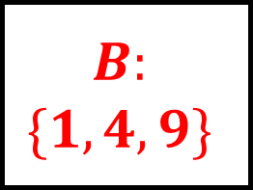
Sets and Venn Diagrams Spider 3 – Answers
$$A:$$
$$\{10,11,12\}$$
$$A:$$
$$\left\{3,6,9,12 \right\}$$
$$A∪B:$$
$$5,7,9,10,$$
$$11,12$$
$$A∪B:$$
$$2,3,4,6,$$
$$8,9,10,12$$
$$A∩B:$$
$$11$$
$$A∩B:$$
$$6,12$$
$$B:$$
$$\{5,7,9,11\}$$
$$B:$$
$$\{2,4,6,8,$$
$$10,12\}$$
Fill in the blanks…
$$B:$$
$$\{1,4,9\}$$
$$B:$$
$$\{5,6,7,8\}$$
$$A∩B:$$
$$1,9$$
$$A∩B:$$
$$5,7$$
$$A:$$
$$\{1,3,5,7,9\}$$
$$A:$$
$$\{3,5,7,9\}$$
$$A∪B:$$
$$1,3,4,5,7,9$$
$$A∪B:$$
$$3,5,7,8,9$$
Find the members of the two sets.

Slide 7
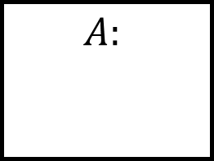
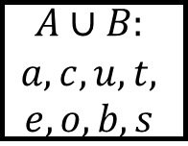
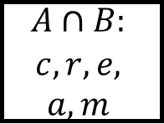
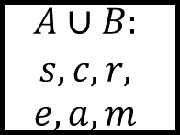










Sets and Venn Diagrams Spider 4 – Answers
$$A:$$
$$A:$$
$$A∪B:$$
$$a,c,u,t,$$
$$e,o,b,s$$
$$A∪B:$$
$$l,a,k,$$
$$e,i,t$$
$$A∩B:$$
$$u,t,e$$
$$A∩B:$$
$$e,k$$
$$B:$$
$$B:$$
Fill in the blanks…
$$B:$$
$$B:$$
$$A∩B:$$
$$a,y$$
$$A∩B:$$
$$c,r,e,$$
$$a,m$$
$$A:$$
$$A:$$
$$A∪B:$$
$$p,l,a,$$
$$y,r,d$$
$$A∪B:$$
$$s,c,r,$$
$$e,a,m$$
Find the members of the two sets; they are words in regular use.

Slide 8








Sets and Venn Diagrams Spider 4 – Answers
$$A:$$
$$\{a,c,u,t,e\}$$
$$A:$$
$$\{l,a,k,e\}$$
$$A∪B:$$
$$a,c,u,t,$$
$$e,o,b,s$$
$$A∪B:$$
$$l,a,k,$$
$$e,i,t$$
$$A∩B:$$
$$u,t,e$$
$$A∩B:$$
$$e,k$$
$$B:$$
$$\{o,b,t,u,s,e\}$$
$$B:$$
$$\{k,i,t,e\}$$
Fill in the blanks…
$$B:$$
$$\{y,a,r,d\}$$
$$B:$$
$$\{s,c,r,e,a,m\}$$
$$A∩B:$$
$$a,y$$
$$A∩B:$$
$$c,r,e,$$
$$a,m$$
$$A:$$
$$\{p,l,a,y\}$$
$$A:$$
$$\{c,r,e,a,m\}$$
$$A∪B:$$
$$p,l,a,$$
$$y,r,d$$
$$A∪B:$$
$$s,c,r,$$
$$e,a,m$$
Find the members of the two sets; they are words in regular use.

Slide 9







Sets and Venn Diagrams Spider 5 - Answers
$$\left(A∩B\right)′$$
$$B$$
Shade the correct area of each Venn diagram
$$A∩B$$
$$A∪B$$

Slide 10






Sets and Venn Diagrams Spider 5 - Answers
$$\left(A∩B\right)′$$
$$B$$
Shade the correct area of each Venn diagram
$\left(A∪B\right)′$ or
$$A′∩B′$$
$$A′$$
$$A∩B$$
$$A∪B$$

Slide 11






Sets and Venn Diagrams Spider 6 - Answers
$$A′∩B′$$
$$A∩B′$$
Shade the correct area of each Venn diagram
$$A′∪B′$$
$$A′∪B$$

Slide 12






Sets and Venn Diagrams Spider 6 - Answers
$$A′∩B′$$
$$A∩B′$$
Shade the correct area of each Venn diagram
$$A′∪B′$$
$$A′∪B$$
$$A′∩B$$
$$A∪B′$$

Slide 13



















Sets and Venn Diagrams Spider – Answers
$$ε:\{integers from 1 to 12 inclusive\}$$
$$ε:\{integers from 1 to 12 inclusive\}$$
$$ε:\{integers from 1 to 12 inclusive\}$$
$$ε:\{integers from 1 to 12 inclusive\}$$
List the values asked for at the centre.

Slide 14






Sets and Venn Diagrams Spider - Answers
Shade the correct area of each Venn diagram

