Slide 1
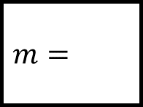
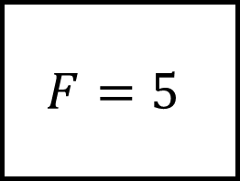
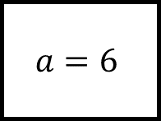
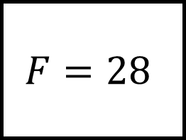

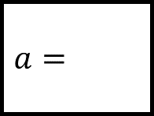
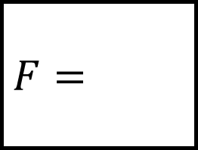
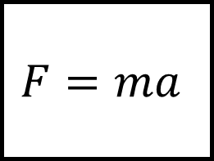
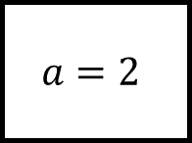
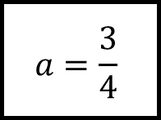
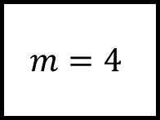

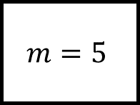
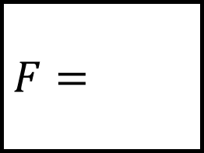
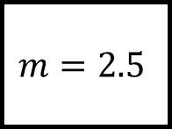
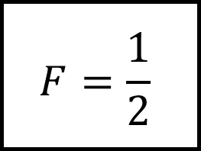
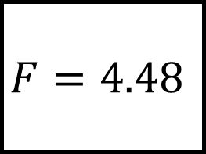
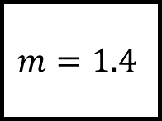
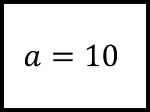
Rearranging Formulae Spider 1
$$F=\frac{1}{2}$$
$$F=$$
$$a=\frac{3}{4}$$
$$a=2$$
$$m=$$
$$m=5$$
$$F=4.48$$
$$F=ma$$
$$F=28$$
$$a=$$
$$m=1.4$$
$$m=4$$
$$a=$$
$$m=2.5$$
$$m=$$
$$F=$$
$$F=5$$
$$a=6$$
Fill in the blanks above using the formula at the centre.
$$a=10$$

Slide 2
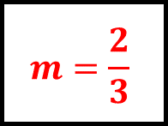
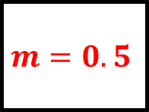
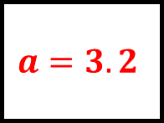
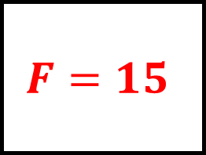
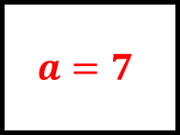
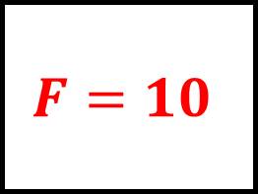
Rearranging Formulae Spider 1 – Answers
$$F=\frac{1}{2}$$
$$F=10$$
$$a=\frac{3}{4}$$
$$a=2$$
$$m=\frac{2}{3}$$
$$m=5$$
$$F=4.48$$
$$F=ma$$
$$F=28$$
$$a=3.2$$
$$m=1.4$$
$$m=4$$
$$a=7$$
$$m=2.5$$
$$m=0.5$$
$$F=15$$
$$F=5$$
$$a=6$$
Fill in the blanks above using the formula at the centre.
$$a=10$$

Slide 3
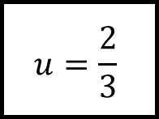
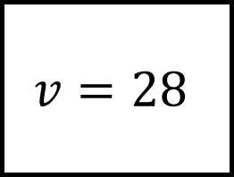
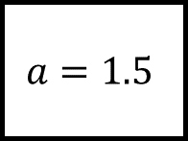
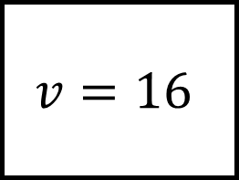
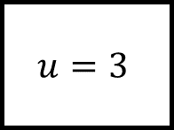
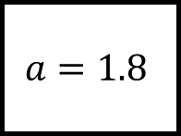
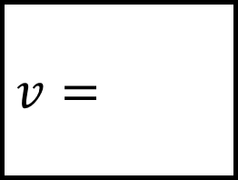
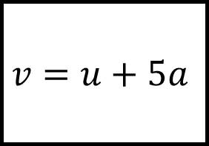
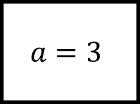

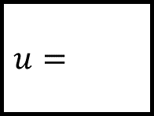
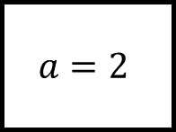
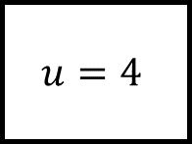
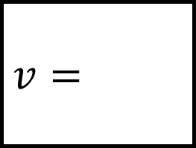
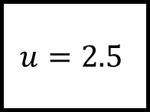
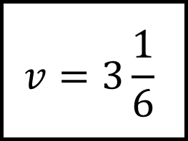
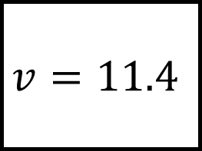

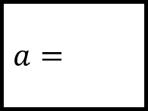
Rearranging Formulae Spider 2
$$v=3\frac{1}{6}$$
$$v=$$
$$a=$$
$$a=3$$
$$u=\frac{2}{3}$$
$$u=4$$
$$v=11.4$$
$$v=u+5a$$
$$v=16$$
$$a=1.8$$
$$u=$$
$$u=$$
$$a=2$$
$$u=2.5$$
$$u=3$$
$$v=$$
$$v=28$$
$$a=1.5$$
Fill in the blanks above using the formula at the centre.
$$a=$$

Slide 4
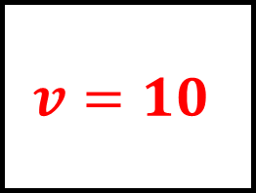
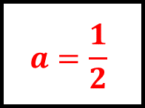
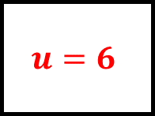
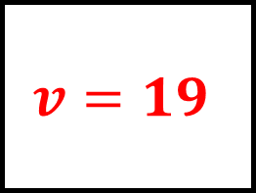
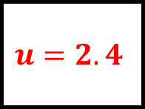
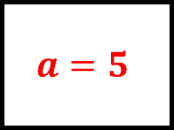
Rearranging Formulae Spider 2 – Answers
$$v=3\frac{1}{6}$$
$$v=19$$
$$a=\frac{1}{2}$$
$$a=3$$
$$u=\frac{2}{3}$$
$$u=4$$
$$v=11.4$$
$$v=u+5a$$
$$v=16$$
$$a=1.8$$
$$u=2.4$$
$$u=6$$
$$a=2$$
$$u=2.5$$
$$u=3$$
$$v=10$$
$$v=28$$
$$a=1.5$$
Fill in the blanks above using the formula at the centre.
$$a=5$$

Slide 5
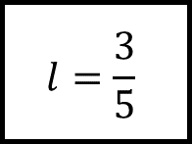
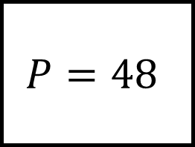
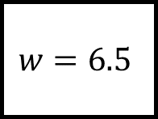
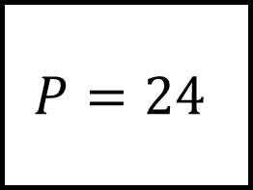















Rearranging Formulae Spider 3
$$P=1\frac{27}{35}$$
$$P=$$
$$w=$$
$$w=4$$
$$l=\frac{3}{5}$$
$$l=6$$
$$P=12.4$$
$$P=2(l+w)$$
$$P=24$$
$$w=2.7$$
$$l=$$
$$l=$$
$$w=5$$
$$l=4.5$$
$$l=13$$
$$P=$$
$$P=48$$
$$w=6.5$$
Fill in the blanks above using the formula at the centre.
$$w=$$

Slide 6






Rearranging Formulae Spider 3 – Answers
$$P=1\frac{27}{35}$$
$$P=20$$
$$w=\frac{2}{7}$$
$$w=4$$
$$l=\frac{3}{5}$$
$$l=6$$
$$P=12.4$$
$$P=2(l+w)$$
$$P=24$$
$$w=2.7$$
$$l=3.5$$
$$l=7$$
$$w=5$$
$$l=4.5$$
$$l=13$$
$$P=22$$
$$P=48$$
$$w=6.5$$
Fill in the blanks above using the formula at the centre.
$$w=11$$

Slide 7



















Rearranging Formulae Spider 4
$$V=279.9π$$
$$V=$$
$$h=8.7$$
$$h=8$$
$$r=$$
$$r=3$$
$$V=75π$$
$$V=πr^{2}h$$
$$V=176π$$
$$h=$$
$$r=2.5$$
$$r=4$$
$$h=$$
$$r=8$$
$$r=$$
$$V=$$
$$V=252π$$
$$h=6$$
Fill in the blanks above using the formula at the centre.
$$h=7$$

Slide 8






Rearranging Formulae Spider 4 – Answers
$$V=279.9π$$
$$V=72π$$
$$h=8.7$$
$$h=8$$
$$r=3.2$$
$$r=3$$
$$V=75π$$
$$V=πr^{2}h$$
$$V=176π$$
$$h=12$$
$$r=2.5$$
$$r=4$$
$$h=11$$
$$r=8$$
$$r=6$$
$$V=384π$$
$$V=252π$$
$$h=6$$
Fill in the blanks above using the formula at the centre.
$$h=7$$

Slide 9











Rearranging Formulae Spider 5
$$x=$$
$$x=$$
$$y=\frac{20}{x}$$
$$y=x+5$$
$$x=y+a$$
Fill in the blanks…
$$x=\frac{y}{6}$$
$$y=\frac{x}{3}$$
$$y=8−x$$
$$x=$$
$$x=$$
Rearrange each formula above.
$x$ should be the subject at the end of each leg; you may choose your subject otherwise…

Slide 10






Rearranging Formulae Spider 5 - Answers
$$x=\frac{20}{y}$$
$$x=y−5$$
$$y=\frac{20}{x}$$
$$y=x+5$$
$$y=x−a$$
$$a=x−y$$
$$y=6x$$
$$6=\frac{y}{x}$$
$$x=y+a$$
Fill in the blanks…
$$x=\frac{y}{6}$$
$$y=\frac{x}{3}$$
$$y=8−x$$
$$x=3y$$
$$x=8−y$$
Rearrange each formula above.
$x$ should be the subject at the end of each leg; you may choose your subject otherwise…

Slide 11






Rearranging Formulae Spider 6
$$x=$$
$$x=$$
$$y=\frac{x}{n}+k$$
$$y=2x+3$$
$$x=\frac{m−y}{n}$$
Fill in the blanks…
$$x=4y+1$$
$$y=ax−b$$
$$y=5(x−2)$$
$$x=$$
$$x=$$
Rearrange each formula above.
$x$ should be the subject at the end of each leg; you may choose your subject otherwise…

Slide 12






Rearranging Formulae Spider 6 - Answers
$$x=n(y−k)$$
$$x=\frac{y−3}{2}$$
$$y=\frac{x}{n}+k$$
$$y=2x+3$$
$$y=m−nx$$
$$n=\frac{m−y}{x}$$
$$m=y+nx$$
$$y=\frac{x−1}{4}$$
$$4=\frac{x−1}{y}$$
$$1=x−4y$$
$$x=\frac{m−y}{n}$$
Fill in the blanks…
$$x=4y+1$$
$$y=ax−b$$
$$y=5(x−2)$$
$$x=\frac{y+b}{a}$$
$$x=\frac{y}{5}+2$$
Rearrange each formula above.
$x$ should be the subject at the end of each leg; you may choose your subject otherwise…

Slide 13











Rearranging Formulae Spider 7
$$r=$$
$$r=$$
$$V=\frac{4}{3}πr^{3}$$
$$C=2πr$$
$$r=\sqrt{\frac{V}{πh}}$$
Fill in the blanks…
$$r=\sqrt{\frac{A}{π}}$$
$$V=\frac{1}{3}πr^{2}h$$
$$S=4πr^{2}$$
$$r=$$
$$r=$$
Rearrange each formula above.
$r$ should be the subject at the end of each leg; you may choose your subject otherwise…

Slide 14






Rearranging Formulae Spider 7 - Answers
$$r=\sqrt[3]{\frac{3V}{4π}}$$
$$r=\frac{C}{2π}$$
$$V=\frac{4}{3}πr^{3}$$
$$C=2πr$$
$$V=πr^{2}h$$
$$h=\frac{V}{πr^{2}}$$
$$π=\frac{V}{r^{2}h}$$
$$A=πr^{2}$$
$$π=\frac{A}{r^{2}}$$
$$r=\sqrt{\frac{V}{πh}}$$
Fill in the blanks…
$$r=\sqrt{\frac{A}{π}}$$
$$V=\frac{1}{3}πr^{2}h$$
$$S=4πr^{2}$$
$$r=\sqrt{\frac{3V}{πh}}$$
$$r=\sqrt{\frac{S}{4π}}$$
Rearrange each formula above.
$r$ should be the subject at the end of each leg; you may choose your subject otherwise…

Slide 15









Rearranging Formulae Spider 8
$$x=$$
$$x=$$
$$πx+y=4x−3y$$
$$3x+4y=2x−n$$
$$x=$$
$$ax−m=bx+n$$
Fill in the blanks…
$$x+5a=4x−b$$
$$x=$$
$$x=\frac{m−5}{n−1}$$
$$x=\frac{b}{a+2}$$
Rearrange each formula above.
$x$ should be the subject at the end of each leg; you may choose your subject otherwise…

Slide 16






Rearranging Formulae Spider 8 - Answers
$$x=\frac{−4y}{π−4}$$
$$x=−4y−n$$
$$πx+y=4x−3y$$
$$3x+4y=2x−n$$
$$x=\frac{m+n}{a−b}$$
$$ax−m=bx+n$$
Fill in the blanks…
$$x+5a=4x−b$$
$$x=\frac{5a+b}{3}$$
$$m=x\left(n−1\right)+5$$
$$n=\frac{m−5}{x}+1$$
$$5=m−x(n−1)$$
$$1=n−\frac{m−5}{x}$$
$$a=\frac{b}{x}−2$$
$$b=x(a+2)$$
$$2=\frac{b}{x}−a$$
$$x=\frac{m−5}{n−1}$$
$$x=\frac{b}{a+2}$$
Rearrange each formula above.
$x$ should be the subject at the end of each leg; you may choose your subject otherwise…

Slide 17



















Rearranging Formulae Spider – Answers
Fill in the blanks above using the formula at the centre.

Slide 18












Rearranging Formulae Spider - Answers
Fill in the blanks…
Rearrange each formula above.
$x$ should be the subject at the end of each leg; you may choose your subject otherwise…

