Slide 1
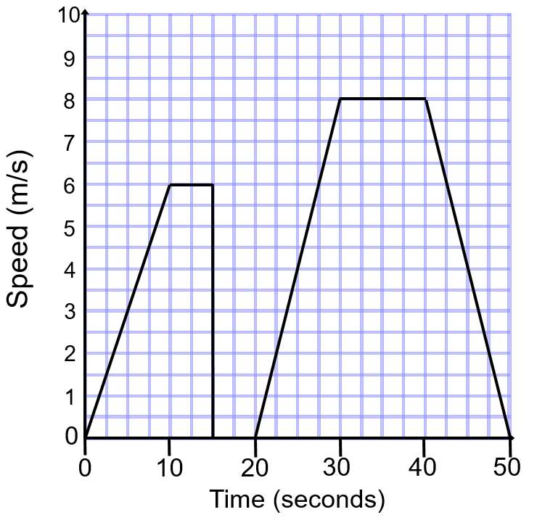
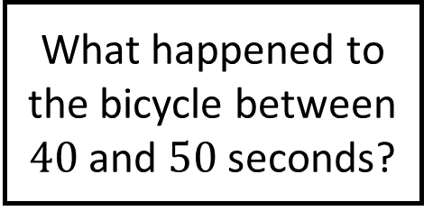
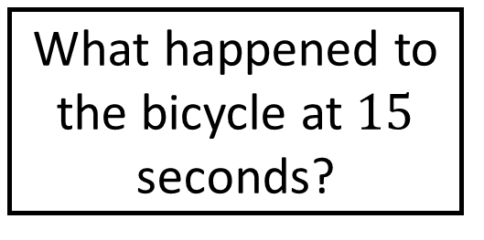
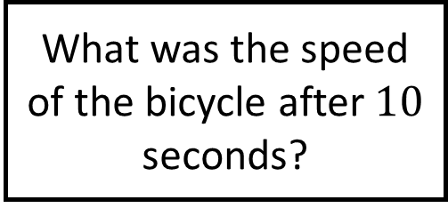
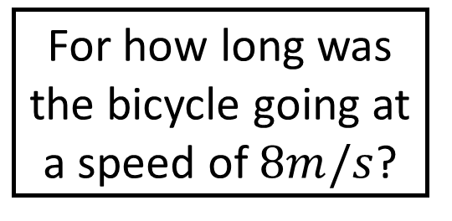
Speed-Time Graphs Spider 1
What happened to the bicycle between $40$ and $50$ seconds?
What happened to the bicycle at $15$ seconds?
How many times during the journey did the bicycle move at constant speed?
What was the speed of the bicycle after $10$ seconds?
For how long was the bicycle stationary?
For how long was the bicycle going at a speed of $8m/s$?
The speed-time graph shows the journey made by a bicycle.

Slide 2

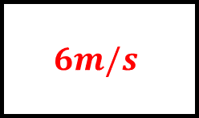


Speed-Time Graphs Spider 1 - Answers
What happened to the bicycle between $40$ and $50$ seconds?
What happened to the bicycle at $15$ seconds?
It decelerated then stopped
It stopped suddenly
How many times during the journey did the bicycle move at constant speed?
What was the speed of the bicycle after $10$ seconds?
$2$ times
$$6m/s$$
$5$ seconds
$10$ seconds
For how long was the bicycle stationary?
For how long was the bicycle going at a speed of $8m/s$?
The speed-time graph shows the journey made by a bicycle.

Slide 3
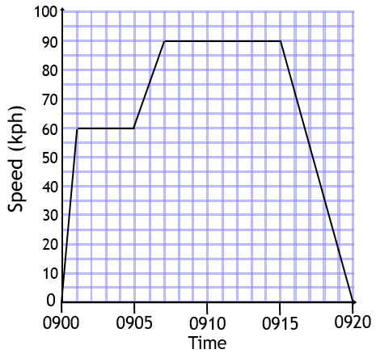
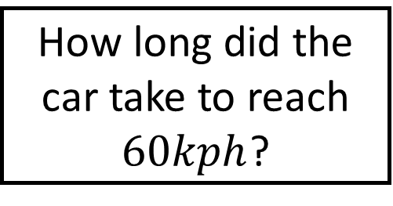
Speed-Time Graphs Spider 2
How far did the car travel in total?
How long did the car take to reach $60kph$?
How long was the car driving at its fastest?
At what time did the car start to slow down?
Between which times did the car accelerate fastest?
What was the greatest speed reached by the car?
The speed-time graph shows the journey made by a car.

Slide 4

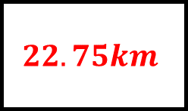




Speed-Time Graphs Spider 2 - Answers
How far did the car travel in total?
How long did the car take to reach $60kph$?
$$22.75km$$
$1$ minute
How long was the car driving at its fastest?
At what time did the car start to slow down?
$8$ minutes
$$0915$$
$0900$ to $0901$
$$90kph$$
Between which times did the car accelerate fastest?
What was the greatest speed reached by the car?
The speed-time graph shows the journey made by a car.

Slide 5
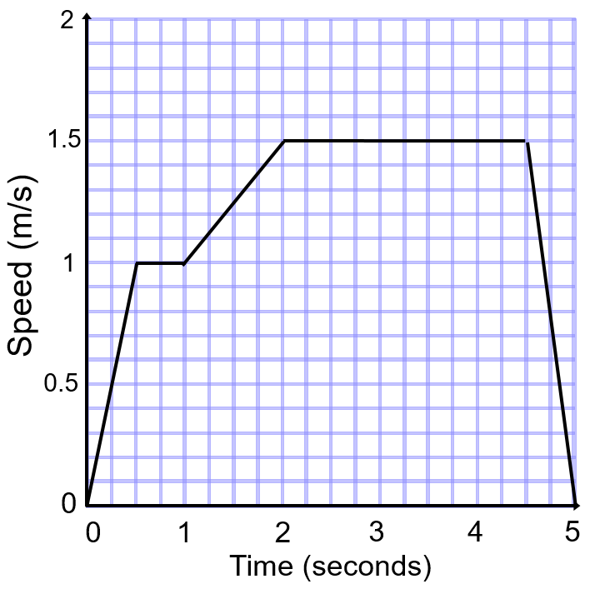
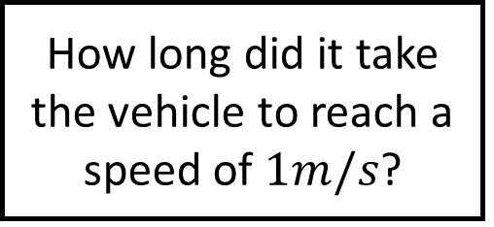
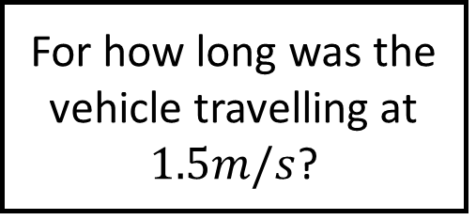
Speed-Time Graphs Spider 3
How far did the vehicle travel in total?
How long did it take the vehicle to reach a speed of $1m/s$?
Calculate the deceleration of the vehicle until it stopped.
For how long was the vehicle travelling at $1.5m/s$?
What was the acceleration of the toy vehicle at the very start of its journey?
Calculate the acceleration between 1 and 2 seconds.
The speed-time graph shows the journey made by a toy vehicle.

Slide 6
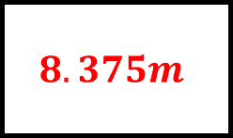
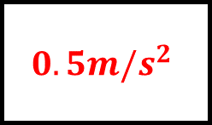
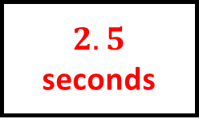
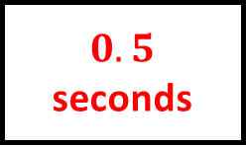
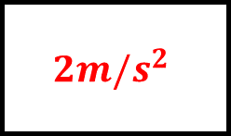

Speed-Time Graphs Spider 3 - Answers
How far did the vehicle travel in total?
How long did it take the vehicle to reach a speed of $1m/s$?
$$8.375m$$
$0.5$ seconds
Calculate the deceleration of the vehicle until it stopped.
For how long was the vehicle travelling at $1.5m/s$?
$$3m/s^{2}$$
$2.5$ seconds
$$2m/s^{2}$$
$$0.5m/s^{2}$$
What was the acceleration of the toy vehicle at the very start of its journey?
Calculate the acceleration between 1 and 2 seconds.
The speed-time graph shows the journey made by a toy vehicle.

Slide 7






Speed-Time Graphs Spider - Answers

