Slide 1
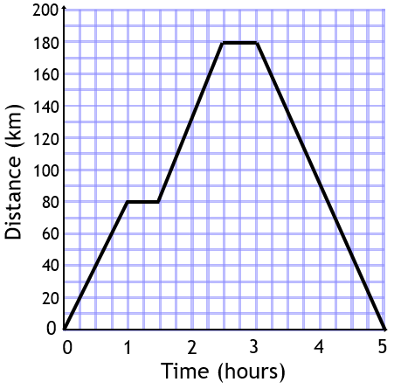
Distance-Time Graphs Spider 1
What was the speed of the car on the return journey?
After how long did the car stop for the first time?
How far did the car drive in total?
How long in total did the car stop over the whole journey?
What was the speed of the car over the second part of the journey?
What was the speed of the car over the first part of the journey?
The distance-time graph shows a car journey.

Slide 2

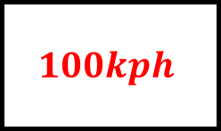

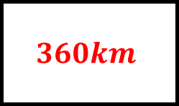

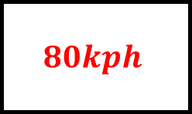
Distance-Time Graphs Spider 1 - Answers
What was the speed of the car on the return journey?
After how long did the car stop for the first time?
$$90kph$$
$1$ hour
How far did the car drive in total?
How long in total did the car stop over the whole journey?
$$360km$$
$1$ hour
$$100kph$$
$$80kph$$
What was the speed of the car over the second part of the journey?
What was the speed of the car over the first part of the journey?
The distance-time graph shows a car journey.

Slide 3
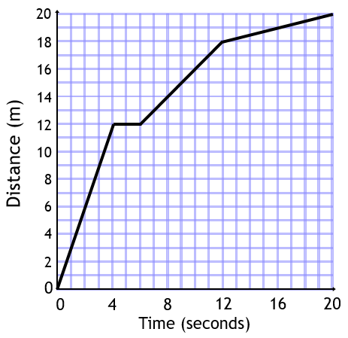
Distance-Time Graphs Spider 2
What was the average speed of the ball over the whole time period?
How far did the ball travel in total?
What was the speed of the ball over the final part of its journey?
How fast was the ball travelling until it stopped?
How far did the ball move from 6 seconds to 12 seconds?
How long was the ball stationary for?
The distance-time graph shows the journey made by a ball.

Slide 4
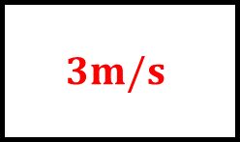
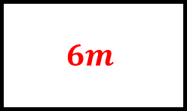
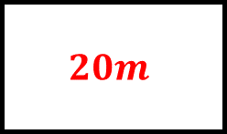
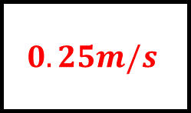
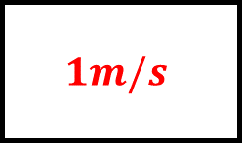

Distance-Time Graphs Spider 2 - Answers
What was the average speed of the ball over the whole time period?
How far did the ball travel in total?
$$1m/s$$
$$20m$$
What was the speed of the ball over the final part of its journey?
How fast was the ball travelling until it stopped?
$$0.25m/s$$
$$3m/s$$
$$6m$$
$2$ seconds
How far did the ball move from 6 seconds to 12 seconds?
How long was the ball stationary for?
The distance-time graph shows the journey made by a ball.

Slide 5
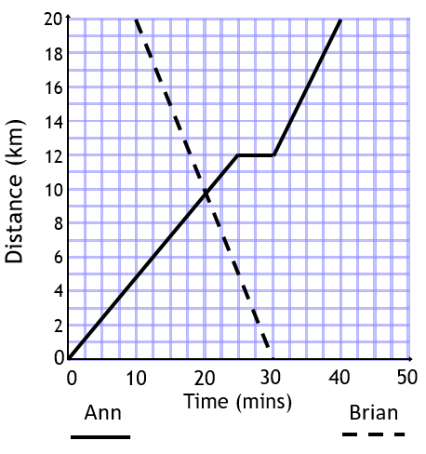
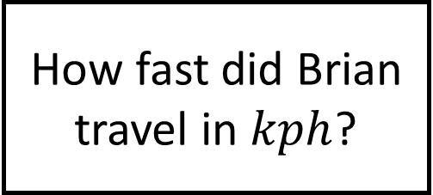
Distance-Time Graphs Spider 3
If Ann wanted to travel back to where she started in the remaining 10 minutes on the graph, at what speed would she have to travel?
How long did Ann’s journey take?
At what speed does Ann travel in the final part of her journey?
What happened after 20 minutes?
How long did Ann take a rest for?
How fast did Brian travel in $kph$?
The distance-time graph shows journeys made by two people, Ann and Brian.

Slide 6



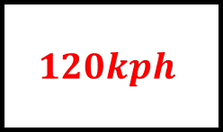
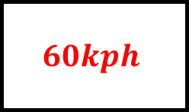
Distance-Time Graphs Spider 3 - Answers
If Ann wanted to travel back to where she started in the remaining 10 minutes on the graph, at what speed would she have to travel?
How long did Ann’s journey take?
$$120kph$$
$40$ minutes
At what speed does Ann travel in the final part of her journey?
What happened after 20 minutes?
$$48kph$$
They passed each other
$5$ minutes
$$60kph$$
How long did Ann take a rest for?
How fast did Brian travel in $kph$?
The distance-time graph shows journeys made by two people, Ann and Brian.

Slide 7
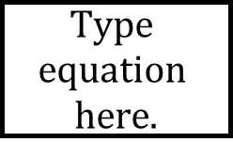
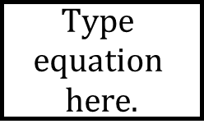
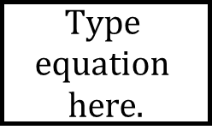



Distance-Time Graphs Spider - Answers

