Slide 1
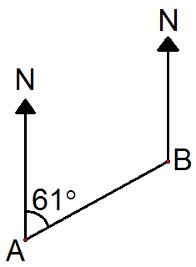
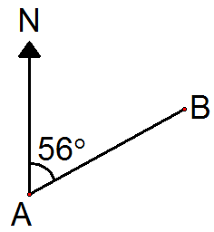
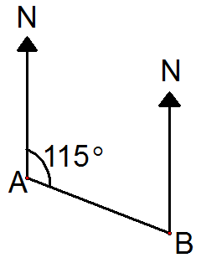
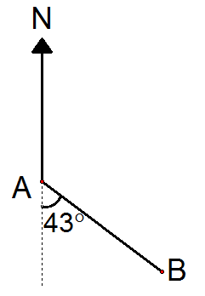
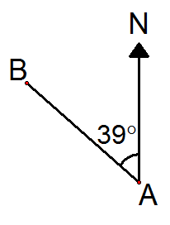
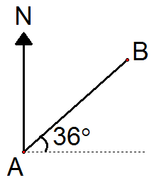
Bearings Spider 1
Bearing of A from B:
Bearing of B from A:
Calculate the bearings in each case…
Bearing of A from B:
Bearing of B from A:
Bearing of B from A:
Bearing of B from A:
Diagrams are not to scale.

Slide 2
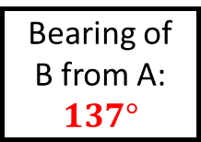
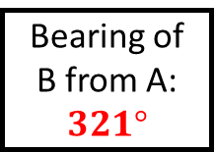
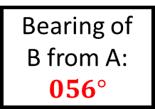
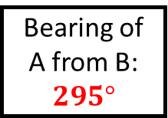
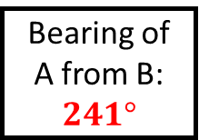
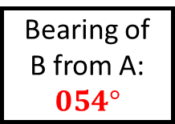
Bearings Spider 1 - Answers
Bearing of A from B:
$$241°$$
Bearing of B from A:
$$056°$$
Calculate the bearings in each case…
Bearing of A from B:
$$295°$$
Bearing of B from A:
$$137°$$
Bearing of B from A:
$$321°$$
Bearing of B from A:
$$054°$$
Diagrams are not to scale.

Slide 3
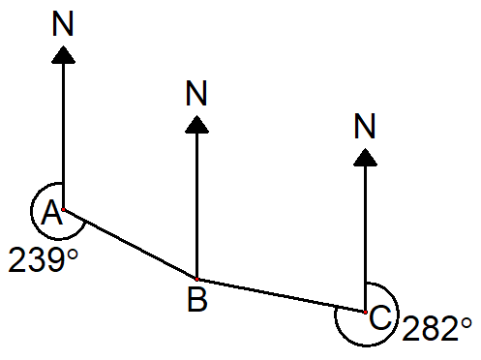
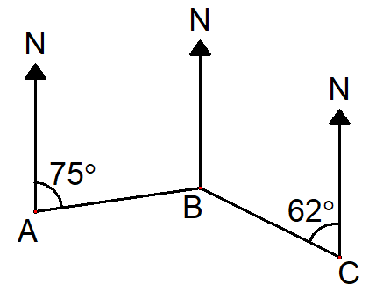
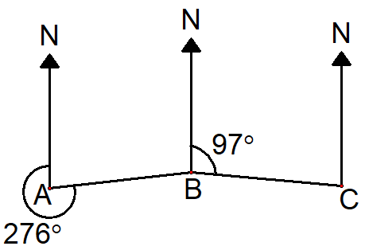
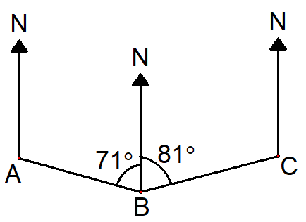
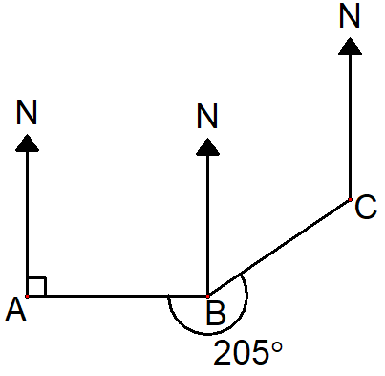
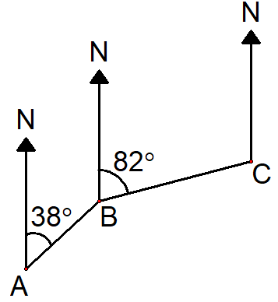
Bearings Spider 2
Bearing of C from B:
Bearing of C from B:
Calculate the bearings in each case…
Bearing of A from B:
Bearing of B from C:
Bearing of C from B:
Bearing of A from B:
Diagrams are not to scale.

Slide 4
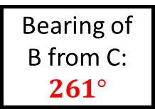
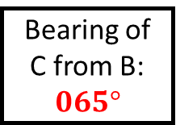
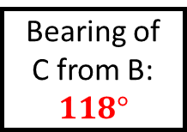

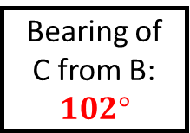
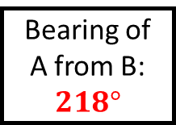
Bearings Spider 2 - Answers
Bearing of C from B:
$$102°$$
Bearing of C from B:
$$118°$$
Calculate the bearings in each case…
Bearing of A from B:
$$264°$$
Bearing of B from C:
$$261°$$
Bearing of C from B:
$$065°$$
Bearing of A from B:
$$218°$$
Diagrams are not to scale.

Slide 5
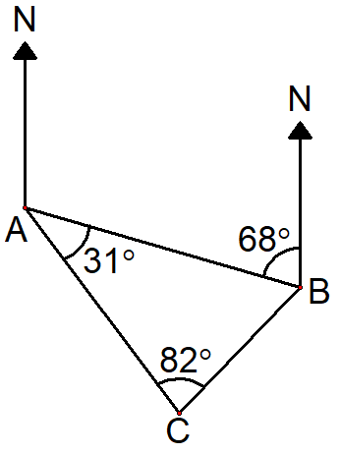
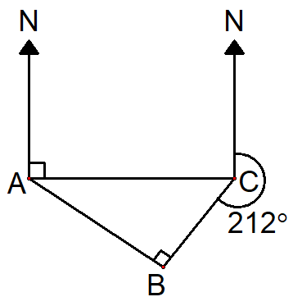
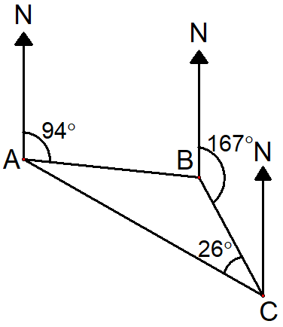
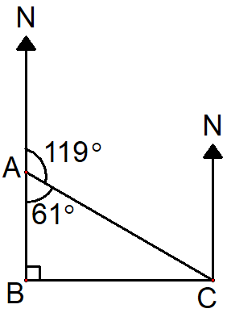
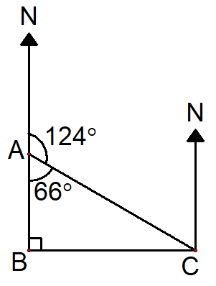
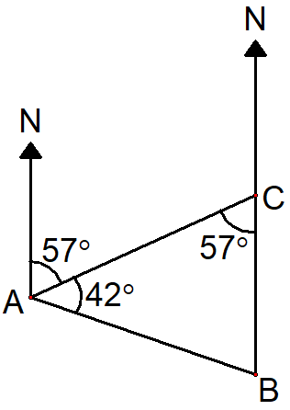
Bearings Spider 3
Bearing of A from C:
Bearing of B from A:
Calculate the bearings in each case…
Bearing of A from C:
Bearing of A from C:
Bearing of A from C:
Diagrams are not to scale.
Bearing of A from B:
Can you write a worded question for these diagrams?

Slide 6
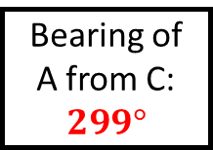
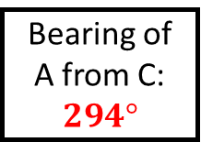
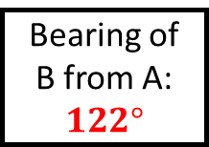
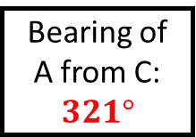
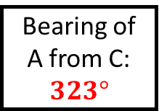
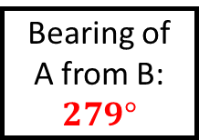
Bearings Spider 3 - Answers
Bearing of A from C:
$$323°$$
Bearing of B from A:
$$122°$$
Calculate the bearings in each case…
Bearing of A from C:
$$321°$$
Bearing of A from C:
$$299°$$
Bearing of A from C:
$$294°$$
Diagrams are not to scale.
Bearing of A from B:
$$279°$$
Can you write a worded question for these diagrams?

Slide 7
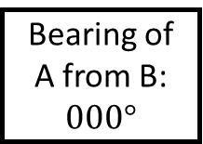
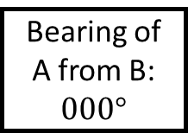
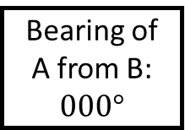



Bearings Spider - Answers
Bearing of A from B:
$$000°$$
Bearing of A from B:
$$000°$$
Calculate the bearings in each case…
Bearing of A from B:
$$000°$$
Bearing of A from B:
$$000°$$
Bearing of A from B:
$$000°$$
Bearing of A from B:
$$000°$$
Diagrams are not to scale.

