Slide 1
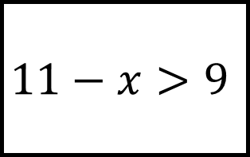
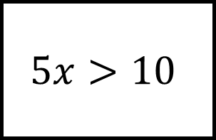
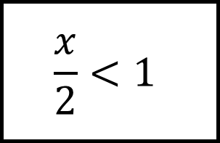
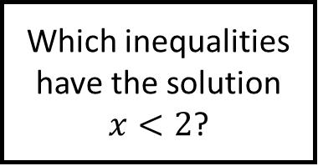
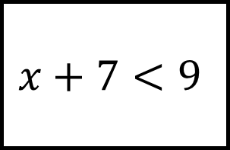
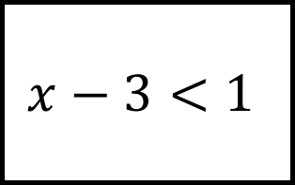
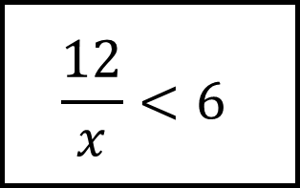
Solving Inequalities Spider 1
$$\frac{12}{x}<6$$
$$5x>10$$
$$11−x>9$$
Which inequalities have the solution $x<2$?
$$\frac{x}{2}<1$$
$$x−3<1$$
$$x+7<9$$
Find the solutions to each inequality showing the workings on each leg.

Slide 2
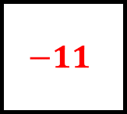
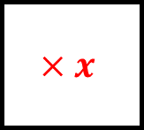
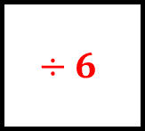


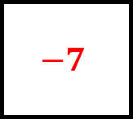

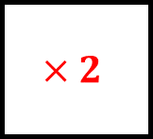
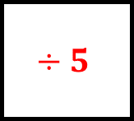
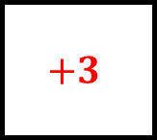
Solving Inequalities Spider 1 - Answers
$$\frac{12}{x}<6$$
$$5x>10$$
$$×x$$
$$x>2$$
$$÷6$$
$$÷5$$
$$x>2$$
$$11−x>9$$
Which inequalities have the solution $x<2$?
$$\frac{x}{2}<1$$
$$−11$$
$$×2$$
Yes!
Yes!
$$+3$$
$$−7$$
$$x−3<1$$
$$x+7<9$$
Find the solutions to each inequality showing the workings on each leg.
$$x<4$$
Yes!

Slide 3
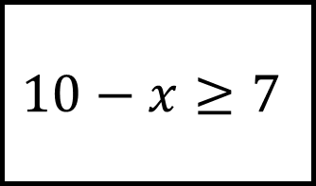
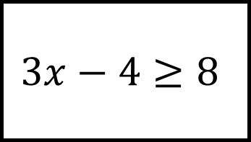
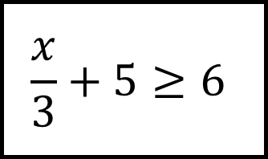
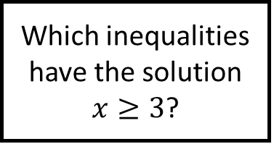
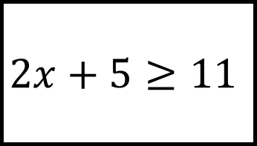
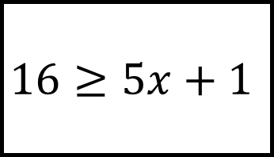
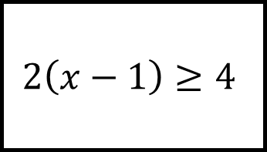
Solving Inequalities Spider 2
$$10−x≥7$$
$$2x+5≥11$$
$$2\left(x−1\right)≥4$$
Which inequalities have the solution $x≥3$?
$$3x−4≥8$$
$$\frac{x}{3}+5≥6$$
$$16≥5x+1$$
Find the solutions to each inequality showing the workings on each leg.

Slide 4
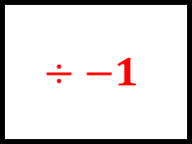
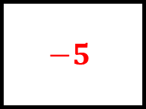

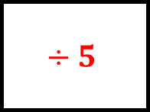
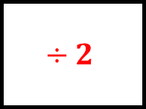
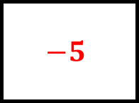
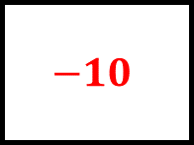
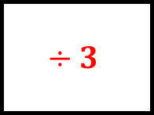
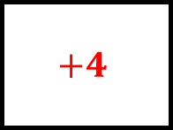
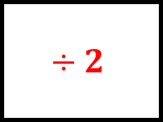

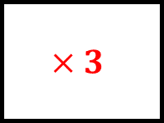
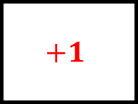
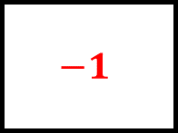

Solving Inequalities Spider 2 – Answers
$$10−x≥7$$
$$2x+5≥11$$
$$−10$$
$$−5$$
$$x≤3$$
$$÷−1$$
$$÷2$$
Yes!
$$2\left(x−1\right)≥4$$
Which inequalities have the solution $x≥3$?
$$3x−4≥8$$
$$÷2$$
$$+1$$
$$÷3$$
$$+4$$
Yes!
$$x≥4$$
$$×3$$
$$÷5$$
$$\frac{x}{3}+5≥6$$
$$16≥5x+1$$
$$−5$$
Find the solutions to each inequality showing the workings on each leg.
$$−1$$
Yes!
$$x≤3$$

Slide 5
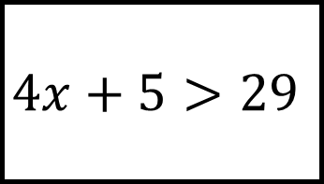
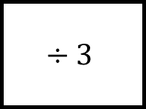
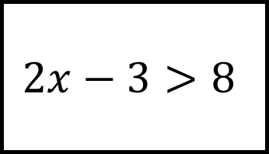
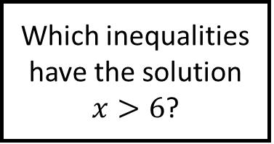
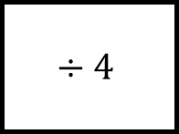
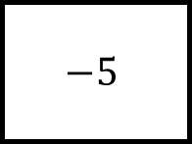
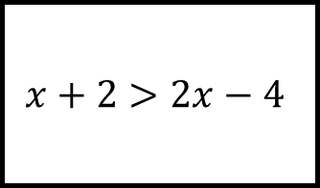
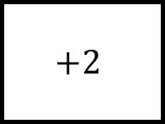
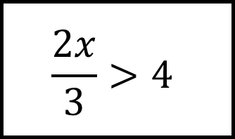
Solving Inequalities Spider 3
$$x+2>2x−4$$
$$4x+5>29$$
Which inequalities have the solution $x>6$?
$$÷4$$
$$+2$$
$$÷3$$
$$−5$$
Yes!
Yes!
$$\frac{2x}{3}>4$$
Find the solutions to each inequality showing the workings on each leg or find the original inequality.
$$2x−3>8$$

Slide 6
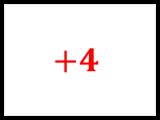
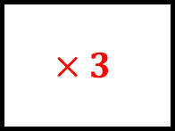
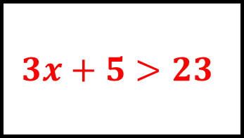


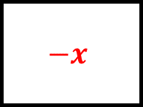
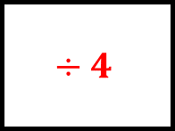
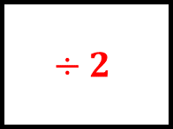
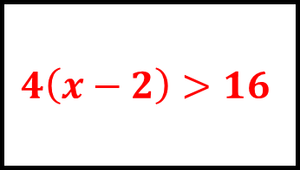
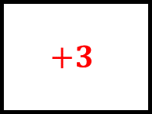

Solving Inequalities Spider 3 – Answers
$$x+2>2x−4$$
$$4x+5>29$$
$$−x$$
$$−5$$
$$x<6$$
$$+4$$
$$÷4$$
Yes!
$$4\left(x−2\right)>16$$
Which inequalities have the solution $x>6$?
$$3x+5>23$$
$$÷4$$
$$+2$$
$$÷3$$
$$−5$$
Yes!
Yes!
$$÷2$$
$$÷2$$
$$\frac{2x}{3}>4$$
Find the solutions to each inequality showing the workings on each leg or find the original inequality.
$$2x−3>8$$
$$×3$$
$$+3$$
Yes!
$$x>5.5$$

Slide 7









Solving Inequalities Spider 4
$$\frac{5x−1}{3}≤−7$$
$$2x+17≤5$$
$$22≤10−3x$$
Which inequalities have the solution $x≤−4$?
$$\frac{2−x}{3}≥2$$
$$−6$$
$$÷3$$
$$×2$$
Find the solutions to each inequality showing the workings on each leg or find the original inequality.
$$−10$$
Yes!
Yes!

Slide 8











Solving Inequalities Spider 4 – Answers
$$\frac{5x−1}{3}≤−7$$
$$2x+17≤5$$
$×$3
$$−17$$
$$+1$$
Yes!
$$÷2$$
$$x≤−6$$
$$÷5$$
$$22≤10−3x$$
Which inequalities have the solution $x≤−4$?
$$\frac{2−x}{3}≥2$$
$$−10$$
$$÷−3$$
$$−2$$
$$×3$$
Yes!
Yes!
$$−6$$
$$÷3$$
$$\frac{x+6}{2}≤1$$
Find the solutions to each inequality showing the workings on each leg or find the original inequality.
$$3x+10≤−2$$
$$×2$$
$$−10$$
Yes!
Yes!

Slide 9






Solving Inequalities Spider 5
$$3\left(x+5\right)≤x+7$$
$$6\left(x+3\right)<48$$
$$2x+5<5x−4$$
Solve these inequalities.
$$\frac{2x−4}{3}≥6$$
$$5x−3>3x+5$$
$$11−3x≥17$$

Slide 10






Solving Inequalities Spider 5 - Answers
$$3\left(x+5\right)≤x+7$$
$$6\left(x+3\right)<48$$
$$x≤−4$$
$$x<5$$
$$2x+5<5x−4$$
Solve these inequalities.
$$\frac{2x−4}{3}≥6$$
$$x>3$$
$$x≥11$$
$$x>4$$
$$x≤−2$$
$$5x−3>3x+5$$
$$11−3x≥17$$

Slide 11






Solving Inequalities Spider 6
$$\frac{5x+9}{2}>3$$
$$4\left(2x+1\right)<16$$
$$2x−1≤10x+5$$
Solve these inequalities.
$$7−2x≥12$$
$$5x−3≤x−2$$
$$3x+9>11$$

Slide 12






Solving Inequalities Spider 6 - Answers
$$\frac{5x+9}{2}>3$$
$$4\left(2x+1\right)<16$$
$$x>−\frac{3}{5}$$
$$x<\frac{3}{2}$$
$$2x−1≤10x+5$$
Solve these inequalities.
$$7−2x≥12$$
$$x≥−\frac{3}{4}$$
$$x≤−\frac{5}{2}$$
$$x≤\frac{1}{4}$$
$$x>\frac{2}{3}$$
$$5x−3≤x−2$$
$$3x+9>11$$

Slide 13



















Solving Inequalities Spider – Answers
Which inequalities have the solution ?
Find the solutions to each inequality showing the workings on each leg.

Slide 14













Solving Inequalities Spider - Answers
Which inequalities have the solution ?
Find the solutions to each inequality showing the workings on each leg.

