Slide 1
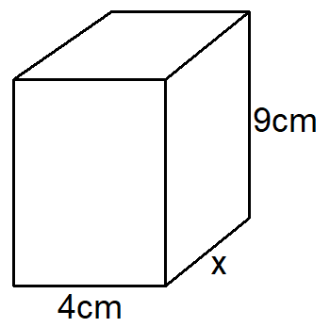
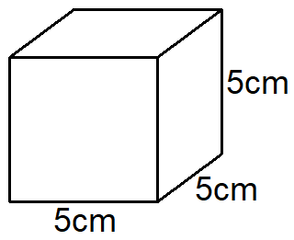
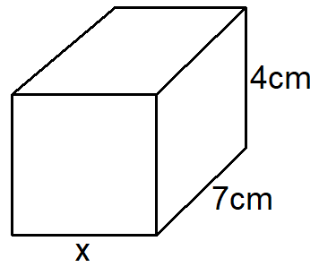
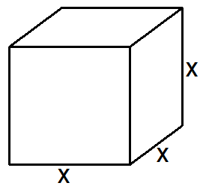
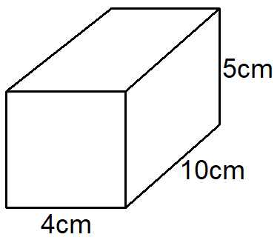
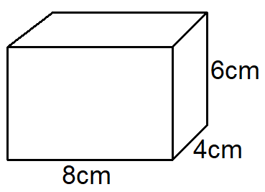
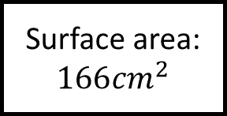
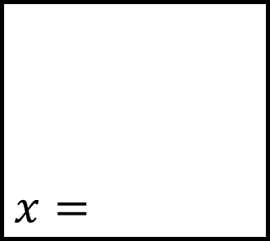
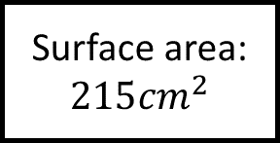
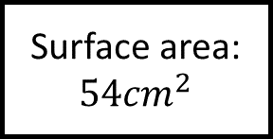
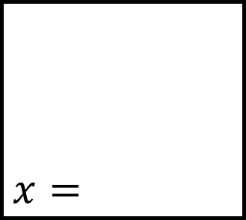
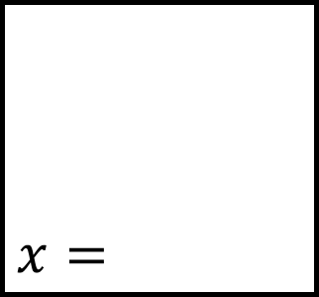
Surface Area Spider 1
$$x=$$
Surface area:
$$215{cm}^{2}$$
Surface area:
$$x=$$
$$x=$$
Fill in the blanks…
Surface area:
$$166{cm}^{2}$$
Surface area:
$$54{cm}^{2}$$
Surface area:
Surface area:
Calculate the surface area of each cube or cuboid.

Slide 2
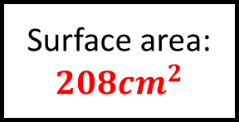
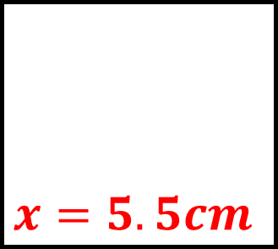
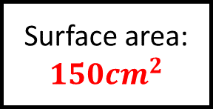
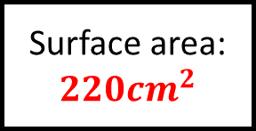
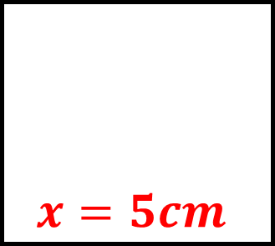
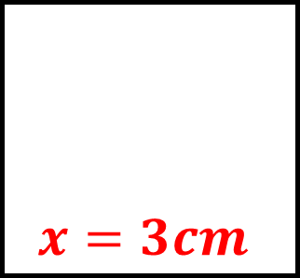
Surface Area Spider 1 - Answers
$$x=5.5cm$$
Surface area:
$$215{cm}^{2}$$
Surface area:
$$150{cm}^{2}$$
$$x=5cm$$
$$x=3cm$$
Fill in the blanks…
Surface area:
$$166{cm}^{2}$$
Surface area:
$$54{cm}^{2}$$
Surface area:
$$220{cm}^{2}$$
Surface area:
$$208{cm}^{2}$$
Calculate the surface area of each cube or cuboid.

Slide 3
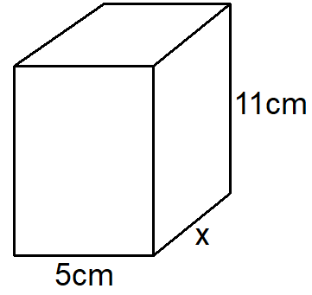
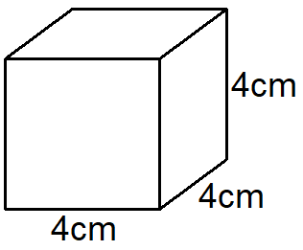
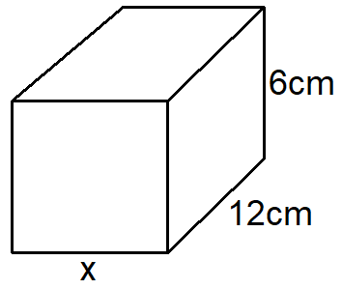
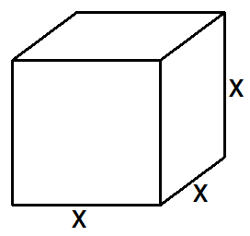
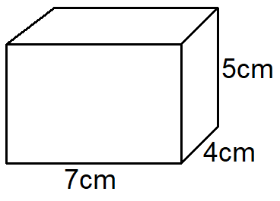
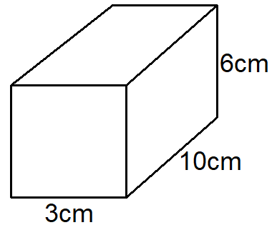
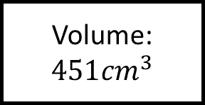
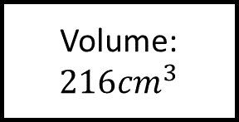
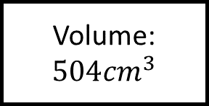
Volume Spider 1
$$x=$$
Volume:
$$451{cm}^{3}$$
Volume:
$$x=$$
$$x=$$
Fill in the blanks…
Volume:
$$504{cm}^{3}$$
Volume:
$$216{cm}^{3}$$
Volume:
Volume:
Calculate the volume of each cube or cuboid.

Slide 4
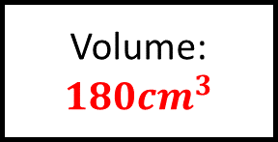
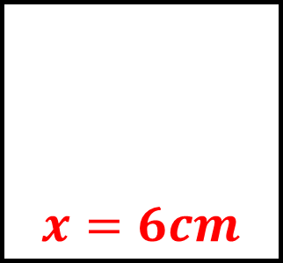
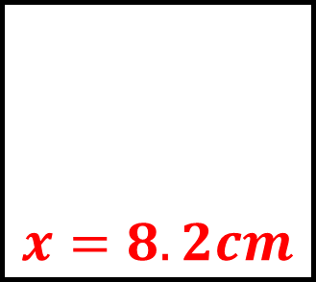
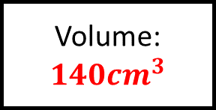
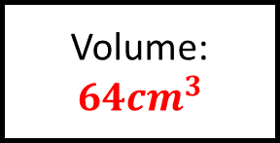
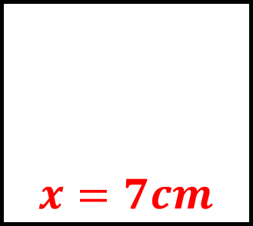
Volume Spider 1 - Answers
$$x=8.2cm$$
Volume:
$$451{cm}^{3}$$
Volume:
$$64{cm}^{3}$$
$$x=7cm$$
$$x=6cm$$
Fill in the blanks…
Volume:
$$504{cm}^{3}$$
Volume:
$$216{cm}^{3}$$
Volume:
$$140{cm}^{3}$$
Volume:
$$180{cm}^{3}$$
Calculate the volume of each cube or cuboid.

Slide 5
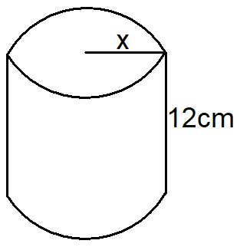
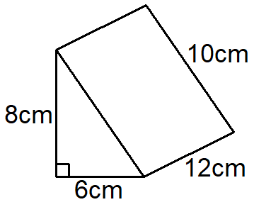
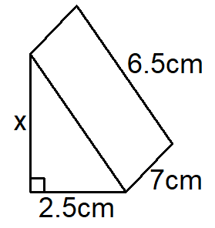
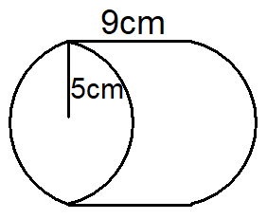
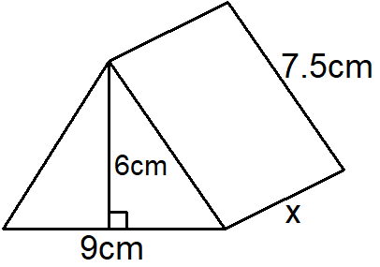
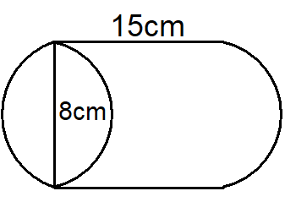
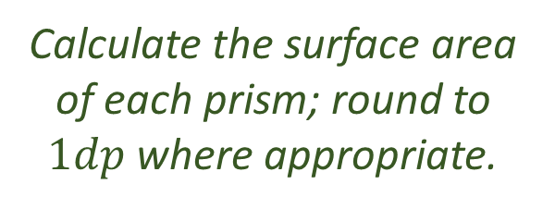
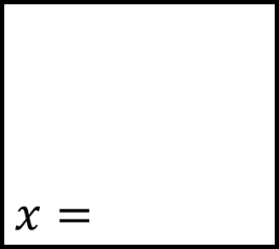

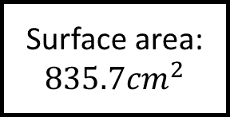

Surface Area Spider 2
$$x=$$
Surface area:
$$835.7{cm}^{2}$$
Surface area:
$$x=$$
Fill in the blanks…
Surface area:
Surface area:
$$120{cm}^{2}$$
Surface area:
$$318{cm}^{2}$$
Surface area:
$$x=$$
Calculate the surface area of each prism; round to $1dp$ where appropriate.

Slide 6
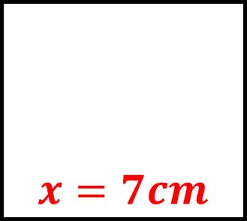
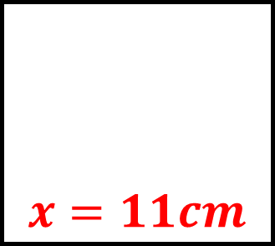
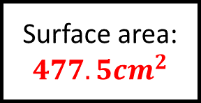

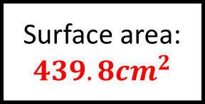
Surface Area Spider 2 - Answers
$$x=7cm$$
Surface area:
$$835.7{cm}^{2}$$
Surface area:
$$336{cm}^{2}$$
$$x=6cm$$
Fill in the blanks…
Surface area:
$$439.8{cm}^{2}$$
Surface area:
$$120{cm}^{2}$$
Surface area:
$$318{cm}^{2}$$
Surface area:
$$477.5{cm}^{2}$$
$$x=11cm$$
Calculate the surface area of each prism; round to $1dp$ where appropriate.

Slide 7
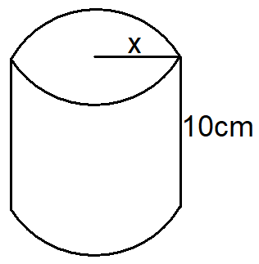
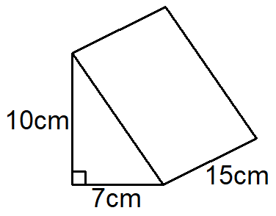
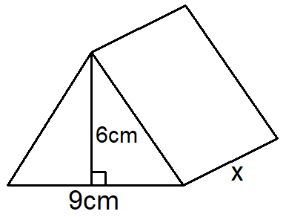
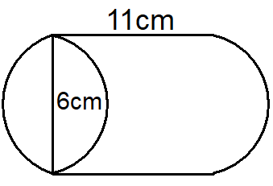






Volume Spider 2
$$x=$$
Volume:
$$1327.3{cm}^{3}$$
Volume:
$$x=$$
Fill in the blanks…
Volume:
Volume:
$$324{cm}^{3}$$
Volume:
$$112{cm}^{3}$$
Volume:
$$x=$$
Calculate the volume of each prism; round to $1dp$ where appropriate.

Slide 8






Volume Spider 2 - Answers
$$x=6.5cm$$
Volume:
$$1327.3{cm}^{3}$$
Volume:
$$525{cm}^{3}$$
$$x=12cm$$
Fill in the blanks…
Volume:
$$311.0{cm}^{3}$$
Volume:
$$324{cm}^{3}$$
Volume:
$$112{cm}^{3}$$
Volume:
$$414{cm}^{3}$$
$$x=7cm$$
Calculate the volume of each prism; round to $1dp$ where appropriate.

Slide 9










Surface Area Spider 3
Total surface area:
Total surface area:
Fill in the blanks…
Total surface area:
Curved surface area:
Curved surface area:
$$113.1{cm}^{2}$$
Curved surface area:
$$188.5{cm}^{2}$$
$$x=$$
$$x=$$
Calculate the surface area of each shape; round to $1dp$ where appropriate.

Slide 10






Surface Area Spider 3 - Answers
Total surface area:
$$461.8{cm}^{2}$$
Total surface area:
$$314.2{cm}^{2}$$
Fill in the blanks…
Total surface area:
$$84{cm}^{2}$$
Curved surface area:
$$804.2{cm}^{2}$$
Curved surface area:
$$113.1{cm}^{2}$$
Curved surface area:
$$188.5{cm}^{2}$$
$$x=3cm$$
$$x=10cm$$
Calculate the surface area of each shape; round to $1dp$ where appropriate.

Slide 11









Volume Spider 3
Volume:
Volume:
$$x=$$
$$x=$$
Fill in the blanks…
Volume:
$$48π{cm}^{3}$$
Volume:
$$972π{cm}^{3}$$
Volume:
Volume:
Calculate the volume of each shape; give your answers in terms of $π$ or to $1dp$ where appropriate.

Slide 12






Volume Spider 3 - Answers
Volume:
$$144π{cm}^{3}$$
Volume:
$$100π{cm}^{3}$$
$$x=8cm$$
$$x=9cm$$
Fill in the blanks…
Volume:
$$48π{cm}^{3}$$
Volume:
$$972π{cm}^{3}$$
Volume:
$$\frac{500π}{3}{cm}^{3}$$
Volume:
$$31.7{cm}^{3}$$
Calculate the volume of each shape; give your answers in terms of $π$ or to $1dp$ where appropriate.

Slide 13













Volume and Surface Area Problems Spider
$$x=$$
Surface area:
$$210{cm}^{2}$$
Volume:
$$r=$$
$$x=$$
Fill in the blanks…
Volume and surface area are equal
Volume:
$$196{cm}^{3}$$
Volume:
Volume:
$$49.1{cm}^{3}$$
$$r=$$
Solve the surface area and volume problems rounding to $1dp$ where appropriate.

Slide 14






Volume and Surface Area Problems Spider - Answers
$$x=5cm \& 7cm$$
Surface area:
$$210{cm}^{2}$$
Volume:
$$112{cm}^{3}$$
$$r=3cm$$
$$x=7cm$$
Fill in the blanks…
Volume and surface area are equal
Volume:
$$196{cm}^{3}$$
Volume:
$$99.0{cm}^{3}$$
Volume:
$$49.1{cm}^{3}$$
$$r=2.5cm$$
Solve the surface area and volume problems rounding to $1dp$ where appropriate.

Slide 15






Volume/Surface Area Spider - Answers
Fill in the blanks…
Calculate the surface area/volume of each shape.

