Slide 1
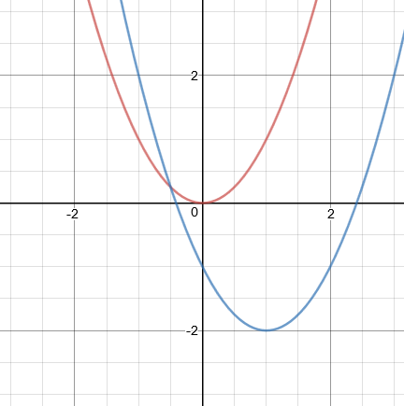
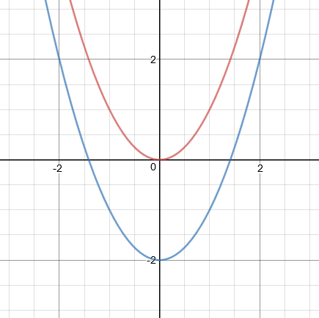
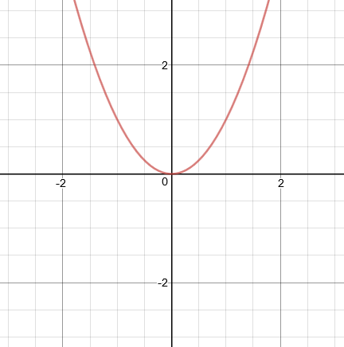
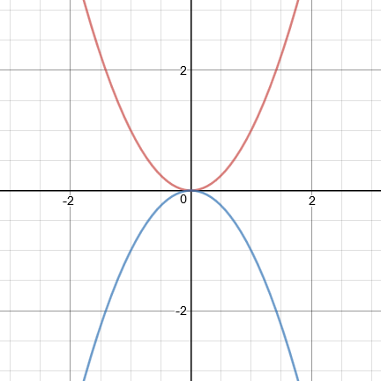
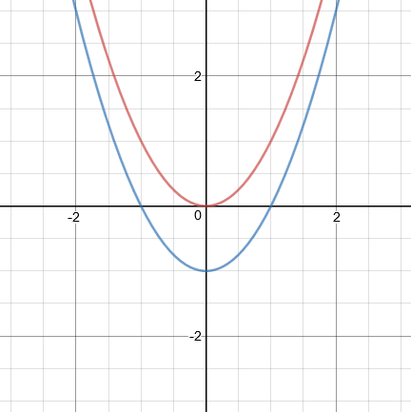
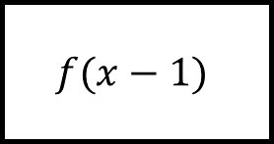
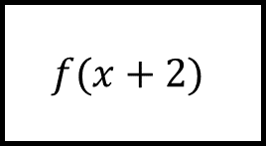
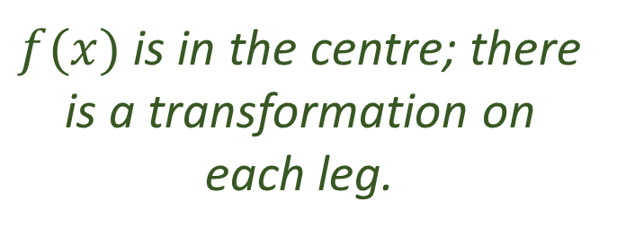
Transforming Functions Spider 1
$$f(x−1)$$
$$f(x+2)$$
$f(x)$ is in the centre; there is a transformation on each leg.

Slide 2
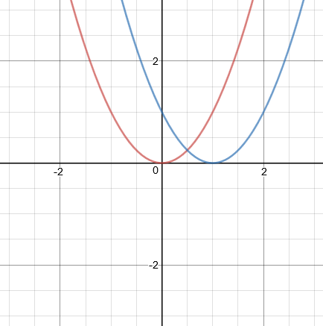
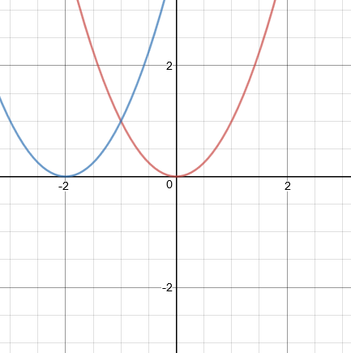
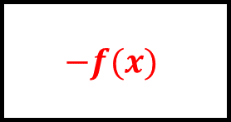
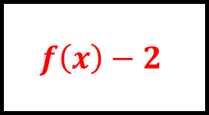
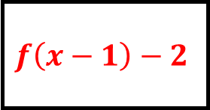
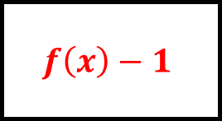
Transforming Functions Spider 1 - Answers
$$f\left(x−1\right)−2$$
$$f\left(x\right)−2$$
$$f(x−1)$$
$$f(x+2)$$
$$−f(x)$$
$$f\left(x\right)−1$$
$f(x)$ is in the centre; there is a transformation on each leg.

Slide 3
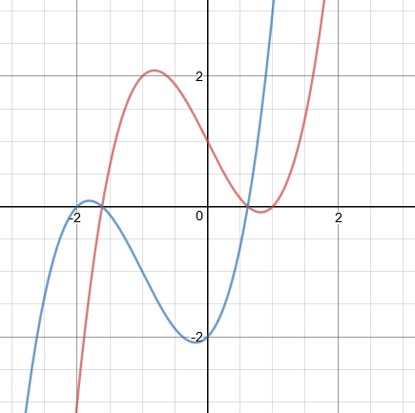
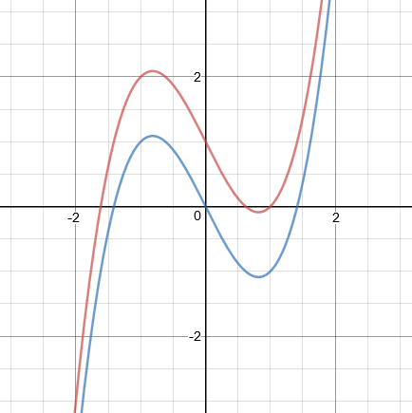
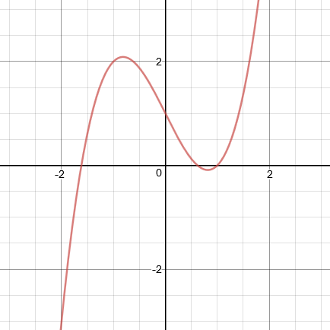
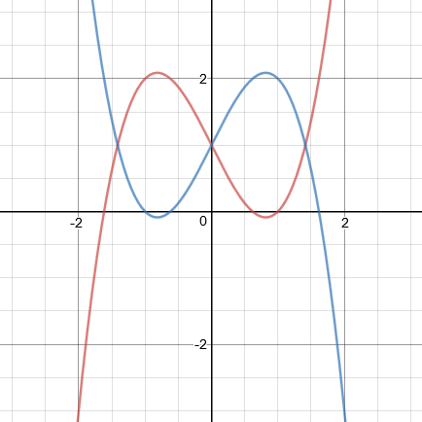
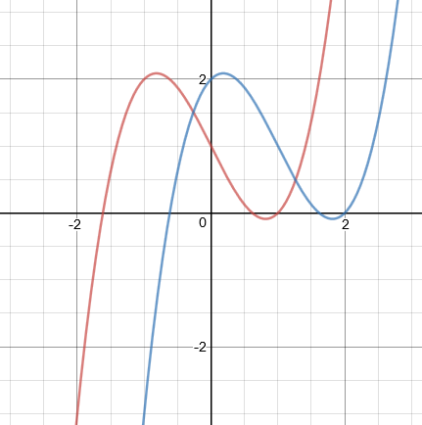
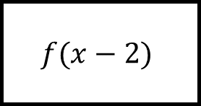
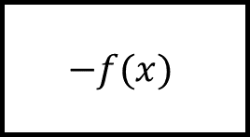
Transforming Functions Spider 2
$$f(x−2)$$
$$−f(x)$$
$f(x)$ is in the centre; there is a transformation on each leg.

Slide 4
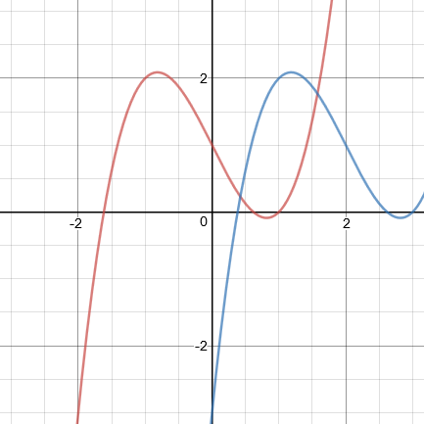
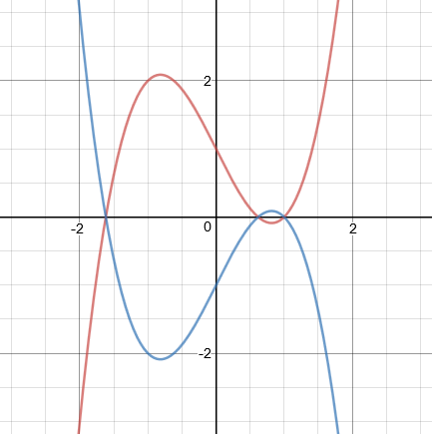
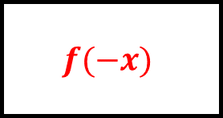

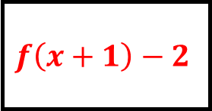
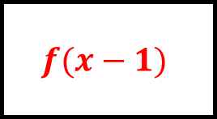
Transforming Functions Spider 2 - Answers
$$f\left(x+1\right)−2$$
$$f\left(x\right)−1$$
$$f(x−2)$$
$$−f(x)$$
$$f(−x)$$
$$f(x−1)$$
$f(x)$ is in the centre; there is a transformation on each leg.

Slide 5
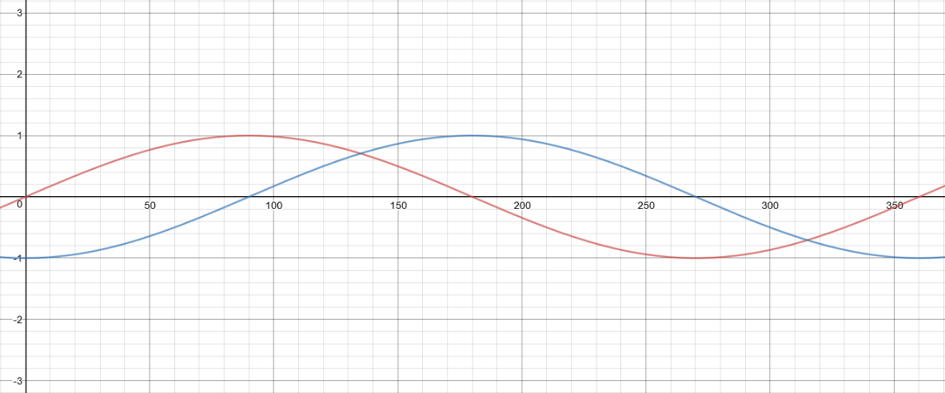
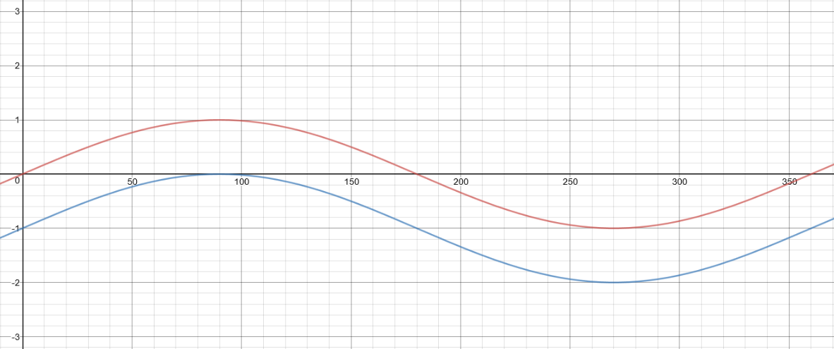
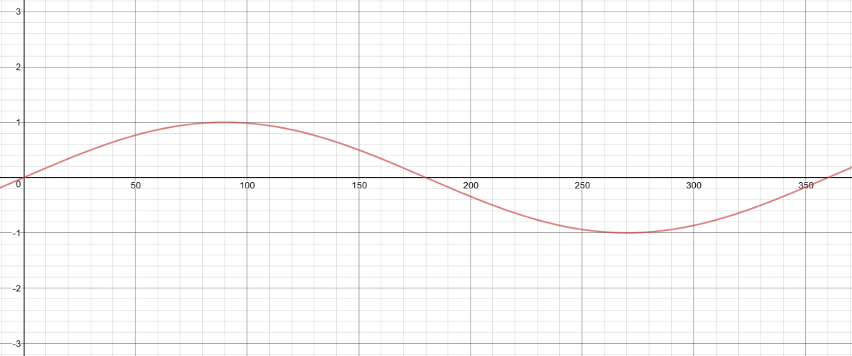
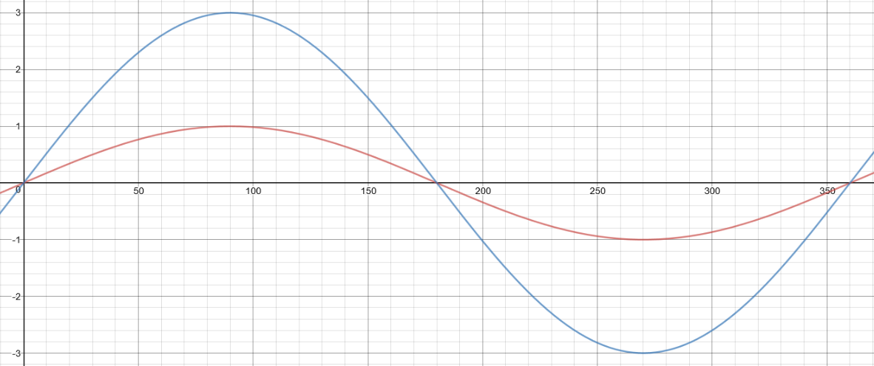
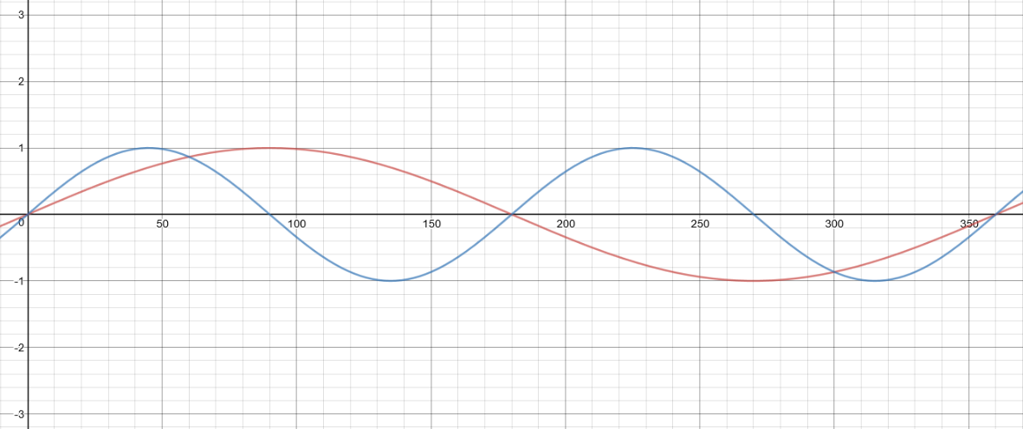
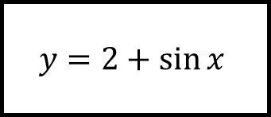
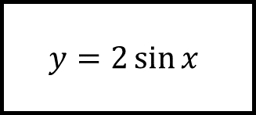
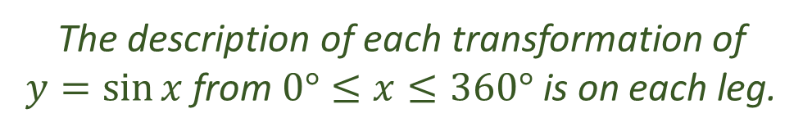
Transforming Functions Spider 3
$$y=2+\sin{x}$$
$$y=2\sin{x}$$
The description of each transformation of $y=\sin{x}$ from $0°≤x≤360°$ is on each leg.

Slide 6
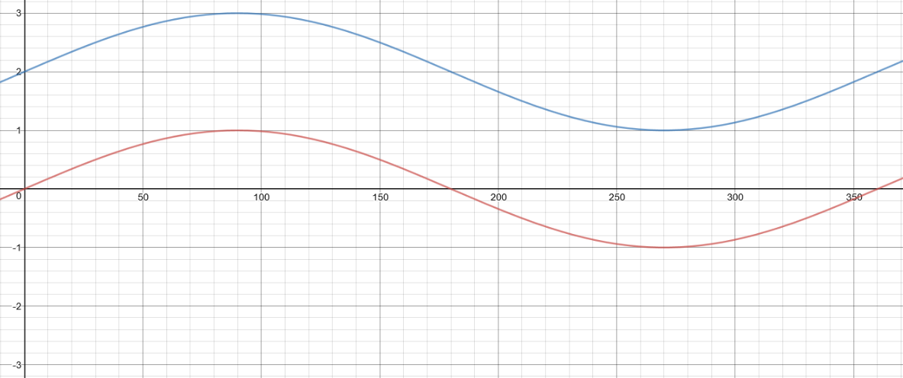
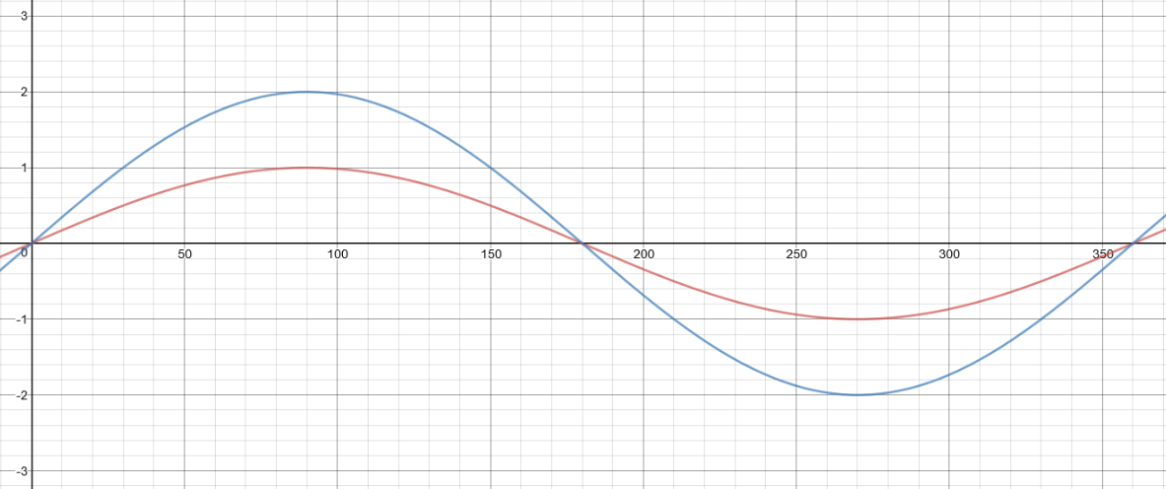
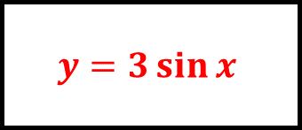
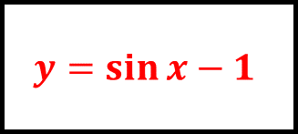
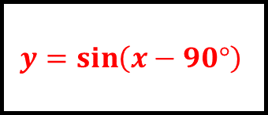
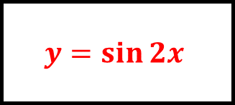
Transforming Functions Spider 3 - Answers
$$y=\sin\left(x−90°\right)$$
$$y=\sin{x}−1$$
$$y=2+\sin{x}$$
$$y=2\sin{x}$$
$$y=3\sin{x}$$
$$y=\sin{2x}$$
The description of each transformation of $y=\sin{x}$ from $0°≤x≤360°$ is on each leg.

Slide 7
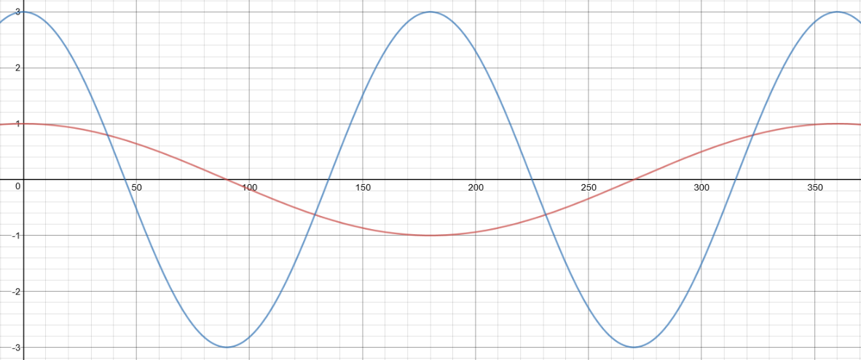
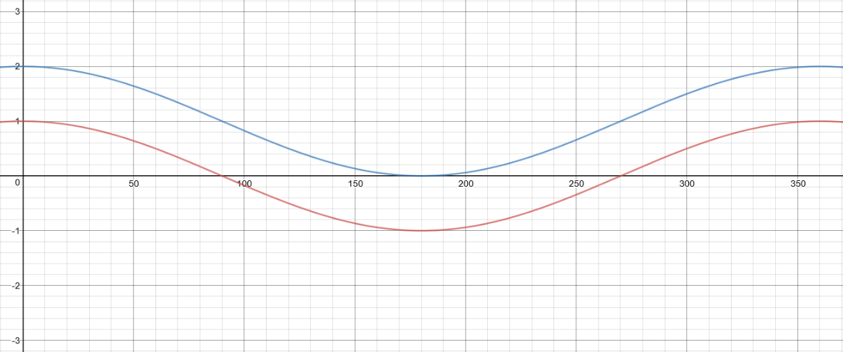
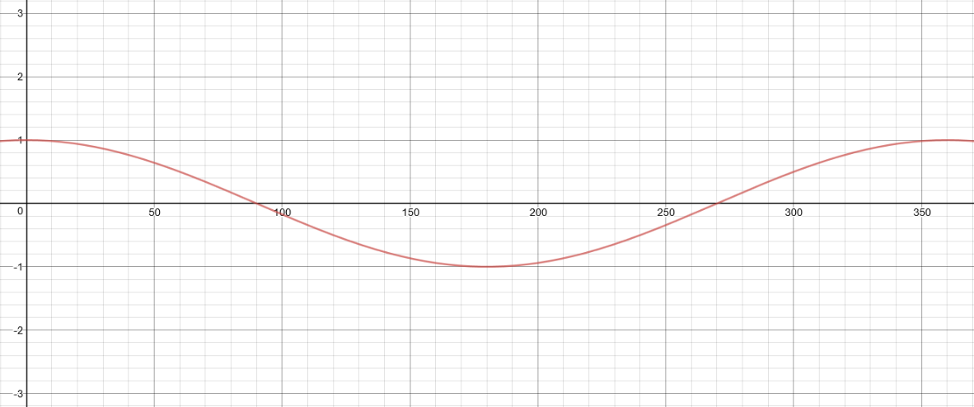
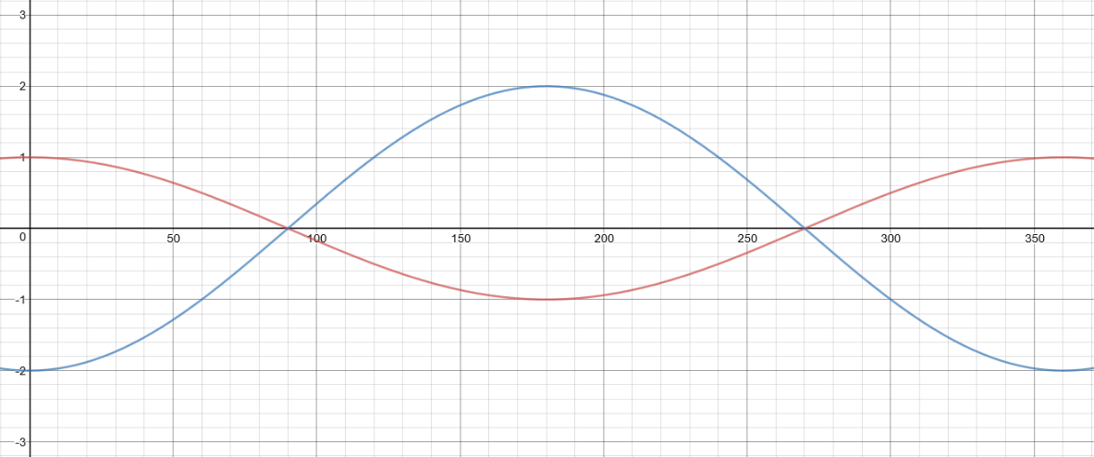
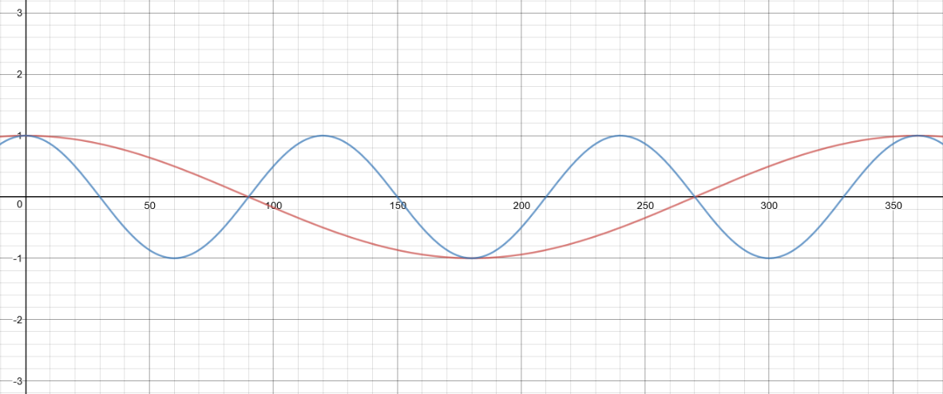
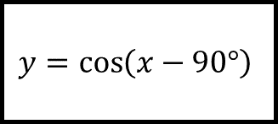
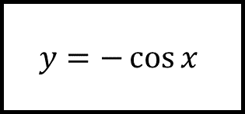
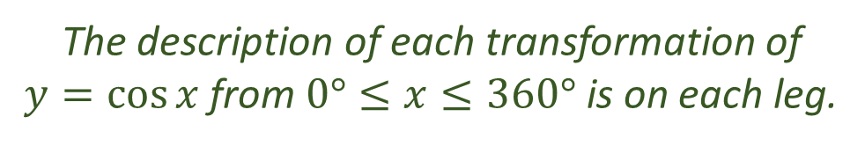
Transforming Functions Spider 4
$$y=\cos\left(x−90°\right)$$
$$y=−\cos{x}$$
The description of each transformation of $y=\cos{x}$ from $0°≤x≤360°$ is on each leg.

Slide 8
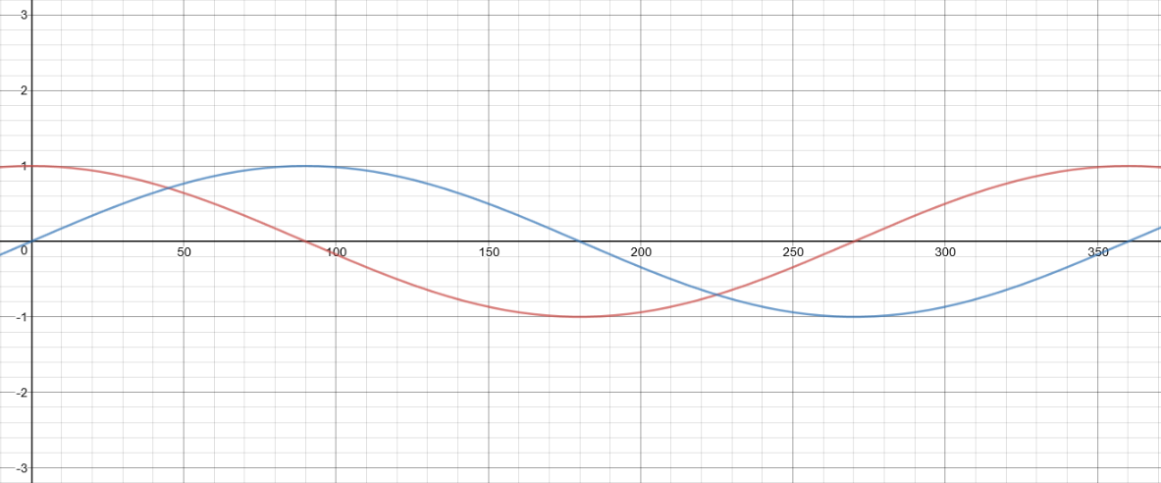
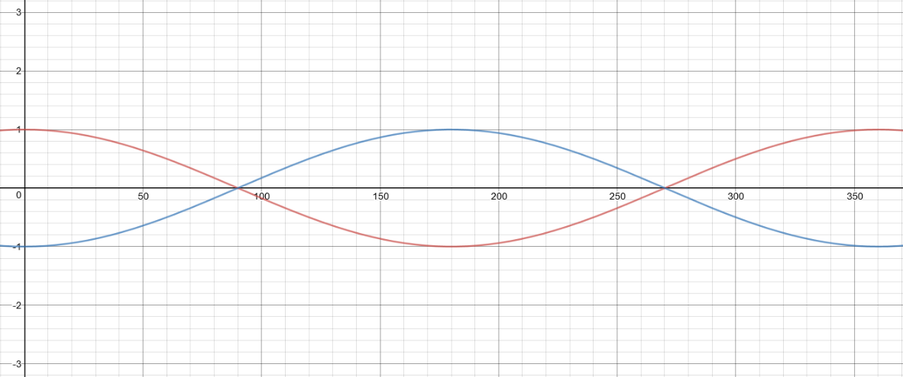




Transforming Functions Spider 4 - Answers
$$y=3\cos\left(2x\right)$$
$$y=1+\cos{x}$$
$$y=\cos\left(x−90°\right)$$
$$y=−\cos{x}$$
$$y=−2\cos{x}$$
$$y=\cos{3x}$$
The description of each transformation of $y=\cos{x}$ from $0°≤x≤360°$ is on each leg.

Slide 9






Transforming Functions Spider - Blank
$f(x)$ is in the centre; there is a transformation on each leg.

