Slide 1
Trigonometry In Right-Angles Triangles Matching
Match one group to the other.
There will be a “spare” ones – what answer should be there?

Slide 2
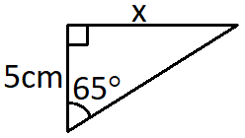
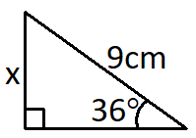
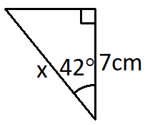
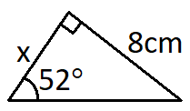
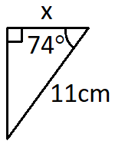
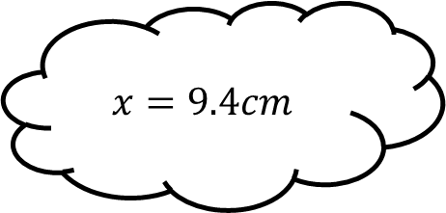
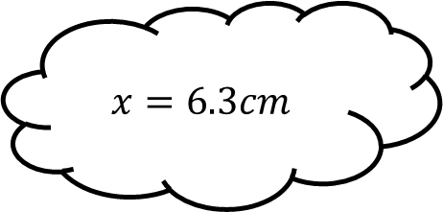
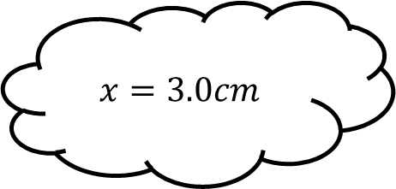
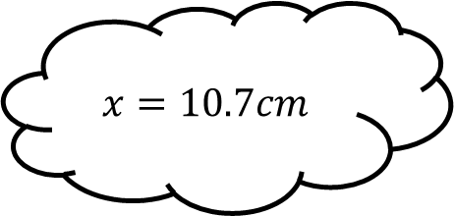
Matching 1
$$x=6.3cm$$
$$x=9.4cm$$
$$x=10.7cm$$
$$x=3.0cm$$

Slide 3

Matching 1 - Answers
$$x=5.3cm$$
$$x=6.3cm$$
$$x=9.4cm$$
$$x=10.7cm$$
$$x=3.0cm$$

Slide 4
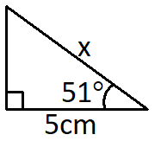
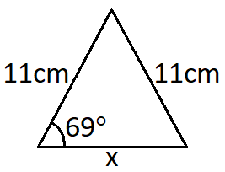
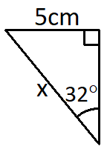
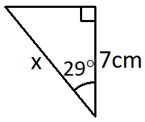
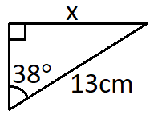
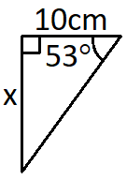
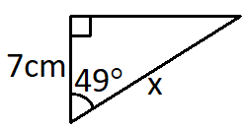
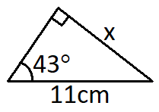
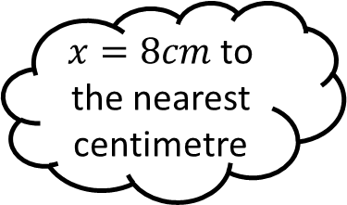
Matching 2
$x=8cm$ to the nearest centimetre

Slide 5


Matching 2 - Answers
$$x=9cm$$
$x=8cm$ to the nearest centimetre
$$x=11cm$$

Slide 6
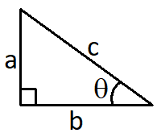
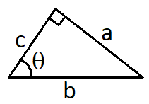
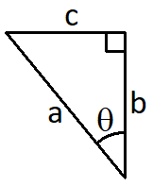
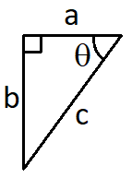
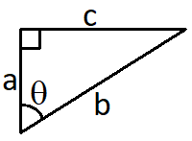
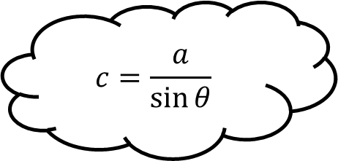
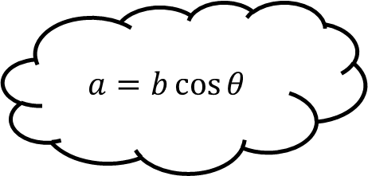
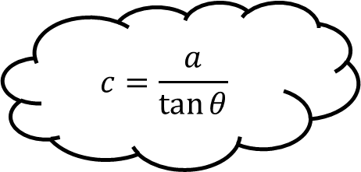
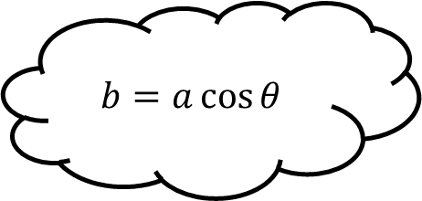
Matching 3
$$a=b\cos{θ}$$
$$c=\frac{a}{\sin{θ}}$$
$$b=a\cos{θ}$$
$$c=\frac{a}{\tan{θ}}$$

Slide 7
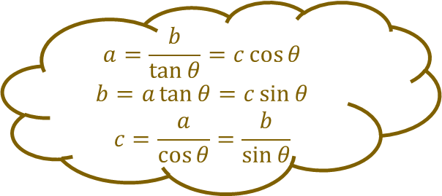
Matching 3 - Answers
$$a=b\cos{θ}$$
$$c=\frac{a}{\sin{θ}}$$
$$b=a\cos{θ}$$
$$a=\frac{b}{\tan{θ}}=c\cos{θ}$$
$$b=a\tan{θ}=c\sin{θ}$$
$$c=\frac{a}{\cos{θ}}=\frac{b}{\sin{θ}}$$
$$c=\frac{a}{\tan{θ}}$$

Slide 8
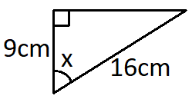
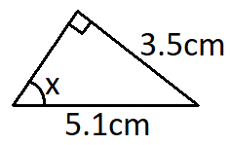
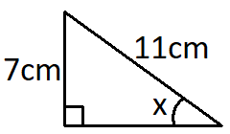
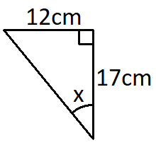
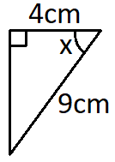
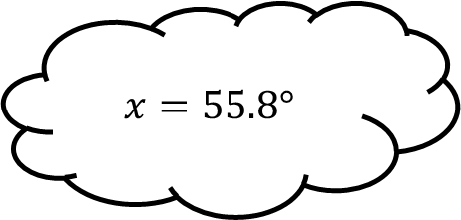
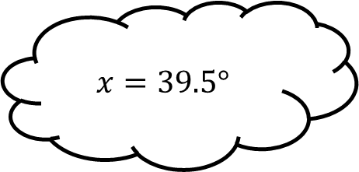
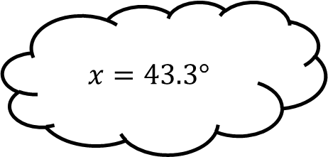
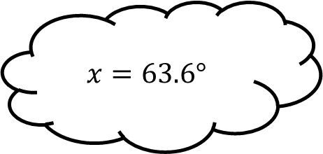
Matching 4
$$x=39.5°$$
$$x=55.8°$$
$$x=63.6°$$
$$x=43.3°$$

Slide 9
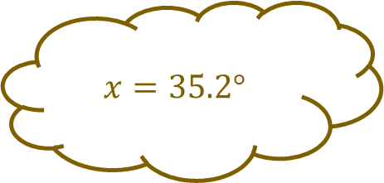
Matching 4 - Answers
$$x=39.5°$$
$$x=55.8°$$
$$x=63.6°$$
$$x=43.3°$$
$$x=35.2°$$

Slide 10
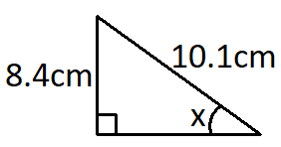
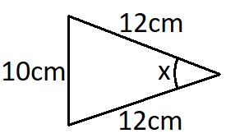
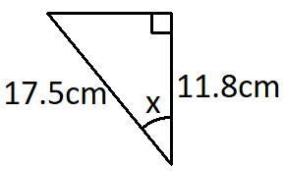
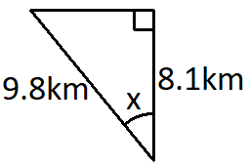
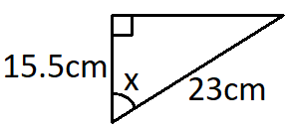
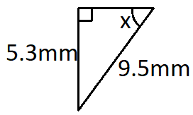
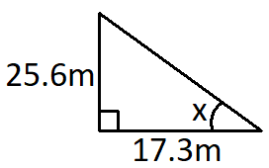
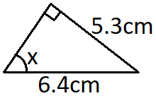
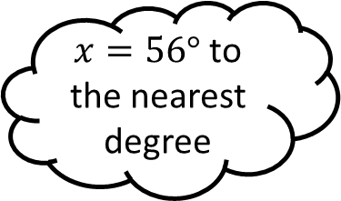
Matching 5
$x=56°$ to the nearest degree

Slide 11





Matching 5 - Answers
$$x=49°$$
$$x=48°$$
$x=56°$ to the nearest degree
$$x=48°$$
$$x=34°$$
$$x=34°$$

Slide 12
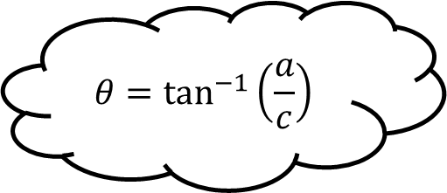
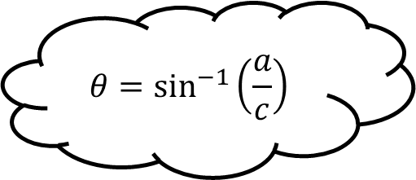
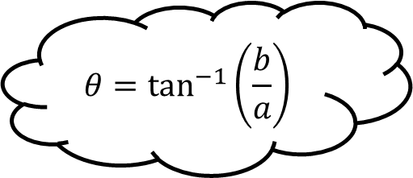

Matching 6
$$θ=\sin^{−1}\left(\frac{a}{c}\right)$$
$$θ=\tan^{−1}\left(\frac{a}{c}\right)$$
$$θ=\cos^{−1}\left(\frac{a}{b}\right)$$
$$θ=\tan^{−1}\left(\frac{b}{a}\right)$$

Slide 13

Matching 6 - Answers
$$θ=\sin^{−1}\left(\frac{a}{c}\right)$$
$$θ=\tan^{−1}\left(\frac{a}{c}\right)$$
$$θ=\sin^{−1}\left(\frac{c}{a}\right)$$
$$θ=\cos^{−1}\left(\frac{b}{a}\right)$$
$$θ=\tan^{−1}\left(\frac{c}{b}\right)$$
$$θ=\cos^{−1}\left(\frac{a}{b}\right)$$
$$θ=\tan^{−1}\left(\frac{b}{a}\right)$$

Slide 14









Matching n

Slide 15









Matching n

