Slide 1
Surface Area and Volume
Matching
Match one group to the other.
There will be a “spare” one – what answer should be there?

Slide 2
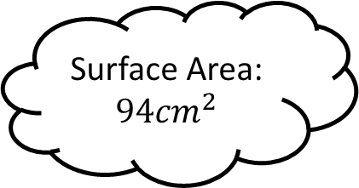
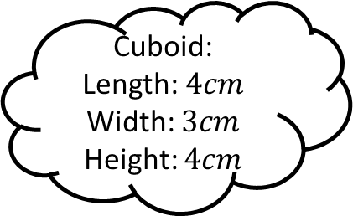
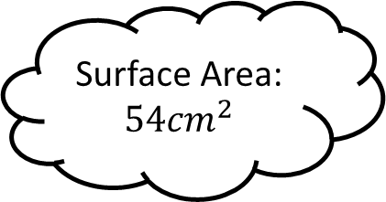
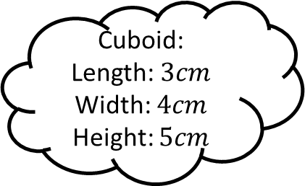
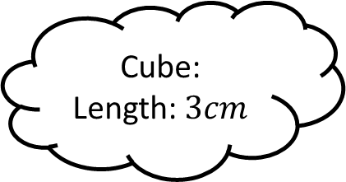
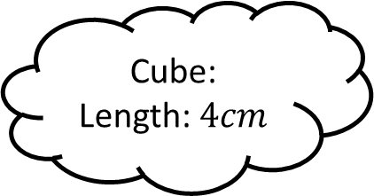
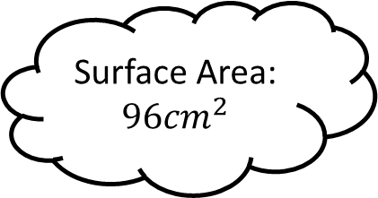
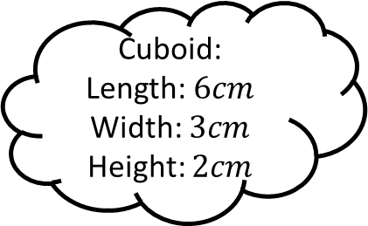
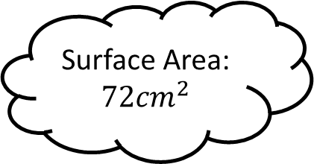
Matching 1
Surface Area:
$$54{cm}^{2}$$
Cuboid:
Length: $3cm$
Width: $4cm$
Height: $5cm$
Cube:
Length: $4cm$
Surface Area:
$$94{cm}^{2}$$
Cuboid:
Length: $4cm$
Width: $3cm$
Height: $4cm$
Surface Area:
$$72{cm}^{2}$$
Cube:
Length: $3cm$
Cuboid:
Length: $6cm$
Width: $3cm$
Height: $2cm$
Surface Area:
$$96{cm}^{2}$$

Slide 3
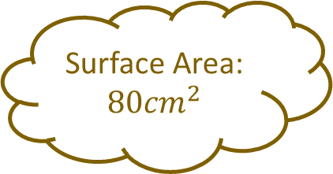
Matching 1 - Answers
Surface Area:
$$54{cm}^{2}$$
Cuboid:
Length: $3cm$
Width: $4cm$
Height: $5cm$
Surface Area:
$$80{cm}^{2}$$
Cube:
Length: $4cm$
Surface Area:
$$94{cm}^{2}$$
Cuboid:
Length: $4cm$
Width: $3cm$
Height: $4cm$
Surface Area:
$$72{cm}^{2}$$
Cube:
Length: $3cm$
Cuboid:
Length: $6cm$
Width: $3cm$
Height: $2cm$
Surface Area:
$$96{cm}^{2}$$

Slide 4
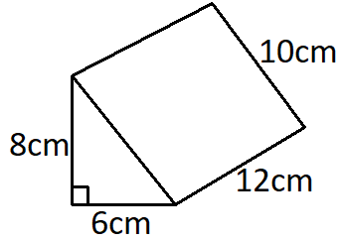
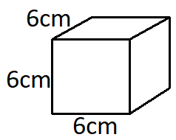
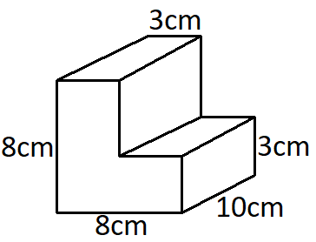
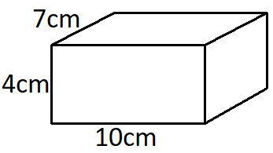
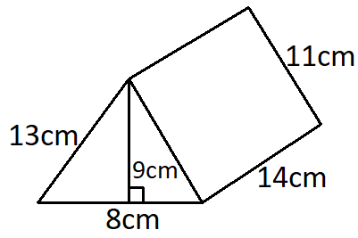
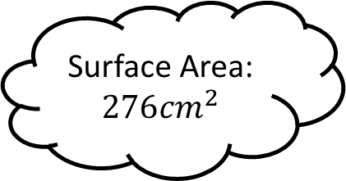
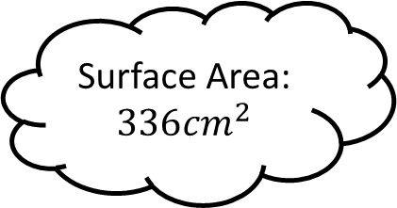
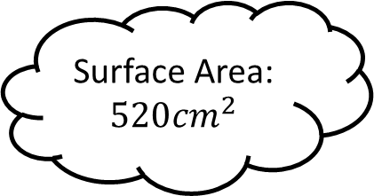
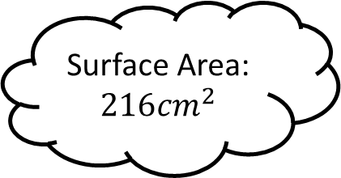
Matching 2
Surface Area:
$$336{cm}^{2}$$
Surface Area:
$$276{cm}^{2}$$
Surface Area:
$$216{cm}^{2}$$
Surface Area:
$$520{cm}^{2}$$

Slide 5
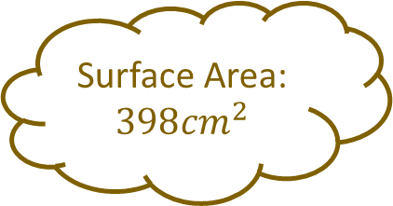
Matching 2 - Answers
Surface Area:
$$336{cm}^{2}$$
Surface Area:
$$398{cm}^{2}$$
Surface Area:
$$276{cm}^{2}$$
Surface Area:
$$216{cm}^{2}$$
Surface Area:
$$520{cm}^{2}$$

Slide 6
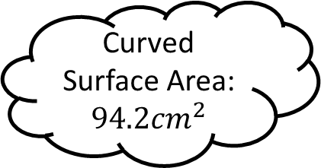
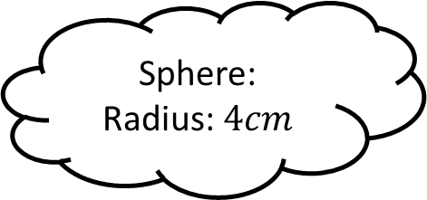
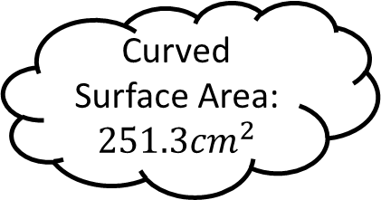
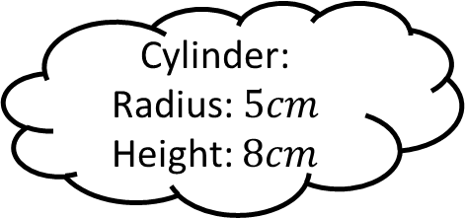
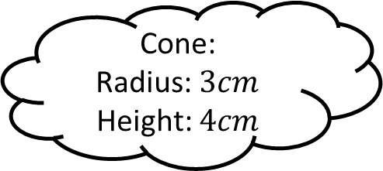
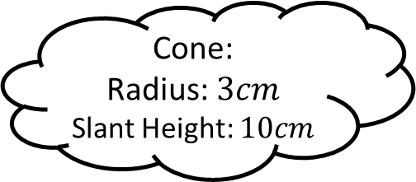
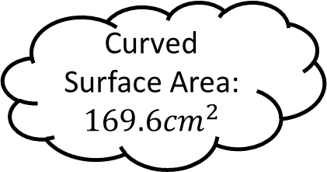
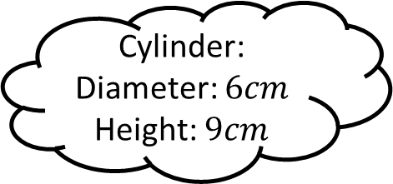
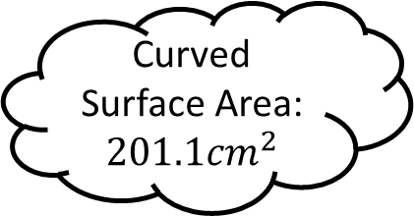
Matching 3
Curved Surface Area:
$$251.3{cm}^{2}$$
Cylinder:
Radius: $5cm$
Height: $8cm$
Cone:
Radius: $3cm$
Slant Height: $10cm$
Curved Surface Area:
$$94.2{cm}^{2}$$
Sphere:
Radius: $4cm$
Curved Surface Area:
$$201.1{cm}^{2}$$
Cone:
Radius: $3cm$
Height: $4cm$
Cylinder:
Diameter: $6cm$
Height: $9cm$
Curved Surface Area:
$$169.6{cm}^{2}$$

Slide 7
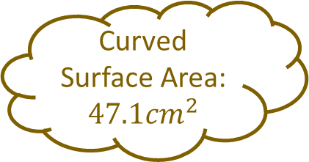
Matching 3
Curved Surface Area:
$$251.3{cm}^{2}$$
Cylinder:
Radius: $5cm$
Height: $8cm$
Cone:
Radius: $3cm$
Slant Height: $10cm$
Curved Surface Area:
$$94.2{cm}^{2}$$
Sphere:
Radius: $4cm$
Curved Surface Area:
$$201.1{cm}^{2}$$
Cone:
Radius: $3cm$
Height: $4cm$
Curved Surface Area:
$$47.1{cm}^{2}$$
Cylinder:
Diameter: $6cm$
Height: $9cm$
Curved Surface Area:
$$169.6{cm}^{2}$$

Slide 8
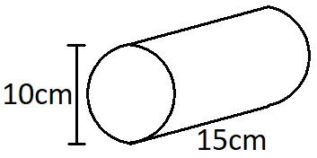
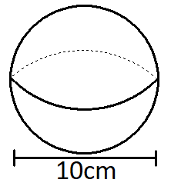
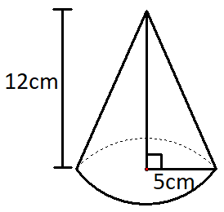
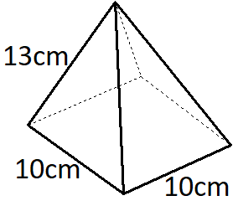
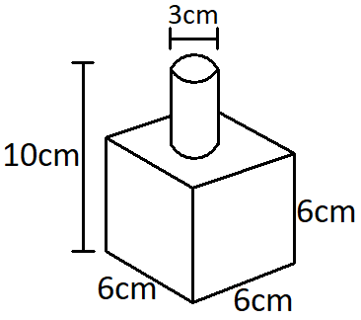
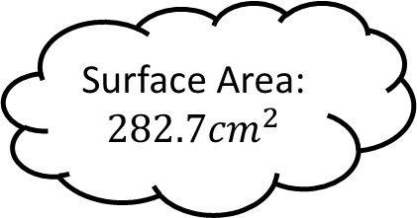
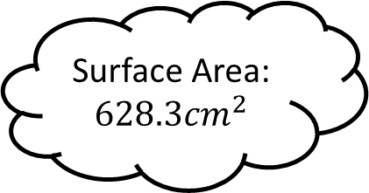
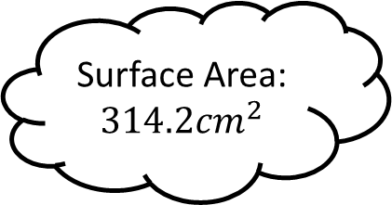
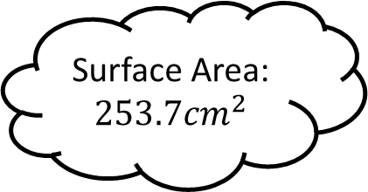
Matching 4
Surface Area:
$$628.3{cm}^{2}$$
Surface Area:
$$282.7{cm}^{2}$$
Surface Area:
$$253.7{cm}^{2}$$
Surface Area:
$$314.2{cm}^{2}$$

Slide 9
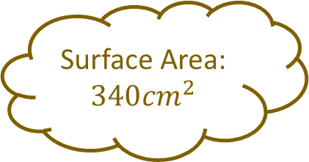
Matching 4 - Answers
Surface Area:
$$628.3{cm}^{2}$$
Surface Area:
$$282.7{cm}^{2}$$
Surface Area:
$$253.7{cm}^{2}$$
Surface Area:
$$340{cm}^{2}$$
Surface Area:
$$314.2{cm}^{2}$$

Slide 10
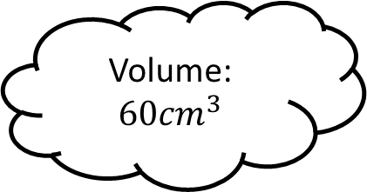
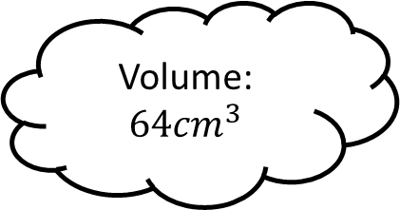
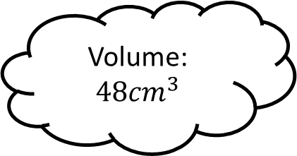
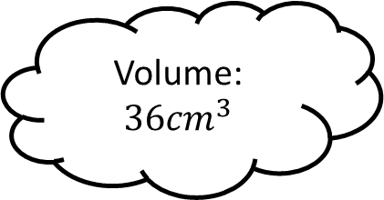
Matching 5
Volume:
$$64{cm}^{3}$$
Cuboid:
Length: $3cm$
Width: $4cm$
Height: $5cm$
Cube:
Length: $4cm$
Volume:
$$60{cm}^{3}$$
Cuboid:
Length: $4cm$
Width: $3cm$
Height: $4cm$
Volume:
$$36{cm}^{3}$$
Cube:
Length: $3cm$
Cuboid:
Length: $6cm$
Width: $3cm$
Height: $2cm$
Volume:
$$48{cm}^{3}$$

Slide 11
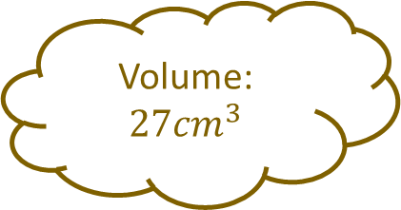
Matching 5 - Answers
Volume:
$$64{cm}^{3}$$
Cuboid:
Length: $3cm$
Width: $4cm$
Height: $5cm$
Cube:
Length: $4cm$
Volume:
$$60{cm}^{3}$$
Cuboid:
Length: $4cm$
Width: $3cm$
Height: $4cm$
Volume:
$$36{cm}^{3}$$
Cube:
Length: $3cm$
Cuboid:
Length: $6cm$
Width: $3cm$
Height: $2cm$
Volume:
$$27{cm}^{3}$$
Volume:
$$48{cm}^{3}$$

Slide 12
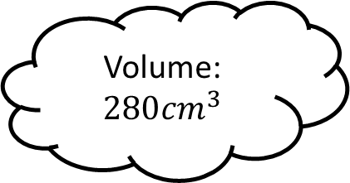
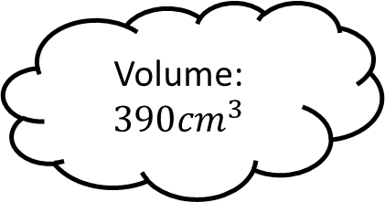
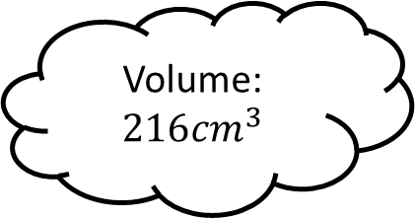
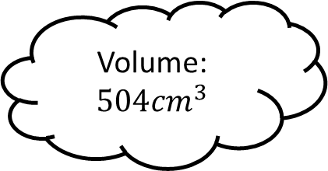
Matching 6
Volume:
$$390{cm}^{3}$$
Volume:
$$280{cm}^{3}$$
Volume:
$$504{cm}^{3}$$
Volume:
$$216{cm}^{3}$$

Slide 13
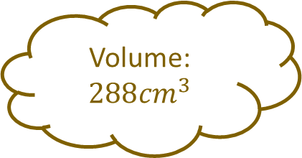
Matching 6 - Answers
Volume:
$$288{cm}^{3}$$
Volume:
$$390{cm}^{3}$$
Volume:
$$280{cm}^{3}$$
Volume:
$$504{cm}^{3}$$
Volume:
$$216{cm}^{3}$$

Slide 14





Matching 7
Volume:
$$268.1{cm}^{3}$$
Cylinder:
Radius: $5cm$
Height: $8cm$
Cone:
Radius: $6cm$
Slant Height: $10cm$
Volume:
$$37.7{cm}^{3}$$
Sphere:
Radius: $4cm$
Volume:
$$628.3{cm}^{3}$$
Cone:
Radius: $3cm$
Height: $4cm$
Cylinder:
Diameter: $6cm$
Height: $9cm$
Volume:
$$254.5{cm}^{3}$$

Slide 15

Matching 7 - Answers
Volume:
$$301.6{cm}^{3}$$
Volume:
$$268.1{cm}^{3}$$
Cylinder:
Radius: $5cm$
Height: $8cm$
Cone:
Radius: $6cm$
Slant Height: $10cm$
Volume:
$$37.7{cm}^{3}$$
Sphere:
Radius: $4cm$
Volume:
$$628.3{cm}^{3}$$
Cone:
Radius: $3cm$
Height: $4cm$
Cylinder:
Diameter: $6cm$
Height: $9cm$
Volume:
$$254.5{cm}^{3}$$

Slide 16




Matching 8
Volume:
$$1178.1{cm}^{3}$$
Volume:
$$363.6{cm}^{3}$$
Volume:
$$314.2{cm}^{3}$$
Volume:
$$523.6{cm}^{3}$$

Slide 17

Matching 8 - Answers
Volume:
$$1178.1{cm}^{3}$$
Volume:
$$363.6{cm}^{3}$$
Volume:
$$314.2{cm}^{3}$$
Volume:
$$244.3{cm}^{3}$$
Volume:
$$523.6{cm}^{3}$$

Slide 18









Matching n

Slide 19









Matching n

