Slide 1
Perimeter and Area Matching
Match one group to the other.
There will be a “spare” one – what answer should be there?

Slide 2
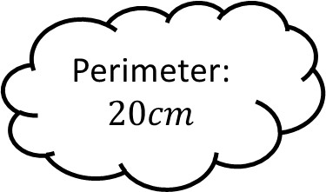
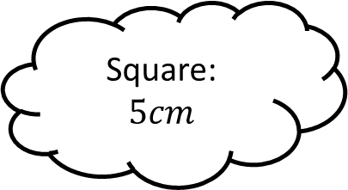
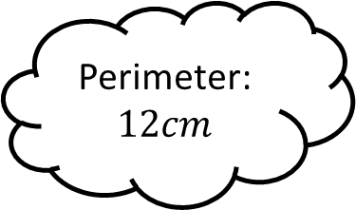
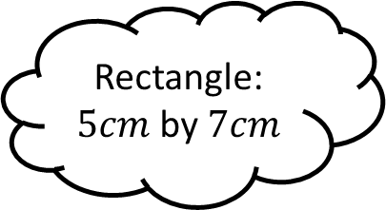
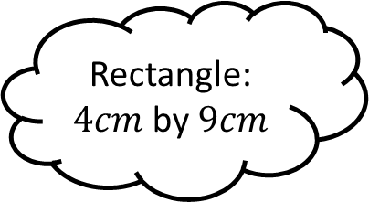
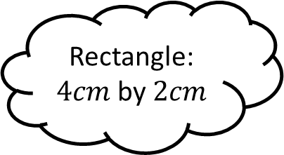
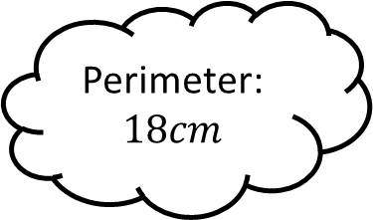
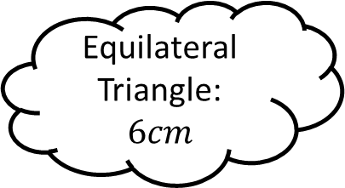
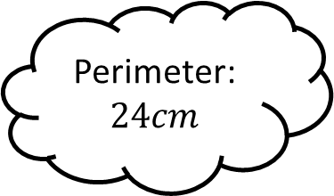
Matching 1
Perimeter:
$$12cm$$
Rectangle:
$5cm$ by $7cm$
Rectangle:
$4cm$ by $2cm$
Perimeter:
$$20cm$$
Square:
$$5cm$$
Perimeter:
$$24cm$$
Rectangle:
$4cm$ by $9cm$
Equilateral Triangle:
$$6cm$$
Perimeter:
$$18cm$$

Slide 3
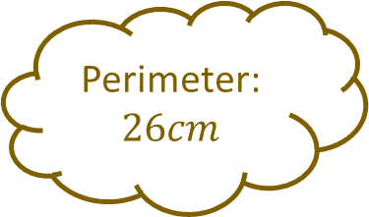
Matching 1 - Answers
Perimeter:
$$12cm$$
Rectangle:
$5cm$ by $7cm$
Rectangle:
$4cm$ by $2cm$
Perimeter:
$$20cm$$
Square:
$$5cm$$
Perimeter:
$$24cm$$
Rectangle:
$4cm$ by $9cm$
Perimeter:
$$26cm$$
Equilateral Triangle:
$$6cm$$
Perimeter:
$$18cm$$

Slide 4
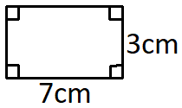
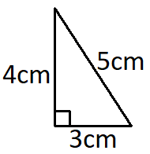
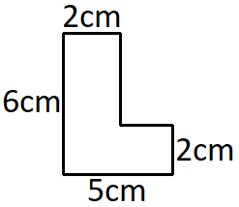
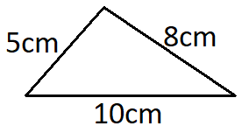
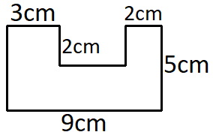
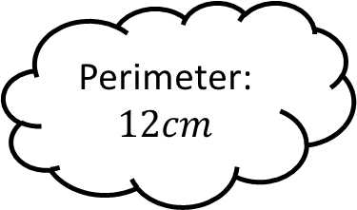
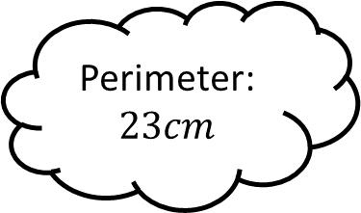
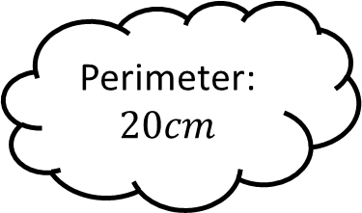
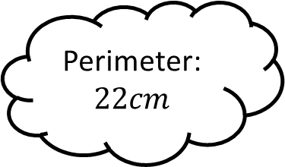
Matching 2
Perimeter:
$$23cm$$
Perimeter:
$$12cm$$
Perimeter:
$$22cm$$
Perimeter:
$$20cm$$

Slide 5
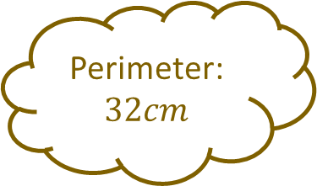
Matching 2 - Answers
Perimeter:
$$23cm$$
Perimeter:
$$12cm$$
Perimeter:
$$22cm$$
Perimeter:
$$32cm$$
Perimeter:
$$20cm$$

Slide 6
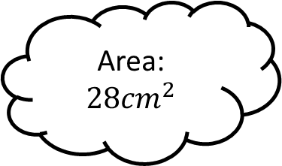
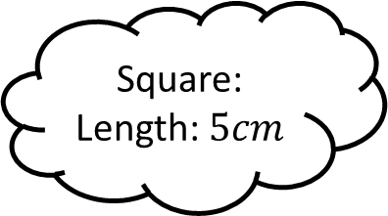
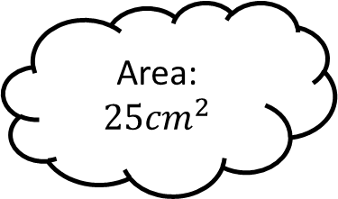
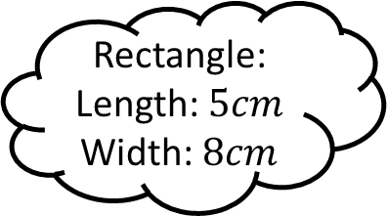
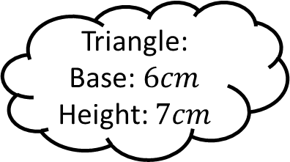
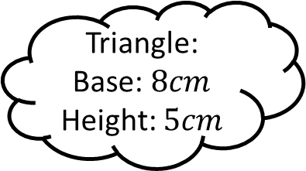
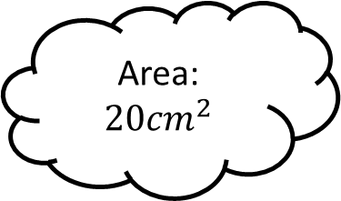
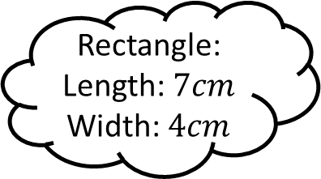
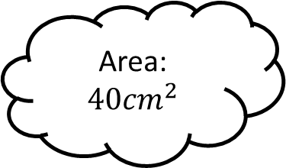
Matching 3
Area:
$$25{cm}^{2}$$
Rectangle:
Length: $5cm$
Width: $8cm$
Triangle:
Base: $8cm$
Height: $5cm$
Area:
$$28{cm}^{2}$$
Square:
Length: $5cm$
Area:
$$40{cm}^{2}$$
Triangle:
Base: $6cm$
Height: $7cm$
Rectangle:
Length: $7cm$
Width: $4cm$
Area:
$$20{cm}^{2}$$

Slide 7
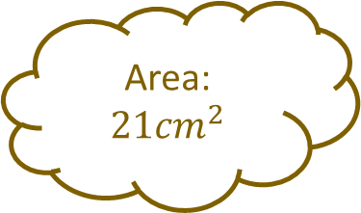
Matching 3 - Answers
Area:
$$25{cm}^{2}$$
Rectangle:
Length: $5cm$
Width: $8cm$
Triangle:
Base: $8cm$
Height: $5cm$
Area:
$$28{cm}^{2}$$
Square:
Length: $5cm$
Area:
$$40{cm}^{2}$$
Triangle:
Base: $6cm$
Height: $7cm$
Rectangle:
Length: $7cm$
Width: $4cm$
Area:
$$21{cm}^{2}$$
Area:
$$20{cm}^{2}$$

Slide 8
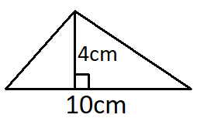
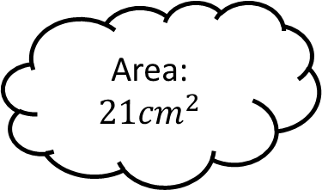
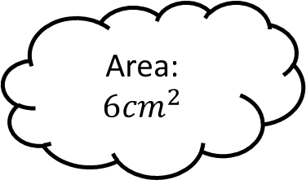
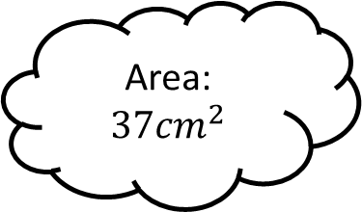
Matching 4
Area:
$$6{cm}^{2}$$
Area:
$$21{cm}^{2}$$
Area:
$$37{cm}^{2}$$
Area:
$$20{cm}^{2}$$

Slide 9

Matching 4 - Answers
Area:
$$6{cm}^{2}$$
Area:
$$21{cm}^{2}$$
Area:
$$18{cm}^{2}$$
Area:
$$37{cm}^{2}$$
Area:
$$20{cm}^{2}$$

Slide 10
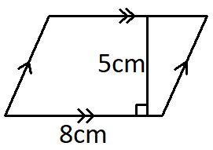
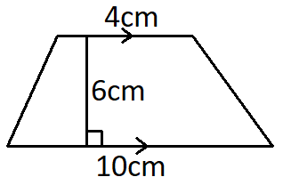
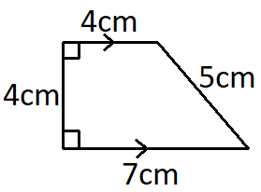
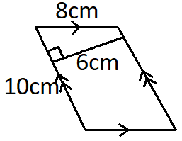
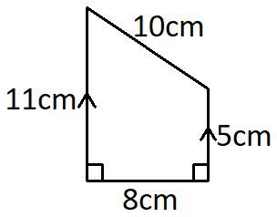
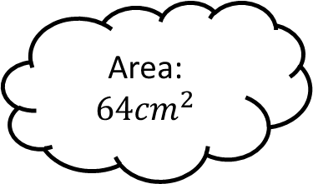
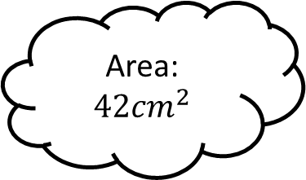
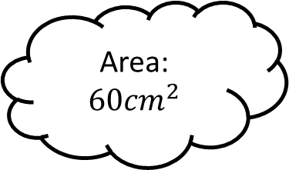
Matching 5
Area:
$$42{cm}^{2}$$
Area:
$$64{cm}^{2}$$
Area:
$$40{cm}^{2}$$
Area:
$$60{cm}^{2}$$

Slide 11

Matching 5 - Answers
Area:
$$42{cm}^{2}$$
Area:
$$64{cm}^{2}$$
Area:
$$40{cm}^{2}$$
Area:
$$22{cm}^{2}$$
Area:
$$60{cm}^{2}$$

Slide 12
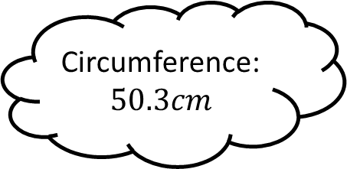
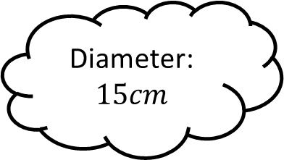
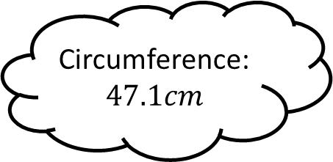
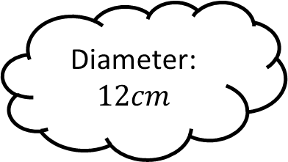
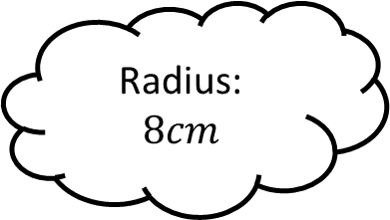
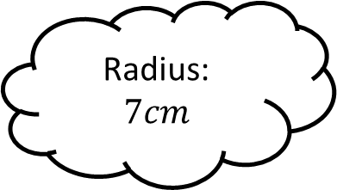
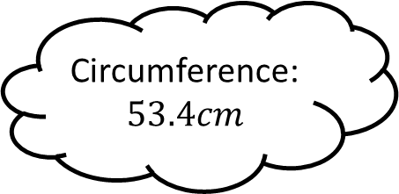
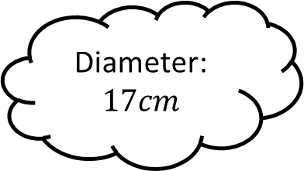

Matching 6
Circumference:
$$47.1cm$$
Diameter:
$$12cm$$
Radius:
$$7cm$$
Circumference:
$$50.3cm$$
Diameter:
$$15cm$$
Circumference:
$$44.0cm$$
Radius:
$$8cm$$
Diameter:
$$17cm$$
Circumference:
$$53.4cm$$

Slide 13

Matching 6 - Answers
Circumference:
$$47.1cm$$
Circumference:
$$47.1cm$$
Diameter:
$$12cm$$
Radius:
$$7cm$$
Circumference:
$$50.3cm$$
Diameter:
$$15cm$$
Circumference:
$$44.0cm$$
Radius:
$$8cm$$
Diameter:
$$17cm$$
Circumference:
$$53.4cm$$

Slide 14








Matching 7
Area:
$$78.5{cm}^{2}$$
Diameter:
$$6cm$$
Radius:
$$6cm$$
Area:
$$153.9{cm}^{2}$$
Diameter:
$$10cm$$
Area:
$$28.3{cm}^{2}$$
Radius:
$$8cm$$
Diameter:
$$14cm$$
Area:
$$201.1{cm}^{2}$$

Slide 15

Matching 7 - Answers
Area:
$$113.1{cm}^{2}$$
Area:
$$78.5{cm}^{2}$$
Diameter:
$$6cm$$
Radius:
$$6cm$$
Area:
$$153.9{cm}^{2}$$
Diameter:
$$10cm$$
Area:
$$28.3{cm}^{2}$$
Radius:
$$8cm$$
Diameter:
$$14cm$$
Area:
$$201.1{cm}^{2}$$

Slide 16









Matching 8
Area:
$$44.1{cm}^{2}$$
Perimeter:
$$14.3cm$$
Area:
$$30.8{cm}^{2}$$
Perimeter:
$$25.7cm$$

Slide 17

Matching 8 - Answers
Perimeter:
$$117.0cm$$
Area:
$$54.6{cm}^{2}$$
Area:
$$44.1{cm}^{2}$$
Perimeter:
$$14.3cm$$
Area:
$$30.8{cm}^{2}$$
Perimeter:
$$25.7cm$$

Slide 18









Matching n

Slide 19









Matching n

