Slide 1
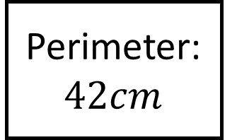
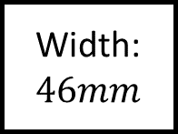
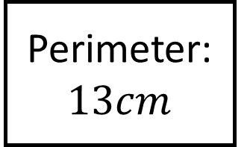
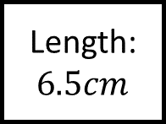
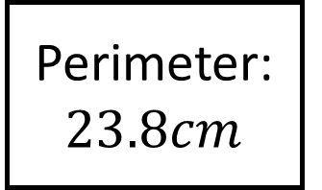
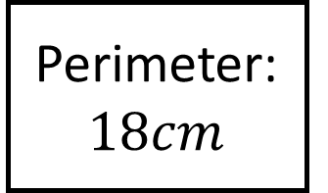
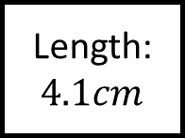
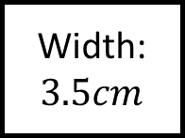
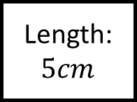
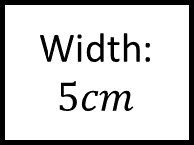
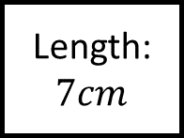
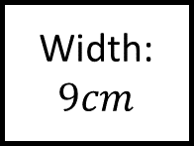
Perimeter: $23.8cm$
Area and Perimeter Spider 1
Perimeter:
Width: $46mm$
Width: $5cm$
Length:
Length: $7cm$
Perimeter: $13cm$
Fill in the blanks…
Perimeter: $18cm$
Width:
Length: $4.1cm$
Length: $5cm$
Width:
Length: $6.5cm$
Length:
Perimeter:
Perimeter: $42cm$
Width: $3.5cm$
Find the missing information for these rectangles
Width: $9cm$

Slide 2
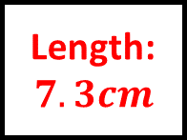
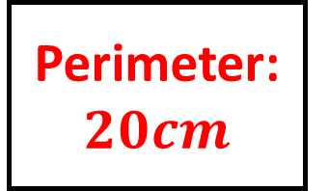
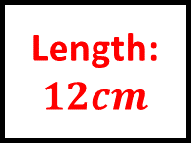
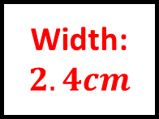
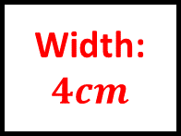
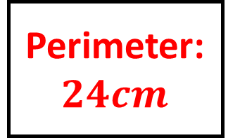
Perimeter: $23.8cm$
Area and Perimeter Spider 1 – Answers
Perimeter: $24cm$
Width: $46mm$
Width: $5cm$
Length: $7.3cm$
Length: $7cm$
Perimeter: $13cm$
Fill in the blanks…
Perimeter: $18cm$
Width: $2.4cm$
Length: $4.1cm$
Length: $5cm$
Width: $4cm$
Length: $6.5cm$
Length: $12cm$
Perimeter: $20cm$
Perimeter: $42cm$
Width: $3.5cm$
Find the missing information for these rectangles
Width: $9cm$

Slide 3
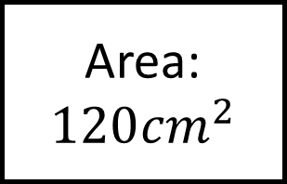
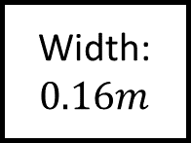
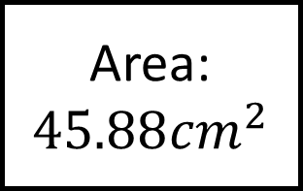
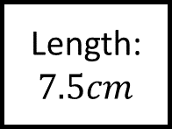
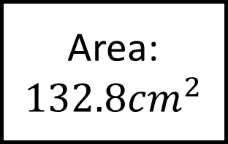
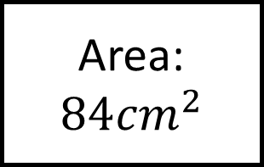
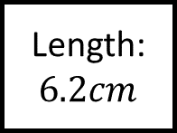
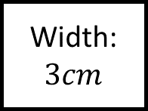
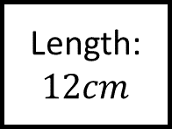
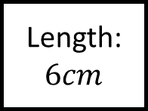
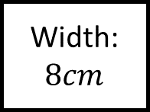
Area:
$$132.8{cm}^{2}$$
Area and Perimeter Spider 2
Area:
Width: $0.16m$
Width: $5cm$
Length:
Length: $6cm$
Area:
$$45.88{cm}^{2}$$
Fill in the blanks…
Area:
$$84{cm}^{2}$$
Width:
Length: $6.2cm$
Length: $12cm$
Width:
Length: $7.5cm$
Length:
Area:
Area:
$$120{cm}^{2}$$
Width: $3cm$
Find the missing information for these rectangles
Width: $8cm$

Slide 4
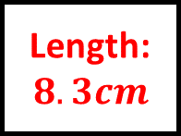
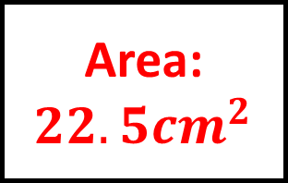
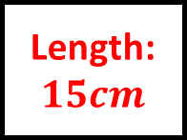
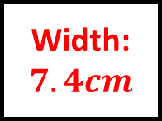
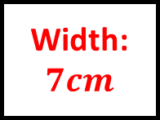
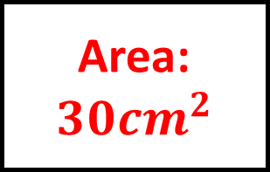
Area:
$$132.8{cm}^{2}$$
Area and Perimeter Spider 2 – Answers
Area:
$$30{cm}^{2}$$
Width: $0.16m$
Width: $5cm$
Length: $8.3cm$
Length: $6cm$
Area:
$$45.88{cm}^{2}$$
Fill in the blanks…
Area:
$$84{cm}^{2}$$
Width: $7.4cm$
Length: $6.2cm$
Length: $12cm$
Width: $7cm$
Length: $7.5cm$
Length: $15cm$
Area:
$$22.5{cm}^{2}$$
Area:
$$120{cm}^{2}$$
Width: $3cm$
Find the missing information for these rectangles
Width: $8cm$

Slide 5
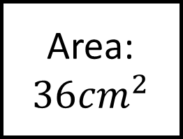
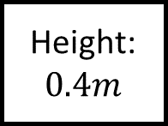
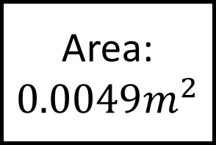
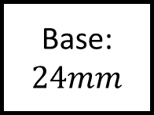
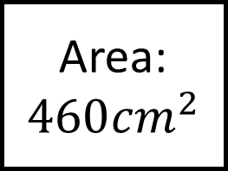
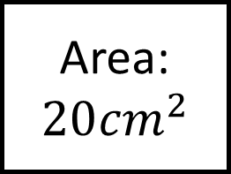
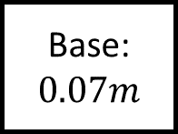
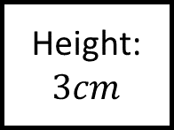
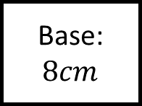
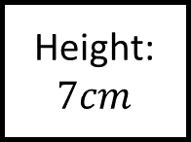
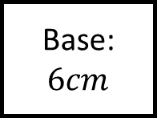
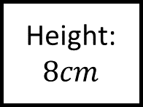
Area:
$$460{cm}^{2}$$
Area and Perimeter Spider 3
Area:
Height: $0.4m$
Height: $7cm$
Base:
Base:
$$6cm$$
Area:
$$0.0049m^{2}$$
Fill in the blanks…
Area:
$$20{cm}^{2}$$
Height:
Base:
$$0.07m$$
Base:
$$8cm$$
Height:
Base:
$$24mm$$
Base:
Area:
Area:
$$36{cm}^{2}$$
Height: $3cm$
Find the missing information for these triangles
Height: $8cm$

Slide 6
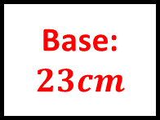
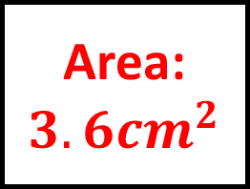
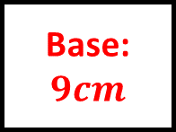



Area:
$$460{cm}^{2}$$
Area and Perimeter Spider 3 – Answers
Area:
$$21{cm}^{2}$$
Height: $0.4m$
Height: $7cm$
Base:
$$23cm$$
Base:
$$6cm$$
Area:
$$0.0049m^{2}$$
Fill in the blanks…
Area:
$$20{cm}^{2}$$
Height: $14cm$
Base:
$$0.07m$$
Base:
$$8cm$$
Height: $5cm$
Base:
$$24mm$$
Base:
$$9cm$$
Area:
$$3.6{cm}^{2}$$
Area:
$$36{cm}^{2}$$
Height: $3cm$
Find the missing information for these triangles
Height: $8cm$

Slide 7























Area:
$$10.85{cm}^{2}$$
Area and Perimeter Spider 4
Area:
$$h=31mm$$
$$h=4cm$$
$$b=43mm$$
$$b=5cm$$
$$a=$$
$$a=3cm$$
Area:
$$12.6{cm}^{2}$$
Fill in the blanks…
Area:
$$56{cm}^{2}$$
$$h=$$
$$b=4.9cm$$
$$a=3.5cm$$
$$a=6cm$$
$$b=10cm$$
$$h=$$
$$a=7cm$$
$$a=5cm$$
$$b=6cm$$
$$b=$$
Find the missing information for these trapeziums
Area:
Area:
$$72{cm}^{2}$$
$$h=4cm$$
$$h=8$$

Slide 8






Area:
$$10.85{cm}^{2}$$
Area and Perimeter Spider 4 – Answers
Area:
$$16{cm}^{2}$$
$$h=31mm$$
$$h=4cm$$
$$b=43mm$$
$$b=5cm$$
$$a=27mm$$
$$a=3cm$$
Area:
$$12.6{cm}^{2}$$
Fill in the blanks…
Area:
$$56{cm}^{2}$$
$$h=3cm$$
$$b=4.9cm$$
$$a=3.5cm$$
$$a=6cm$$
$$b=10cm$$
$$h=7cm$$
$$a=7cm$$
$$a=5cm$$
$$b=6cm$$
$$b=13cm$$
Find the missing information for these trapeziums
Area:
$$26{cm}^{2}$$
Area:
$$72{cm}^{2}$$
$$h=4cm$$
$$h=8$$

Slide 9









Area:
Area: $18.9{cm}^{2}$
Circumference:
Area and Perimeter Spider 5
Radius: $5cm$
Diameter:
Diameter: $12cm$
Circumference:
$$23.2cm$$
Fill in the blanks…
Circumference:
Radius:
Radius:
$$4cm$$
Find the missing information for these circles to $1dp$.
Radius:
Diameter:
$$6cm$$
Diameter:
Area: $1256.6{cm}^{2}$
Area:
Circumference:
$$27.3cm$$

Slide 10








Area: $78.5{cm}^{2}$
Area: $18.9{cm}^{2}$
Circumference:
$$37.7cm$$
Area and Perimeter Spider 5 - Answers
Radius: $5cm$
Diameter:
$$4.9cm$$
Diameter: $12cm$
Circumference:
$$23.2cm$$
Fill in the blanks…
Circumference:
$$25.1cm$$
Radius:
$$3.7cm$$
Radius:
$$4cm$$
Find the missing information for these circles to $1dp$.
Radius:
$$0.2m$$
Diameter:
$$6cm$$
Diameter:
$$8.7cm$$
Area: $1256.6{cm}^{2}$
Area: ${28.3cm}^{2}$
Circumference:
$$27.3cm$$

Slide 11







Area:
Area and Perimeter Spider 6
Area:
Perimeter:
Fill in the blanks…
Perimeter:
Area:
Find the missing information for these shapes to $1dp$ where appropriate.
Area:

Slide 12






Area:
$$138{cm}^{2}$$
Area and Perimeter Spider 6 - Answers
Area:
$$34{cm}^{2}$$
Perimeter:
$$70.8m$$
Fill in the blanks…
Perimeter:
$$25.0cm$$
Area:
$$5963.5m^{2}$$
Find the missing information for these shapes to $1dp$ where appropriate.
Area:
$$79.3{cm}^{2}$$

Slide 13
















Area and Perimeter Spider - Blank
Fill in the blanks…
Find the missing information for these circles.

Slide 14


















Area and Perimeter Spider – Answers
Fill in the blanks…
Find the missing information for these shapes

Slide 15
























Area:
$${cm}^{2}$$
Area and Perimeter Spider – Answers
Area:
$${cm}^{2}$$
Area:
$${cm}^{2}$$
Fill in the blanks…
Area:
$${cm}^{2}$$
Find the missing information for these trapeziums
Area:
$${cm}^{2}$$
Area:
$${cm}^{2}$$

