Slide 1
Angles Matching
Match one group to the other.
There will be a “spare” one – what answer should be there?

Slide 2
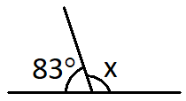
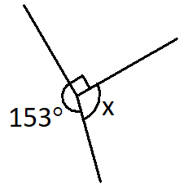
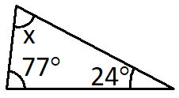
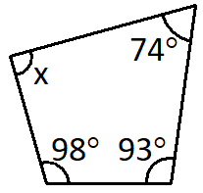
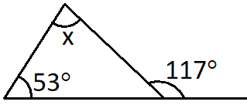
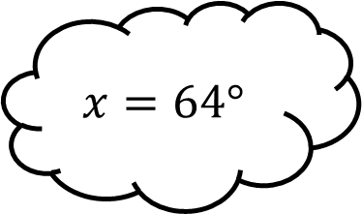
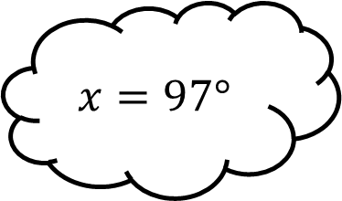
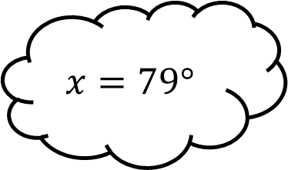
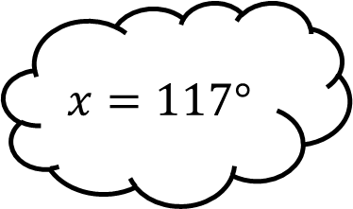
Matching 1
$$x=117°$$
$$x=79°$$
$$x=97°$$
$$x=64°$$

Slide 3
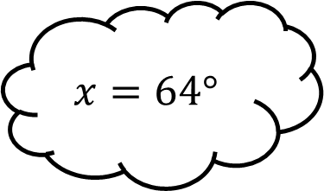
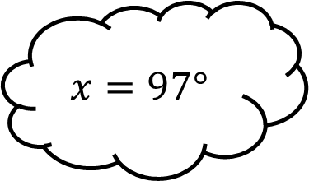
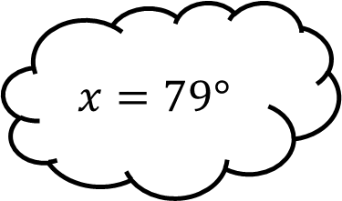
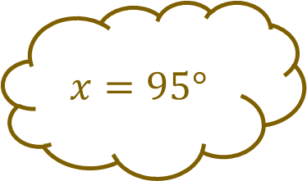
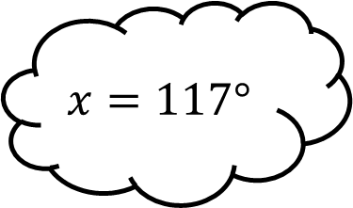
Matching 1 - Answers
$$x=117°$$
$$x=79°$$
$$x=97°$$
$$x=95°$$
$$x=64°$$

Slide 4
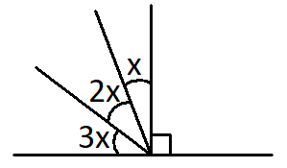
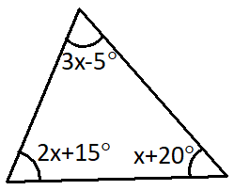
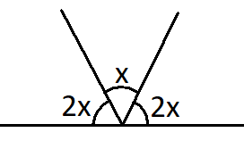
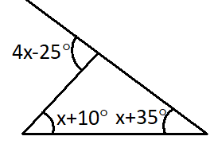
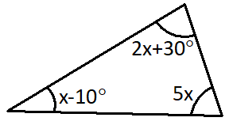
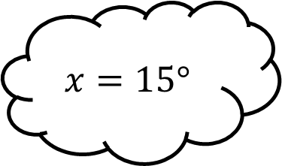
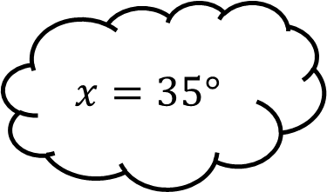
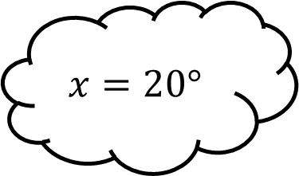
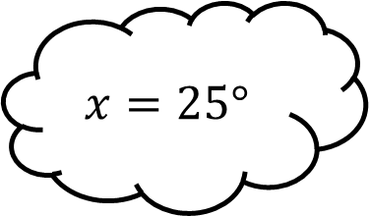
Matching 2
$$x=35°$$
$$x=15°$$
$$x=25°$$
$$x=20°$$

Slide 5
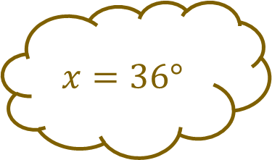
Matching 2 - Answers
$$x=35°$$
$$x=15°$$
$$x=25°$$
$$x=36°$$
$$x=20°$$

Slide 6
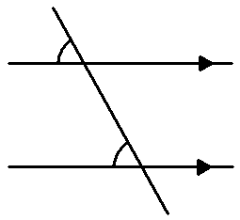
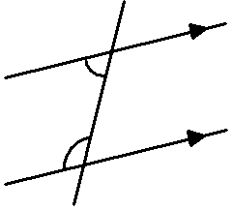
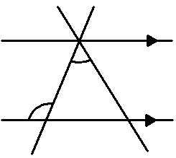
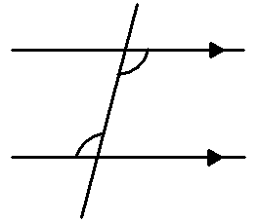
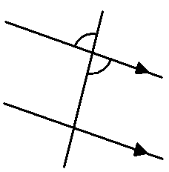
Matching 3
Alternate
Corresponding
Vertically Opposite
Supplementary

Slide 7
Matching 3 - Answers
Alternate
Corresponding
None
Vertically Opposite
Supplementary

Slide 8
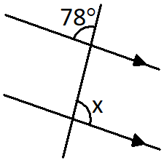
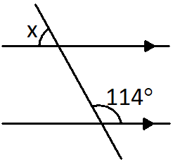
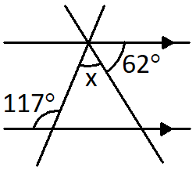
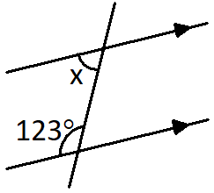
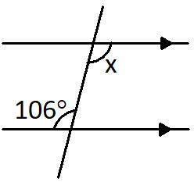
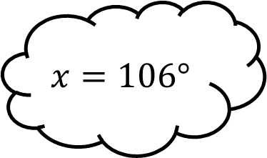
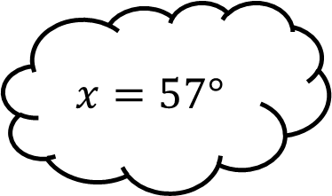
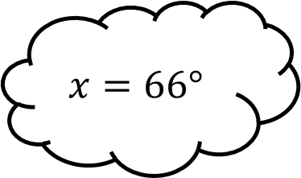
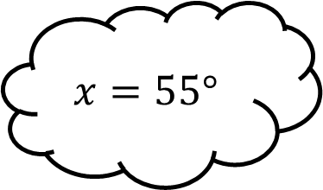
Matching 4
$$x=57°$$
$$x=106°$$
$$x=55°$$
$$x=66°$$

Slide 9
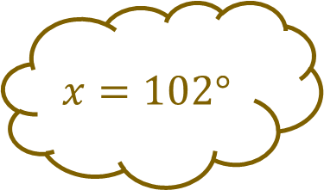
Matching 4 - Answers
$$x=102°$$
$$x=57°$$
$$x=106°$$
$$x=55°$$
$$x=66°$$

Slide 10
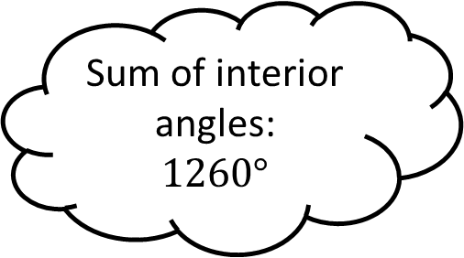
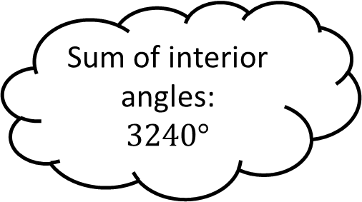
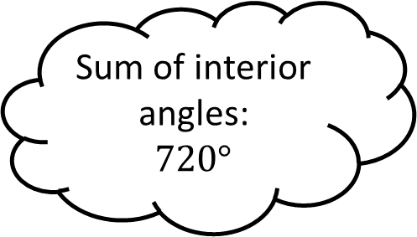
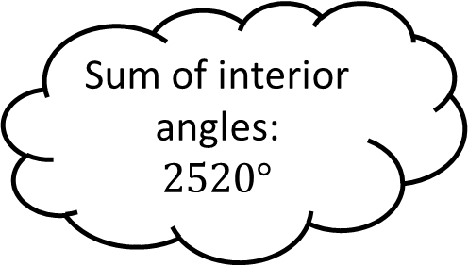
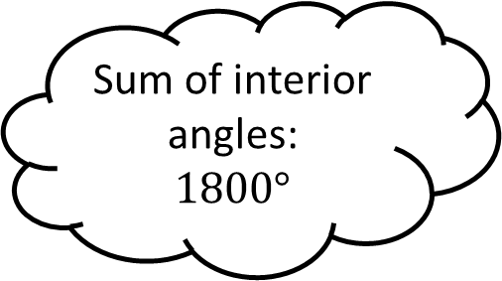
Matching 5
Sum of interior angles:
$$3240°$$
Icosagon
Sum of interior angles:
$$2520°$$
Hexagon
Sum of interior angles:
$$1260°$$
Sum of interior angles:
$$720°$$
Dodecagon
Sum of interior angles:
$$1800°$$
Nonagon

Slide 11
Matching 5 - Answers
Sum of interior angles:
$$3240°$$
Icosagon
Sum of interior angles:
$$2520°$$
Hexadecagon
Hexagon
Sum of interior angles:
$$1260°$$
Sum of interior angles:
$$720°$$
Dodecagon
Sum of interior angles:
$$1800°$$
Nonagon

Slide 12
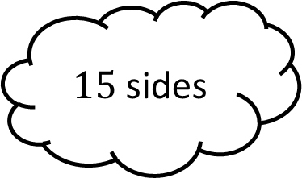
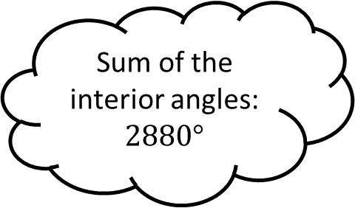
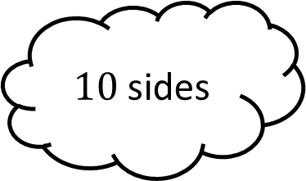
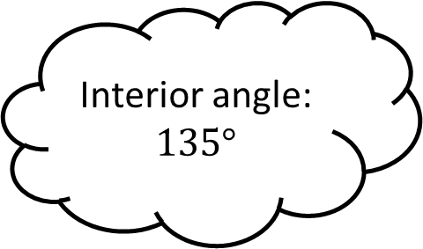
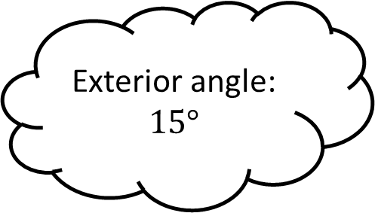
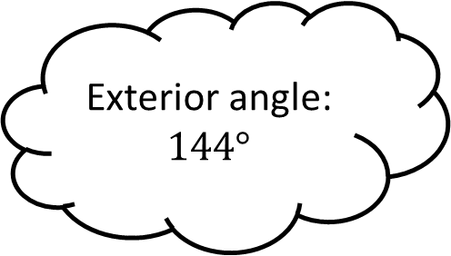



Matching 6
(Regular Polygons)
Interior angle:
$$135°$$
$10$ sides
Exterior angle:
$$144°$$
$15$ sides
Sum of the interior angles:
$$2880°$$
Exterior angle:
$$15°$$
$8$ sides
Interior angle:
$$156°$$
$18$ sides

Slide 13

Matching 6 - Answers
(Regular Polygons)
Interior angle:
$$135°$$
$10$ sides
Exterior angle:
$$144°$$
$15$ sides
Sum of the interior angles:
$$2880°$$
Exterior angle:
$$15°$$
$8$ sides
Interior angle:
$$156°$$
$24$ sides
$18$ sides

Slide 14









Matching 7
$$x=82°$$
$$x=47°$$
$$x=111°$$
$$x=54°$$

Slide 15

Matching 7 - Answers
$$x=82°$$
$$x=47°$$
$$x=63°$$
$$x=111°$$
$$x=54°$$

Slide 16





Matching 8
$$x=34°$$
$$x=82°$$

Slide 17

Matching 8 - Answers
$$x=34°$$
$$x=82°$$
$$x=8cm$$

Slide 18




Matching n

