Slide 1

Exploding Simultaneous Equations
Can you fill in the blanks?

Slide 2
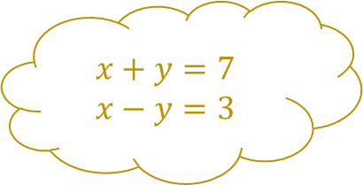

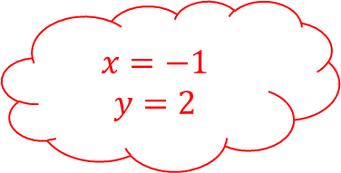
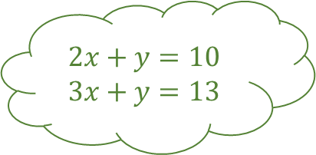
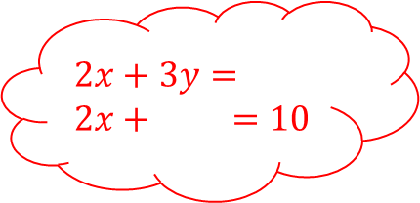


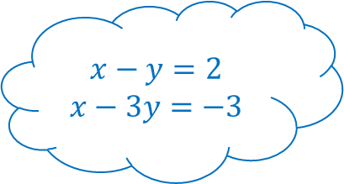
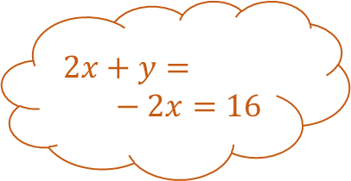

Exploding Simultaneous Equations 1
$$x+y=7$$
$$x−y=3$$
$$x=$$
$$y=$$
$$2x+y=$$
$$− 2x=16$$
$$2x+y=10$$
$$3x+y=13$$
Solve the simultaneous equations and fill in the blanks
$$x−y=2$$
$$x−3y=−3$$
$$x=$$
$$y=$$
$$x=−2$$
$$y=4$$
$$2x+3y=$$
$$2x + =10$$
$$x=−1$$
$$y=2$$
$$x=$$
$$y=$$

Slide 3
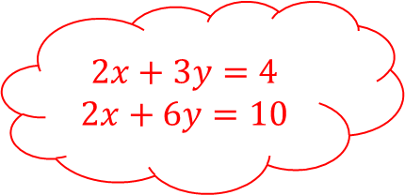
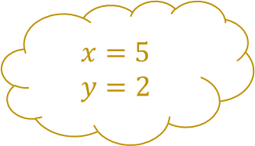
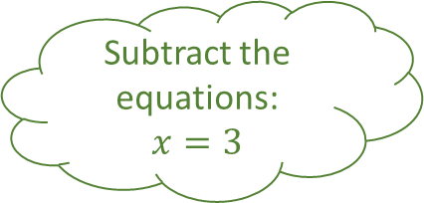
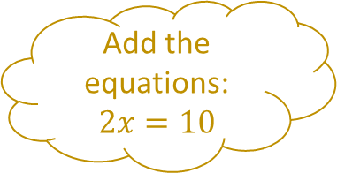
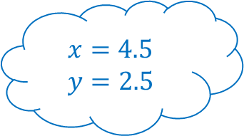
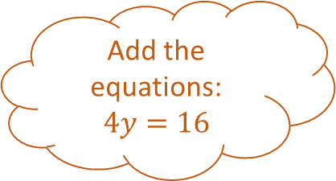
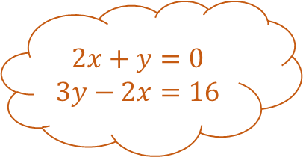
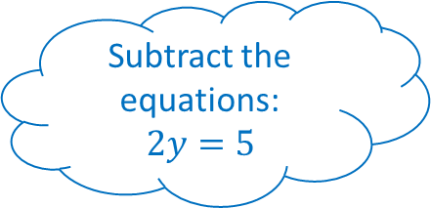
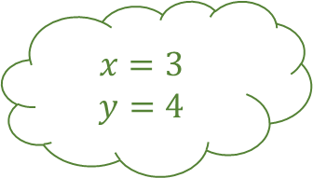
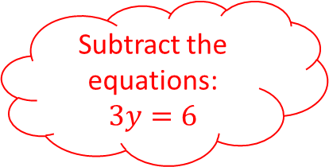
Exploding Simultaneous Equations 1 – Answers
$$x+y=7$$
$$x−y=3$$
Add the equations:
$$2x=10$$
$$x=5$$
$$y=2$$
$$2x+y=0$$
$$3y−2x=16$$
$$2x+y=10$$
$$3x+y=13$$
Add the equations:
$$4y=16$$
Subtract the equations:
$$x=3$$
Solve the simultaneous equations and fill in the blanks
$$x−y=2$$
$$x−3y=−3$$
$$x=3$$
$$y=4$$
$$x=−2$$
$$y=4$$
$$2x+3y=4$$
$$2x+6y=10$$
Subtract the equations:
$$2y=5$$
$$x=−1$$
$$y=2$$
Subtract the equations:
$$3y=6$$
$$x=4.5$$
$$y=2.5$$

Slide 4

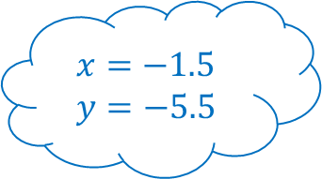


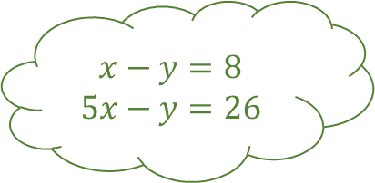

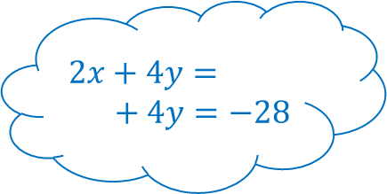



Exploding Simultaneous Equations 2
$$x+y=1$$
$$y−x=4$$
$$x=$$
$$y=$$
$$+ y=$$
$$5x =2$$
$$x−y=8$$
$$5x−y=26$$
Add the equations:
$$9x=6$$
Solve the simultaneous equations and fill in the blanks
$$2x+4y=$$
$$+ 4y=−28$$
$$x=$$
$$y=$$
$$x=$$
$$y=$$
$$x+y=1$$
$$y−3x=0$$
Subtract the equations:
$$2x=−3$$
$$x=$$
$$y=$$
$$x=−1.5$$
$$y=−5.5$$

Slide 5
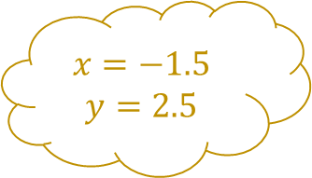
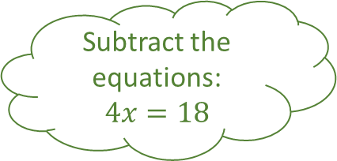
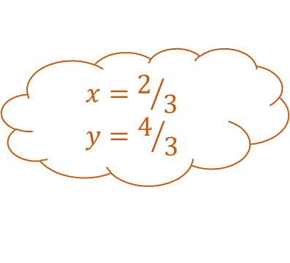
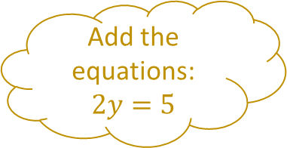
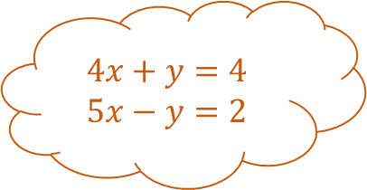
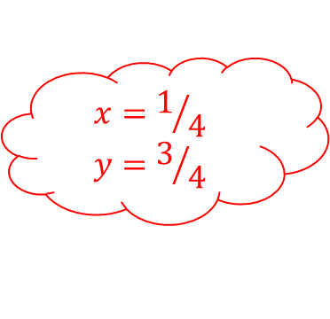
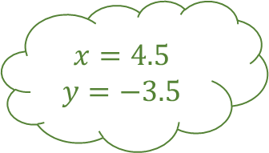

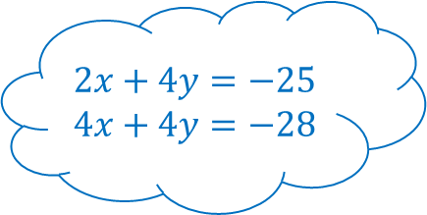
Exploding Simultaneous Equations 2 – Answers
$$x+y=1$$
$$y−x=4$$
Add the equations:
$$2y=5$$
$$x=−1.5$$
$$y=2.5$$
$$4x+y=4$$
$$5x−y=2$$
$$x−y=8$$
$$5x−y=26$$
Add the equations:
$$9x=6$$
Subtract the equations:
$$4x=18$$
Solve the simultaneous equations and fill in the blanks
$$2x+4y=−25$$
$$4x+4y=−28$$
$$x=4.5$$
$$y=−3.5$$
$$x=2/3$$
$$y=4/3$$
$$x+y=1$$
$$y−3x=0$$
Subtract the equations:
$$2x=−3$$
$$x=1/4$$
$$y=3/4$$
Subtract the equations:
$$4x=1$$
$$x=−1.5$$
$$y=−5.5$$

Slide 6
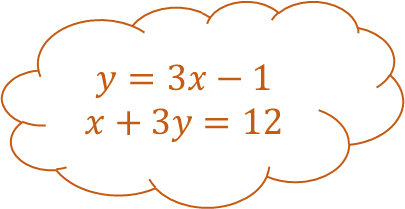
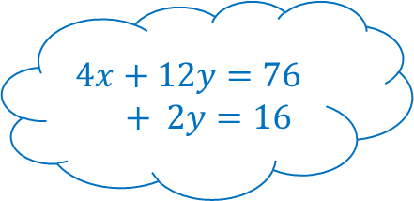


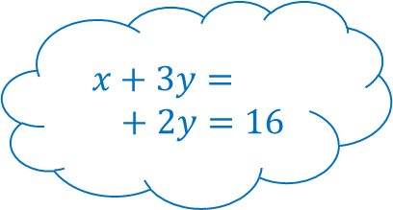



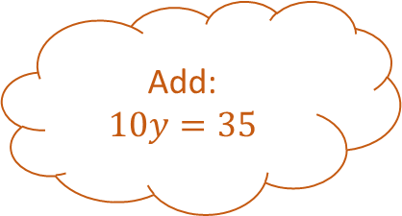
Exploding Simultaneous Equations 3
$$2x+y=8$$
$$3x+2y=14$$
$$y=3x−1$$
$$x+3y=12$$
$$x+3y=$$
$$+ 2y=16$$
Solve the simultaneous equations and fill in the blanks
Add:
$$10y=35$$
$$x=$$
$$y=$$
$$4x+12y=76$$
$$+ 2y=16$$
$$2x+5y=11$$
$$2y−4x=14$$
$$x=$$
$$y=$$
$$x=$$
$$y=$$
$$x=$$
$$y=$$

Slide 7




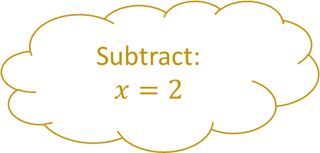
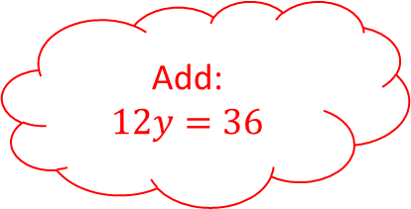

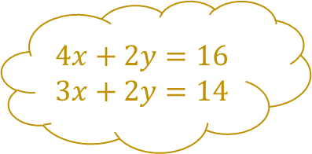
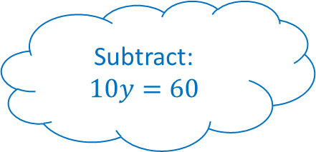



Exploding Simultaneous Equations 3 – Answers
$$2x+y=8$$
$$3x+2y=14$$
$$4x+2y=16$$
$$3x+2y=14$$
$$y−3x=−1$$
$$3x+9y=36$$
$$y=3x−1$$
$$x+3y=12$$
Subtract:
$$x=2$$
$$x+3y=19$$
$$4x+2y=16$$
Solve the simultaneous equations and fill in the blanks
Add:
$$10y=35$$
$$x=2$$
$$y=4$$
$$4x+12y=76$$
$$4x+2y=16$$
$$2x+5y=11$$
$$2y−4x=14$$
$$x=1.5$$
$$y=3.5$$
Subtract:
$$10y=60$$
Add:
$$12y=36$$
$$4x+10y=22$$
$$2y−4x=14$$
$$x=1$$
$$y=6$$
$$x=−2$$
$$y=3$$

Slide 8
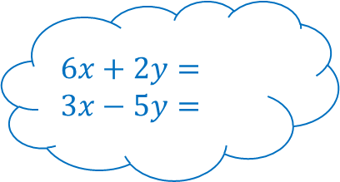
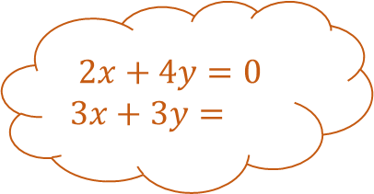

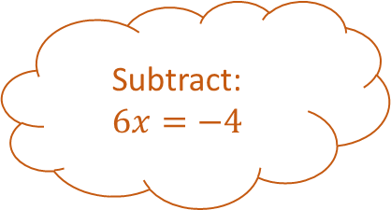

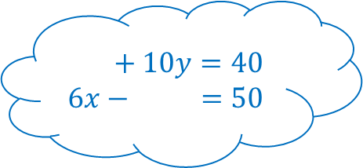
Exploding Simultaneous Equations 4
$$2x+4y=11$$
$$5y−3x=22$$
$$2x+4y=0$$
$$3x+3y=$$
$$6x+2y=$$
$$3x−5y=$$
Solve the simultaneous equations and fill in the blanks
Subtract:
$$6x=−4$$
$$x=$$
$$y=$$
$$+ 10y=40$$
$$6x − =50$$
$$2x+2y=2$$
$$9x−y=3$$
$$x=$$
$$y=$$
$$x=$$
$$y=$$
$$x=$$
$$y=$$

Slide 9
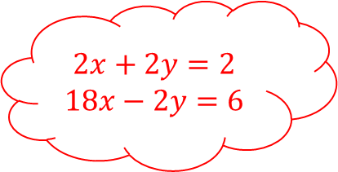
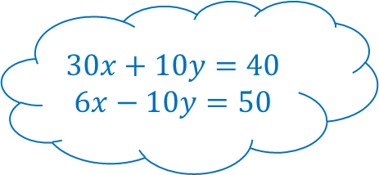
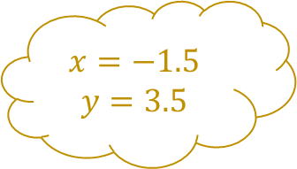

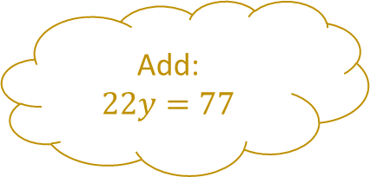

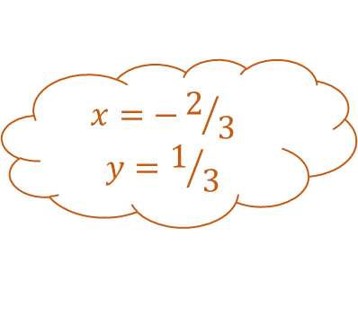

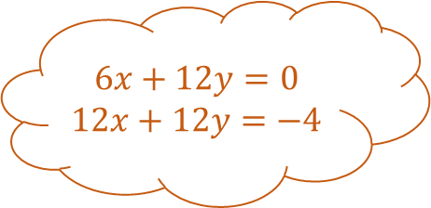
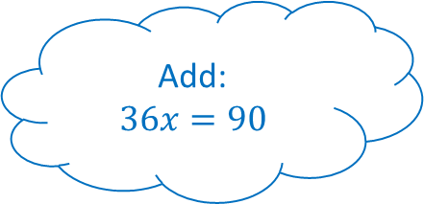
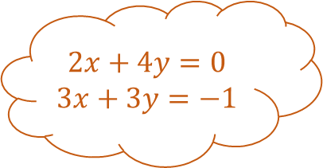
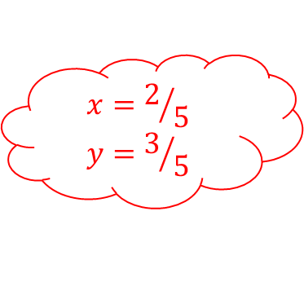
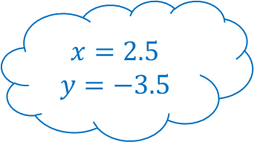
Exploding Simultaneous Equations 4 – Answers
$$2x+4y=11$$
$$5y−3x=22$$
$$6x+12y=33$$
$$10y−6x=44$$
$$6x+12y=0$$
$$12x+12y=−4$$
$$2x+4y=0$$
$$3x+3y=−1$$
Add:
$$22y=77$$
$$6x+2y=8$$
$$3x−5y=25$$
Solve the simultaneous equations and fill in the blanks
Subtract:
$$6x=−4$$
$$x=−1.5$$
$$y=3.5$$
$$30x+10y=40$$
$$6x−10y=50$$
$$2x+2y=2$$
$$9x−y=3$$
$$x=−2/3$$
$$y=1/3$$
Add:
$$36x=90$$
Add:
$$20x=8$$
$$2x+2y=2$$
$$18x−2y=6$$
$$x=2.5$$
$$y=−3.5$$
$$x=2/5$$
$$y=3/5$$

Slide 10
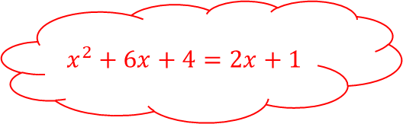






Exploding Simultaneous Equations 5
$$y=3−x$$
$$y=x^{2}−2x−17$$
$$y=x+2$$
$$y=x^{2}$$
$$x= \&$$
$$y= \&$$
Solve the simultaneous equations and fill in the blanks
$$y=$$
$$y=$$
$$x= \&$$
$$y= \&$$
$$x= \&$$
$$y= \&$$
$$x^{2}+6x+4=2x+1$$

Slide 11












Exploding Simultaneous Equations 5 – Answers
$$y=x+2$$
$$y=x^{2}$$
$$x^{2}=x+2$$
$$y=3−x$$
$$y=x^{2}−2x−17$$
$$x^{2}−2x−17=3−x$$
$$x^{2}−x−2=0$$
$$x=−1 \& −3$$
$$y=−1 \& −5$$
Solve the simultaneous equations and fill in the blanks
$$x^{2}−x−20=0$$
$$\left(x+1\right)\left(x−2\right)=0$$
$$\left(x+1\right)\left(x+3\right)=0$$
$$y=2x+1$$
$$y=x^{2}+6x+4$$
$$\left(x+4\right)\left(x−5\right)=0$$
$$x=−1 \& 2$$
$$y=1 \& 4$$
$$x^{2}+4x+3=0$$
$$x=−4 \& 5$$
$$y=7 \& −2$$
$$x^{2}+6x+4=2x+1$$

Slide 12











Exploding Simultaneous Equations 6
$$y=x−2$$
$$x^{2}+xy−3y^{2}=4$$
$${\left(10−2y\right)}^{2}+y^{2}=25$$
$$=10$$
$$x^{2}+y^{2}=25$$
$$x= \&$$
$$y= \&$$
Solve the simultaneous equations and fill in the blanks (give answers to $3sf$ where appropriate).
$$3x+y=$$
$$xy=−4$$
$$x= \&$$
$$y= \&$$
$$x= \&$$
$$y= \&$$
$$x\left(4−3x\right)=−4$$

Slide 13












Exploding Simultaneous Equations 6 – Answers
$$y=x−2$$
$$x^{2}+xy−3y^{2}=4$$
$$x^{2}+x\left(x−2\right)−3{\left(x−2\right)}^{2}=4$$
$${\left(10−2y\right)}^{2}+y^{2}=25$$
$$x+2y=10$$
$$x^{2}+y^{2}=25$$
$$x=−2/3 \& 2$$
$$y=6 \& −2$$
$$x^{2}−10x+16=0$$
Solve the simultaneous equations and fill in the blanks (give answers to $3sf$ where appropriate).
$$5y^{2}−40y+75=0$$
$$\left(3x+2\right)\left(x−2\right)=0$$
$$\left(x−2\right)\left(x−8\right)=0$$
$$\left(x−3\right)\left(x−5\right)=0$$
$$3x+y=4$$
$$xy=−4$$
$$3x^{2}−4x−4=0$$
$$x=2 \& 8$$
$$y=0 \& 6$$
$$x=4 \& 0$$
$$y=3 \& 5$$
$$x\left(4−3x\right)=−4$$

Slide 14
















Exploding Simultaneous Equations – Blank
Solve the simultaneous equations and fill in the blanks
$$x=$$
$$y=$$
$$x=$$
$$y=$$
$$x=$$
$$y=$$
$$x=$$
$$y=$$

Slide 15















Exploding Simultaneous Equations – Blank
$$y=$$
$$y=$$
$$y=$$
$$y=$$
$$x=$$
$$y=$$
Solve the simultaneous equations and fill in the blanks
$$y=$$
$$y=$$
$$x=$$
$$y=$$
$$x=$$
$$y=$$

Slide 16
Exploding Simultaneous Equations – Blank
Solve the simultaneous equations and fill in the blanks

Slide 17
Exploding Simultaneous Equations – Blank
Solve the simultaneous equations and fill in the blanks

