Slide 1

Exploding Algebraic Fractions
Can you fill in the blanks?

Slide 2
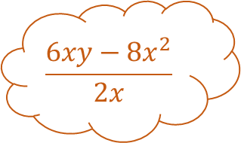
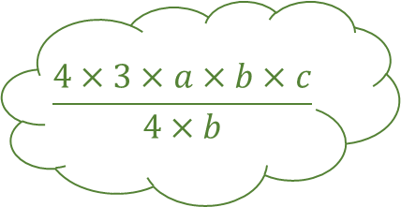
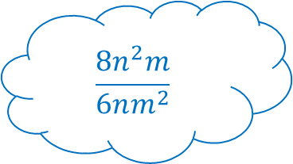
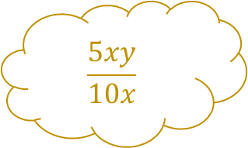
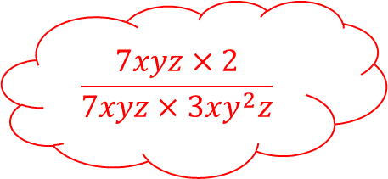
$$\frac{5xy}{10x}$$
Exploding Algebraic Fractions 1
$$\frac{6xy−8x^{2}}{2x}$$
$$\frac{4×3×a×b×c}{4×b}$$
Fill in the blanks for these simplifications…
$$\frac{8n^{2}m}{6nm^{2}}$$
$$\frac{7xyz×2}{7xyz×3xy^{2}z}$$

Slide 3
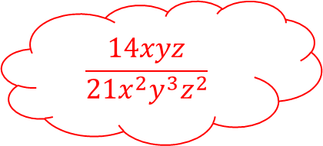



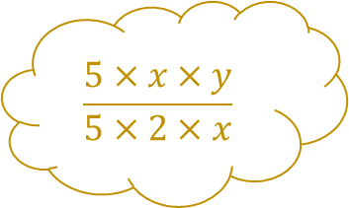
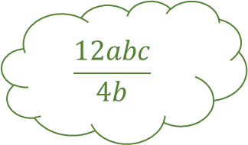
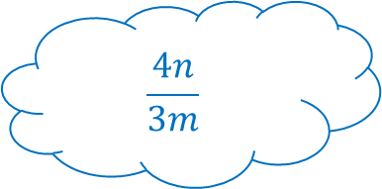
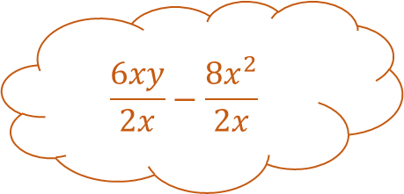
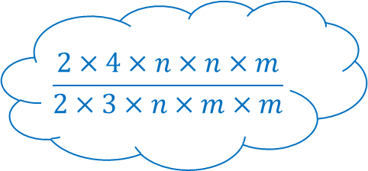
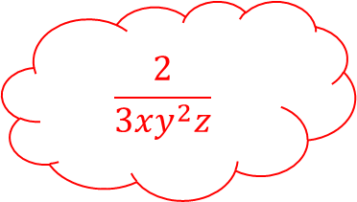

$$\frac{5xy}{10x}$$
$$\frac{5×x×y}{5×2×x}$$
Exploding Algebraic Fractions 1 – Answers
$$\frac{y}{2}$$
$$\frac{6xy−8x^{2}}{2x}$$
$$\frac{12abc}{4b}$$
$$\frac{6xy}{2x}−\frac{8x^{2}}{2x}$$
$$\frac{4×3×a×b×c}{4×b}$$
Fill in the blanks for these simplifications…
$$3ac$$
$$\frac{8n^{2}m}{6nm^{2}}$$
$$3y−4x$$
$$\frac{14xyz}{21x^{2}y^{3}z^{2}}$$
$$\frac{2×4×n×n×m}{2×3×n×m×m}$$
$$\frac{2}{3xy^{2}z}$$
$$\frac{7xyz×2}{7xyz×3xy^{2}z}$$
$$\frac{4n}{3m}$$

Slide 4
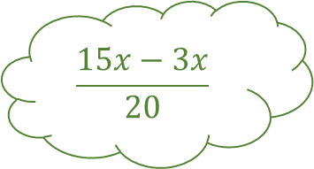
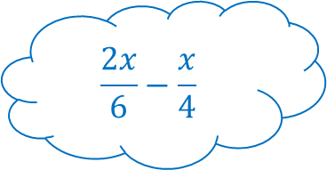

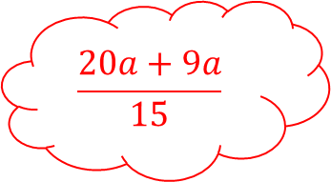
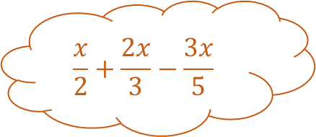
$$\frac{2x}{5}+\frac{3x}{10}$$
Exploding Algebraic Fractions 2
$$\frac{x}{2}+\frac{2x}{3}−\frac{3x}{5}$$
$$\frac{15x−3x}{20}$$
Fill in the blanks adding and subtracting these fractions…
$$\frac{2x}{6}−\frac{x}{4}$$
$$\frac{20a+9a}{15}$$

Slide 5
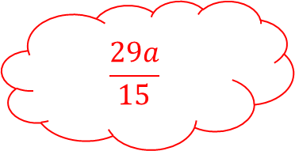

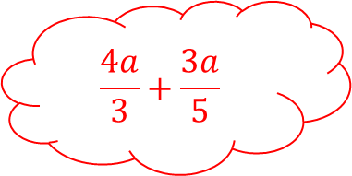
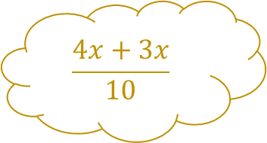
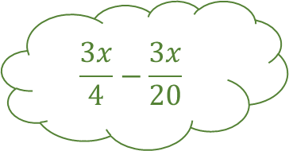


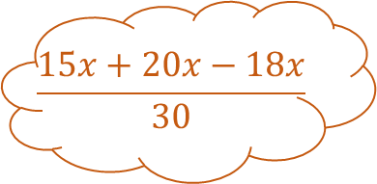
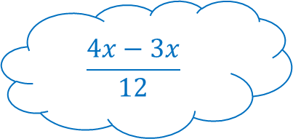
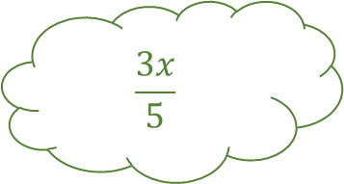
$$\frac{2x}{5}+\frac{3x}{10}$$
$$\frac{4x+3x}{10}$$
Exploding Algebraic Fractions 2 – Answers
$$\frac{7x}{10}$$
$$\frac{x}{2}+\frac{2x}{3}−\frac{3x}{5}$$
$$\frac{3x}{4}−\frac{3x}{20}$$
$$\frac{15x+20x−18x}{30}$$
$$\frac{15x−3x}{20}$$
Fill in the blanks adding and subtracting these fractions…
$$\frac{3x}{5}$$
$$\frac{2x}{6}−\frac{x}{4}$$
$$\frac{17x}{30}$$
$$\frac{4a}{3}+\frac{3a}{5}$$
$$\frac{4x−3x}{12}$$
$$\frac{29a}{15}$$
$$\frac{20a+9a}{15}$$
$$\frac{x}{12}$$

Slide 6
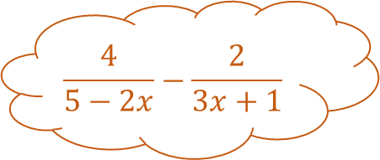
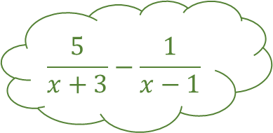
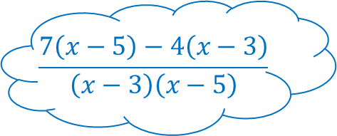
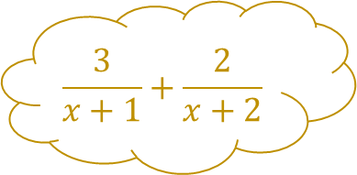
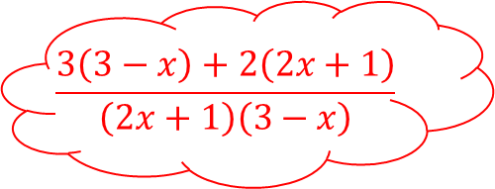
$$\frac{3}{x+1}+\frac{2}{x+2}$$
Exploding Algebraic Fractions 3
$$\frac{4}{5−2x}−\frac{2}{3x+1}$$
$$\frac{5}{x+3}−\frac{1}{x−1}$$
Fill in the blanks adding and subtracting these fractions…
$$\frac{7\left(x−5\right)−4\left(x−3\right)}{\left(x−3\right)\left(x−5\right)}$$
$$\frac{3\left(3−x\right)+2\left(2x+1\right)}{\left(2x+1\right)\left(3−x\right)}$$

Slide 7
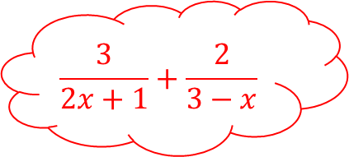
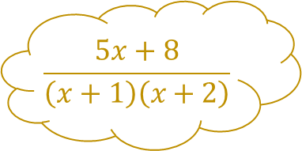
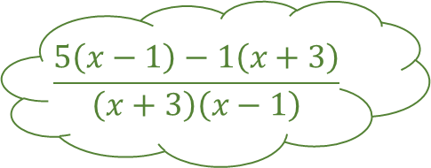
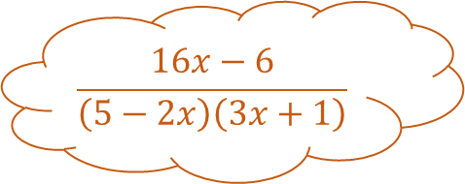
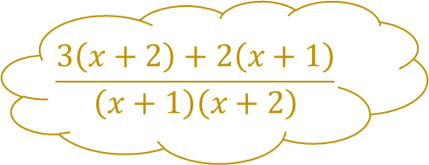
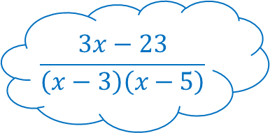
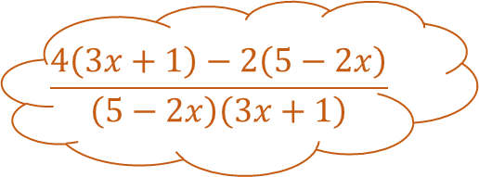
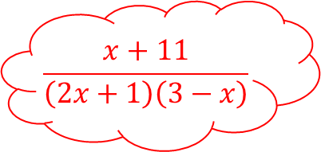
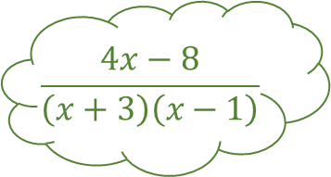
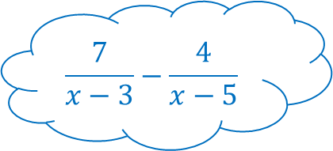
$$\frac{3}{x+1}+\frac{2}{x+2}$$
$$\frac{3\left(x+2\right)+2\left(x+1\right)}{\left(x+1\right)\left(x+2\right)}$$
Exploding Algebraic Fractions 3 – Answers
$$\frac{5x+8}{\left(x+1\right)\left(x+2\right)}$$
$$\frac{4}{5−2x}−\frac{2}{3x+1}$$
$$\frac{5}{x+3}−\frac{1}{x−1}$$
$$\frac{5\left(x−1\right)−1\left(x+3\right)}{\left(x+3\right)\left(x−1\right)}$$
$$\frac{4\left(3x+1\right)−2\left(5−2x\right)}{\left(5−2x\right)\left(3x+1\right)}$$
Fill in the blanks adding and subtracting these fractions…
$$\frac{4x−8}{\left(x+3\right)\left(x−1\right)}$$
$$\frac{7}{x−3}−\frac{4}{x−5}$$
$$\frac{16x−6}{\left(5−2x\right)\left(3x+1\right)}$$
$$\frac{3}{2x+1}+\frac{2}{3−x}$$
$$\frac{7\left(x−5\right)−4\left(x−3\right)}{\left(x−3\right)\left(x−5\right)}$$
$$\frac{x+11}{\left(2x+1\right)\left(3−x\right)}$$
$$\frac{3\left(3−x\right)+2\left(2x+1\right)}{\left(2x+1\right)\left(3−x\right)}$$
$$\frac{3x−23}{\left(x−3\right)\left(x−5\right)}$$

Slide 8
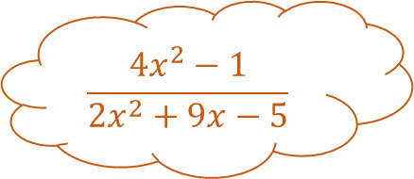
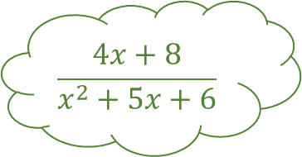
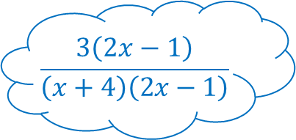
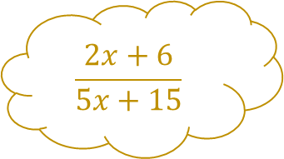
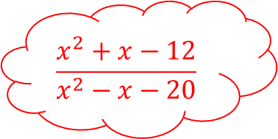
$$\frac{2x+6}{5x+15}$$
Exploding Algebraic Fractions 4
$$\frac{{4x}^{2}−1}{{2x}^{2}+9x−5}$$
$$\frac{4x+8}{x^{2}+5x+6}$$
Fill in the blanks adding and subtracting these fractions…
$$\frac{x^{2}+x−12}{x^{2}−x−20}$$
$$\frac{3\left(2x−1\right)}{\left(x+4\right)\left(2x−1\right)}$$

Slide 9

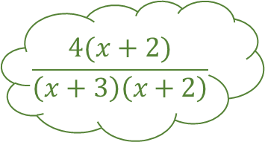


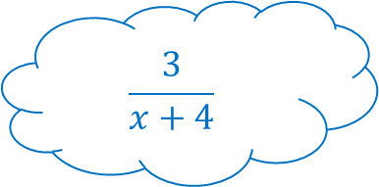
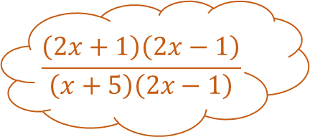
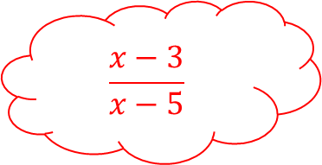
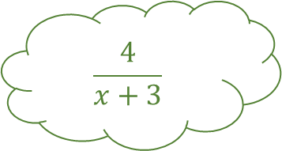
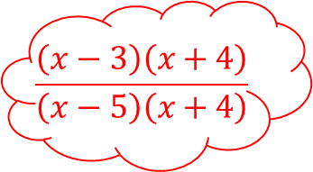
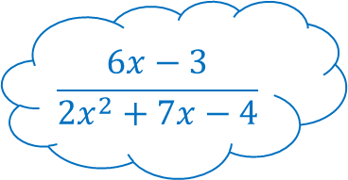
$$\frac{2x+6}{5x+15}$$
$$\frac{2\left(x+3\right)}{5\left(x+3\right)}$$
Exploding Algebraic Fractions 4 – Answers
$$\frac{2}{5}$$
$$\frac{{4x}^{2}−1}{{2x}^{2}+9x−5}$$
$$\frac{4x+8}{x^{2}+5x+6}$$
$$\frac{4(x+2)}{\left(x+3\right)\left(x+2\right)}$$
$$\frac{\left(2x+1\right)\left(2x−1\right)}{\left(x+5\right)\left(2x−1\right)}$$
Fill in the blanks adding and subtracting these fractions…
$$\frac{4}{x+3}$$
$$\frac{6x−3}{2x^{2}+7x−4}$$
$$\frac{2x+1}{x+5}$$
$$\frac{x^{2}+x−12}{x^{2}−x−20}$$
$$\frac{3\left(2x−1\right)}{\left(x+4\right)\left(2x−1\right)}$$
$$\frac{x−3}{x−5}$$
$$\frac{\left(x−3\right)\left(x+4\right)}{\left(x−5\right)\left(x+4\right)}$$
$$\frac{3}{x+4}$$

Slide 10















Exploding Algebraic Fractions – Template
Fill in the blanks adding and subtracting these fractions…

Slide 11
Exploding Algebraic Fractions – Blank

Slide 12
Exploding Algebraic Fractions – Blank

