Slide 1
Equations of Circles Matching
Match one group to the other.
There will be “spare” ones – what answers should be there?

Slide 2
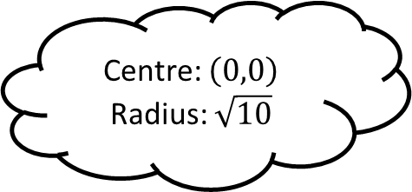
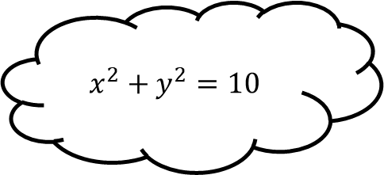
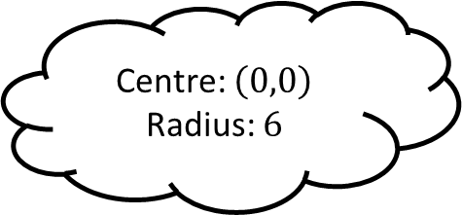
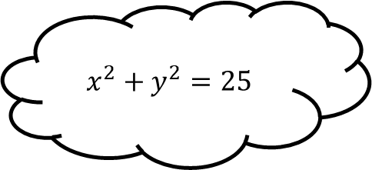
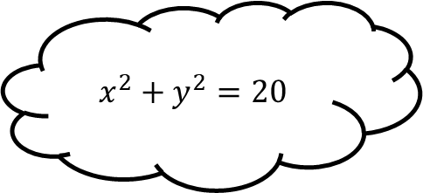
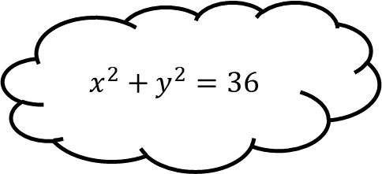
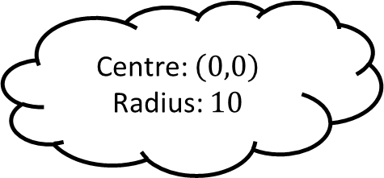
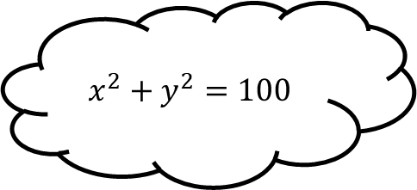
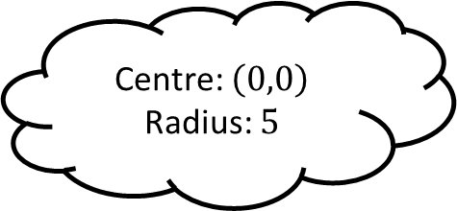
Matching 1
Centre: $\left(0,0\right)$
Radius: $6$
$$x^{2}+y^{2}=25$$
$$x^{2}+y^{2}=36$$
Centre: $\left(0,0\right)$
Radius: $\sqrt{10}$
$$x^{2}+y^{2}=10$$
Centre: $\left(0,0\right)$
Radius: $5$
$$x^{2}+y^{2}=20$$
$$x^{2}+y^{2}=100$$
Centre: $\left(0,0\right)$
Radius: $10$

Slide 3
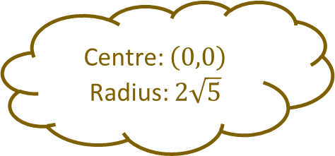
Matching 1 - Answers
Centre: $\left(0,0\right)$
Radius: $6$
$$x^{2}+y^{2}=25$$
$$x^{2}+y^{2}=36$$
Centre: $\left(0,0\right)$
Radius: $\sqrt{10}$
$$x^{2}+y^{2}=10$$
Centre: $\left(0,0\right)$
Radius: $5$
$$x^{2}+y^{2}=20$$
Centre: $\left(0,0\right)$
Radius: $2\sqrt{5}$
$$x^{2}+y^{2}=100$$
Centre: $\left(0,0\right)$
Radius: $10$

Slide 4
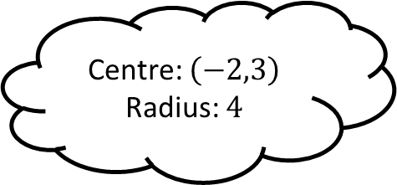
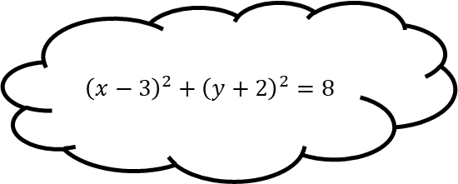
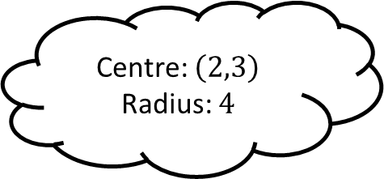
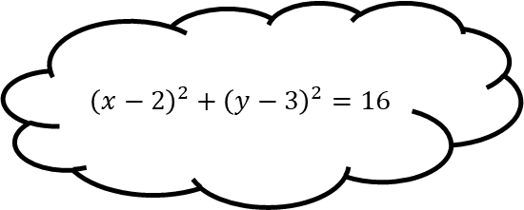
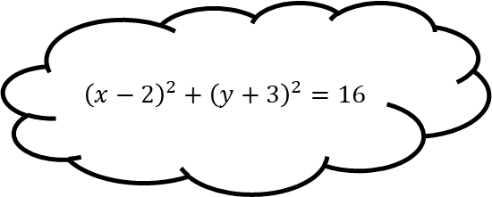
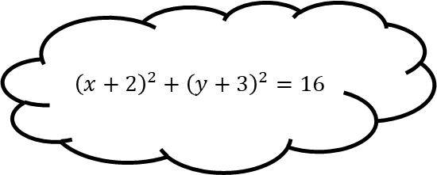
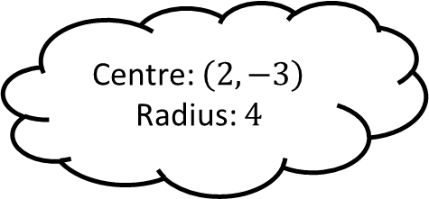
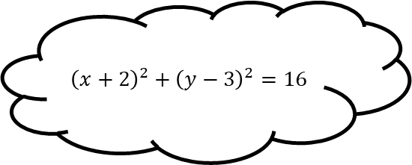
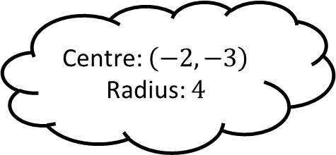
Matching 2
Centre: $\left(2,3\right)$
Radius: $4$
$${\left(x−2\right)}^{2}+{\left(y−3\right)}^{2}=16$$
$${\left(x+2\right)}^{2}+{\left(y+3\right)}^{2}=16$$
Centre: $\left(−2,3\right)$
Radius: $4$
$${\left(x−3\right)}^{2}+{\left(y+2\right)}^{2}=8$$
Centre: $\left(−2,−3\right)$
Radius: $4$
$${\left(x−2\right)}^{2}+{\left(y+3\right)}^{2}=16$$
$${\left(x+2\right)}^{2}+{\left(y−3\right)}^{2}=16$$
Centre: $\left(2,−3\right)$
Radius: $4$

Slide 5
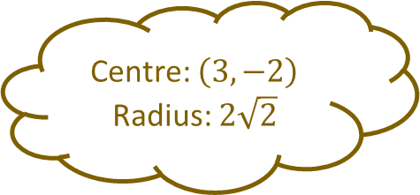
Matching 2 - Answers
Centre: $\left(2,3\right)$
Radius: $4$
$${\left(x−2\right)}^{2}+{\left(y−3\right)}^{2}=16$$
Centre: $\left(3,−2\right)$
Radius: $2\sqrt{2}$
$${\left(x+2\right)}^{2}+{\left(y+3\right)}^{2}=16$$
Centre: $\left(−2,3\right)$
Radius: $4$
$${\left(x−3\right)}^{2}+{\left(y+2\right)}^{2}=8$$
Centre: $\left(−2,−3\right)$
Radius: $4$
$${\left(x−2\right)}^{2}+{\left(y+3\right)}^{2}=16$$
$${\left(x+2\right)}^{2}+{\left(y−3\right)}^{2}=16$$
Centre: $\left(2,−3\right)$
Radius: $4$

Slide 6
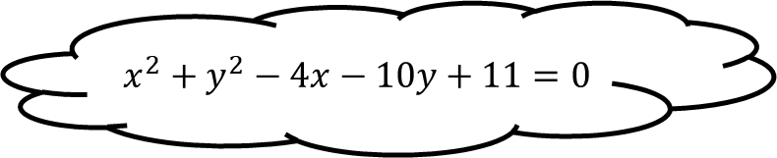
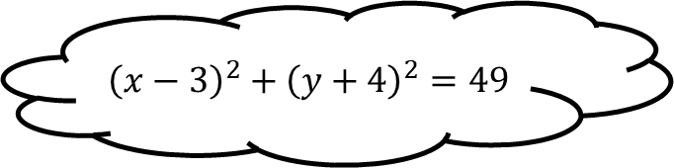
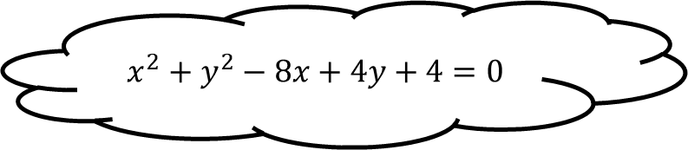
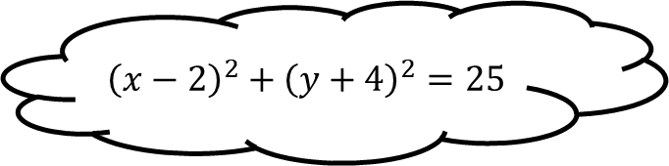
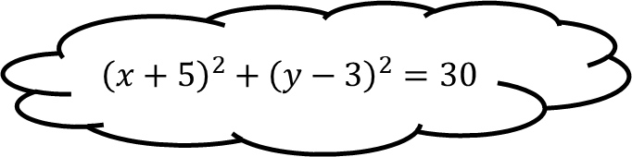
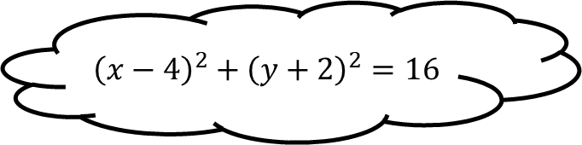
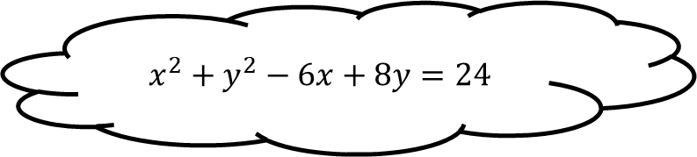
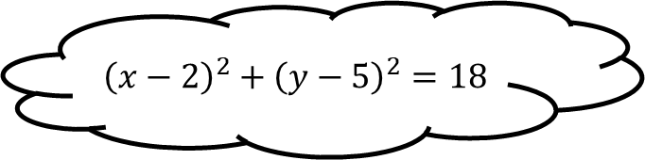
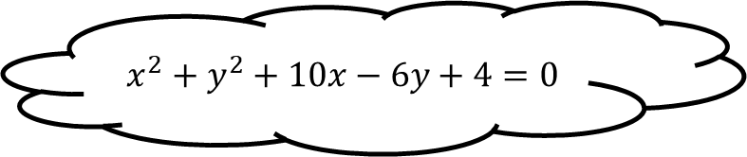
Matching 3
$${\left(x−2\right)}^{2}+{\left(y+4\right)}^{2}=25$$
$$x^{2}+y^{2}−8x+4y+4=0$$
$${\left(x−4\right)}^{2}+{\left(y+2\right)}^{2}=16$$
$$x^{2}+y^{2}−4x−10y+11=0$$
$${\left(x−3\right)}^{2}+{\left(y+4\right)}^{2}=49$$
$$x^{2}+y^{2}+10x−6y+4=0$$
$${\left(x+5\right)}^{2}+{\left(y−3\right)}^{2}=30$$
$${\left(x−2\right)}^{2}+{\left(y−5\right)}^{2}=18$$
$$x^{2}+y^{2}−6x+8y=24$$

Slide 7
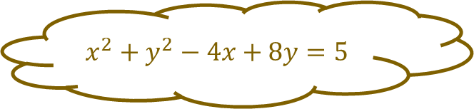
Matching 3 - Answers
$${\left(x−2\right)}^{2}+{\left(y+4\right)}^{2}=25$$
$$x^{2}+y^{2}−8x+4y+4=0$$
$${\left(x−4\right)}^{2}+{\left(y+2\right)}^{2}=16$$
$$x^{2}+y^{2}−4x+8y=5$$
$$x^{2}+y^{2}−4x−10y+11=0$$
$${\left(x−3\right)}^{2}+{\left(y+4\right)}^{2}=49$$
$$x^{2}+y^{2}+10x−6y+4=0$$
$${\left(x+5\right)}^{2}+{\left(y−3\right)}^{2}=30$$
$${\left(x−2\right)}^{2}+{\left(y−5\right)}^{2}=18$$
$$x^{2}+y^{2}−6x+8y=24$$

Slide 8
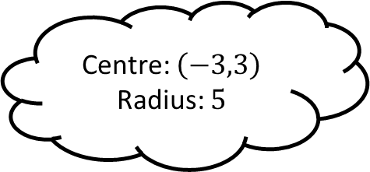
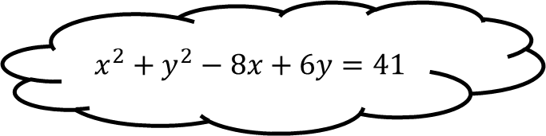
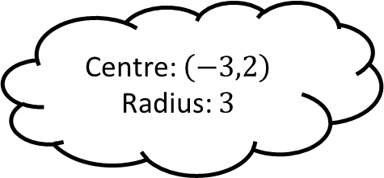
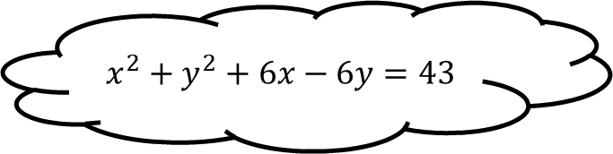
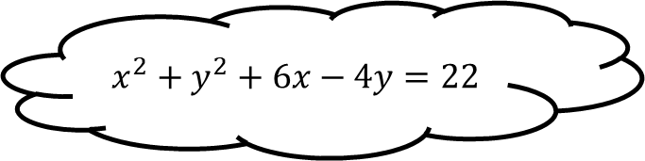
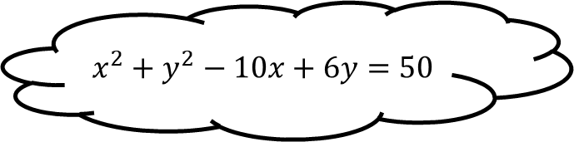
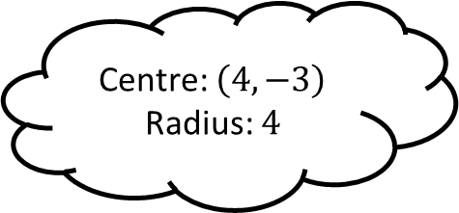
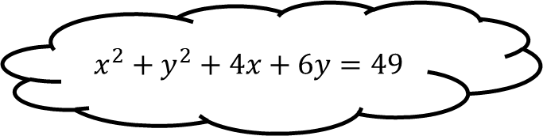
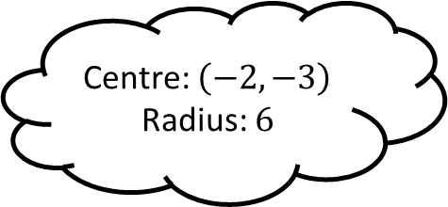
Matching 4
Centre: $\left(−3,2\right)$
Radius: $3$
$$x^{2}+y^{2}+6x−6y=43$$
$$x^{2}+y^{2}−10x+6y=50$$
Centre: $\left(−3,3\right)$
Radius: $5$
$$x^{2}+y^{2}−8x+6y=41$$
Centre: $\left(−2,−3\right)$
Radius: $6$
$$x^{2}+y^{2}+6x−4y=22$$
Centre: $\left(4,−3\right)$
Radius: $4$
$$x^{2}+y^{2}+4x+6y=49$$

Slide 9
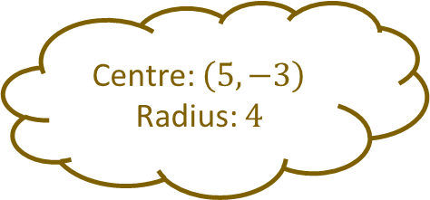
Matching 4 - Answers
Centre: $\left(5,−3\right)$
Radius: $4$
Centre: $\left(−3,2\right)$
Radius: $3$
$$x^{2}+y^{2}+6x−6y=43$$
$$x^{2}+y^{2}−10x+6y=50$$
Centre: $\left(−3,3\right)$
Radius: $5$
$$x^{2}+y^{2}−8x+6y=41$$
Centre: $\left(−2,−3\right)$
Radius: $6$
$$x^{2}+y^{2}+6x−4y=22$$
Centre: $\left(4,−3\right)$
Radius: $4$
$$x^{2}+y^{2}+4x+6y=49$$

Slide 10
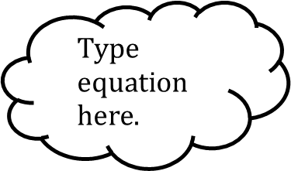
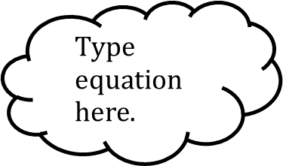
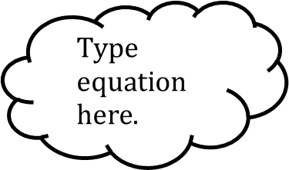
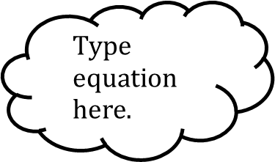
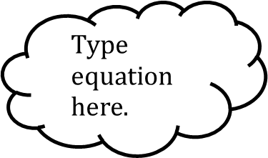
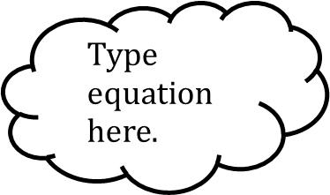
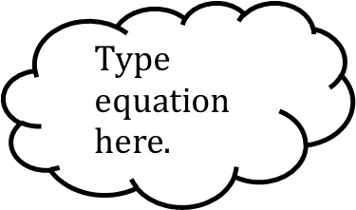
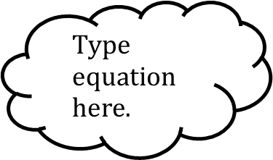
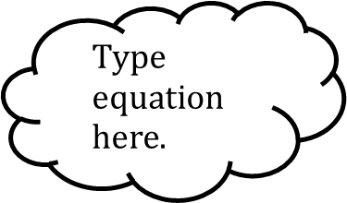
Matching n

