Slide 1
Algebraic Fractions Matching
Match one group to the other.
There will be “spare” ones – what answers should be there?

Slide 2
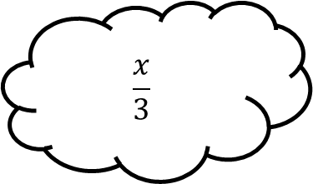
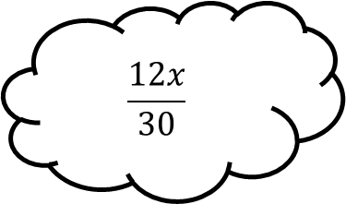
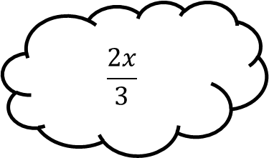
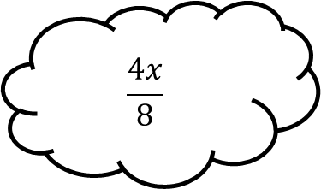
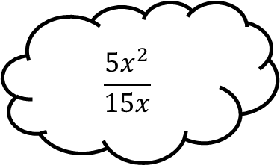
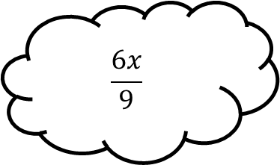
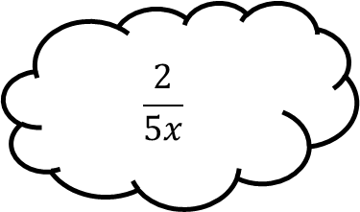
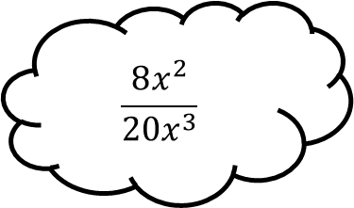
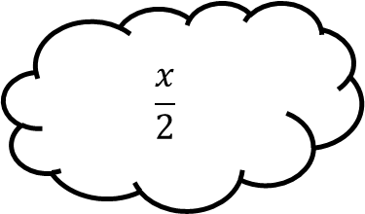
Matching 1
$$\frac{2x}{3}$$
$$\frac{4x}{8}$$
$$\frac{6x}{9}$$
$$\frac{x}{3}$$
$$\frac{12x}{30}$$
$$\frac{x}{2}$$
$$\frac{5x^{2}}{15x}$$
$$\frac{8x^{2}}{20x^{3}}$$
$$\frac{2}{5x}$$

Slide 3
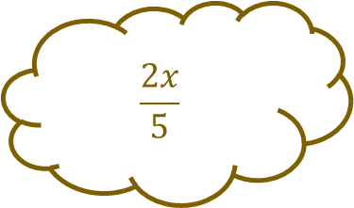
Matching 1 - Answers
$$\frac{2x}{3}$$
$$\frac{4x}{8}$$
$$\frac{6x}{9}$$
$$\frac{x}{3}$$
$$\frac{12x}{30}$$
$$\frac{x}{2}$$
$$\frac{5x^{2}}{15x}$$
$$\frac{2x}{5}$$
$$\frac{8x^{2}}{20x^{3}}$$
$$\frac{2}{5x}$$

Slide 4
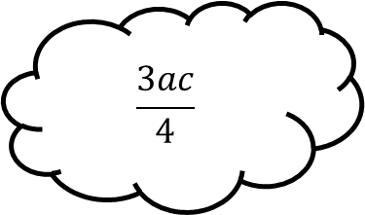
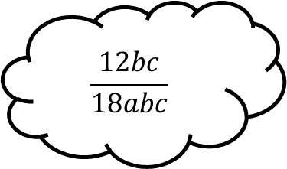
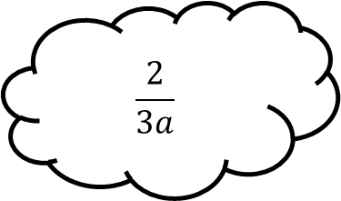
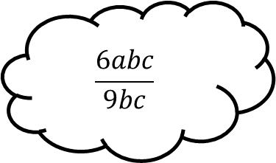
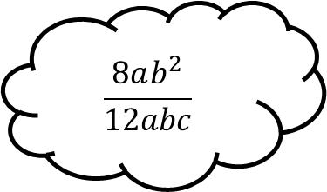
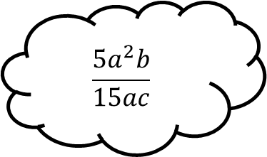
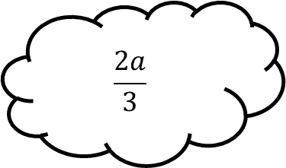
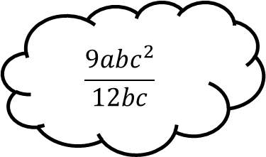
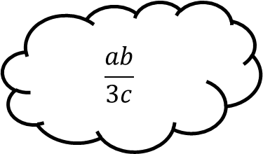
Matching 2
$$\frac{2}{3a}$$
$$\frac{6abc}{9bc}$$
$$\frac{5a^{2}b}{15ac}$$
$$\frac{3ac}{4}$$
$$\frac{12bc}{18abc}$$
$$\frac{ab}{3c}$$
$$\frac{8ab^{2}}{12abc}$$
$$\frac{9abc^{2}}{12bc}$$
$$\frac{2a}{3}$$

Slide 5
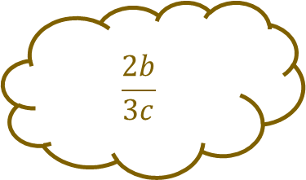
Matching 2 - Answers
$$\frac{2}{3a}$$
$$\frac{6abc}{9bc}$$
$$\frac{5a^{2}b}{15ac}$$
$$\frac{3ac}{4}$$
$$\frac{12bc}{18abc}$$
$$\frac{ab}{3c}$$
$$\frac{8ab^{2}}{12abc}$$
$$\frac{2b}{3c}$$
$$\frac{9abc^{2}}{12bc}$$
$$\frac{2a}{3}$$

Slide 6
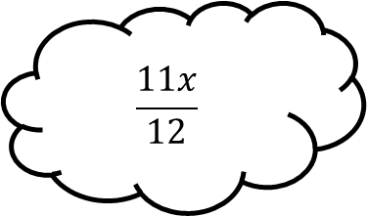
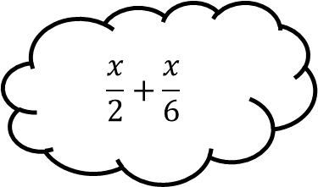
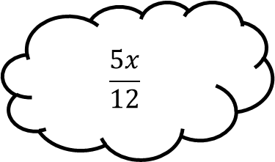
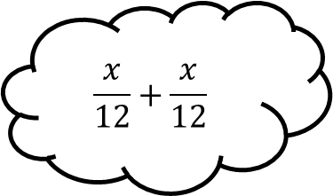
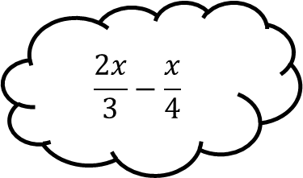
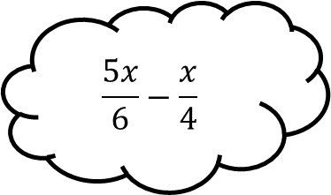
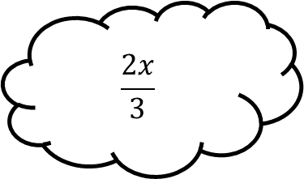
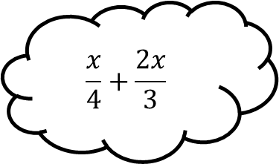
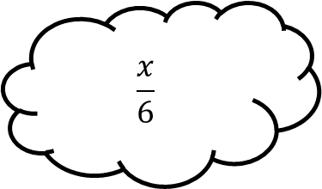
Matching 3
$$\frac{5x}{12}$$
$$\frac{x}{12}+\frac{x}{12}$$
$$\frac{5x}{6}−\frac{x}{4}$$
$$\frac{11x}{12}$$
$$\frac{x}{2}+\frac{x}{6}$$
$$\frac{x}{6}$$
$$\frac{2x}{3}−\frac{x}{4}$$
$$\frac{x}{4}+\frac{2x}{3}$$
$$\frac{2x}{3}$$

Slide 7
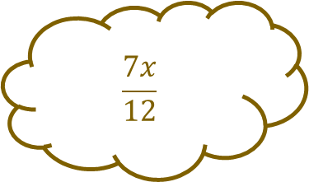
Matching 3 - Answers
$$\frac{5x}{12}$$
$$\frac{7x}{12}$$
$$\frac{x}{12}+\frac{x}{12}$$
$$\frac{5x}{6}−\frac{x}{4}$$
$$\frac{11x}{12}$$
$$\frac{x}{2}+\frac{x}{6}$$
$$\frac{x}{6}$$
$$\frac{2x}{3}−\frac{x}{4}$$
$$\frac{x}{4}+\frac{2x}{3}$$
$$\frac{2x}{3}$$

Slide 8
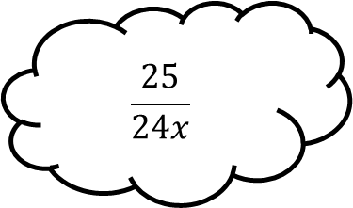
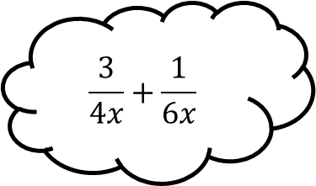
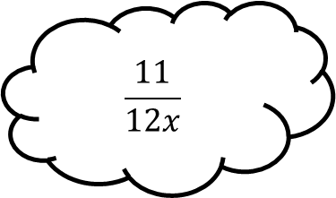
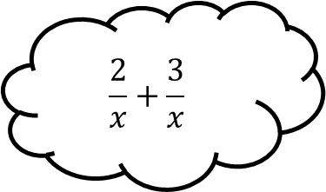
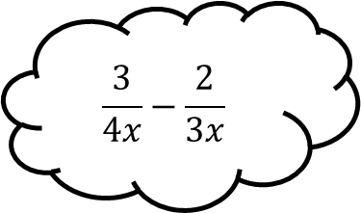
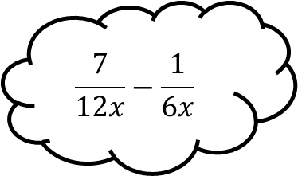
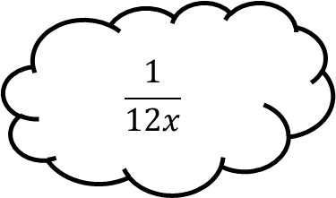
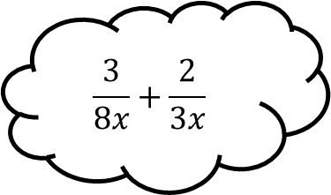
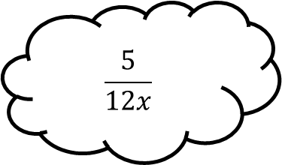
Matching 4
$$\frac{11}{12x}$$
$$\frac{2}{x}+\frac{3}{x}$$
$$\frac{7}{12x}−\frac{1}{6x}$$
$$\frac{25}{24x}$$
$$\frac{3}{4x}+\frac{1}{6x}$$
$$\frac{5}{12x}$$
$$\frac{3}{4x}−\frac{2}{3x}$$
$$\frac{3}{8x}+\frac{2}{3x}$$
$$\frac{1}{12x}$$

Slide 9
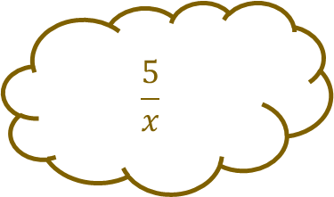
Matching 4 - Answers
$$\frac{5}{x}$$
$$\frac{11}{12x}$$
$$\frac{2}{x}+\frac{3}{x}$$
$$\frac{7}{12x}−\frac{1}{6x}$$
$$\frac{25}{24x}$$
$$\frac{3}{4x}+\frac{1}{6x}$$
$$\frac{5}{12x}$$
$$\frac{3}{4x}−\frac{2}{3x}$$
$$\frac{3}{8x}+\frac{2}{3x}$$
$$\frac{1}{12x}$$

Slide 10
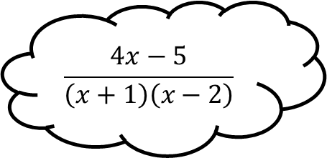
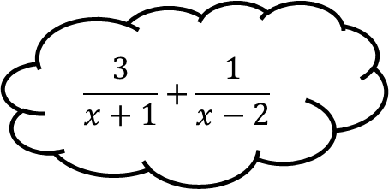
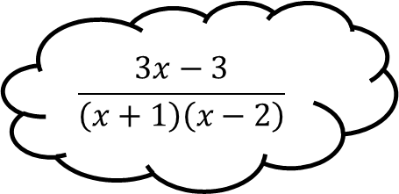
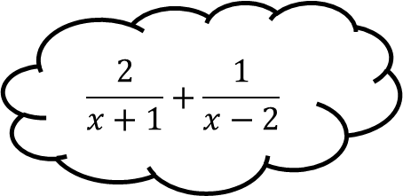
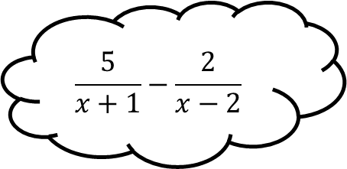
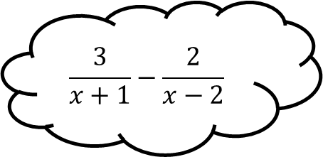
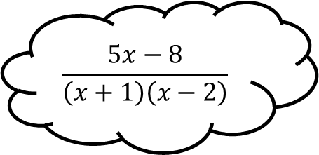
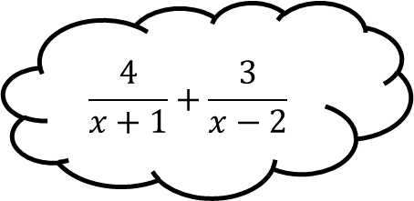
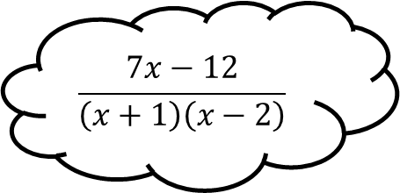
Matching 5
$$\frac{3x−3}{\left(x+1\right)\left(x−2\right)}$$
$$\frac{2}{x+1}+\frac{1}{x−2}$$
$$\frac{3}{x+1}−\frac{2}{x−2}$$
$$\frac{4x−5}{\left(x+1\right)\left(x−2\right)}$$
$$\frac{3}{x+1}+\frac{1}{x−2}$$
$$\frac{7x−12}{\left(x+1\right)\left(x−2\right)}$$
$$\frac{5}{x+1}−\frac{2}{x−2}$$
$$\frac{4}{x+1}+\frac{3}{x−2}$$
$$\frac{5x−8}{\left(x+1\right)\left(x−2\right)}$$

Slide 11
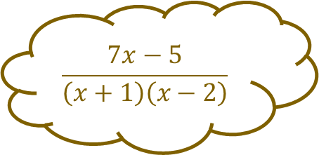
Matching 5 - Answers
$$\frac{3x−3}{\left(x+1\right)\left(x−2\right)}$$
$$\frac{2}{x+1}+\frac{1}{x−2}$$
$$\frac{3}{x+1}−\frac{2}{x−2}$$
$$\frac{4x−5}{\left(x+1\right)\left(x−2\right)}$$
$$\frac{3}{x+1}+\frac{1}{x−2}$$
$$\frac{7x−12}{\left(x+1\right)\left(x−2\right)}$$
$$\frac{5}{x+1}−\frac{2}{x−2}$$
$$\frac{4}{x+1}+\frac{3}{x−2}$$
$$\frac{5x−8}{\left(x+1\right)\left(x−2\right)}$$
$$\frac{7x−5}{\left(x+1\right)\left(x−2\right)}$$

Slide 12









Matching 6
$$\frac{5x+12}{\left(2x−3\right)\left(x+5\right)}$$
$$\frac{1}{2x−3}+\frac{2}{x+5}$$
$$\frac{2}{2x−3}−\frac{1}{x+5}$$
$$\frac{9x−1}{\left(2x−3\right)\left(x+5\right)}$$
$$\frac{3}{2x−3}+\frac{2}{x+5}$$
$$\frac{7x+9}{\left(2x−3\right)\left(x+5\right)}$$
$$\frac{3}{2x−3}−\frac{2}{x+5}$$
$$\frac{3}{2x−3}+\frac{1}{x+5}$$
$$\frac{21−x}{\left(2x−3\right)\left(x+5\right)}$$

Slide 13

Matching 6 - Answers
$$\frac{13}{\left(2x−3\right)\left(x+5\right)}$$
$$\frac{5x+12}{\left(2x−3\right)\left(x+5\right)}$$
$$\frac{1}{2x−3}+\frac{2}{x+5}$$
$$\frac{2}{2x−3}−\frac{1}{x+5}$$
$$\frac{9x−1}{\left(2x−3\right)\left(x+5\right)}$$
$$\frac{3}{2x−3}+\frac{2}{x+5}$$
$$\frac{7x+9}{\left(2x−3\right)\left(x+5\right)}$$
$$\frac{3}{2x−3}−\frac{2}{x+5}$$
$$\frac{3}{2x−3}+\frac{1}{x+5}$$
$$\frac{21−x}{\left(2x−3\right)\left(x+5\right)}$$

Slide 14









Matching 7
$$\frac{2}{x−3}$$
$$\frac{3x+9}{x^{2}+5x+6}$$
$$\frac{3x+6}{x^{2}+3x+2}$$
$$\frac{3}{x+2}$$
$$\frac{2x−4}{x^{2}−5x+6}$$
$$\frac{2}{x−2}$$
$$\frac{5x+15}{x^{2}+2x−3}$$
$$\frac{2x−6}{x^{2}−5x+6}$$
$$\frac{3}{x+1}$$

Slide 15

Matching 7 - Answers
$$\frac{2}{x−3}$$
$$\frac{3x+9}{x^{2}+5x+6}$$
$$\frac{3x+6}{x^{2}+3x+2}$$
$$\frac{3}{x+2}$$
$$\frac{2x−4}{x^{2}−5x+6}$$
$$\frac{2}{x−2}$$
$$\frac{5x+15}{x^{2}+2x−3}$$
$$\frac{2x−6}{x^{2}−5x+6}$$
$$\frac{5}{x−1}$$
$$\frac{3}{x+1}$$

Slide 16









Matching 8
$$\frac{x−2}{x+1}$$
$$\frac{x^{2}−5x+6}{x^{2}−2x−3}$$
$$\frac{x^{2}−5x+6}{x^{2}−4x+3}$$
$$\frac{x−3}{x+2}$$
$$\frac{x^{2}+x−2}{x^{2}+5x+6}$$
$$\frac{x+1}{x+3}$$
$$\frac{x^{2}−9}{x^{2}+5x+6}$$
$$\frac{x^{2}−2x−3}{x^{2}−9}$$
$$\frac{x−2}{x−1}$$

Slide 17

Matching 8 - Answers
$$\frac{x−2}{x+1}$$
$$\frac{x^{2}−5x+6}{x^{2}−2x−3}$$
$$\frac{x−1}{x+3}$$
$$\frac{x^{2}−5x+6}{x^{2}−4x+3}$$
$$\frac{x−3}{x+2}$$
$$\frac{x^{2}+x−2}{x^{2}+5x+6}$$
$$\frac{x+1}{x+3}$$
$$\frac{x^{2}−9}{x^{2}+5x+6}$$
$$\frac{x^{2}−2x−3}{x^{2}−9}$$
$$\frac{x−2}{x−1}$$

Slide 18









Matching n

Slide 19









Matching n

