Slide 1
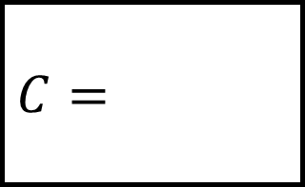
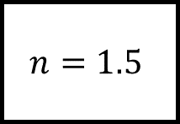
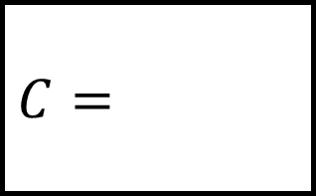
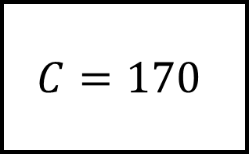
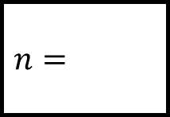
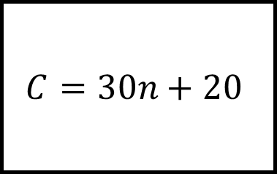
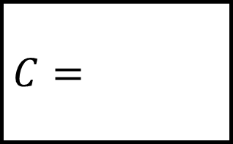
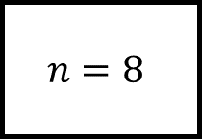
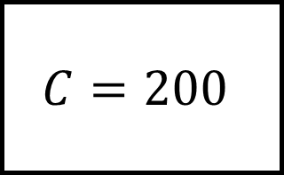

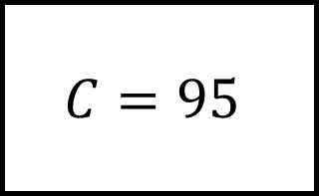
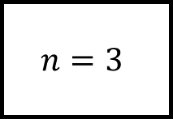

Substitution Spider 1
$$C=95$$
$$C=$$
$$n=$$
$$n=3$$
$$C=$$
$$C=30n+20$$
$$C=170$$
$$n=1.5$$
$$n=$$
$$n=$$
$$n=8$$
$$C=200$$
$$C=$$
Using the formula at the centre fill in the blanks.

Slide 2
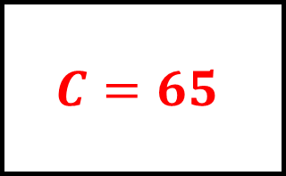
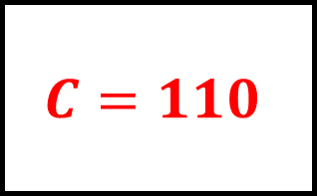
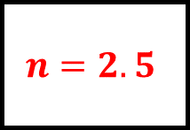
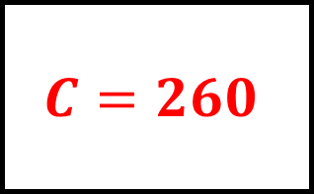
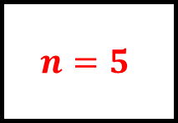
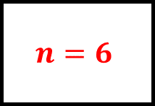
Substitution Spider 1 - Answers
$$C=95$$
$$C=110$$
$$n=2.5$$
$$n=3$$
$$C=65$$
$$C=30n+20$$
$$C=170$$
$$n=1.5$$
$$n=5$$
$$n=6$$
$$n=8$$
$$C=200$$
$$C=260$$
Using the formula at the centre fill in the blanks.

Slide 3
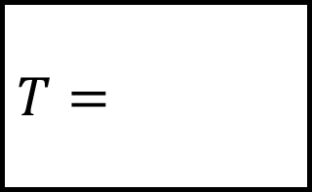
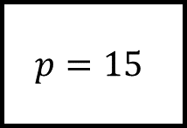
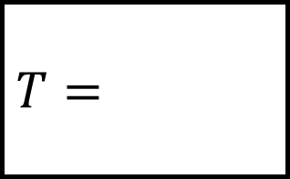
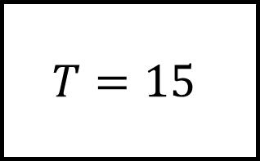
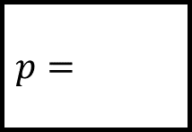
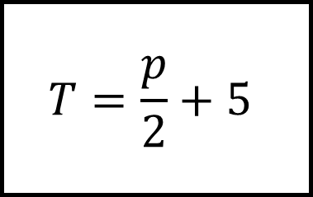
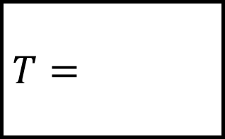
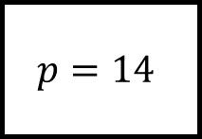
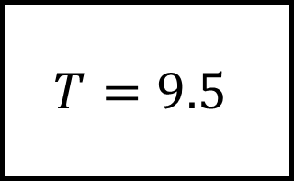

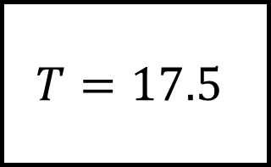
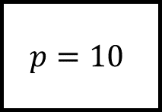

Substitution Spider 2
$$T=17.5$$
$$T=$$
$$p=$$
$$p=10$$
$$T=$$
$$T=\frac{p}{2}+5$$
$$T=15$$
$$p=15$$
$$p=$$
$$p=$$
$$p=14$$
$$T=9.5$$
$$T=$$
Using the formula at the centre fill in the blanks.

Slide 4
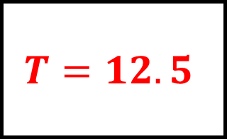
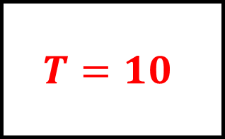
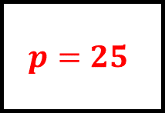
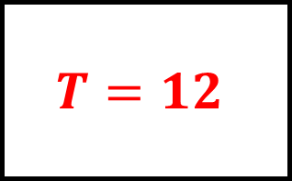
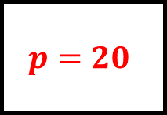
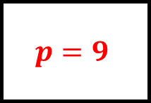
Substitution Spider 2 - Answers
$$T=17.5$$
$$T=10$$
$$p=25$$
$$p=10$$
$$T=12.5$$
$$T=\frac{p}{2}+5$$
$$T=15$$
$$p=15$$
$$p=20$$
$$p=9$$
$$p=14$$
$$T=9.5$$
$$T=12$$
Using the formula at the centre fill in the blanks.

Slide 5
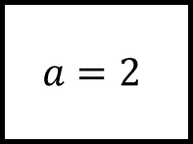
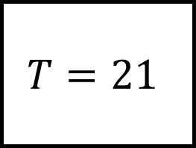
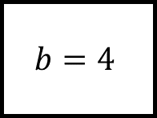
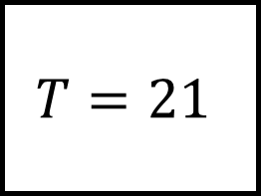
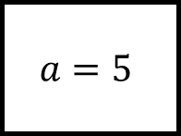
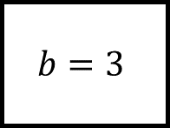
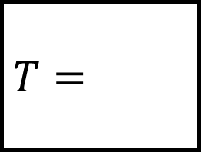
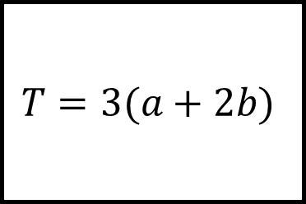
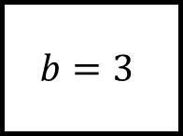
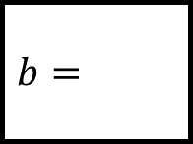
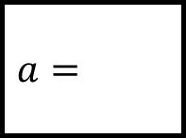
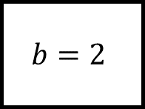

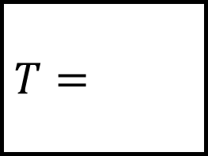
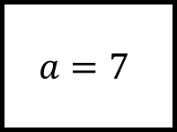
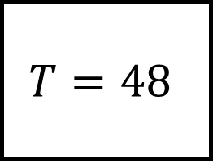
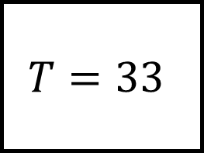


Substitution Spider 3
$$T=48$$
$$T=$$
$$b=$$
$$b=3$$
$$a=2$$
$$a=2$$
$$T=33$$
$$T=3(a+2b)$$
$$T=21$$
$$b=3$$
$$a=$$
$$a=$$
$$b=2$$
$$a=7$$
$$a=5$$
$$T=$$
$$T=21$$
$$b=4$$
Using the formula at the centre fill in the blanks.
$$b=$$

Slide 6






Substitution Spider 3 – Answers
$$T=48$$
$$T=24$$
$$b=7$$
$$b=3$$
$$a=2$$
$$a=2$$
$$T=33$$
$$T=3(a+2b)$$
$$T=21$$
$$b=3$$
$$a=5$$
$$a=3$$
$$b=2$$
$$a=7$$
$$a=5$$
$$T=45$$
$$T=21$$
$$b=4$$
Using the formula at the centre fill in the blanks.
$$b=1$$

Slide 7



















Substitution Spider 4
$$C=−1.75$$
$$C=$$
$$y=$$
$$y=3$$
$$x=−11$$
$$x=11$$
$$C=−2.5$$
$$C=\frac{x−y}{4}$$
$$C=4$$
$$y=−7$$
$$x=$$
$$x=$$
$$y=7$$
$$x=−5$$
$$x=21$$
$$C=$$
$$C=4.5$$
$$y=3$$
Using the formula at the centre fill in the blanks.
$$y=$$

Slide 8






Substitution Spider 4 – Answers
$$C=−1.75$$
$$C=2$$
$$y=−4$$
$$y=3$$
$$x=−11$$
$$x=11$$
$$C=−2.5$$
$$C=\frac{x−y}{4}$$
$$C=4$$
$$y=−7$$
$$x=−17$$
$$x=23$$
$$y=7$$
$$x=−5$$
$$x=21$$
$$C=−2$$
$$C=4.5$$
$$y=3$$
Using the formula at the centre fill in the blanks.
$$y=3$$

Slide 9







Substitution Spider 5
$$T=3.6$$
$$T=$$
$$n=$$
$$n=10$$
$$T=$$
$$L=\frac{2n^{2}}{5}$$
$$T=10$$
$$n=−5$$
$$n=$$
$$n=$$
$$n=2$$
$$T=0.4$$
$$T=$$
Using the formula at the centre fill in the blanks.

Slide 10





Substitution Spider 5 - Answers
$$T=3.6$$
$$T=40$$
$$n=−3$$
$$n=10$$
$$T=10$$
$$L=\frac{2n^{2}}{5}$$
$$T=10$$
$$n=−5$$
$$n=5$$
$$n=1$$
$$n=2$$
$$T=0.4$$
$$T=1.6$$
Using the formula at the centre fill in the blanks.

Slide 11














Substitution Spider 6
$$c=89$$
$$c=$$
$$b=$$
$$b=3$$
$$a=−80$$
$$a=4$$
$$c=65$$
$$c=\sqrt{a^{2}+b^{2}}$$
$$c=13$$
$$b=−56$$
$$a=$$
$$a=$$
$$b=12$$
$$a=24$$
$$a=12$$
$$c=$$
$$c=20$$
$$b=−7$$
Using the formula at the centre fill in the blanks.
$$b=$$

Slide 12






Substitution Spider 6 – Answers
$$c=89$$
$$c=±5$$
$$b=±39$$
$$b=3$$
$$a=−80$$
$$a=4$$
$$c=65$$
$$c=\sqrt{a^{2}+b^{2}}$$
$$c=13$$
$$b=−56$$
$$a=±33$$
$$a=±5$$
$$b=12$$
$$a=24$$
$$a=12$$
$$c=±25$$
$$c=20$$
$$b=−7$$
Using the formula at the centre fill in the blanks.
$$b=±16$$

Slide 13













Substitution Spider - Answers
Using the formula at the centre fill in the blanks.

Slide 14



















Substitution Spider – Answers
Using the formula at the centre fill in the blanks.

