Slide 1
Writing Formulae Matching
Match one group to the other.
There will be a “spare” one – what answer should be there?

Slide 2









Matching 1
$4$ more than $n$
$$n−4$$
$4$ less than $n$
$$4−n$$
$4$ lots of $n$
$n$ less than $4$
$$n+4$$
$n$ split into $4$.
$$\frac{n}{4}$$

Slide 3

Matching 1 - Answers
$4$ more than $n$
$$n−4$$
$4$ less than $n$
$$4−n$$
$$4n$$
$4$ lots of $n$
$n$ less than $4$
$$n+4$$
$n$ split into $4$.
$$\frac{n}{4}$$

Slide 4
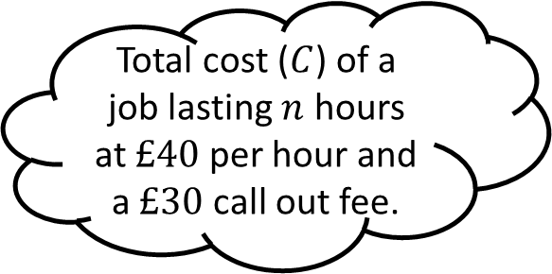
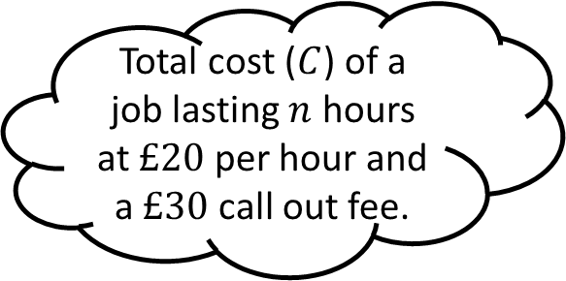
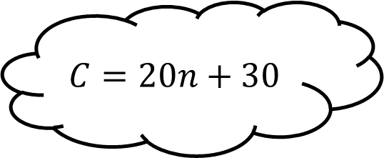
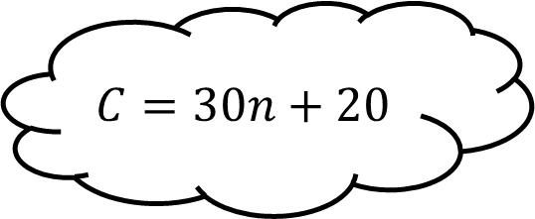
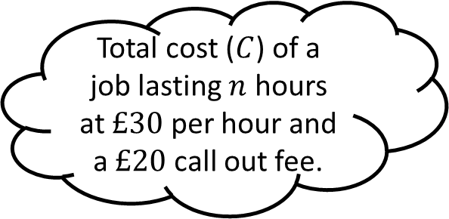
Matching 2
Total cost ($C$) of a job lasting $n$ hours at $£20$ per hour and a $£30$ call out fee.
$$C=30n+20$$
Total cost ($C$) of a job lasting $n$ hours at $£30$ per hour and a $£20$ call out fee.
$$C=20n+30$$
Total cost ($C$) of a job lasting $n$ hours at $£40$ per hour and a $£30$ call out fee.

Slide 5
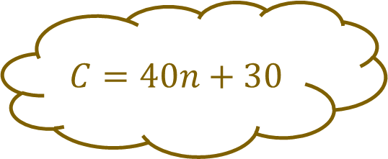
Matching 2 - Answers
Total cost ($C$) of a job lasting $n$ hours at $£20$ per hour and a $£30$ call out fee.
$$C=30n+20$$
Total cost ($C$) of a job lasting $n$ hours at $£30$ per hour and a $£20$ call out fee.
$$C=20n+30$$
Total cost ($C$) of a job lasting $n$ hours at $£40$ per hour and a $£30$ call out fee.
$$C=40n+30$$

Slide 6
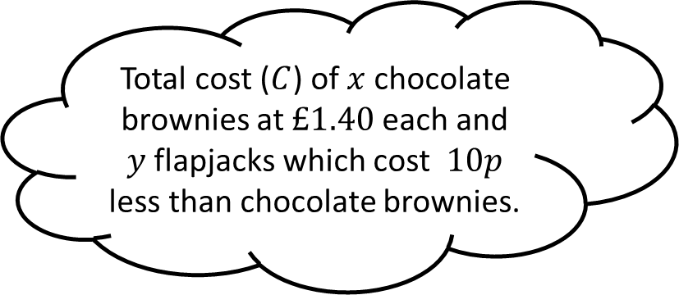
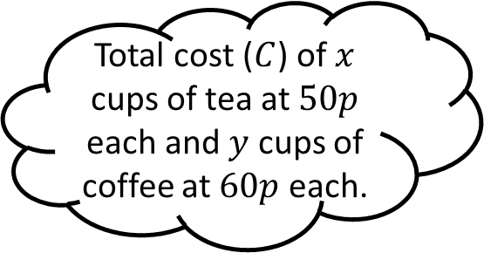
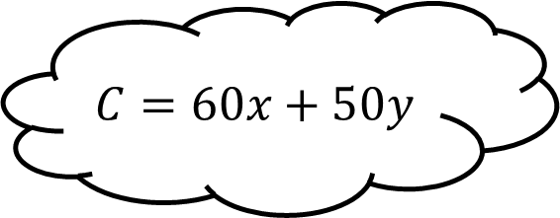
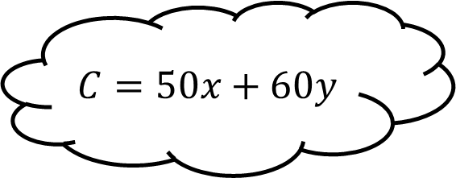
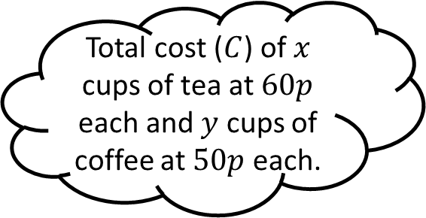
Matching 3
Total cost ($C$) of $x$ cups of tea at $50p$ each and $y$ cups of coffee at $60p$ each.
$$C=50x+60y$$
Total cost ($C$) of $x$ cups of tea at $60p$ each and $y$ cups of coffee at $50p$ each.
$$C=60x+50y$$
Total cost ($C$) of $x$ chocolate brownies at $£1.40$ each and $y$ flapjacks which cost $10p$ less than chocolate brownies.

Slide 7
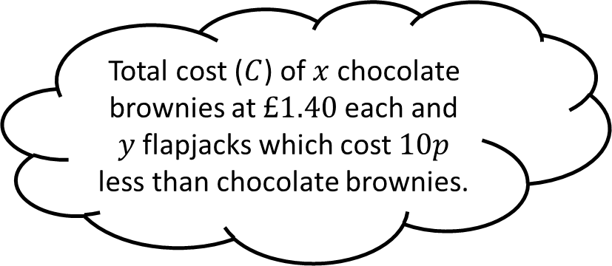

Matching 3 - Answers
Total cost ($C$) of $x$ cups of tea at $50p$ each and $y$ cups of coffee at $60p$ each.
$$C=50x+60y$$
Total cost ($C$) of $x$ cups of tea at $60p$ each and $y$ cups of coffee at $50p$ each.
$$C=60x+50y$$
Total cost ($C$) of $x$ chocolate brownies at $£1.40$ each and $y$ flapjacks which cost $10p$ less than chocolate brownies.
$$C=140x+130y$$

Slide 8
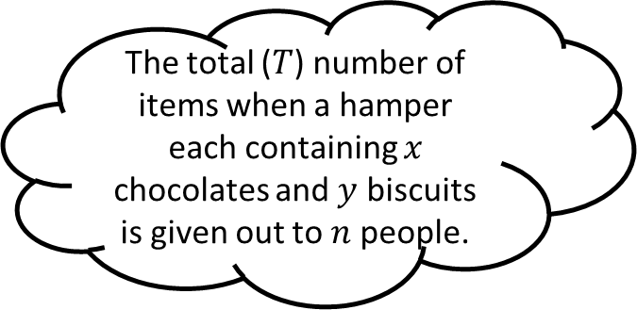
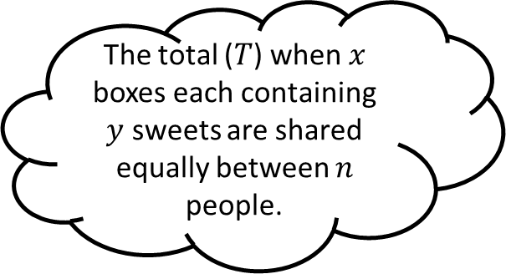

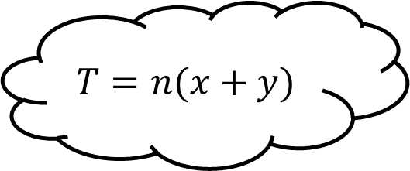
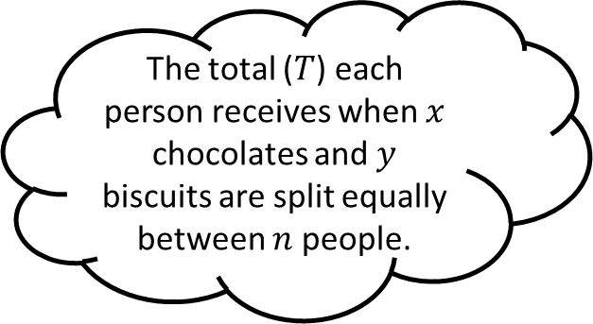
Matching 4
The total ($T$) when $x$ boxes each containing $y$ sweets are shared equally between $n$ people.
$$T=n(x+y)$$
The total ($T$) each person receives when $x$ chocolates and $y$ biscuits are split equally between $n$ people.
$$T=\frac{xy}{n}$$
The total ($T$) number of items when a hamper each containing $x$ chocolates and $y$ biscuits is given out to $n$ people.

Slide 9

Matching 4 - Answers
The total ($T$) when $x$ boxes each containing $y$ sweets are shared equally between $n$ people.
$$T=n(x+y)$$
The total ($T$) each person receives when $x$ chocolates and $y$ biscuits are split equally between $n$ people.
$$T=\frac{xy}{n}$$
The total ($T$) number of items when a hamper each containing $x$ chocolates and $y$ biscuits is given out to $n$ people.
$$T=\frac{x+y}{n}$$

Slide 10





Matching n

Slide 11









Matching n

