Slide 1
Simplifying Expressions & Expanding Brackets Matching
Match one group to the other or to the cloud at the centre.
There will be a “spares” – what answer should be there?

Slide 2
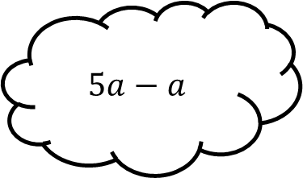
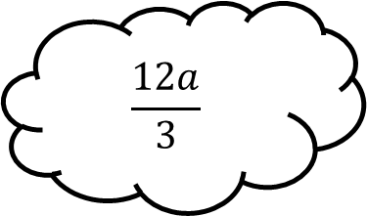
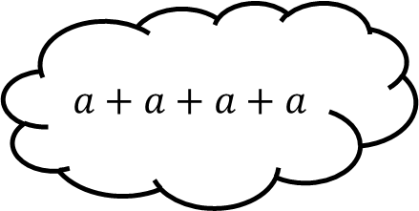
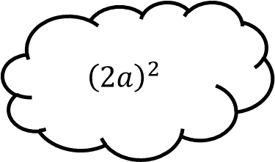
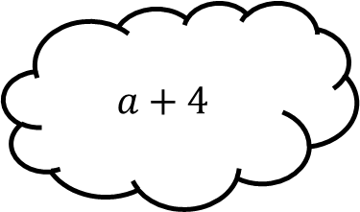
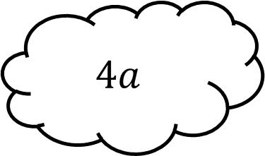
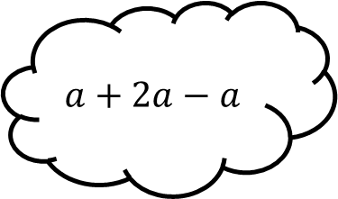
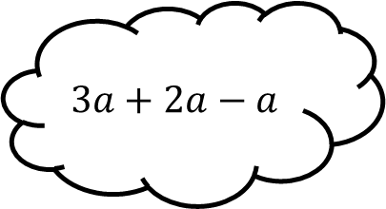
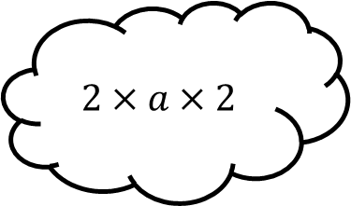
Matching 1
$$a+4$$
$${\left(2a\right)}^{2}$$
$$a+a+a+a$$
$$\frac{12a}{3}$$
$$4a$$
$$5a−a$$
$$3a+2a−a$$
$$2×a×2$$
$$a+2a−a$$

Slide 3



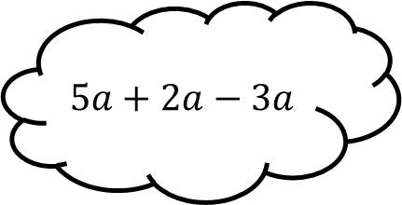
Matching 1 - Answers
$$a+4$$
$${\left(2a\right)}^{2}$$
$$a+a+a+a$$
$$a+4$$
$$4a^{2}$$
$$\frac{12a}{3}$$
$$4a$$
$$5a−a$$
$$5a+2a−3a$$
$$2×a×2$$
$$a+2a−a$$
$$2a$$

Slide 4
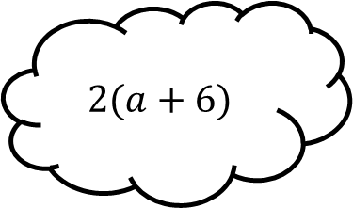
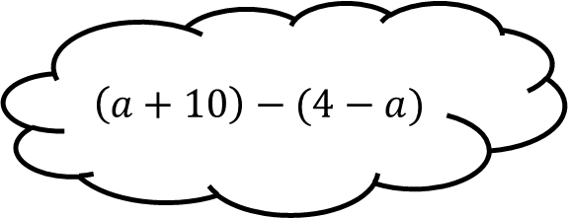
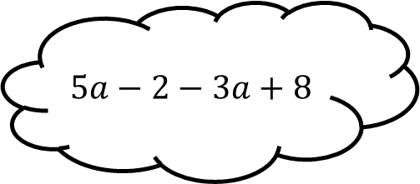
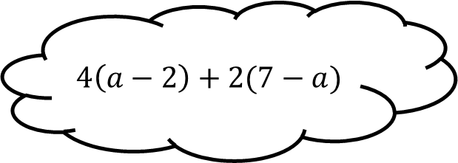
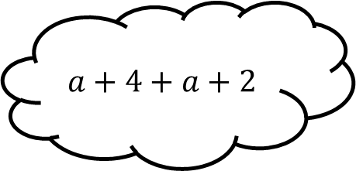
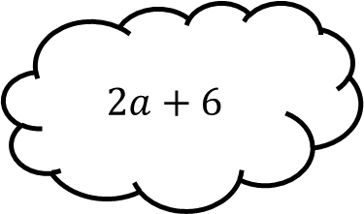
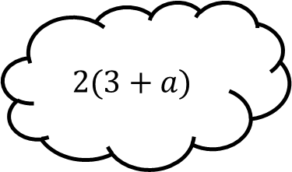
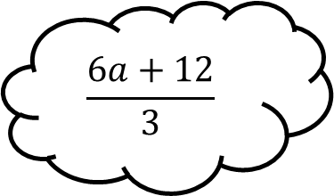
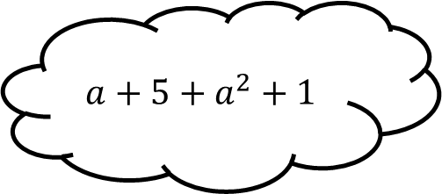
Matching 2
$$a+4+a+2$$
$$4\left(a−2\right)+2(7−a)$$
$$5a−2−3a+8$$
$$\left(a+10\right)−(4−a)$$
$$2a+6$$
$$2(a+6)$$
$$\frac{6a+12}{3}$$
$$a+5+a^{2}+1$$
$$2(3+a)$$

Slide 5


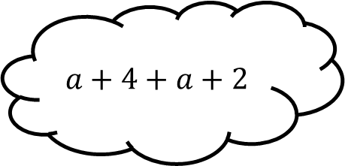

Matching 2 - Answers
$$a+4+a+2$$
$$4\left(a−2\right)+2(7−a)$$
$$5a−2−3a+8$$
$$\left(a+10\right)−(4−a)$$
$$2a+6$$
$$2(a+6)$$
$$2a+12$$
$$\frac{6a+12}{3}$$
$$a+5+a^{2}+1$$
$$2(3+a)$$
$$2a+4$$
$$a^{2}+a+6$$

Slide 6
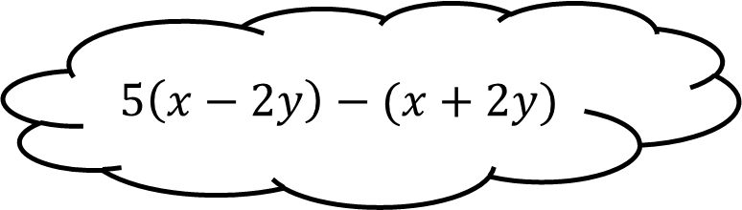
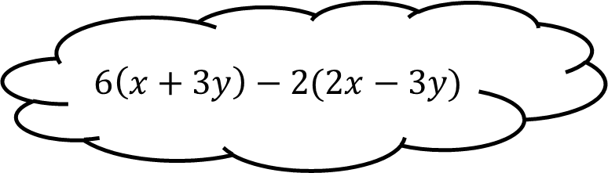
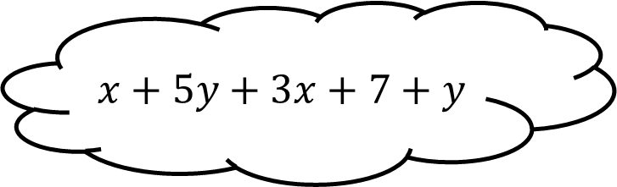

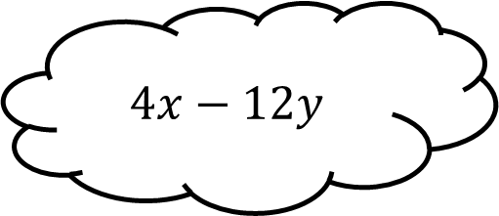
Matching 3
$$6\left(x+3y\right)−2(2x−3y)$$
$$4(x−3y)$$
$$4x−12y$$
$$5\left(x−2y\right)−(x+2y)$$
$$x+5y+3x+7+y$$

Slide 7


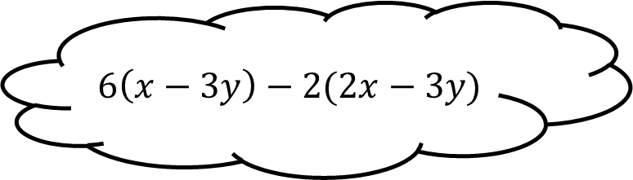
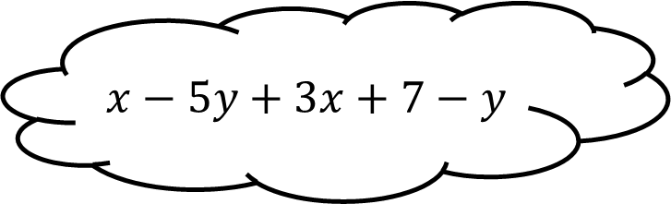
Matching 3 - Answers
$$6\left(x−3y\right)−2(2x−3y)$$
$$4(x−3y)$$
$$2x−12y$$
$$4x−12y$$
$$5\left(x−2y\right)−(x+2y)$$
$$x−5y+3x+7−y$$
$$4x−6y+7$$

Slide 8
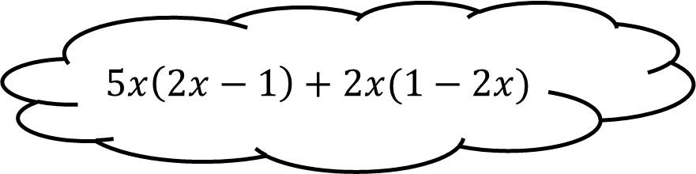
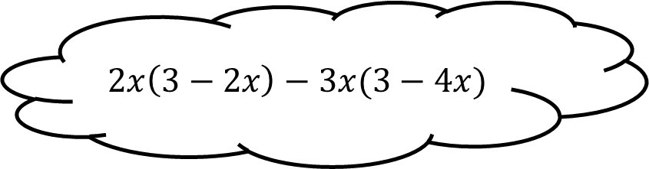

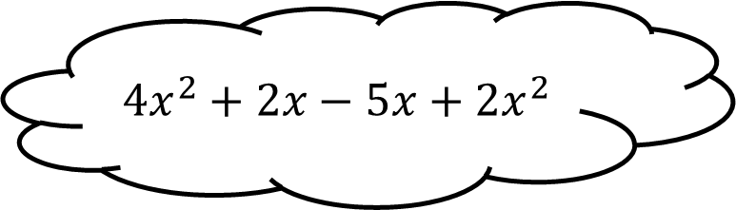
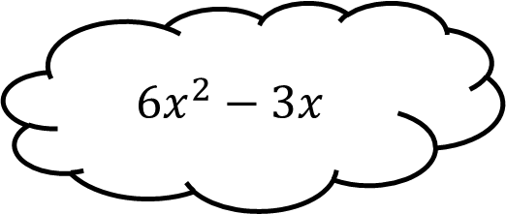
Matching 4
$$2x\left(3−2x\right)−3x(3−4x)$$
$$4x^{2}+2x−5x+2x^{2}$$
$$6x^{2}−3x$$
$$5x\left(2x−1\right)+2x(1−2x)$$
$$3x(2x−1)$$

Slide 9
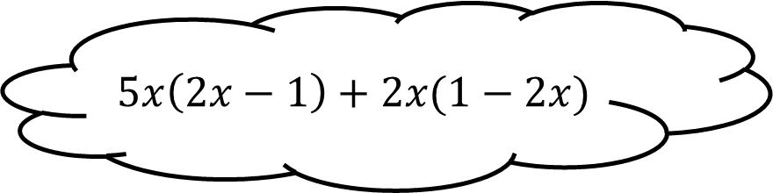

Matching 4 - Answers
$$2x\left(3−2x\right)−3x(3−4x)$$
$$4x^{2}+2x−5x+2x^{2}$$
$$8x^{2}−3x$$
$$6x^{2}−3x$$
$$5x\left(2x−1\right)+2x(1−2x)$$
$$3x(2x−1)$$

Slide 10
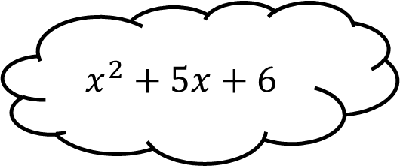
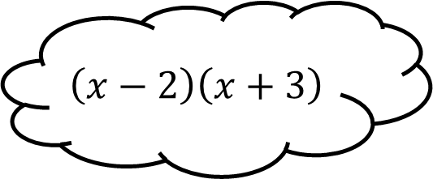
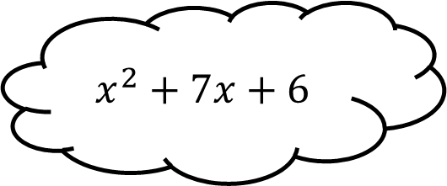
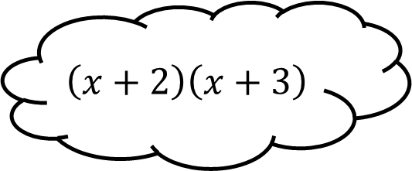
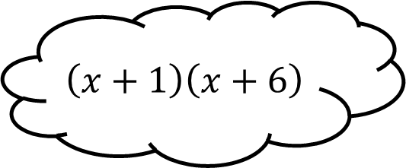
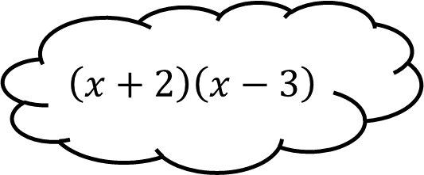
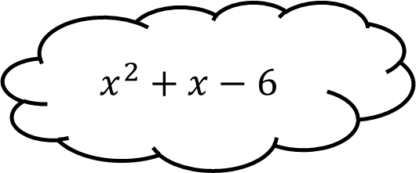
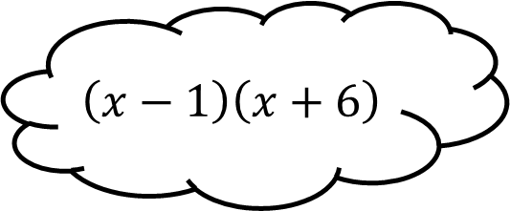
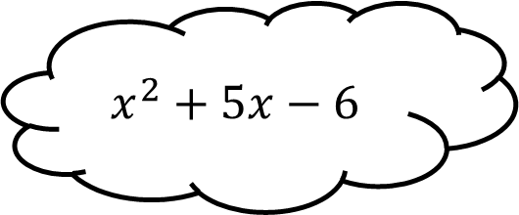
Matching 5
$$\left(x+2\right)\left(x+3\right)$$
$$x^{2}+7x+6$$
$$\left(x+2\right)\left(x−3\right)$$
$$x^{2}+5x+6$$
$$\left(x−2\right)\left(x+3\right)$$
$$x^{2}+5x−6$$
$$\left(x+1\right)\left(x+6\right)$$
$$\left(x−1\right)\left(x+6\right)$$
$$x^{2}+x−6$$

Slide 11
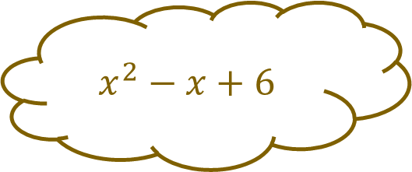
Matching 5 - Answers
$$x^{2}−x+6$$
$$x^{2}+7x+6$$
$$\left(x+2\right)\left(x+3\right)$$
$$\left(x+2\right)\left(x−3\right)$$
$$x^{2}+5x+6$$
$$\left(x−2\right)\left(x+3\right)$$
$$x^{2}+5x−6$$
$$\left(x+1\right)\left(x+6\right)$$
$$\left(x−1\right)\left(x+6\right)$$
$$x^{2}+x−6$$

Slide 12
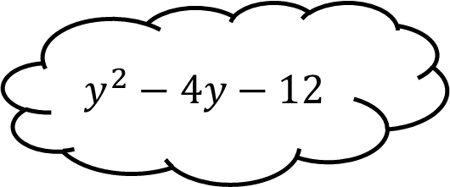
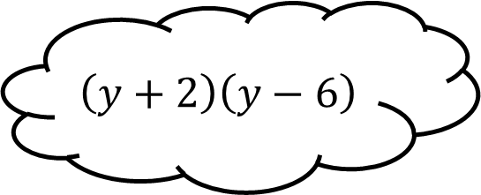
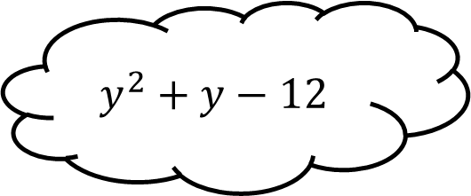
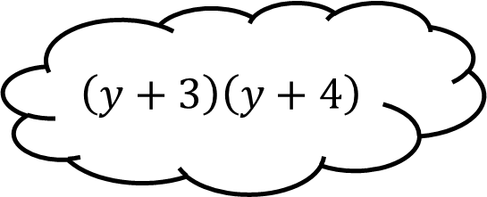
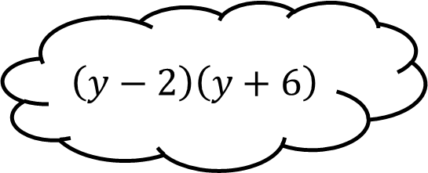
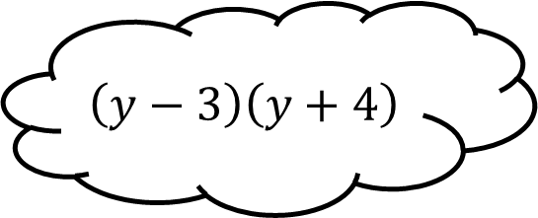
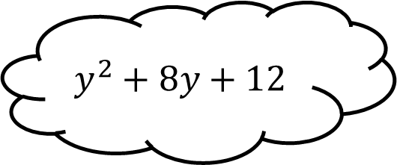
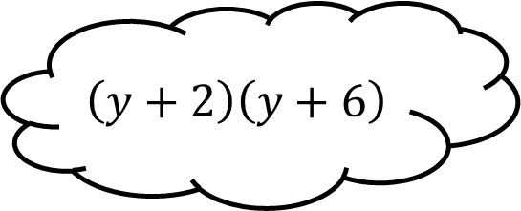
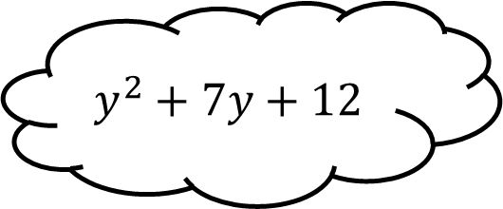
Matching 6
$$\left(y+3\right)\left(y+4\right)$$
$$y^{2}+y−12$$
$$\left(y−3\right)\left(y+4\right)$$
$$y^{2}−4y−12$$
$$\left(y+2\right)\left(y−6\right)$$
$$y^{2}+7y+12$$
$$\left(y−2\right)\left(y+6\right)$$
$$\left(y+2\right)\left(y+6\right)$$
$$y^{2}+8y+12$$

Slide 13

Matching 6 - Answers
$$y^{2}+8y+12$$
$$y^{2}+y−12$$
$$\left(y+3\right)\left(y+4\right)$$
$$\left(y−3\right)\left(y+4\right)$$
$$y^{2}−4y−12$$
$$\left(y+2\right)\left(y−6\right)$$
$$y^{2}+7y+12$$
$$\left(y−2\right)\left(y+6\right)$$
$$\left(y+2\right)\left(y+6\right)$$
$$y^{2}+8y+12$$

Slide 14









Matching 7
$$\left(4x+1\right)\left(x+3\right)$$
$$4x^{2}+7x+3$$
$$\left(4x−1\right)\left(x+3\right)$$
$$4x^{2}+11x−3$$
$$\left(x+1\right)\left(4x+3\right)$$
$$4x^{2}−4x−3$$
$$\left(4x+1\right)\left(x−3\right)$$
$$\left(2x+1\right)\left(2x−3\right)$$
$$4x^{2}−11x−3$$

Slide 15

Matching 7 - Answers
$$\left(4x+1\right)\left(x+3\right)$$
$$4x^{2}+13x+3$$
$$4x^{2}+7x+3$$
$$\left(4x−1\right)\left(x+3\right)$$
$$4x^{2}+11x−3$$
$$\left(x+1\right)\left(4x+3\right)$$
$$4x^{2}−4x−3$$
$$\left(4x+1\right)\left(x−3\right)$$
$$\left(2x+1\right)\left(2x−3\right)$$
$$4x^{2}−11x−3$$

Slide 16









Matching 8
$$\left(2x+1\right)\left(3x−5\right)$$
$$6x^{2}−13x+5$$
$$\left(2x−5\right)\left(3x+1\right)$$
$$6x^{2}+7x−5$$
$$\left(2x−1\right)\left(3x+5\right)$$
$$6x^{2}−7x−5$$
$$\left(2x−5\right)\left(3x−1\right)$$
$$6x^{2}−13x−5$$
$$\left(2x−1\right)\left(3x−5\right)$$

Slide 17

Matching 8 - Answers
$$\left(2x+1\right)\left(3x−5\right)$$
$$6x^{2}−13x+5$$
$$\left(2x−5\right)\left(3x+1\right)$$
$$6x^{2}+7x−5$$
$$\left(2x−1\right)\left(3x+5\right)$$
$$6x^{2}−7x−5$$
$$\left(2x−5\right)\left(3x−1\right)$$
$$6x^{2}−13x−5$$
$$6x^{2}−13x−5$$
$$\left(2x−1\right)\left(3x−5\right)$$

Slide 18









Matching n
$$x^{2}$$
$$x^{2}$$
$$x^{2}$$
$$x^{2}$$

Slide 19









Matching n

