Slide 1
Quadratics Matching
Match one group to the other.
There will be “spare” ones – what answers should be there?

Slide 2
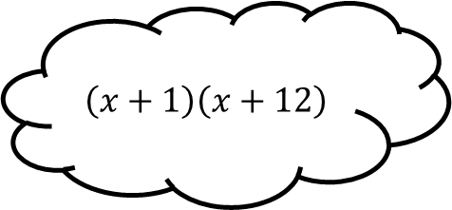
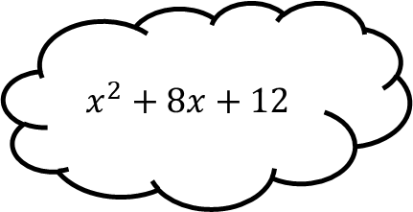
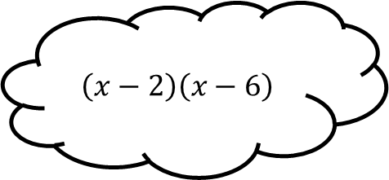
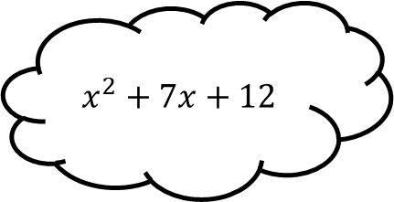
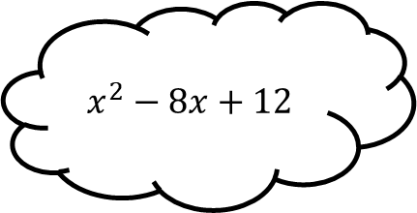
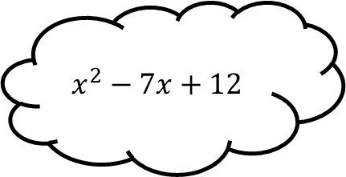
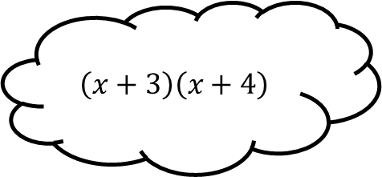
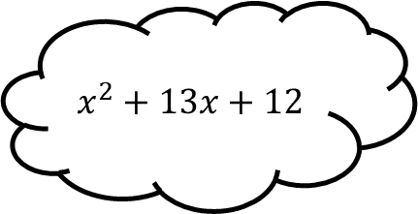
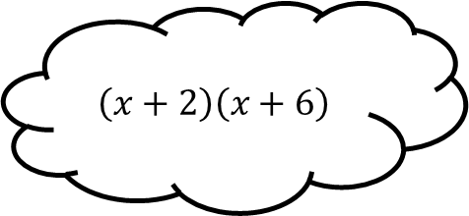
Matching 1
$$x^{2}+7x+12$$
$$\left(x−2\right)\left(x−6\right)$$
$$x^{2}−7x+12$$
$$\left(x+1\right)\left(x+12\right)$$
$$x^{2}+8x+12$$
$$\left(x+2\right)\left(x+6\right)$$
$$x^{2}−8x+12$$
$$x^{2}+13x+12$$
$$\left(x+3\right)\left(x+4\right)$$

Slide 3
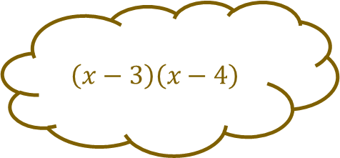
Matching 1 - Answers
$$x^{2}+7x+12$$
$$\left(x−3\right)\left(x−4\right)$$
$$\left(x−2\right)\left(x−6\right)$$
$$x^{2}−7x+12$$
$$\left(x+1\right)\left(x+12\right)$$
$$x^{2}+8x+12$$
$$\left(x+2\right)\left(x+6\right)$$
$$x^{2}−8x+12$$
$$x^{2}+13x+12$$
$$\left(x+3\right)\left(x+4\right)$$

Slide 4
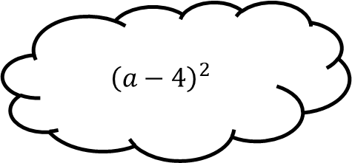
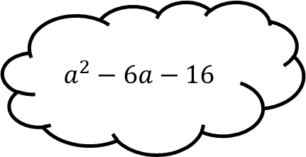
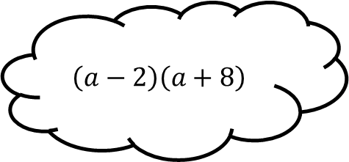
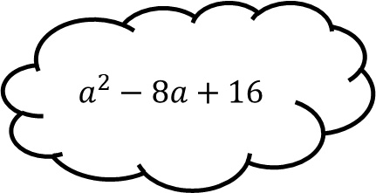
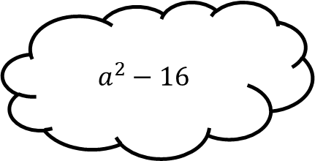
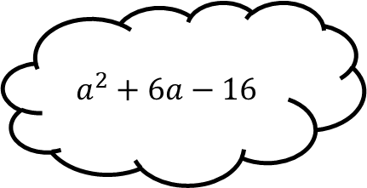
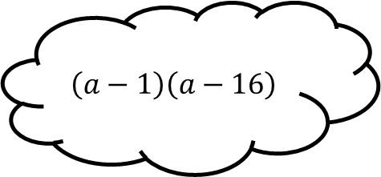
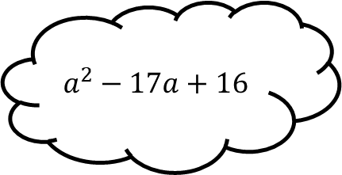
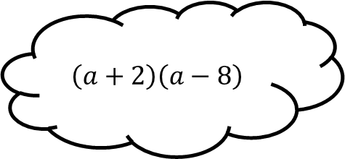
Matching 2
$$a^{2}−8a+16$$
$$\left(a−2\right)\left(a+8\right)$$
$$a^{2}+6a−16$$
$${\left(a−4\right)}^{2}$$
$$a^{2}−6a−16$$
$$\left(a+2\right)\left(a−8\right)$$
$$a^{2}−16$$
$$a^{2}−17a+16$$
$$\left(a−1\right)\left(a−16\right)$$

Slide 5
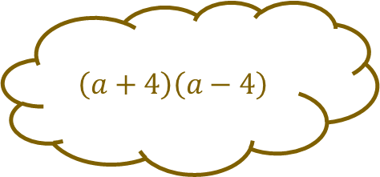
Matching 2 - Answers
$$a^{2}−8a+16$$
$$\left(a−2\right)\left(a+8\right)$$
$$a^{2}+6a−16$$
$${\left(a−4\right)}^{2}$$
$$a^{2}−6a−16$$
$$\left(a+2\right)\left(a−8\right)$$
$$a^{2}−16$$
$$\left(a+4\right)\left(a−4\right)$$
$$a^{2}−17a+16$$
$$\left(a−1\right)\left(a−16\right)$$

Slide 6
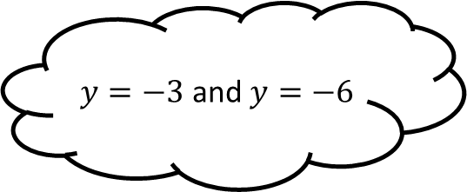
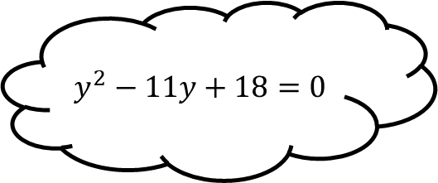
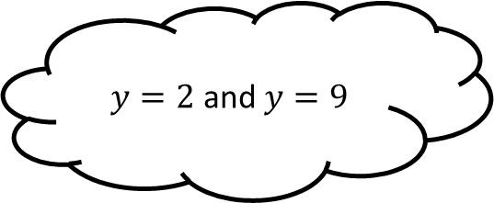
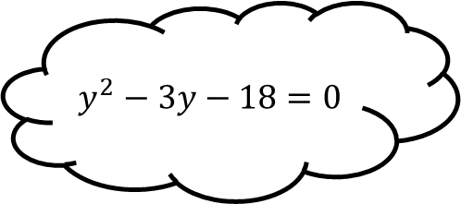
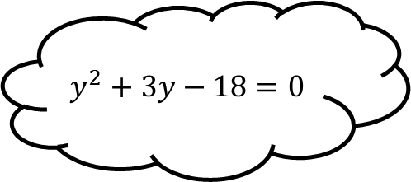
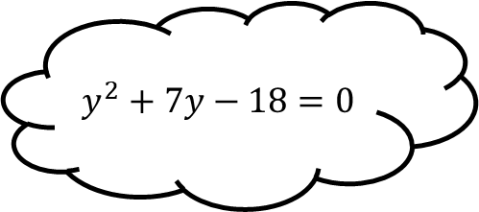
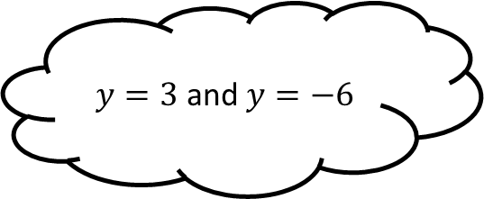
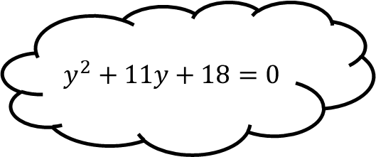
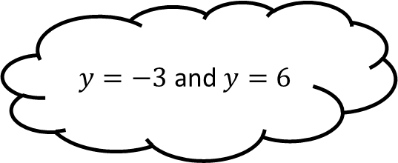
Matching 3
$$y^{2}−3y−18=0$$
$y=2$ and $y=9$
$$y^{2}+7y−18=0$$
$y=−3$ and $y=−6$
$$y^{2}−11y+18=0$$
$y=−3$ and $y=6$
$$y^{2}+3y−18=0$$
$$y^{2}+11y+18=0$$
$y=3$ and $y=−6$

Slide 7
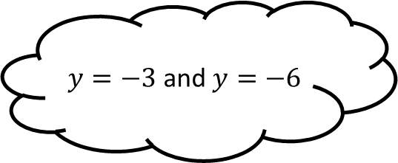
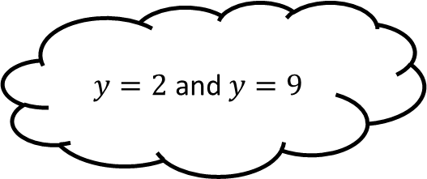
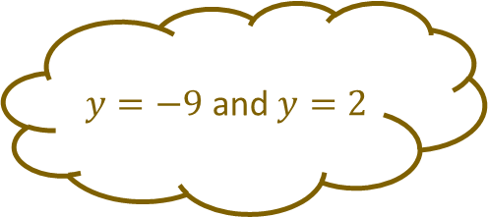
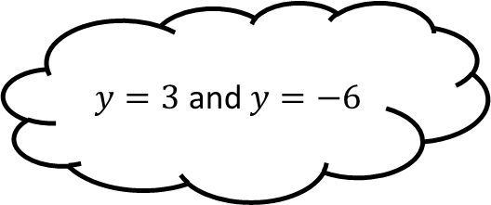
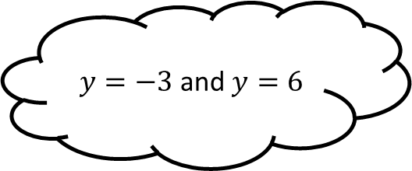
Matching 3 - Answers
$$y^{2}−3y−18=0$$
$y=2$ and $y=9$
$$y^{2}+7y−18=0$$
$y=−3$ and $y=−6$
$$y^{2}−11y+18=0$$
$y=−9$ and $y=2$
$y=−3$ and $y=6$
$$y^{2}+3y−18=0$$
$$y^{2}+11y+18=0$$
$y=3$ and $y=−6$

Slide 8
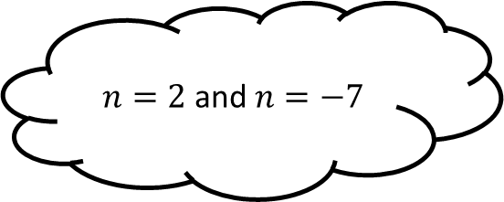
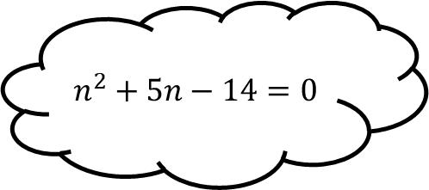
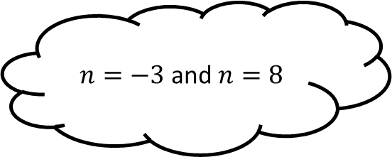
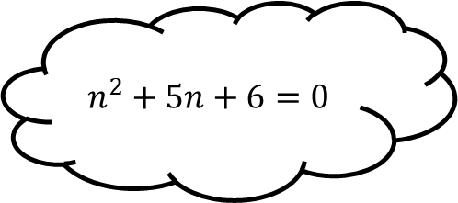
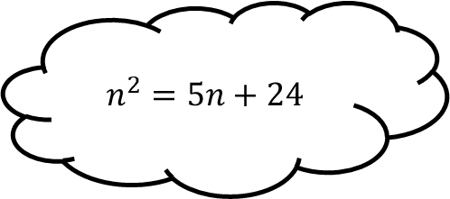
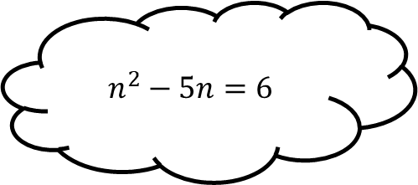
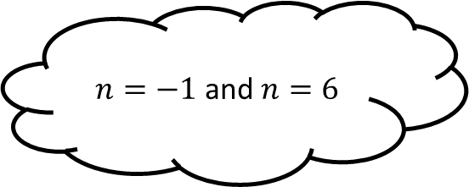
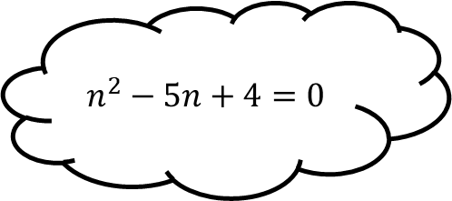
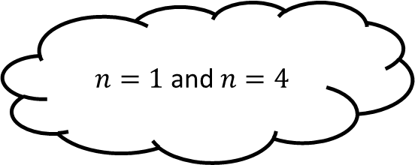
Matching 4
$$n^{2}+5n+6=0$$
$n=−3$ and $n=8$
$$n^{2}−5n=6$$
$n=2$ and $n=−7$
$$n^{2}+5n−14=0$$
$n=1$ and $n=4$
$$n^{2}=5n+24$$
$$n^{2}−5n+4=0$$
$n=−1$ and $n=6$

Slide 9
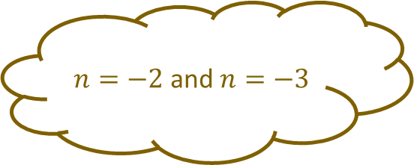
Matching 4 - Answers
$$n^{2}+5n+6=0$$
$n=−2$ and $n=−3$
$n=−3$ and $n=8$
$$n^{2}−5n=6$$
$n=2$ and $n=−7$
$$n^{2}+5n−14=0$$
$n=1$ and $n=4$
$$n^{2}=5n+24$$
$$n^{2}−5n+4=0$$
$n=−1$ and $n=6$

Slide 10
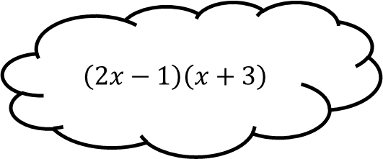
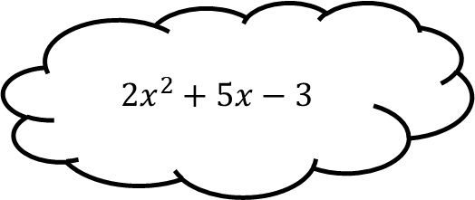
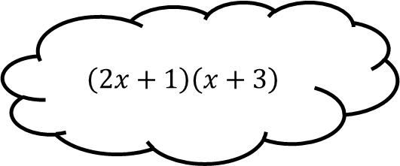
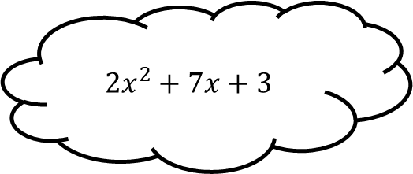
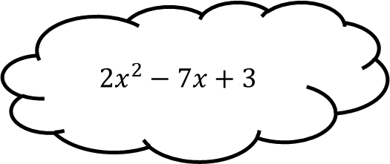
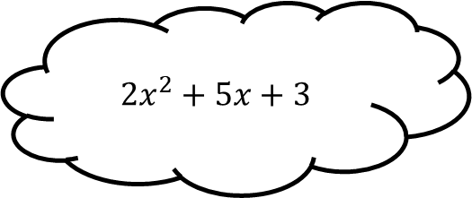



Matching 5
$${2x}^{2}+7x+3$$
$$\left(2x+1\right)\left(x+3\right)$$
$${2x}^{2}+5x+3$$
$$\left(2x−1\right)\left(x+3\right)$$
$${2x}^{2}+5x−3$$
$$\left(2x+3\right)\left(x+1\right)$$
$${2x}^{2}−7x+3$$
$${2x}^{2}−x−3$$
$$\left(2x−3\right)\left(x+1\right)$$

Slide 11

Matching 5 - Answers
$${2x}^{2}+7x+3$$
$$\left(2x+1\right)\left(x+3\right)$$
$${2x}^{2}+5x+3$$
$$\left(2x−1\right)\left(x+3\right)$$
$${2x}^{2}+5x−3$$
$$\left(2x+3\right)\left(x+1\right)$$
$${2x}^{2}−7x+3$$
$$\left(2x−3\right)\left(x−1\right)$$
$${2x}^{2}−x−3$$
$$\left(2x−3\right)\left(x+1\right)$$

Slide 12









Matching 6
$${3x}^{2}+x−2=0$$
$x=−\frac{1}{3}$ and $x=−2$
$${3x}^{2}+5x−2=0$$
$x=−\frac{2}{3}$ and $x=−1$
$${3x}^{2}+7x+2=0$$
$x=\frac{2}{3}$ and $x=−1$
$${3x}^{2}−5x=2$$
$${3x}^{2}+5x+2=0$$
$x=\frac{1}{3}$ and $x=−2$

Slide 13

Matching 6 - Answers
$${3x}^{2}+x−2=0$$
$x=−\frac{1}{3}$ and $x=−2$
$${3x}^{2}+5x−2=0$$
$x=−\frac{2}{3}$ and $x=−1$
$${3x}^{2}+7x+2=0$$
$x=\frac{2}{3}$ and $x=−1$
$${3x}^{2}−5x=2$$
$${3x}^{2}+5x+2=0$$
$x=−\frac{1}{3}$ and $x=2$
$x=\frac{1}{3}$ and $x=−2$

Slide 14









Matching 7
$$y^{2}+6y−3$$
$${\left(y−3\right)}^{2}−7$$
$$y^{2}−6y−3$$
$${\left(y−3\right)}^{2}−12$$
$$y^{2}−6y+14$$
$${\left(y+3\right)}^{2}−12$$
$$y^{2}+6y+2$$
$$y^{2}+6y−7$$
$${\left(y+3\right)}^{2}−16$$

Slide 15

Matching 7 - Answers
$$y^{2}+6y−3$$
$${\left(y−3\right)}^{2}−7$$
$$y^{2}−6y−3$$
$${\left(y−3\right)}^{2}−12$$
$$y^{2}−6y+14$$
$${\left(y+3\right)}^{2}−12$$
$$y^{2}+6y+2$$
$${\left(y−3\right)}^{2}+5$$
$$y^{2}+6y−7$$
$${\left(y+3\right)}^{2}−16$$

Slide 16









Matching 8
$$x^{2}+10x−3$$
$${\left(x−5\right)}^{2}−27$$
$$x^{2}+10x+15$$
$${\left(x+5\right)}^{2}−38$$
$$x^{2}−10x−2$$
$${\left(x+5\right)}^{2}−28$$
$$x^{2}−10x+29$$
$$x^{2}+10x−13$$
$${\left(x−5\right)}^{2}+4$$

Slide 17

Matching 8 - Answers
$$x^{2}+10x−3$$
$${\left(x+5\right)}^{2}−10$$
$${\left(x−5\right)}^{2}−27$$
$$x^{2}+10x+15$$
$${\left(x+5\right)}^{2}−38$$
$$x^{2}−10x−2$$
$${\left(x+5\right)}^{2}−28$$
$$x^{2}−10x+29$$
$$x^{2}+10x−13$$
$${\left(x−5\right)}^{2}+4$$

Slide 18









Matching 9
$$x^{2}+4x−2=0$$
$$x=2±2\sqrt{2}$$
$$x^{2}−4x+2=0$$
$$x=−2±\sqrt{6}$$
$$x^{2}+8x+3=0$$
$$x=−4±\sqrt{19}$$
$$x^{2}+8x−3=0$$
$$x^{2}−4x−4=0$$
$$x=2±\sqrt{2}$$

Slide 19

Matching 9 - Answers
$$x^{2}+4x−2=0$$
$$x=2±2\sqrt{2}$$
$$x^{2}−4x+2=0$$
$$x=−2±\sqrt{6}$$
$$x^{2}+8x+3=0$$
$$x=−4±\sqrt{19}$$
$$x^{2}+8x−3=0$$
$$x^{2}−4x−4=0$$
$$x=−4±\sqrt{13}$$
$$x=2±\sqrt{2}$$

Slide 20









Matching 10
$$x^{2}−10x+6=0$$
$$x=\frac{5}{2}±\sqrt{\frac{13}{4}}$$
$$x^{2}−10x−9=0$$
$$x=5±\sqrt{19}$$
$$x^{2}−5x−1=0$$
$$x=5±\sqrt{34}$$
$$x^{2}+5x+2=0$$
$$x^{2}−5x+3=0$$
$$x=\frac{5}{2}±\sqrt{\frac{29}{4}}$$

Slide 21

Matching 10 - Answers
$$x^{2}−10x+6=0$$
$$x=\frac{5}{2}±\sqrt{\frac{13}{4}}$$
$$x^{2}−10x−9=0$$
$$x=5±\sqrt{19}$$
$$x^{2}−5x−1=0$$
$$x=5±\sqrt{34}$$
$$x^{2}+5x+2=0$$
$$x^{2}−5x+3=0$$
$$x=−\frac{5}{2}±\sqrt{\frac{17}{4}}$$
$$x=\frac{5}{2}±\sqrt{\frac{29}{4}}$$

Slide 22






Matching n

Slide 23









Matching n

