Slide 1

Exploding Surds
Can you fill in the blanks?

Slide 2

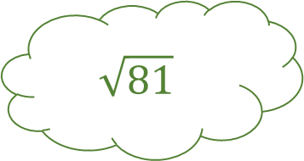
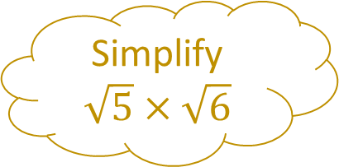

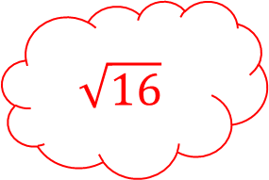

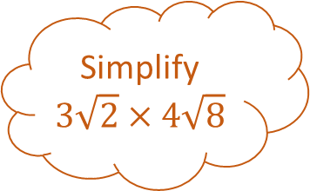
Simplify $\sqrt{5}×\sqrt{6}$
Exploding Surds 1
Simplify
$$3\sqrt{2}×4\sqrt{8}$$
Simplify $\sqrt{}×\sqrt{}$
Fill in the blanks…
Simplify $\frac{\sqrt{21}}{\sqrt{7}}$
$$\sqrt{81}$$
Simplify
$$\sqrt{16}$$

Slide 3
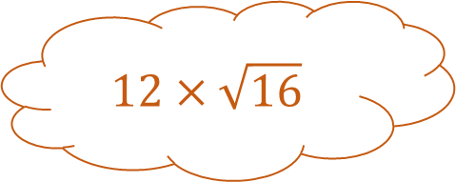


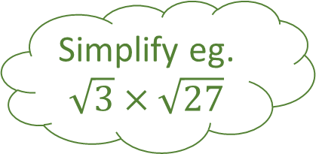
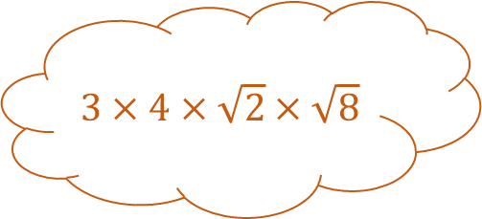


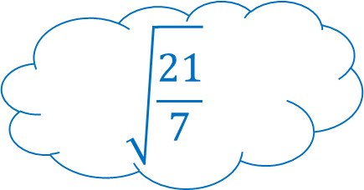

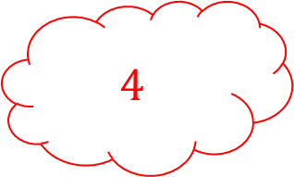
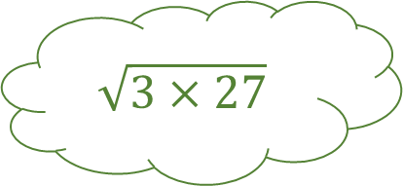
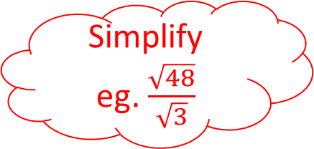

Exploding Surds 1 – Answers
Simplify $\sqrt{5}×\sqrt{6}$
$$\sqrt{5×6}$$
$$\sqrt{30}$$
$$3×4×\sqrt{2}×\sqrt{8}$$
Simplify
$$3\sqrt{2}×4\sqrt{8}$$
Simplify eg. $\sqrt{3}×\sqrt{27}$
$$\sqrt{3×27}$$
Fill in the blanks…
$$12×\sqrt{16}$$
Simplify $\frac{\sqrt{21}}{\sqrt{7}}$
$$\sqrt{81}$$
Simplify
eg. $\frac{\sqrt{48}}{\sqrt{3}}$
$$48$$
$$\sqrt{\frac{21}{7}}$$
$$9$$
$$4$$
$$\sqrt{\frac{48}{3}}$$
$$\sqrt{16}$$
$$\sqrt{3}$$

Slide 4
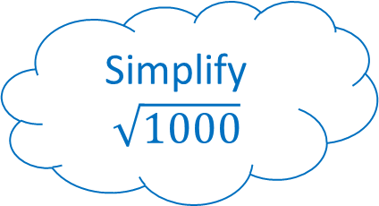
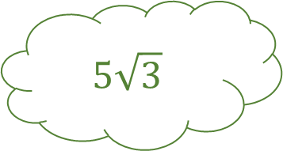


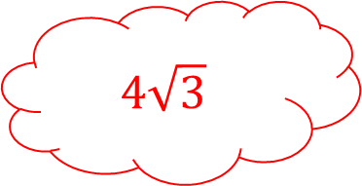

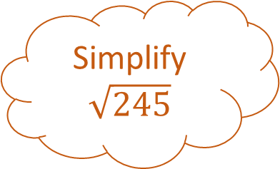
Simplify $\sqrt{18}$
Exploding Surds 2
Simplify $\sqrt{245}$
Simplify
Fill in the blanks…
Simplify $\sqrt{1000}$
$$5\sqrt{3}$$
Simplify
$$4\sqrt{3}$$

Slide 5
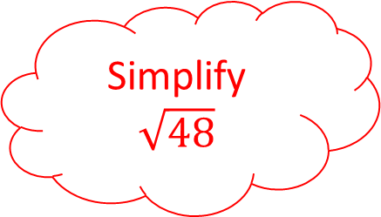

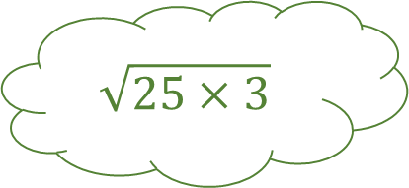



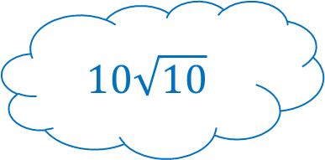
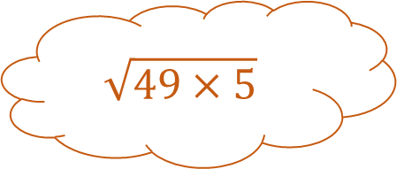
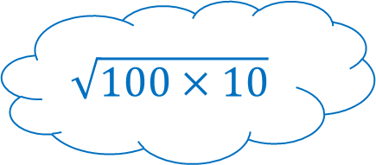

Exploding Surds 2 – Answers
Simplify $\sqrt{18}$
$$\sqrt{9×2}$$
$$3\sqrt{2}$$
Simplify $\sqrt{245}$
Simplify $\sqrt{75}$
$$\sqrt{49×5}$$
$$\sqrt{25×3}$$
Fill in the blanks…
Simplify $\sqrt{1000}$
$$7\sqrt{5}$$
$$5\sqrt{3}$$
Simplify $\sqrt{48}$
$$\sqrt{100×10}$$
$$4\sqrt{3}$$
$$\sqrt{16×3}$$
$$10\sqrt{10}$$

Slide 6

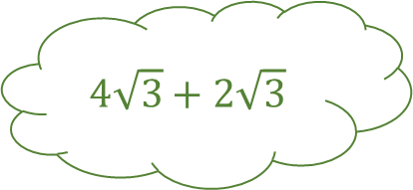
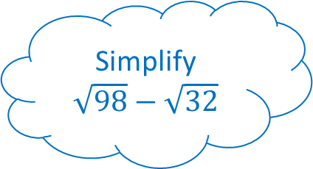
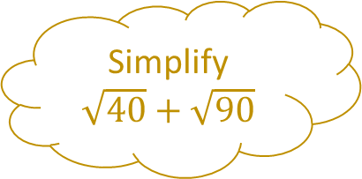
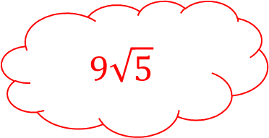
Simplify $\sqrt{40}+\sqrt{90}$
Exploding Surds 3
Simplify
Simplify
$$4\sqrt{3}+2\sqrt{3}$$
Fill in the blanks…
Simplify $\sqrt{98}−\sqrt{32}$
$$\sqrt{7}$$
Simplify
$$9\sqrt{5}$$

Slide 7
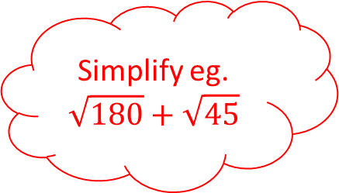
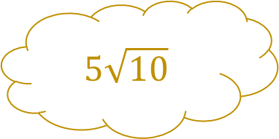
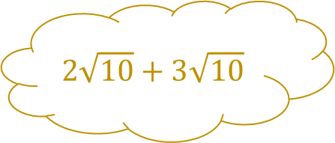
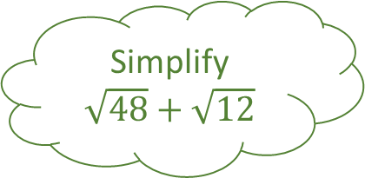
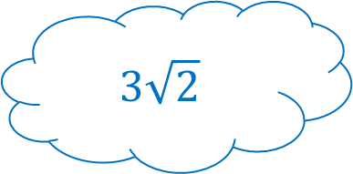
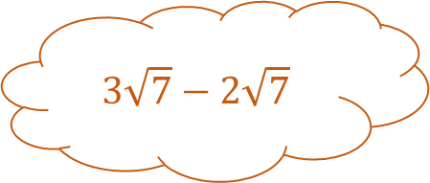
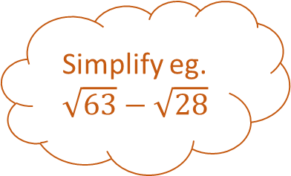
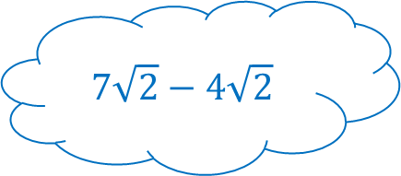

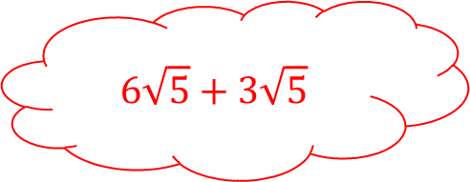
Exploding Surds 3 – Answers
Simplify $\sqrt{40}+\sqrt{90}$
$$2\sqrt{10}+3\sqrt{10}$$
$$5\sqrt{10}$$
Simplify eg. $\sqrt{63}−\sqrt{28}$
Simplify $\sqrt{48}+\sqrt{12}$
$$3\sqrt{7}−2\sqrt{7}$$
$$4\sqrt{3}+2\sqrt{3}$$
Fill in the blanks…
Simplify $\sqrt{98}−\sqrt{32}$
$$\sqrt{7}$$
$$6\sqrt{3}$$
Simplify eg.
$$\sqrt{180}+\sqrt{45}$$
$$7\sqrt{2}−4\sqrt{2}$$
$$9\sqrt{5}$$
$$6\sqrt{5}+3\sqrt{5}$$
$$3\sqrt{2}$$

Slide 8
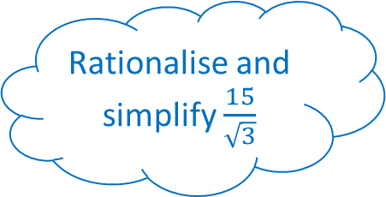
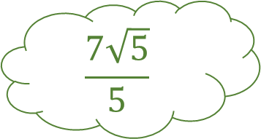
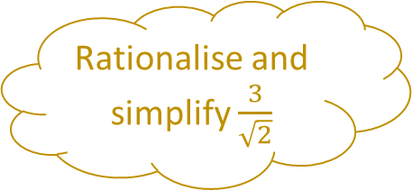

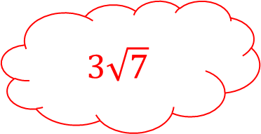
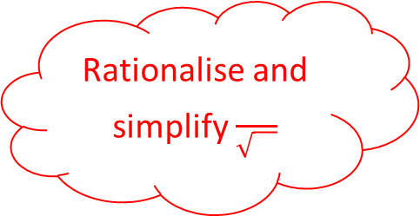
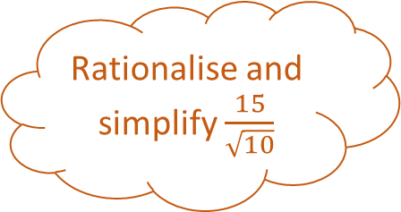
Rationalise and simplify $\frac{3}{\sqrt{2}}$
Exploding Surds 4
Rationalise and simplify $\frac{15}{\sqrt{10}}$
Rationalise and simplify
Fill in the blanks…
Rationalise and simplify $\frac{15}{\sqrt{3}}$
$$\frac{7\sqrt{5}}{5}$$
Rationalise and simplify
$$3\sqrt{7}$$

Slide 9
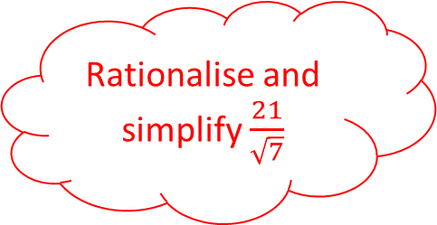
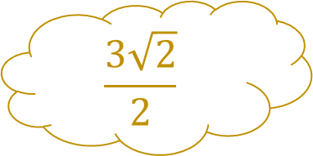
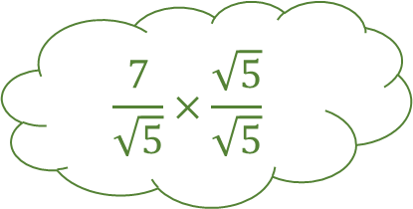

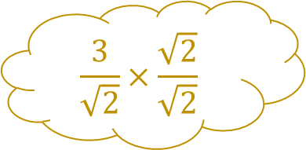
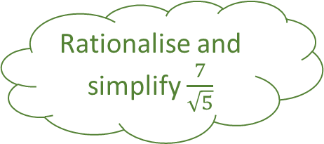

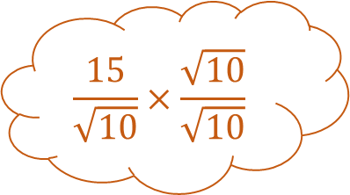
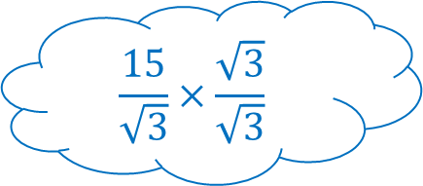

Exploding Surds 4 – Answers
Rationalise and simplify $\frac{3}{\sqrt{2}}$
$$\frac{3}{\sqrt{2}}×\frac{\sqrt{2}}{\sqrt{2}}$$
$$\frac{3\sqrt{2}}{2}$$
Rationalise and simplify $\frac{15}{\sqrt{10}}$
Rationalise and simplify $\frac{7}{\sqrt{5}}$
$$\frac{15}{\sqrt{10}}×\frac{\sqrt{10}}{\sqrt{10}}$$
$$\frac{7}{\sqrt{5}}×\frac{\sqrt{5}}{\sqrt{5}}$$
Fill in the blanks…
Rationalise and simplify $\frac{15}{\sqrt{3}}$
$$\frac{3\sqrt{10}}{2}$$
$$\frac{7\sqrt{5}}{5}$$
Rationalise and simplify $\frac{21}{\sqrt{7}}$
$$\frac{15}{\sqrt{3}}×\frac{\sqrt{3}}{\sqrt{3}}$$
$$3\sqrt{7}$$
$$\frac{21}{\sqrt{7}}×\frac{\sqrt{7}}{\sqrt{7}}$$
$$5\sqrt{3}$$

Slide 10
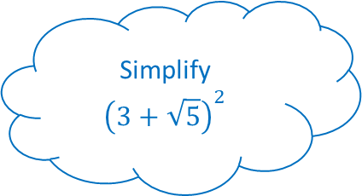
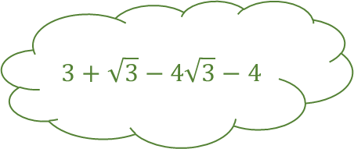
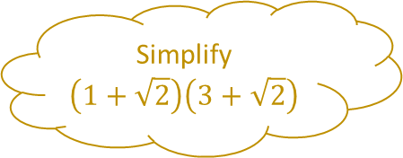

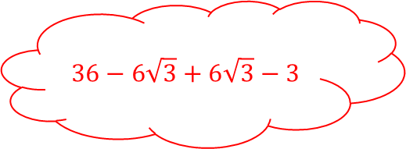


Simplify
$$\left(1+\sqrt{2}\right)\left(3+\sqrt{2}\right)$$
Exploding Surds 5
Simplify
Simplify
$$\left(1+\sqrt{3}\right)\left(\sqrt{3}−1\right)$$
$$3+\sqrt{3}−4\sqrt{3}−4$$
Fill in the blanks…
Simplify
$${\left(3+\sqrt{5}\right)}^{2}$$
Simplify
$$36−6\sqrt{3}+6\sqrt{3}−3$$

Slide 11










Exploding Surds 5 – Answers
Simplify
$$\left(1+\sqrt{2}\right)\left(3+\sqrt{2}\right)$$
$$3+\sqrt{2}+3\sqrt{2}+2$$
$$5+4\sqrt{2}$$
Simplify
$$\left(1+\sqrt{3}\right)\left(\sqrt{3}−1\right)$$
Simplify
$$\left(\sqrt{3}−4\right)\left(\sqrt{3}+1\right)$$
$$\sqrt{3}−1+3−\sqrt{3}$$
$$3+\sqrt{3}−4\sqrt{3}−4$$
Fill in the blanks…
Simplify
$${\left(3+\sqrt{5}\right)}^{2}$$
$$2$$
$$−1−3\sqrt{3}$$
Simplify
$$\left(6+\sqrt{3}\right)\left(6−\sqrt{3}\right)$$
$$9+3\sqrt{5}+3\sqrt{5}+5$$
$$33$$
$$36−6\sqrt{3}+6\sqrt{3}−3$$
$$14+6\sqrt{5}$$

Slide 12





Rationalise and simplify $\frac{3}{5+\sqrt{2}}$
Exploding Surds 6
Rationalise and simplify $\frac{\sqrt{2}+10}{\sqrt{10}}$
Rationalise and simplify $\frac{5}{\sqrt{3}−1}$
Fill in the blanks…
Rationalise and simplify $\frac{10}{2+\sqrt{5}}$
Rationalise and simplify $\frac{12}{1−\sqrt{3}}$

Slide 13










Exploding Surds 6 – Answers
Rationalise and simplify $\frac{3}{5+\sqrt{2}}$
$$\frac{3}{5+\sqrt{2}}×\frac{5−\sqrt{2}}{5−\sqrt{2}}$$
$$\frac{15−3\sqrt{2}}{23}$$
Rationalise and simplify $\frac{\sqrt{2}+10}{\sqrt{10}}$
Rationalise and simplify $\frac{5}{\sqrt{3}−1}$
$$\frac{\sqrt{2}+10}{2−\sqrt{10}}×\frac{2+\sqrt{10}}{2+\sqrt{10}}$$
$$\frac{5}{\sqrt{3}−1}×\frac{\sqrt{3}+1}{\sqrt{3}+1}$$
Fill in the blanks…
Rationalise and simplify $\frac{10}{2+\sqrt{5}}$
$$\frac{5\sqrt{10}+\sqrt{5}}{5}$$
$$\frac{5+5\sqrt{3}}{2}$$
Rationalise and simplify $\frac{12}{1−\sqrt{3}}$
$$\frac{10}{2+\sqrt{5}}×\frac{4−\sqrt{5}}{2−\sqrt{5}}$$
$$−6−6\sqrt{3}$$
$$\frac{12}{1−\sqrt{3}}×\frac{1+\sqrt{3}}{1+\sqrt{3}}$$
$$−20+10\sqrt{5}$$

Slide 14














Exploding Surds n – Answers
Simplify
Simplify
Simplify
Fill in the blanks…
Simplify
Simplify

Slide 15
Exploding Indices and Surds

Slide 16
Exploding Indices and Surds

