Slide 1
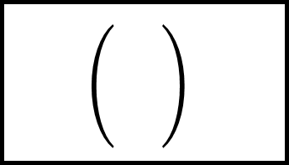
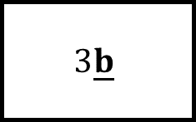
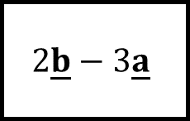
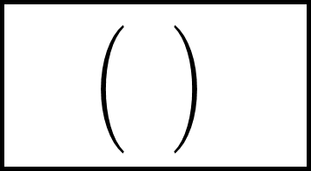
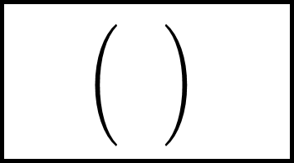
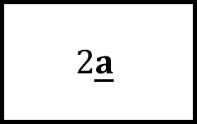
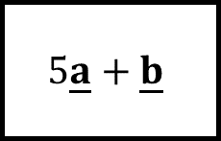
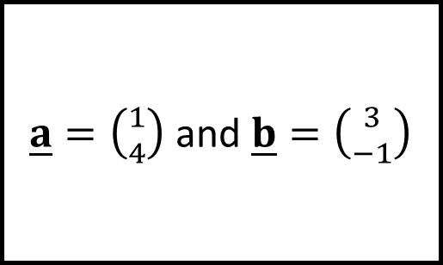
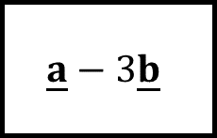
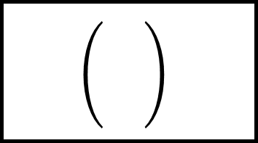
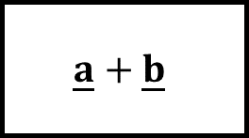
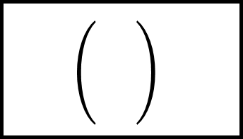
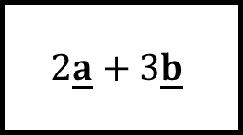
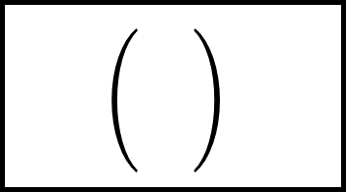
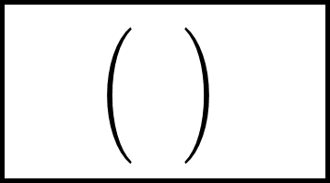
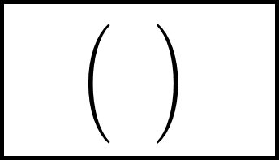
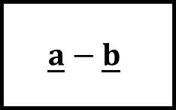
$$\underline{a}+\underline{b}$$
Vectors Spider 1
$$\underline{a}−3\underline{b}$$
$$2\underline{a}$$
$\underline{a}=\left({1 \atop 4}\right)$ and $\underline{b}=\left({3 \atop −1}\right)$
$$5\underline{a}+\underline{b}$$
$$3\underline{b}$$
$$2\underline{b}−3\underline{a}$$
$$\underline{a}−\underline{b}$$
$$2\underline{a}+3\underline{b}$$

Slide 2
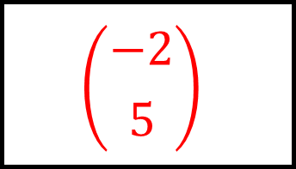
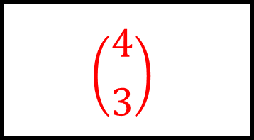
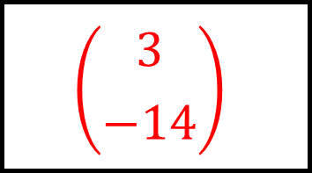
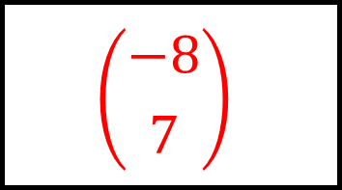
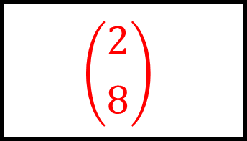
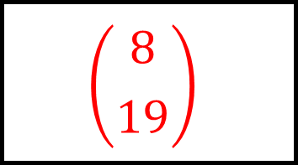
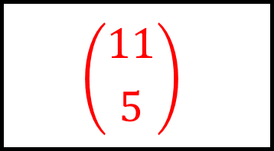
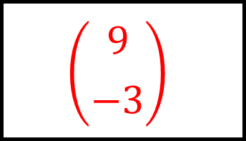
$$\left({4 \atop 3}\right)$$
$$\left({−8 \atop 7}\right)$$
$$\left({2 \atop 8}\right)$$
$$\underline{a}+\underline{b}$$
Vectors Spider 1 - Answers
$$\underline{a}−3\underline{b}$$
$$2\underline{a}$$
$\underline{a}=\left({1 \atop 4}\right)$ and $\underline{b}=\left({3 \atop −1}\right)$
$$\left({8 \atop 19}\right)$$
$$\left({9 \atop −3}\right)$$
$$5\underline{a}+\underline{b}$$
$$3\underline{b}$$
$$2\underline{b}−3\underline{a}$$
$$\underline{a}−\underline{b}$$
$$2\underline{a}+3\underline{b}$$
$$\left({3 \atop −14}\right)$$
$$\left({−2 \atop 5}\right)$$
$$\left({11 \atop 5}\right)$$

Slide 3
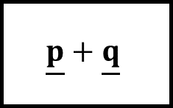
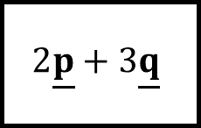
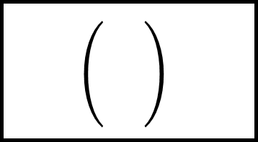
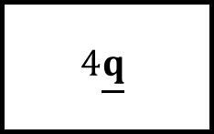
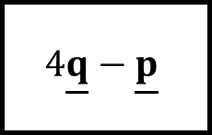
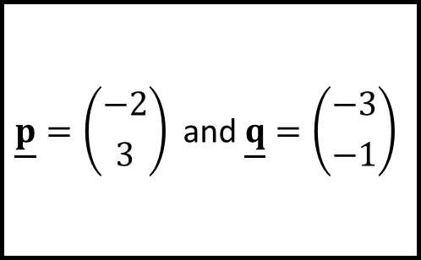
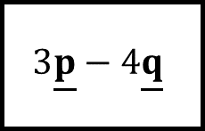
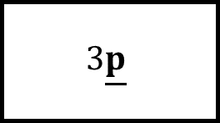
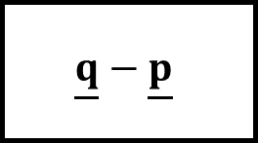
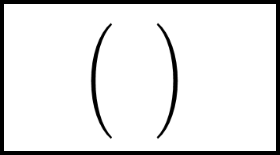

$$3\underline{p}$$
$$3\underline{p}−4\underline{q}$$
$$4\underline{q}$$
Vectors Spider 2
$$\underline{p}=\left({−2 \atop 3}\right) \text{and} \underline{q}=\left({−3 \atop −1}\right)$$
$$4\underline{q}−\underline{p}$$
$$\underline{p}+\underline{q}$$
$$2\underline{p}+3\underline{q}$$
$$\underline{p}−\underline{q}$$
$$\underline{q}−\underline{p}$$

Slide 4
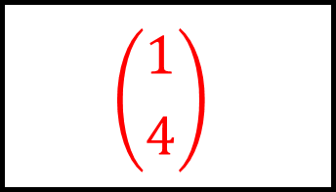
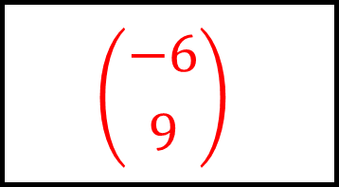
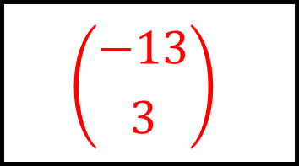
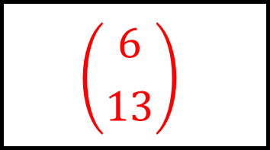
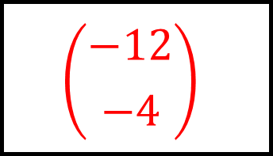
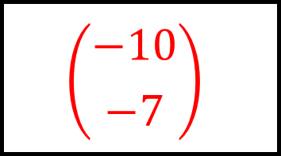
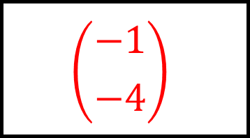
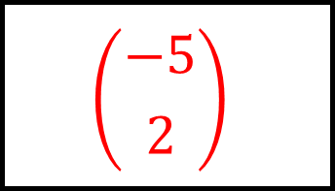
$$\left({−6 \atop 9}\right)$$
$$\left({6 \atop 13}\right)$$
$$\left({−12 \atop −4}\right)$$
$$3\underline{p}$$
Vectors Spider 2 - Answers
$$3\underline{p}−4\underline{q}$$
$$4\underline{q}$$
$$\underline{p}=\left({−2 \atop 3}\right) \text{and} \underline{q}=\left({−3 \atop −1}\right)$$
$$\left({−10 \atop −7}\right)$$
$$\left({−5 \atop 2}\right)$$
$$4\underline{q}−\underline{p}$$
$$\underline{p}+\underline{q}$$
$$2\underline{p}+3\underline{q}$$
$$\underline{p}−\underline{q}$$
$$\underline{q}−\underline{p}$$
$$\left({−13 \atop 3}\right)$$
$$\left({1 \atop 4}\right)$$
$$\left({−1 \atop −4}\right)$$

Slide 5
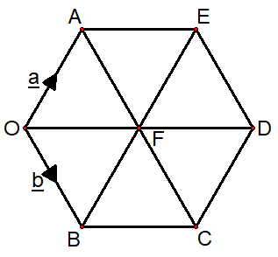
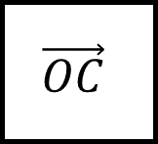
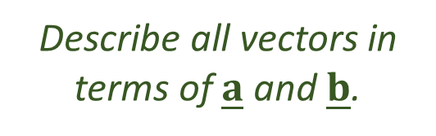
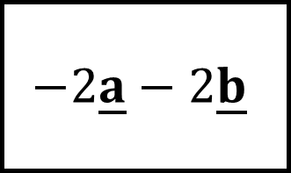
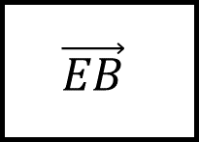
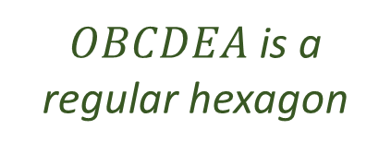
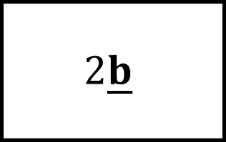





$$−2\underline{a}−2\underline{b}$$
$$2\underline{b}$$
$$\vec{OF}$$
Vectors Spider 3
$OBCDEA$ is a regular hexagon
$$\vec{CE}$$
$$\vec{EB}$$
Describe all vectors in terms of $\underline{a}$ and $\underline{b}$.
$$\vec{OA}=\underline{a}$$
$$\vec{OB}=\underline{b}$$
$$\vec{OC}$$
$$−\underline{a}−2\underline{b}$$
$$−\underline{a}−\underline{b}$$

Slide 6








$$\underline{a}+\underline{b}$$
$$−2\underline{a}−2\underline{b}$$
$$2\underline{b}$$
$$\vec{OF}$$
Vectors Spider 3 - Answers
$$\vec{DO}$$
$$\vec{AC}$$
$OBCDEA$ is a regular hexagon
$$\underline{a}−\underline{b}$$
$$−2\underline{a}$$
$$\vec{CE}$$
$$\vec{EB}$$
Describe all vectors in terms of $\underline{a}$ and $\underline{b}$.
$$\vec{OA}=\underline{a}$$
$$\vec{OB}=\underline{b}$$
$$\vec{DA}$$
$$\vec{CB}$$
$$\vec{OC}$$
$$−\underline{a}−2\underline{b}$$
$$−\underline{a}−\underline{b}$$
$$\underline{a}+2\underline{b}$$

Slide 7












$$\frac{1}{2}\underline{q}−\frac{1}{2}\underline{p}$$
$$2\underline{q}−\underline{p}$$
$$\vec{OR}$$
Vectors Spider 4
$OPRQ$ is a parallelogram.
$M$ is the midpoint of $QR$.
$$\vec{QN}$$
$$\vec{QO}$$
Describe all vectors in terms of $\underline{p}$ and $\underline{q}$.
$\vec{OP}=\underline{p}$ and $\vec{OQ}=2\underline{q}$
$\vec{PN}:\vec{NR}$ is $3:1$
$$\vec{PM}$$
$$\underline{p}+\frac{3}{2}\underline{q}$$
$$\frac{1}{2}\underline{p}+2\underline{q}$$

Slide 8








$$\underline{p}+2\underline{q}$$
$$\frac{1}{2}\underline{q}−\frac{1}{2}\underline{p}$$
$$2\underline{q}−\underline{p}$$
$$\vec{OR}$$
Vectors Spider 4 - Answers
$$\vec{NM}$$
$$\vec{PQ}$$
$OPRQ$ is a parallelogram.
$M$ is the midpoint of $QR$.
$$\underline{p}−\frac{1}{2}\underline{q}$$
$$−2\underline{q}$$
$$\vec{QN}$$
$$\vec{QO}$$
Describe all vectors in terms of $\underline{p}$ and $\underline{q}$.
$\vec{OP}=\underline{p}$ and $\vec{OQ}=2\underline{q}$
$\vec{PN}:\vec{NR}$ is $3:1$
$$\vec{ON}$$
$$\vec{OM}$$
$$\vec{PM}$$
$$\underline{p}+\frac{3}{2}\underline{q}$$
$$\frac{1}{2}\underline{p}+2\underline{q}$$
$$2\underline{q}−\frac{1}{2}\underline{p}$$

Slide 9

















Vectors Spider - Blank

