Slide 1
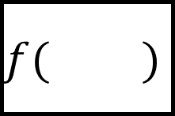
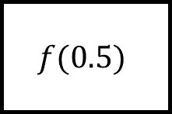
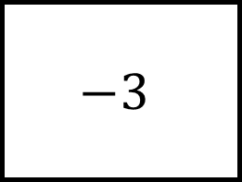
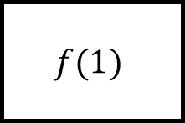
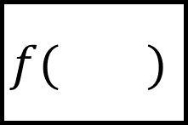
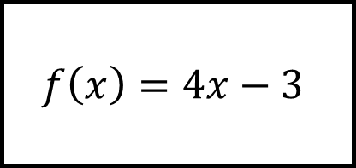
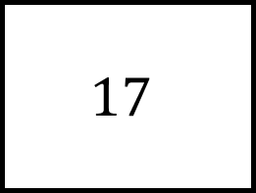
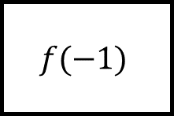
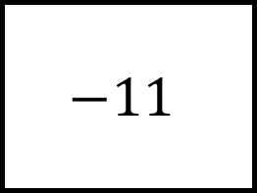

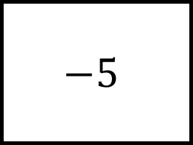
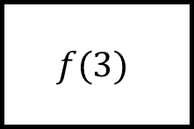

$$−5$$
$$−3$$
$$f(1)$$
Functions Spider 1
$$f( )$$
$$f( )$$
$$f\left(x\right)=4x−3$$
$$f(0.5)$$
$$f(3)$$
$$f( )$$
$$f( )$$
$$f(−1)$$
$$−11$$
$$17$$

Slide 2
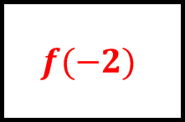

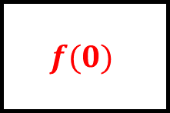
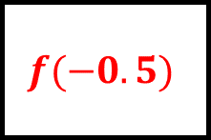
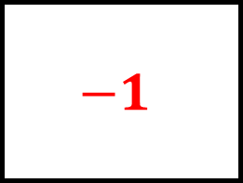
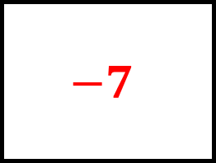
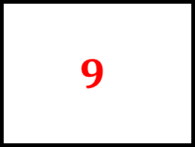
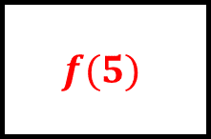
$$1$$
$$−5$$
$$−3$$
Functions Spider 1 - Answers
$$f(1)$$
$$f(−0.5)$$
$$f(0)$$
$$−1$$
$$f\left(x\right)=4x−3$$
$$9$$
$$f(0.5)$$
$$f(3)$$
$$f(−2)$$
$$f(5)$$
$$f(−1)$$
$$−11$$
$$17$$
$$−7$$

Slide 3
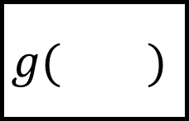
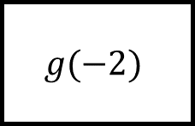

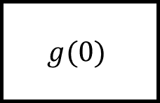

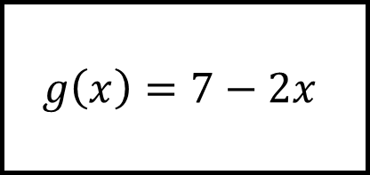
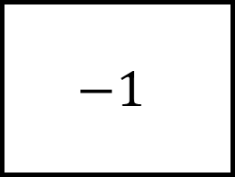
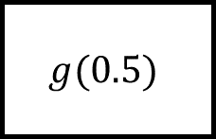
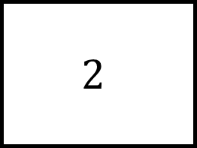
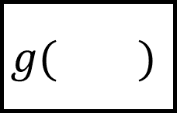
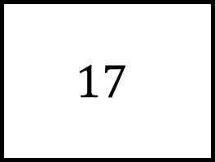
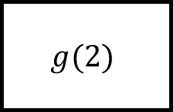

$$17$$
$$1$$
$$g(0)$$
Functions Spider 2
$$g( )$$
$$g( )$$
$$g\left(x\right)=7−2x$$
$$g(−2)$$
$$g(2)$$
$$g( )$$
$$g( )$$
$$g(0.5)$$
$$2$$
$$−1$$

Slide 4
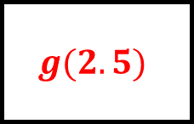
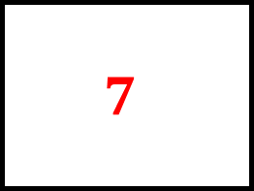
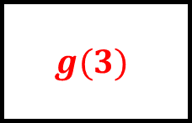
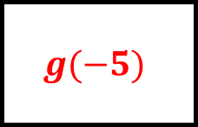
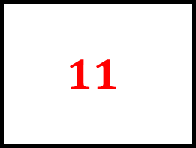
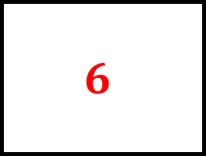

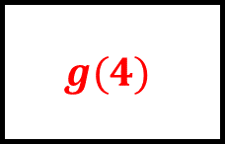
$$7$$
$$17$$
$$1$$
Functions Spider 2 - Answers
$$g(0)$$
$$g(−5)$$
$$g(3)$$
$$11$$
$$g\left(x\right)=7−2x$$
$$3$$
$$g(−2)$$
$$g(2)$$
$$g(2.5)$$
$$g(4)$$
$$g(0.5)$$
$$2$$
$$−1$$
$$6$$

Slide 5
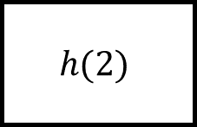
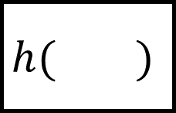
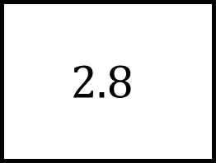
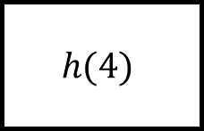
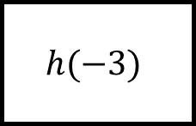
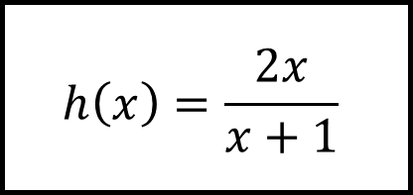
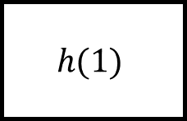

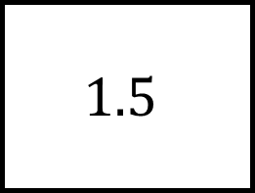

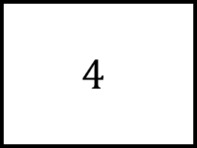

$$h(1)$$
$$h(−1)$$
$$h(4)$$
Functions Spider 3
$$h\left(x\right)=\frac{2x}{x+1}$$
$$h(−3)$$
$$h(2)$$
$$h( )$$
$$h( )$$
$$h( )$$
$$4$$
$$1.5$$
$$2.8$$

Slide 6
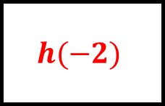

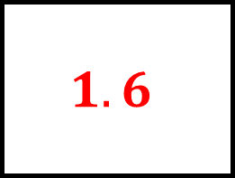
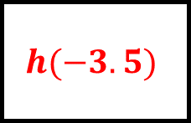

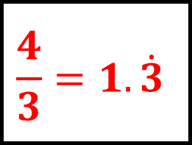
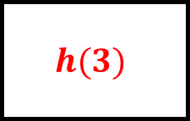
$$1$$
$$∞$$
$$1.6$$
Functions Spider 3 - Answers
$$h(1)$$
$$h(−1)$$
$$h(4)$$
$$3$$
$$h\left(x\right)=\frac{2x}{x+1}$$
$$\frac{4}{3}=1.\dot{3}$$
$$h(−3)$$
$$h(2)$$
$$h(−2)$$
$$h(3)$$
$$h(−3.5)$$
$$4$$
$$1.5$$
$$2.8$$

Slide 7
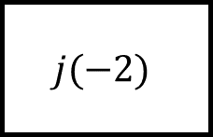








$$j(0)$$
Functions Spider 4
$$j(−2)$$
$$j(2)$$
$$j\left(x\right)=x^{2}+2x$$
$$j(−3)$$
$$j(5)$$
$$j(−1)$$
$$j(3)$$
$$j(7)$$

Slide 8







$$0$$
$$0$$
$$8$$
Functions Spider 4 - Answers
$$j(0)$$
$$j(−2)$$
$$j(2)$$
$$3$$
$$j\left(x\right)=x^{2}+2x$$
$$35$$
$$j(−3)$$
$$j(5)$$
$$j(−1)$$
$$j(3)$$
$$j(7)$$
$$−1$$
$$15$$
$$63$$

Slide 9









$$g\left(x\right)=3x−2$$
$$g\left(x\right)=2x−1$$
$$f\left(x\right)=2x^{2}−x$$
$$f\left(x\right)=x+1$$
$$fg(2)$$
Functions Spider 5
$$f\left(x\right)=\frac{1}{x+2}$$
$$f\left(x\right)=x^{2}$$
$$g\left(x\right)=3x−1$$
$$g\left(x\right)=x+3$$

Slide 10




$$28$$
$$4$$
$$g\left(x\right)=3x−2$$
$$g\left(x\right)=2x−1$$
$$f\left(x\right)=2x^{2}−x$$
$$f\left(x\right)=x+1$$
Functions Spider 5 – Answers
$$fg(2)$$
$$f\left(x\right)=\frac{1}{x+2}$$
$$f\left(x\right)=x^{2}$$
$$\frac{1}{7}$$
$$25$$
$$g\left(x\right)=3x−1$$
$$g\left(x\right)=x+3$$

Slide 11



$$g\left(x\right)=3x−2$$
$$g\left(x\right)=2x−1$$
$$f\left(x\right)=2x^{2}−x$$
$$f\left(x\right)=x+1$$
$$gf(−1)$$
Functions Spider 6
$$f\left(x\right)=\frac{1}{x+2}$$
$$f\left(x\right)=x^{2}$$
$$g\left(x\right)=3x−1$$
$$g\left(x\right)=x+3$$

Slide 12




$$7$$
$$−1$$
$$g\left(x\right)=3x−2$$
$$g\left(x\right)=2x−1$$
$$f\left(x\right)=2x^{2}−x$$
$$f\left(x\right)=x+1$$
Functions Spider 6 – Answers
$$gf(−1)$$
$$f\left(x\right)=\frac{1}{x+2}$$
$$f\left(x\right)=x^{2}$$
$$2$$
$$4$$
$$g\left(x\right)=3x−1$$
$$g\left(x\right)=x+3$$

Slide 13








$$f^{−1}\left(x\right)=\sqrt{\frac{x−2}{3}}$$
$$f^{−1}\left(x\right)=$$
$$f\left(x\right)=$$
$$f\left(x\right)=2x+1$$
Functions Spider 7 – Answers
Fill in the blanks
$$f\left(x\right)=$$
$$f\left(x\right)=x^{2}−3$$
$$f^{−1}\left(x\right)=3(x+5)$$
$$f^{−1}\left(x\right)=$$

Slide 14




$$f^{−1}\left(x\right)=\sqrt{\frac{x−2}{3}}$$
$$f^{−1}\left(x\right)=\frac{x−1}{2}$$
$$f\left(x\right)=3x^{2}+2$$
$$f\left(x\right)=2x+1$$
Functions Spider 7 – Answers
Fill in the blanks
$$f\left(x\right)=\frac{x}{3}−5$$
$$f\left(x\right)=x^{2}−3$$
$$f^{−1}\left(x\right)=3(x+5)$$
$$f^{−1}\left(x\right)=\sqrt{x+3}$$

