Slide 1
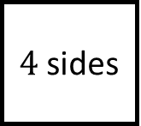
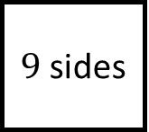
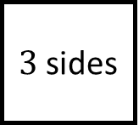
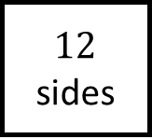
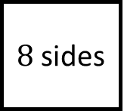
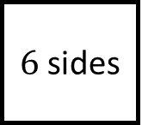
Pentagon
$3$ sides
$12$ sides
sides
Shapes Spider 1
Polygons
$9$ sides
$4$ sides
sides
$6$ sides
$8$ sides
Decagon

Slide 2
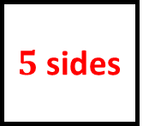
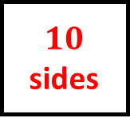
Triangle
Dodecagon
Pentagon
Shapes Spider 1 - Answers
$3$ sides
$12$ sides
$5$ sides
Nonagon
Polygons
Quadrilateral
$9$ sides
$4$ sides
$10$ sides
$6$ sides
$8$ sides
Decagon
Hexagon
Octagon

Slide 3
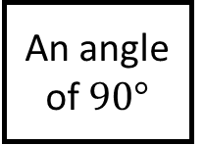
Isosceles
No equal sides
No equal angles
Triangles
Shapes Spider 2
Fill in the blanks with the properties or name of the shape
Equilateral
An angle of $90°$

Slide 4
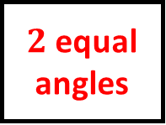
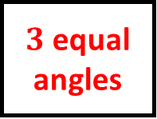
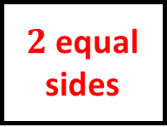
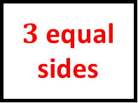
Isosceles
Scalene
$2$ equal sides
No equal sides
$2$ equal angles
No equal angles
Shapes Spider 2 – Answers
Triangles
$3$ equal angles
Right-angled
Fill in the blanks with the properties of the shape
Equilateral
An angle of $90°$
Fill in the blanks with the properties or name of the shape
$3$ equal sides

Slide 5
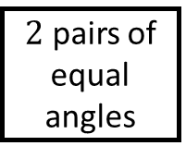
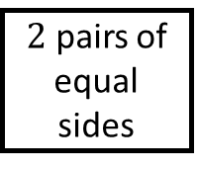
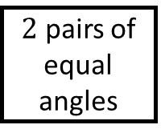
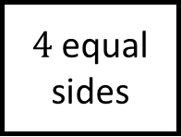
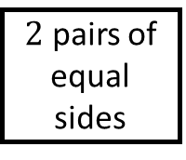
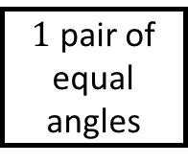
Arrowhead
Rectangle
Shapes Spider 3
Quadrilaterals
$4$ equal sides
$2$ pairs of equal angles
$2$ pairs of equal angles
$2$ pairs of equal sides
$1$ pair of equal angles
Fill in the blanks with the properties or name of the shape
Trapezium
$2$ pairs of equal sides

Slide 6
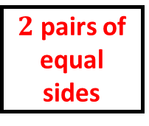
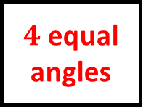

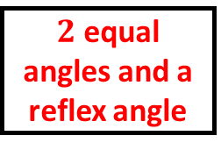
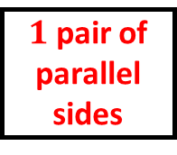
Arrowhead
Rectangle
$2$ pairs of equal sides
$2$ pairs of equal sides
$2$ equal angles and a reflex angle
$4$ equal angles
Shapes Spider 3 – Answers
Rhombus
Quadrilaterals
Parallelogram
$4$ equal sides
$2$ pairs of equal angles
$2$ pairs of equal angles
$2$ pairs of equal sides
$1$ pair of equal angles
Kite
Fill in the blanks with the properties or name of the shape
Trapezium
$2$ pairs of equal sides
$1$ pair of parallel sides

Slide 7
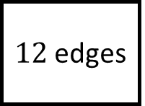
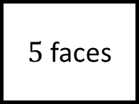
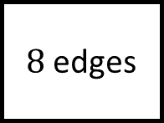
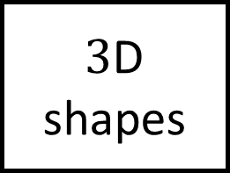
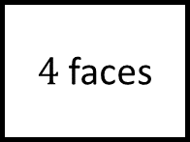
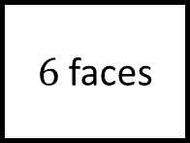
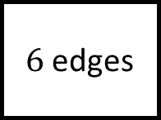
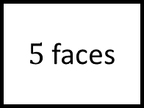
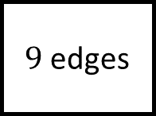
$6$ edges
$9$ edges
$4$ faces
$5$ faces
Shapes Spider 4
All points on the surface are exactly the same distance from the centre
$3$D shapes
$5$ faces
$8$ edges
A prism
$6$ faces
Has a curved surface
Fill in the blanks with the properties or name of the shape
$12$ edges

Slide 8
Tetrahedron
Triangular prism
$6$ edges
$9$ edges
$4$ faces
$5$ faces
Shapes Spider 4 – Answers
Sphere
All points on the surface are exactly the same distance from the centre
$3$D shapes
Square-based pyramid
$5$ faces
$8$ edges
A prism
$6$ faces
Cylinder
Fill in the blanks with the properties or name of the shape
Cube or cuboid
Has a curved surface
$12$ edges

Slide 9
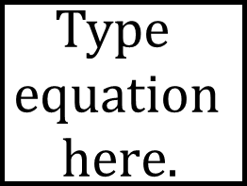
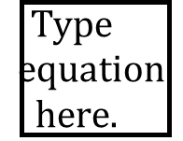
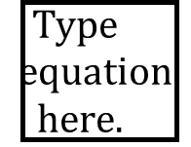
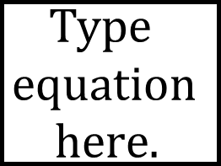
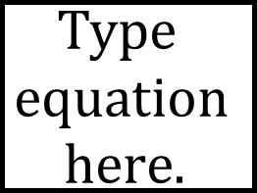


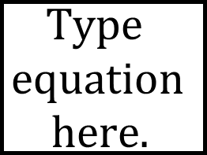

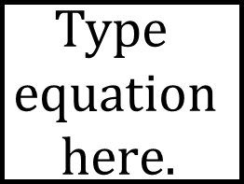

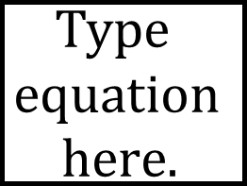

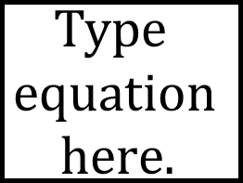
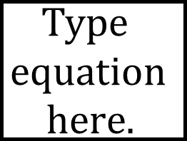
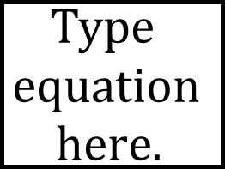

Shapes Spider - Blank

Slide 10
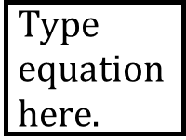

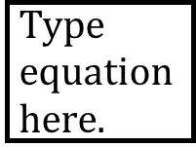
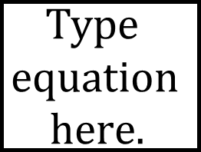
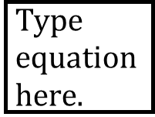
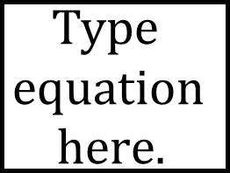
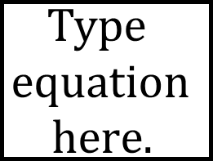


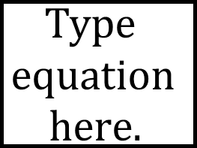









Shapes Spider – Answers

