Slide 1
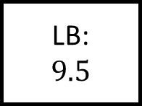
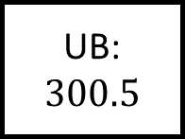
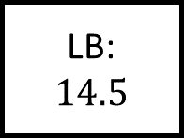
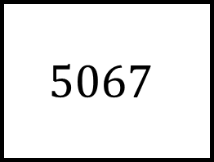
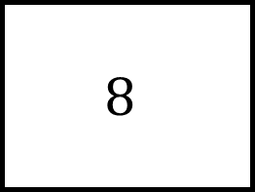
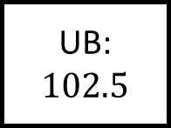
$$8$$
UB: $300.5$
UB:
LB:
LB:
Bounds Spider 1
Rounded to nearest integer
UB:
LB:
$$9.5$$
LB:
$$14.5$$
UB:
LB:
LB:
$$5067$$
UB:
UB:
$$102.5$$

Slide 2
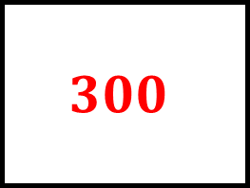
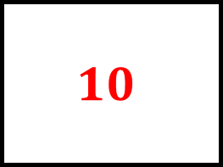
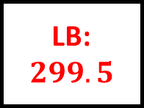
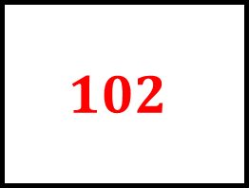
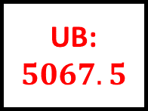
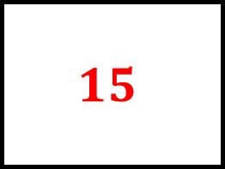
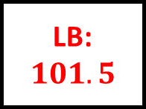


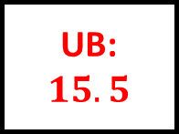
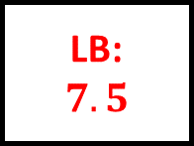
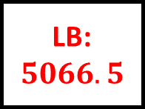
$$300$$
$$8$$
UB: $300.5$
UB:
$$8.5$$
LB:
$$299.5$$
LB:
$$7.5$$
Bounds Spider 1 – Answers
$$10$$
Rounded to nearest integer
$$15$$
UB:
$$10.5$$
LB:
$$9.5$$
LB:
$$14.5$$
UB:
$$15.5$$
LB:
$$5066.5$$
LB:
$$101.5$$
$$5067$$
$$102$$
UB:
$$5067.5$$
UB:
$$102.5$$

Slide 3
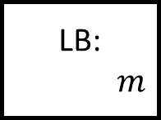
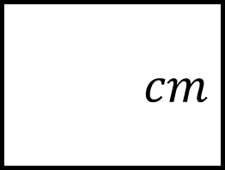
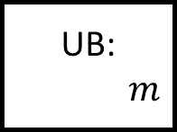
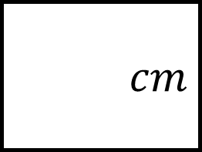
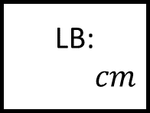
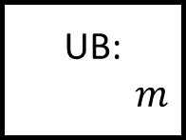
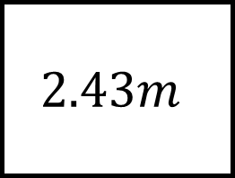
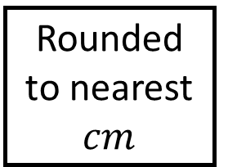
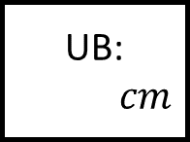
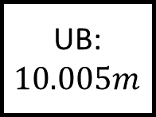
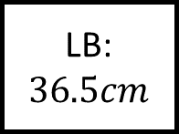

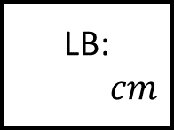
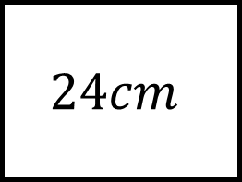

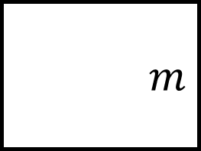
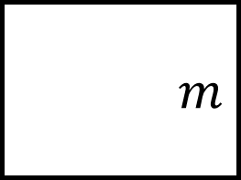
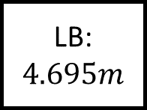
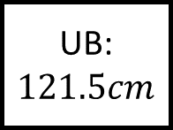
$$m$$
$$24cm$$
UB: $10.005m$
UB:
$$cm$$
LB:
$$m$$
LB:
$$cm$$
Bounds Spider 2
$$m$$
Rounded to nearest $cm$
$$cm$$
UB:
$$m$$
LB:
$$4.695m$$
LB:
$$36.5cm$$
UB:
$$cm$$
LB:
$$m$$
LB:
$$cm$$
$$2.43m$$
$$cm$$
UB:
$$m$$
UB:
$$121.5cm$$

Slide 4
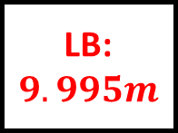
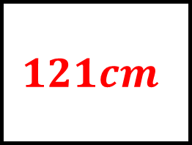
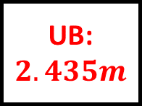
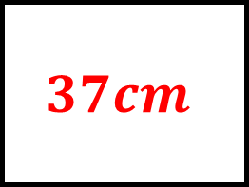
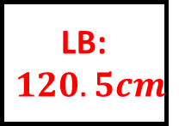
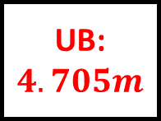
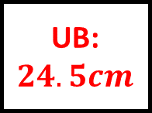
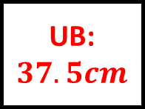
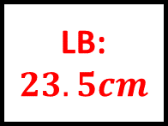
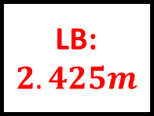
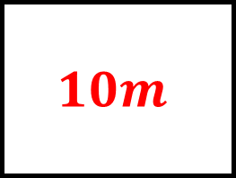
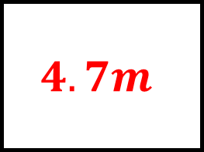
$$10m$$
$$24cm$$
UB: $10.005m$
UB:
$$24.5cm$$
LB:
$$9.995m$$
LB:
$$23.5cm$$
Bounds Spider 2 – Answers
$$4.7m$$
Rounded to nearest $cm$
$$37cm$$
UB:
$$4.705m$$
LB:
$$4.695m$$
LB:
$$36.5cm$$
UB:
$$37.5cm$$
LB:
$$2.425m$$
LB:
$$120.5cm$$
$$2.43m$$
$$121cm$$
UB:
$$2.435m$$
UB:
$$121.5cm$$

Slide 5
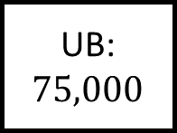
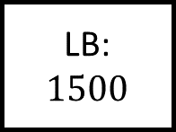
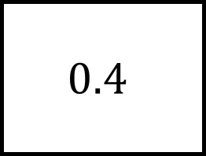
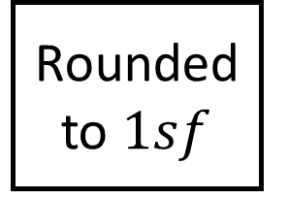
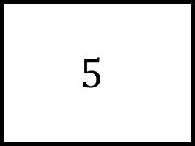


$$5$$
UB: $75,000$
UB:
LB:
LB:
Bounds Spider 3
Rounded to $1sf$
UB:
LB:
$$0.075$$
LB:
$$1500$$
UB:
LB:
LB:
$$0.4$$
UB:
UB:
$$65$$

Slide 6












$$70,000$$
$$5$$
UB: $75,000$
UB:
$$5.5$$
LB:
$$65,000$$
LB:
$$4.5$$
Bounds Spider 3 – Answers
$$0.08$$
Rounded to $1sf$
$$2000$$
UB:
$$0.085$$
LB:
$$0.075$$
LB:
$$1500$$
UB:
$$2500$$
LB:
$$0.35$$
LB:
$$55$$
$$0.4$$
$$60$$
UB:
$$0.45$$
UB:
$$65$$

Slide 7







$$37$$
UB:
$$705$$
UB:
LB:
LB:
Bounds Spider 4
Rounded to $2sf$
UB:
LB:
$$19.5$$
LB:
$$1650$$
UB:
LB:
LB:
$$0.023$$
UB:
UB:
$$0.655$$

Slide 8












$$700$$
$$37$$
UB:
$$705$$
UB:
$$37.5$$
LB:
$$695$$
LB:
$$36.5$$
Bounds Spider 4 – Answers
$$20$$
Rounded to $2sf$
$$1700$$
UB:
$$20.5$$
LB:
$$19.5$$
LB:
$$1650$$
UB:
$$1750$$
LB:
$$0.0225$$
LB:
$$0.645$$
$$0.023$$
$$0.65$$
UB:
$$0.0235$$
UB:
$$0.655$$

Slide 9



















UB:
UB:
LB:
LB:
Bounds Spider – Answers
Rounded to
UB:
LB:
LB:
UB:
LB:
LB:
UB:
UB:

