Slide 1

Exploding Ratio
Can you fill in the blanks?

Slide 2















$$2:1$$
Share $£60$
$$£ :£$$
Share
$$£40$$
$$:3$$
$$1:2$$
Share $£45$
$$£ :£24$$
Fill in the blanks…
$$:$$
$$£ :£$$
Exploding Ratio 1
$$:$$
Share
$$£$$
$$£18:£12$$
Share
$$£$$
$$£5:£15$$

Slide 3









$$2:1$$
Share $£60$
$$£40:£20$$
Share $£40$
$$2:3$$
$$1:2$$
Share $£45$
$$£16:£24$$
Fill in the blanks…
$$1:3$$
$$£15:£30$$
Exploding Ratio 1 – Answers
$$3:2$$
Share $£20$
$$£18:£12$$
Share $£30$
$$£5:£15$$

Slide 4





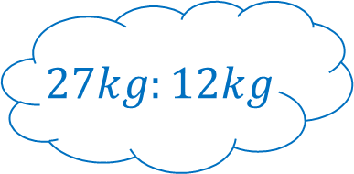







$$3:5$$
Share $£32$
$$£ :£$$
Share $5.2l$
$$5:$$
$$7:5$$
Share $3.6m$
$$3.25l: l$$
Fill in the blanks…
$$:$$
$$m: m$$
Exploding Ratio 2
$$:$$
Share $kg$
$$£13.50:£31.50$$
Share
$$£$$
$$27kg:12kg$$

Slide 5








$$3:5$$
Share $£32$
$$£12:£20$$
Share $5.2l$
$$5:3$$
$$7:5$$
Share $3.6m$
$$3.25l:1.95l$$
Fill in the blanks…
$$9:4$$
$$2.1m:1.5m$$
Exploding Ratio 2 – Answers
$$3:7$$
Share $39kg$
$$£13.50:£31.50$$
Share $£45$
$$27kg:12kg$$

Slide 6













$$:$$
Share
$kg$
$$2.4kg:1.8kg$$
Share
$l$
$$:$$
$$:$$
Share $cm$
$$600ml:140cl$$
Fill in the blanks…
$$:$$
$$10.5cm:16.5cm$$
Exploding Ratio 3
$$:$$
Share $hours$
$$800ml:1l$$
Share
$l$
$$1 hour 12 mins:48 mins$$

Slide 7










$$4:3$$
Share $4.2kg$
$$2.4kg:1.8kg$$
Share
$$2l$$
$$3:7$$
$$7:11$$
Share $27cm$
$$600ml:140cl$$
Fill in the blanks…
$$3:2$$
$$10.5cm:16.5cm$$
Exploding Ratio 3 – Answers
$$4:5$$
Share $2 hours$
$$800ml:1l$$
Share $1.8l$
$$1 hour 12 mins:48 mins$$

Slide 8









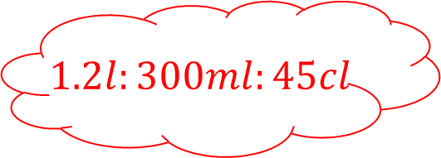



$$:$$
Share
$m$
$$50mm:1m$$
Share
$mins$
$$: :$$
$$:$$
Share $hours$
$$5 mins:20 secs:1 hour$$
Fill in the blanks…
$$: :$$
$$2 hours:24 mins$$
Exploding Ratio 4
$$: :$$
Share
$kg$
$$1.2l:300ml:45cl$$
Share
$$l$$
$$1kg:500g:3kg$$

Slide 9










$$1:20$$
Share $1.05m$
$$50mm:1m$$
Share $65. \dot{3} mins$
$$15:1:180$$
$$5:1$$
Share $2.4 hours$
$$5 mins:20 secs:1 hour$$
Fill in the blanks…
$$2:1:6$$
$$2 hours:24 mins$$
Exploding Ratio 4 – Answers
$$8:2:3$$
Share $4.5kg$
$$1.2l:300ml:45cl$$
Share $1.95l$
$$1kg:500g:3kg$$

Slide 10
Fill in the blanks…
Exploding Ratio – Template

Slide 11
Fill in the blanks…
Exploding Ratio – Template

