Slide 1

Exploding Angles
Can you fill in the blanks?

Slide 2
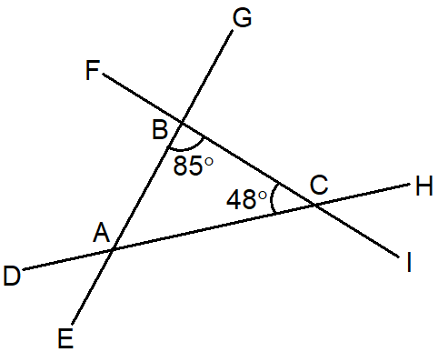







Exploding Angles 1 – Calculate/Reason
Find $HCI$
Find $CAE$
Find $BAC$
$$ABC=85°$$
$$ACB=48°$$
Find $CBG$
Find $DAE$

Slide 3


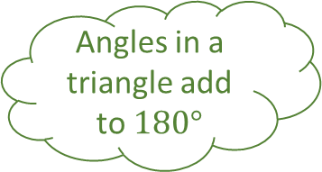




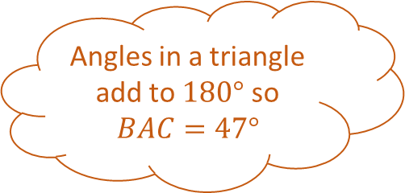
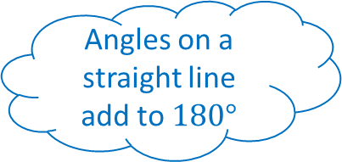


Exploding Angles 1 – Answers
Find $HCI$
Vertically opposite to $ACB$
$$48°$$
Angles in a triangle add to $180°$ so $BAC=47°$
Find $CAE$
Find $BAC$
$$ABC=85°$$
Angles on a straight line add to $180°$
Angles in a triangle add to $180°$
$$47°$$
$$ACB=48°$$
Find $CBG$
$$133°$$
Find $DAE$
Angles on a straight line add to $180°$
$$47°$$
Vertically opposite angles are equal
Angles in a triangle add to $180°$ so $BAC=47°$
$$95°$$

Slide 4
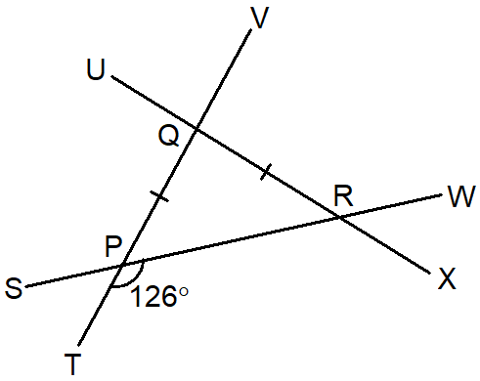





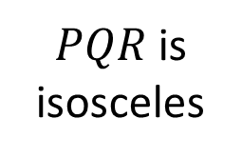


Exploding Angles 2 – Calculate/Reason
Find $SPT$
Find $PQU$
$PQR$ is isosceles
$$72°$$
$$RPT=126°$$
Find $PQR$
$$54°$$
$$54°$$

Slide 5

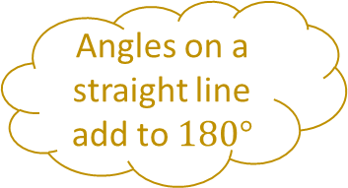
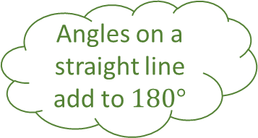


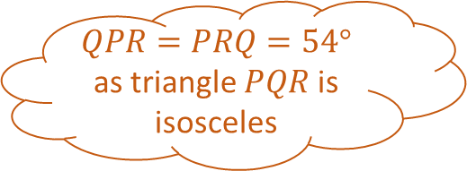
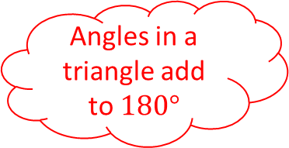

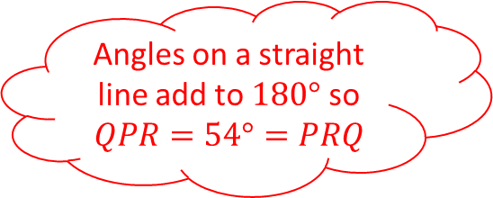

Exploding Angles 2 – Answers
Find $SPT$
Angles on a straight line add to $180°$
$$54°$$
$QPR=PRQ=54°$ as triangle $PQR$ is isosceles
Find $PQU$
$PQR$ is isosceles
Find $QPR$
Angles on a straight line add to $180°$
Angles on a straight line add to $180°$
$$72°$$
$$RPT=126°$$
Find $PRQ$
$$108°$$
Find $PQR$
$PQR$ is isosceles so $PRQ=QPR$
$$54°$$
Angles on a straight line add to $180°$ so $QPR=54°=PRQ$
Angles in a triangle add to $180°$
$$54°$$

Slide 6
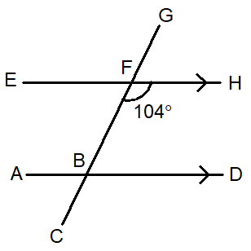






Exploding Angles 3 – Calculate/Reason
Find $DBF$
Find $ABC$
Find $CBD$
$$BFH=104°$$
Find $ABF$
Find $EFG$

Slide 7




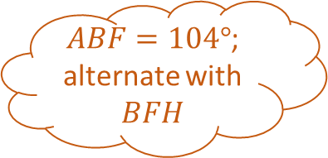
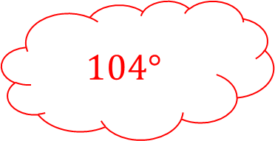
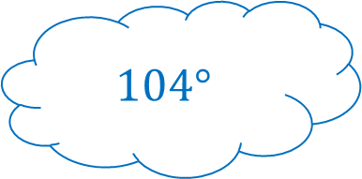
Exploding Angles 3 – Answers
Find $DBF$
Supplementary angles add to $180°$
$$76°$$
$ABF=104°$; alternate with $BFH$
Find $ABC$
Find $CBD$
Angles on a straight line add to $180°$
Corresponding angles are equal
$$BFH=104°$$
Find $ABF$
$$76°$$
Find $EFG$
Alternate angles are equal
$$104°$$
$$104°$$
Vertically opposite angles are equal
$$104°$$

Slide 8
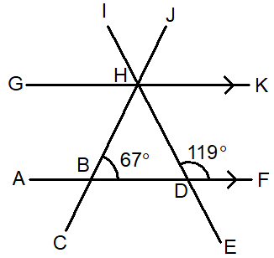







Exploding Angles 4 – Calculate/Reason
Find $BDE$
Find $GHD$
Find $ABH$
$$DBH=67°$$
$$FDH=119°$$
Find $JHK$
Find $BHD$

Slide 9


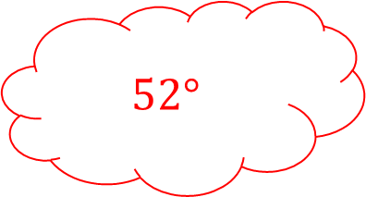
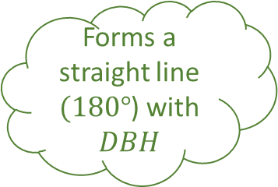



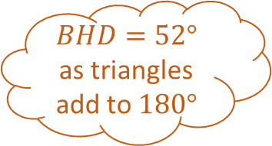

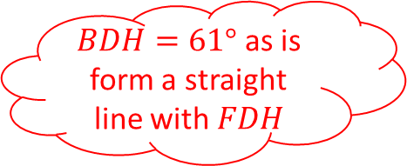


Exploding Angles 4 – Answers
Find $BDE$
Vertically opposite to $FDH$
$$119°$$
$BHD=52°$ as triangles add to $180°$
Find $GHD$
Find $ABH$
$$DBH=67°$$
$BHG=67°$ as it is alternate with $DBH$
$$FDH=119°$$
Forms a straight line $(180°$) with $DBH$
$$52°$$
Find $JHK$
$$119°$$
Find $BHD$
Corresponding with $DBH$
$$113°$$
$BDH$, $DBH$ and $BHD$ form a triangle $(180°)$
$BDH=61°$ as is form a straight line with $FDH$
$$67°$$

Slide 10
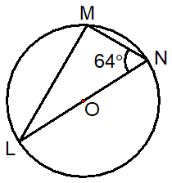
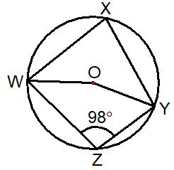
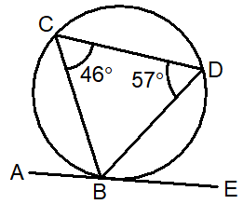
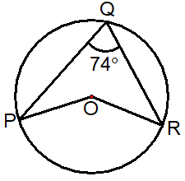




Exploding Angles 5 – Calculate/Reason
Find $MLN$
Find $WOY$
Find the angles asked for, giving reasons for your answer
Find $ABC$
Find $POR$

Slide 11


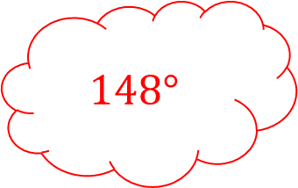




Exploding Angles 5 – Answers
Find $MLN$
Angle subtended from a diameter is $90°$
Find $WOY$
Find the angles asked for, giving reasons for your answer
$$26°$$
$WXY=82°$ - cyclic quadrilateral
$WOY=2WXY$
$$148°$$
$$164°$$
$$57°$$
Find $ABC$
$$POR=2PQR$$
Find $POR$
Alternate segment

Slide 12


















Exploding Angles n – Answers
Find
Find
Find
$$ABC=°$$
Find
Find

Slide 13
Exploding Angles – Blank

Slide 14
Exploding Angles – Blank

