Slide 1

Properties of Number Explosions
Can you fill in the blanks?
There’s a choice of finding the numbers from the properties or vice versa.

Slide 2

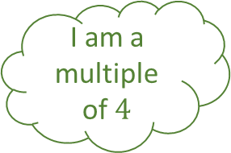



I am an even number
Properties of Number 1 – Find the Number
I am a square number
I am a two digit number
I am a multiple of $4$
I am a factor of $16$
I am a cube number
Fill in the blanks…
I am a cube number
I am a two digit number
I am a factor of $20$
I am not $20$
I am greater than $1$
I am a square number

Slide 3




Properties of Number 1 – Name the Properties
Fill in the blanks…
$$4$$
$$64$$
$$8$$
$$10$$

Slide 4
I am an even number
Properties of Number 1 – Answers
I am a square number
I am a two digit number
I am a multiple of $4$
I am a factor of $16$
I am a cube number
Fill in the blanks…
I am a cube number
$$4$$
I am a two digit number
$$64$$
I am a factor of $20$
$$8$$
I am not $20$
I am greater than $1$
I am a square number
$$10$$

Slide 5

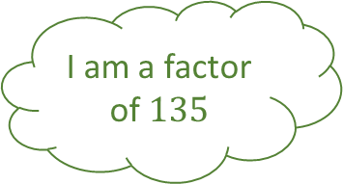

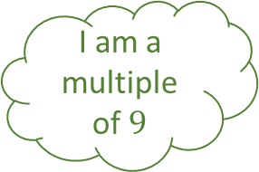
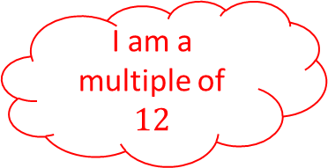

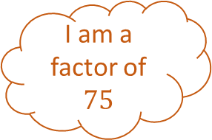
I am an odd number
Properties of Number 2 – Find the Number
I am a multiple of $5$
I am a factor of $75$
I am a multiple of $9$
I am a factor of $135$
I am a triangular number
Fill in the blanks…
I am a cube number
I am greater than $1$
I am a square number
I am a factor of $45$
I am a multiple of $12$
I am a two digit number

Slide 6




Properties of Number 2 – Name the Properties
Fill in the blanks…
$$36$$
$$15$$
$$27$$
$$9$$

Slide 7
I am an odd number
Properties of Number 2 – Answers
I am a multiple of $5$
I am a factor of $75$
I am a multiple of $9$
I am a factor of $135$
I am a triangular number
Fill in the blanks…
I am a cube number
$$36$$
I am greater than $1$
$$15$$
I am a square number
$$27$$
I am a factor of $45$
I am a multiple of $12$
I am a two digit number
$$9$$

Slide 8



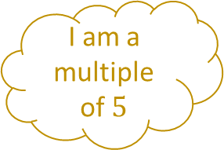

I am a multiple of $5$
Properties of Number 3 – Find the Number
I am a triangular number
I am a factor of $220$
I am a two digit number
I am a factor of $150$
I am two digit number
Fill in the blanks…
I am a square number
I am a two digit number
I am a factor of $24$
I am not $24$
I am a triangular number
I am an even number

Slide 9




Properties of Number 3 – Name the Properties
Fill in the blanks…
$$6$$
$$55$$
$$25$$
$$12$$

Slide 10
I am a multiple of $5$
Properties of Number 3 – Answers
I am a triangular number
I am a factor of $220$
I am a two digit number
I am a factor of $150$
I am two digit number
Fill in the blanks…
I am a square number
$$6$$
I am a two digit number
$$55$$
I am a factor of $24$
I am not $24$
$$25$$
I am a triangular number
I am an even number
$$12$$

Slide 11




Properties of Number n – Answers
Fill in the blanks…

Slide 12
Properties of Number – Blank

Slide 13
Properties of Number - Blank

