Slide 1
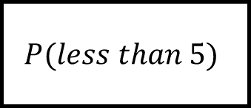
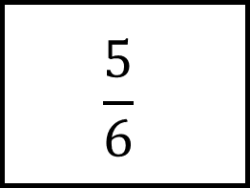
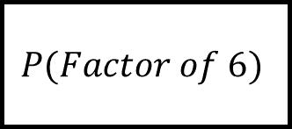
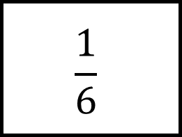
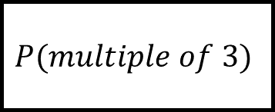
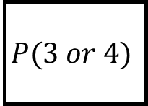
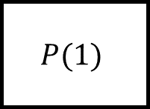
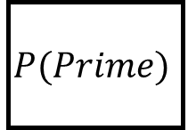
$$\frac{1}{6}$$
$$P(1)$$
Probability Spider 1
$$P(less than 5)$$
$$\frac{5}{6}$$
Roll a fair, 6-sided dice
$$P(3 or 4)$$
$$P(Prime)$$
$$P(multiple of 3)$$
Fill in the blanks; the events or the probabilities.
No events are repeated.
$$P(Factor of 6)$$

Slide 2
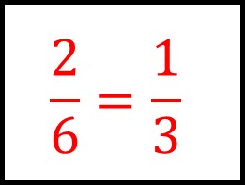
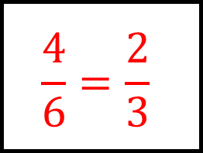
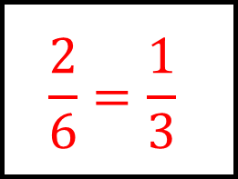
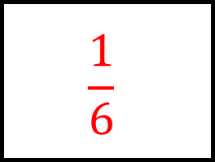
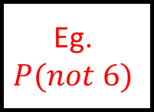
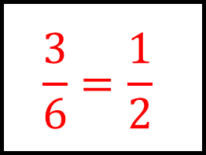
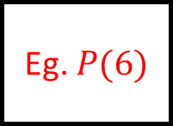
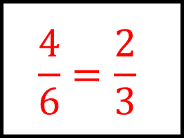
$$\frac{1}{6}$$
$$\frac{4}{6}=\frac{2}{3}$$
$$\frac{1}{6}$$
$$P(1)$$
Probability Spider 1 - Answers
$$P(less than 5)$$
Eg. $P(6)$
$$\frac{5}{6}$$
Roll a fair, 6-sided dice
$$\frac{2}{6}=\frac{1}{3}$$
Eg.
$$P(not 6)$$
$$P(3 or 4)$$
$$P(Prime)$$
$$P(multiple of 3)$$
Fill in the blanks; the events or the probabilities.
No events are repeated.
$$P(Factor of 6)$$
$$\frac{3}{6}=\frac{1}{2}$$
$$\frac{2}{6}=\frac{1}{3}$$
$$\frac{4}{6}=\frac{2}{3}$$

Slide 3
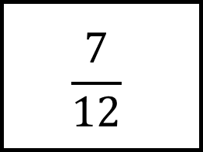
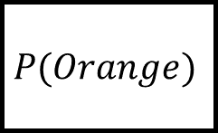
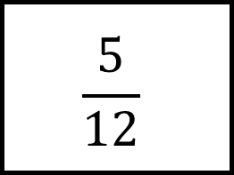
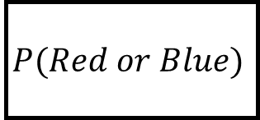
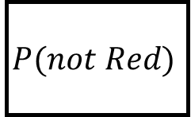
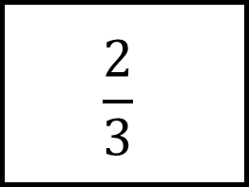
Probability Spider 2
$$\frac{5}{12}$$
$$P(Orange)$$
3 red, 4 blue, 5 green counters in a bag are picked at random.
$$\frac{2}{3}$$
$$P(not Red)$$
$$P(Red or Blue)$$
Fill in the blanks; the events or the probabilities.
No events are repeated.
$$\frac{7}{12}$$

Slide 4
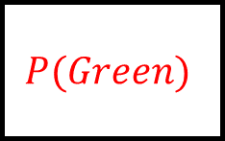
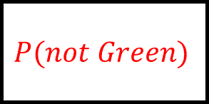
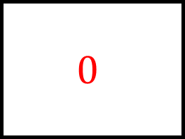
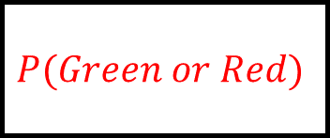
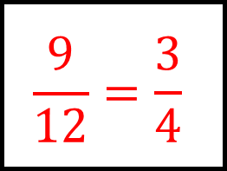
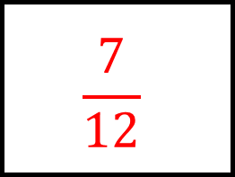
$$0$$
Probability Spider 2 - Answers
$$\frac{5}{12}$$
$$P(Orange)$$
$$P(Green)$$
3 red, 4 blue, 5 green counters in a bag are picked at random and then replaced afterwards.
$$\frac{2}{3}$$
$$\frac{9}{12}=\frac{3}{4}$$
$$P(Green or Red)$$
$$P(not Red)$$
$$P(not Green)$$
$$P(Red or Blue)$$
Fill in the blanks; the events or the probabilities.
No events are repeated.
$$\frac{7}{12}$$
$$\frac{7}{12}$$

Slide 5
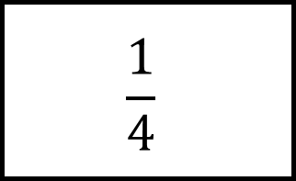
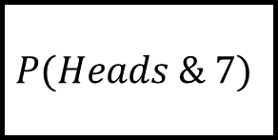
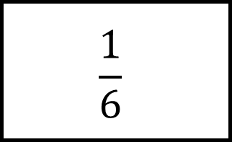
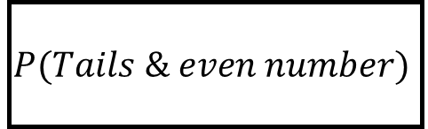
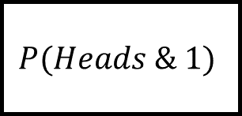
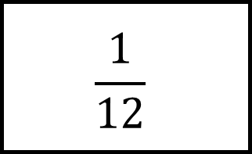
$$\frac{1}{6}$$
Probability Spider 3
$$P(Heads \& 1)$$
A coin is flipped and a 6-sided dice rolled; both are unbiased.
$$\frac{1}{12}$$
$$P(Heads \& 7)$$
$$P(Tails \& even number)$$
$$\frac{1}{4}$$
Fill in the blanks; the events or the probabilities.
No events are repeated.

Slide 6
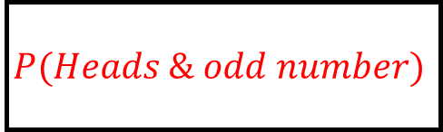
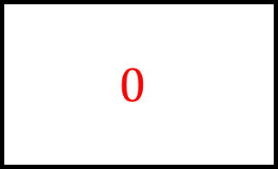
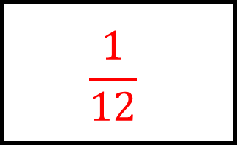
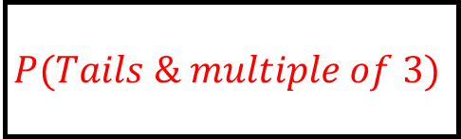
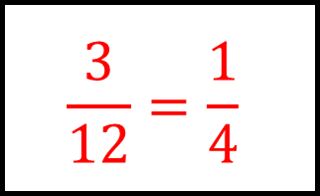

$$\frac{1}{6}$$
Probability Spider 3 - Answers
$$\frac{1}{12}$$
$$P(Tails \& multiple of 3)$$
$$P(Heads \& 1)$$
$$0$$
A coin is flipped and a 6-sided dice rolled; both are unbiased.
$$\frac{1}{12}$$
$$P(Heads \& 7)$$
$$P(Tails \& 6)$$
$$P(Heads \& odd number)$$
$$P(Tails \& even number)$$
$$\frac{1}{4}$$
Fill in the blanks; the events or the probabilities.
No events are repeated.
$$\frac{3}{12}=\frac{1}{4}$$

Slide 7
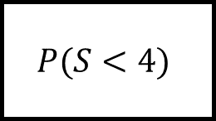
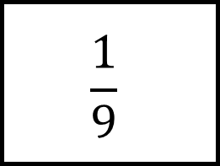
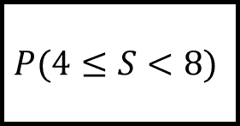
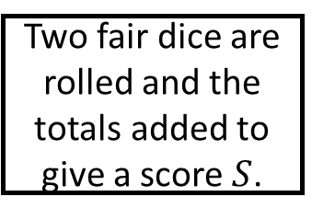
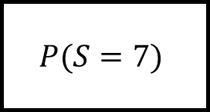
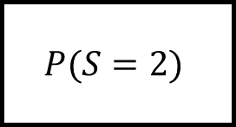
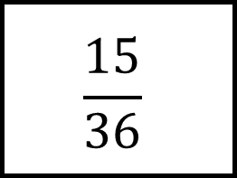
Probability Spider 4
$$P(4≤S<8)$$
$$P(S=2)$$
$$\frac{15}{36}$$
Two fair dice are rolled and the totals added to give a score $S$.
$$\frac{1}{9}$$
$$P(S<4)$$
Fill in the blanks; the events or the probabilities.
No events are repeated.
$$P(S=7)$$

Slide 8
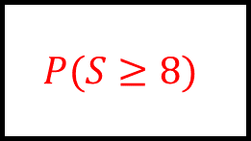
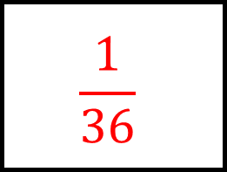
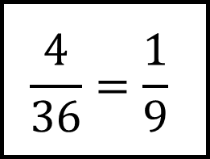
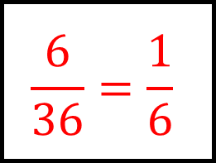



$$\frac{18}{36}=\frac{1}{2}$$
Probability Spider 4 - Answers
$$\frac{1}{36}$$
$$P(4≤S<8)$$
$$P(S=2)$$
$$\frac{15}{36}$$
Two fair dice are rolled and the totals added to give a score $S$.
$$\frac{4}{36}=\frac{1}{9}$$
$$P(S≥8)$$
$$P(S=9)$$
$$P(S<4)$$
Fill in the blanks; the events or the probabilities.
No events are repeated.
$$P(S=7)$$
$$\frac{3}{36}=\frac{1}{12}$$
$$\frac{6}{36}=\frac{1}{6}$$

Slide 9






$$\frac{78}{90}$$
Probability Spider 5
$$P( Two mints)$$
4 mints, 6 toffees. Two sweets are picked at random and eaten
$$P(At least one mint)$$
$$P(Two toffees)$$
$$P(Two the same)$$
$$\frac{48}{90}$$
Fill in the blanks; the events or the probabilities.
No events are repeated.

Slide 10






$$\frac{78}{90}$$
Probability Spider 5 - Answers
$$\frac{12}{90}$$
$$P(At least one toffee)$$
$$P( Two mints)$$
4 mints, 6 toffees. Two sweets are picked at random and eaten
$$\frac{60}{90}$$
$$\frac{30}{90}$$
$$P(At least one mint)$$
$$P(Two toffees)$$
$$P(Both different)$$
$$P(Two the same)$$
$$\frac{48}{90}$$
Fill in the blanks; the events or the probabilities.
No events are repeated.
$$\frac{42}{90}$$

Slide 11






Probability Spider 6
$$P(Both different colours)$$
$$P(Two blues)$$
3 red, 4 blue, 5 green counters in a bag. Two are picked at random and not replaced.
$$P(At least one red)$$
$P(Blue,Green)$ in that order
$$P(Both the same colour)$$
$P(Blue, Green)$ in any order
Fill in the blanks; the events or the probabilities.
No events are repeated.

Slide 12






$$\frac{94}{132}$$
Probability Spider 6 - Answers
$$\frac{12}{132}$$
$$P(Both different colours)$$
$$P(Two blues)$$
3 red, 4 blue, 5 green counters in a bag. Two are picked at random and not replaced.
$$\frac{60}{132}$$
$$\frac{20}{132}$$
$$P(At least one red)$$
$P(Blue,Green)$ in that order
$$P(Both the same colour)$$
$P(Blue, Green)$ in any order
$$\frac{38}{132}$$
$$\frac{40}{132}$$
Fill in the blanks; the events or the probabilities.
No events are repeated.

