Slide 1
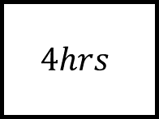
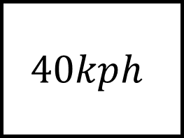
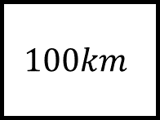
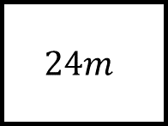
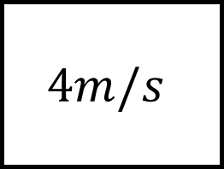
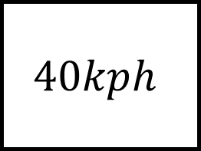
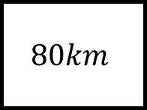
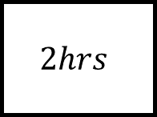
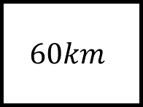
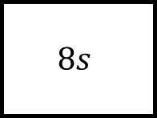
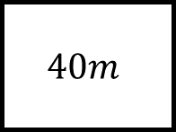
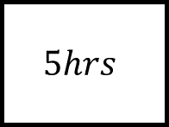
Compound Measures Spider 1
$$40kph$$
$$2hrs$$
$$60km$$
$$100km$$
Fill in the blanks…
$$40kph$$
$$5hrs$$
$$80km$$
$$4hrs$$
$$24m$$
$$40m$$
$$4m/s$$
$$8s$$
Each leg contains a speed, distance and time.
Give units with your answers.

Slide 2
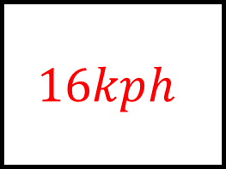
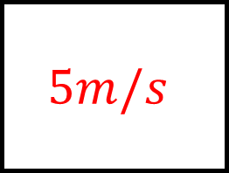
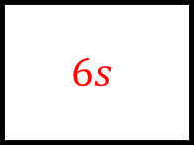
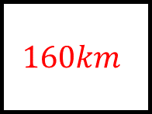
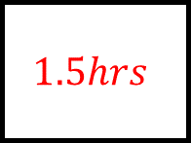
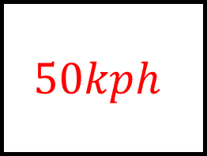
Compound Measures Spider 1 – Answers
$$40kph$$
$$50kph$$
$$1.5hrs$$
$$2hrs$$
$$60km$$
$$100km$$
$$16kph$$
Fill in the blanks…
$$40kph$$
$$5hrs$$
$$80km$$
$$160km$$
$$4hrs$$
$$24m$$
$$40m$$
$$4m/s$$
$$5m/s$$
$$6s$$
$$8s$$
Each leg contains a speed, distance and time.
Give units with your answers.

Slide 3
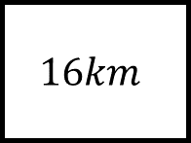
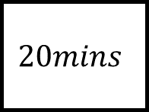
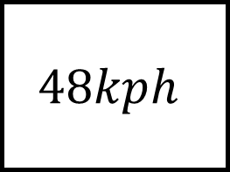
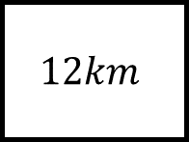
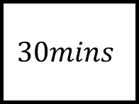
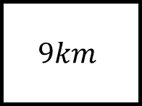
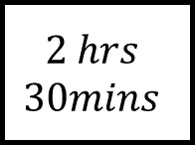
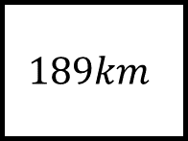
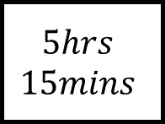

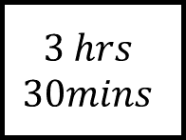
Compound Measures Spider 2
$$20mins$$
$$2 hrs$$
$$30mins$$
$$9km$$
$$60km$$
$$48kph$$
Fill in the blanks…
$$40kph$$
$$12km$$
$$3 hrs$$
$$30mins$$
$$16km$$
$$189km$$
$$30mins$$
$$5hrs$$
$$15mins$$
Each leg contains a speed, distance and time.
Give units with your answers.

Slide 4
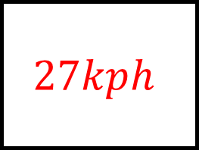
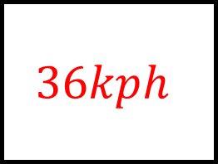
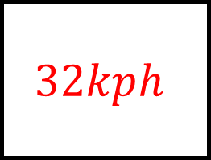
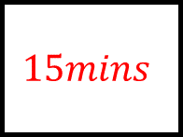
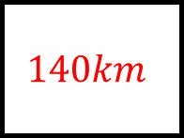
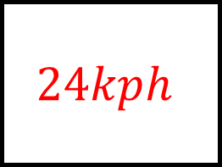
Compound Measures Spider 2 – Answers
$$27kph$$
$$24kph$$
$$20mins$$
$$2 hrs$$
$$30mins$$
$$9km$$
$$60km$$
$$48kph$$
Fill in the blanks…
$$40kph$$
$$15mins$$
$$12km$$
$$140km$$
$$3 hrs$$
$$30mins$$
$$16km$$
$$189km$$
$$32kph$$
$$36kph$$
$$30mins$$
$$5hrs$$
$$15mins$$
Each leg contains a speed, distance and time.
Give units with your answers.

Slide 5
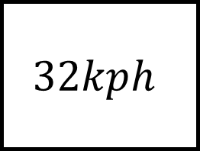
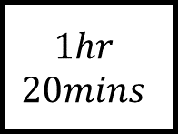
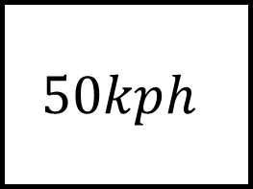
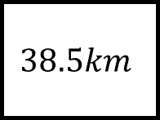
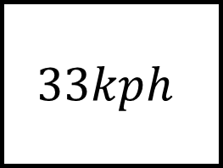
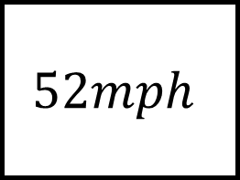
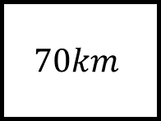
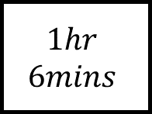
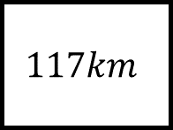
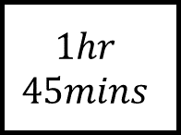
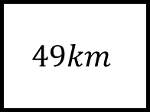
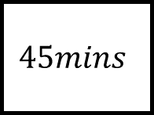
Compound Measures Spider 3
$$33kph$$
$$1hr$$
$$20mins$$
$$1hr$$
$$45mins$$
$$49km$$
$$50kph$$
Fill in the blanks…
$$52mph$$
$$70km$$
$$117km$$
$$38.5km$$
$$32kph$$
$$1hr$$
$$6mins$$
$$45mins$$
Each leg contains a speed, distance and time.
Give units with your answers.

Slide 6
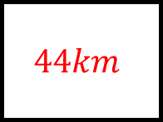
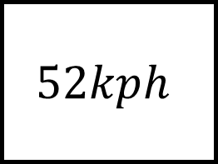

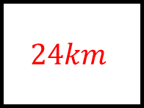
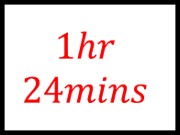


Compound Measures Spider 3 – Answers
$$33kph$$
$$28kph$$
$$1hr$$
$$20mins$$
$$1hr$$
$$45mins$$
$$44km$$
$$49km$$
$$50kph$$
Fill in the blanks…
$$52kph$$
$$1hr$$
$$24mins$$
$$70km$$
$$117km$$
$$2hrs$$
$$15mins$$
$$38.5km$$
$$24km$$
$$35kph$$
$$32kph$$
$$1hr$$
$$6mins$$
$$45mins$$
Each leg contains a speed, distance and time.
Give units with your answers.

Slide 7












Compound Measures Spider 4
$$1.4kg/m^{3}$$
$$10m^{3}$$
$$4{cm}^{3}$$
$$8g$$
$$3.75g/{cm}^{3}$$
Fill in the blanks…
$$4g/{cm}^{3}$$
$$30g$$
$$12g$$
$$44kg$$
$$4.5g/{cm}^{3}$$
$$11m^{3}$$
$$4{cm}^{3}$$
Each leg contains a density, mass and volume.
Give units with your answers.

Slide 8






Compound Measures Spider 4 – Answers
$$1.4kg/m^{3}$$
$$2g/{cm}^{3}$$
$$10m^{3}$$
$$4{cm}^{3}$$
$$14kg$$
$$8g$$
$$3.75g/{cm}^{3}$$
Fill in the blanks…
$$4g/{cm}^{3}$$
$$8{cm}^{3}$$
$$30g$$
$$12g$$
$$3{cm}^{3}$$
$$44kg$$
$$18g$$
$$4kg/m^{3}$$
$$4.5g/{cm}^{3}$$
$$11m^{3}$$
$$4{cm}^{3}$$
Each leg contains a density, mass and volume.
Give units with your answers.

Slide 9












Compound Measures Spider 5
$$3125$$
$$people/{km}^{2}$$
$$54{km}^{2}$$
$$5{km}^{2}$$
$$20,000$$
$$people$$
$$4650$$
$$people/{km}^{2}$$
Fill in the blanks…
$$3000$$
$$people/{km}^{2}$$
$$186,000$$
$$people$$
$$36,000$$
$$people$$
$$230,000$$
$$people$$
$$2,000$$
$$people/{km}^{2}$$
$${20km}^{2}$$
$${2.5km}^{2}$$
Each leg contains a population density, population and area.
Give units with your answers.

Slide 10






Compound Measures Spider 5 – Answers
$$3125$$
$$people/{km}^{2}$$
$$4000$$
$$people/{km}^{2}$$
$$54{km}^{2}$$
$$5{km}^{2}$$
$$168,750$$
$$people$$
$$20,000$$
$$people$$
$$4650$$
$$people/{km}^{2}$$
Fill in the blanks…
$$3000$$
$$people/{km}^{2}$$
$$40{km}^{2}$$
$$186,000$$
$$people$$
$$36,000$$
$$people$$
$$12{km}^{2}$$
$$230,000$$
$$people$$
$$5,000$$
$$people$$
$$11,500$$
$$people/{km}^{2}$$
$$2,000$$
$$people/{km}^{2}$$
$${20km}^{2}$$
$${2.5km}^{2}$$
Each leg contains a population density, population and area.
Give units with your answers.

Slide 11












Compound Measures Spider 6
$$15N/m^{2}$$
$$6m^{2}$$
$$6N$$
$$18N$$
$$4.8N/m^{2}$$
Fill in the blanks…
$$6N/m^{2}$$
$$5m^{2}$$
$$5m^{2}$$
$$2N$$
$$28N$$
$$3.5N/m^{2}$$
$$50{cm}^{2}$$
Each leg contains a pressure, force and area.
Give units with your answers.

Slide 12






Compound Measures Spider 6 – Answers
$$15N/m^{2}$$
$$3N/m^{2}$$
$$0.4m^{2}$$
$$6m^{2}$$
$$6N$$
$$18N$$
$$4.8N/m^{2}$$
Fill in the blanks…
$$6N/m^{2}$$
$$5m^{2}$$
$$24N$$
$$30N$$
$$5m^{2}$$
$$2N$$
$$28N$$
$$0.04N/cm^{2}$$
$$3.5N/m^{2}$$
$$50{cm}^{2}$$
$$8m^{2}$$
Each leg contains a pressure, force and area.
Give units with your answers.

