Slide 1
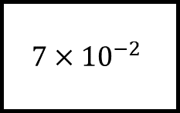
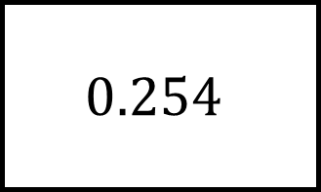
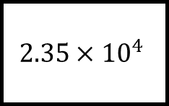
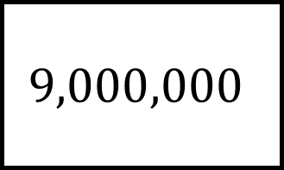
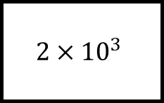
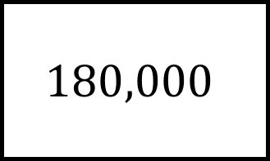
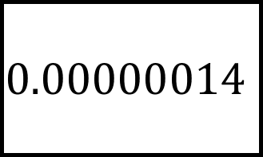
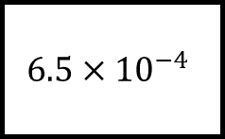
$$0.254$$
$$9,000,000$$
Standard Form Spider 1
$$2×{10}^{3}$$
Fill in the blanks…
$$6.5×{10}^{−4}$$
$$2.35×{10}^{4}$$
$$7×{10}^{−2}$$
$$0.00000014$$
$$180,000$$

Slide 2
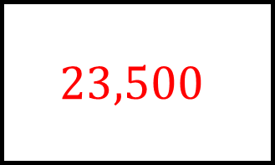
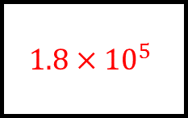
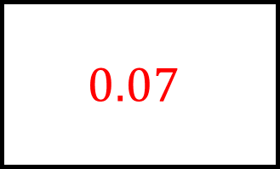
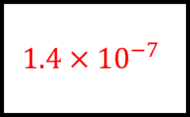

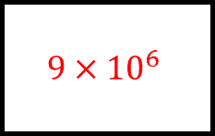
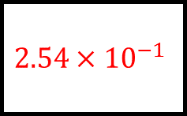
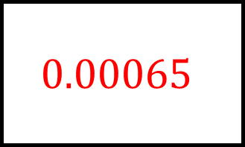
$$2000$$
$$0.254$$
$$9,000,000$$
Standard Form Spider 1 - Answers
$$2×{10}^{3}$$
$$2.54×{10}^{−1}$$
$$9×{10}^{6}$$
$$0.00065$$
Fill in the blanks…
$$23,500$$
$$6.5×{10}^{−4}$$
$$2.35×{10}^{4}$$
$$1.4×{10}^{−7}$$
$$1.8×{10}^{5}$$
$$7×{10}^{−2}$$
$$0.00000014$$
$$180,000$$
$$0.07$$

Slide 3
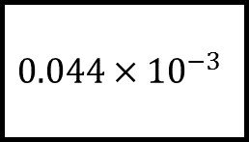
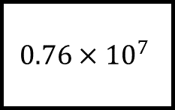
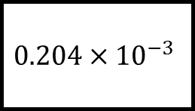
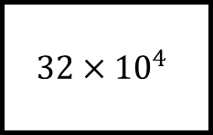
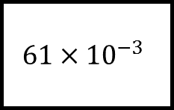
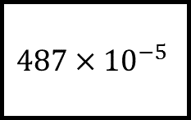
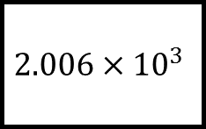
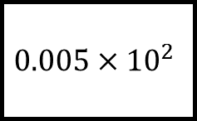
Standard Form Spider 2
$$32×{10}^{4}$$
$$0.204×{10}^{−3}$$
$$0.76×{10}^{7}$$
Are they in standard form?
$$0.044×{10}^{−3}$$
$$2.006×{10}^{3}$$
$$0.005×{10}^{2}$$
$$487×{10}^{−5}$$
$$61×{10}^{−3}$$

Slide 4
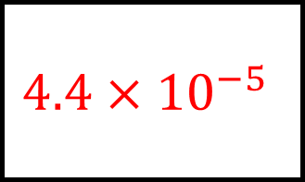
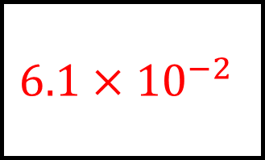
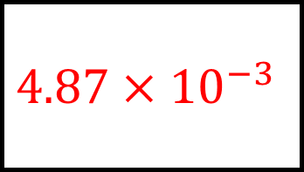
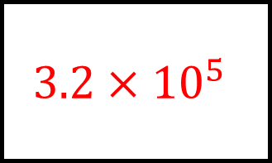
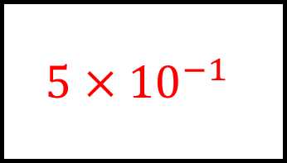
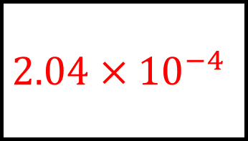
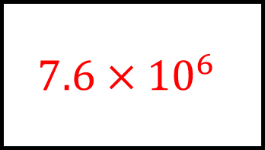
$$3.2×{10}^{5}$$
$$2.04×{10}^{−4}$$
$$7.6×{10}^{6}$$
Standard Form Spider 2 - Answers
$$32×{10}^{4}$$
$$0.204×{10}^{−3}$$
$$0.76×{10}^{7}$$
$$4.4×{10}^{−5}$$
Are they in standard form?
Yes!
$$0.044×{10}^{−3}$$
$$2.006×{10}^{3}$$
$$0.005×{10}^{2}$$
$$487×{10}^{−5}$$
$$61×{10}^{−3}$$
$$5×{10}^{−1}$$
$$4.87×{10}^{−3}$$
$$6.1×{10}^{−2}$$

Slide 5
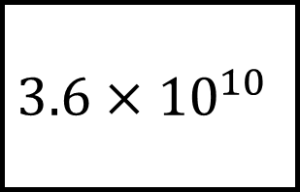
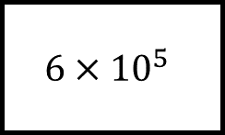
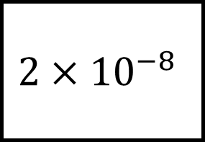
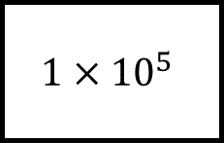
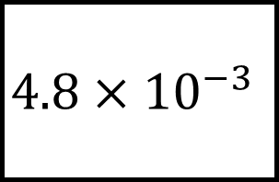
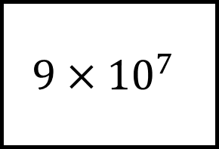
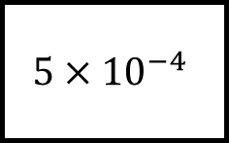
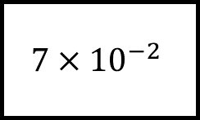
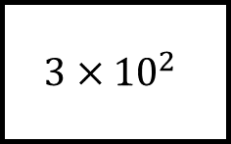
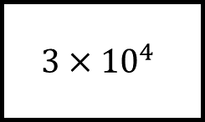
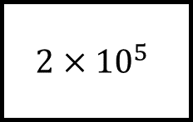
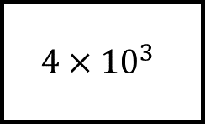
Standard Form Spider 3
$$4.8×{10}^{−3}$$
$$6×{10}^{5}$$
$$3×{10}^{4}$$
$$2×{10}^{5}$$
$$2×{10}^{−8}$$
Fill in the blanks…
$$9×{10}^{7}$$
$$5×{10}^{−4}$$
$$3×{10}^{2}$$
$$1×{10}^{5}$$
$$3.6×{10}^{10}$$
$$7×{10}^{−2}$$
The numbers on the legs multiply to give the number at the end of each leg.
$$4×{10}^{3}$$

Slide 6
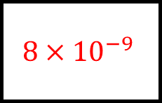
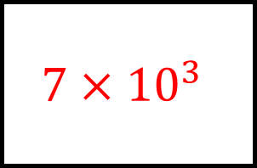
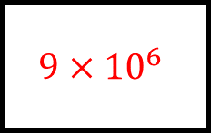
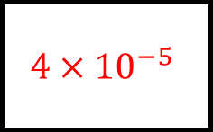
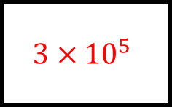
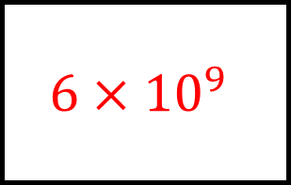
Standard Form Spider 3 – Answers
$$4.8×{10}^{−3}$$
$$6×{10}^{9}$$
$$6×{10}^{5}$$
$$3×{10}^{4}$$
$$8×{10}^{−9}$$
$$2×{10}^{5}$$
$$2×{10}^{−8}$$
Fill in the blanks…
$$9×{10}^{7}$$
$$4×{10}^{−5}$$
$$5×{10}^{−4}$$
$$3×{10}^{2}$$
$$3×{10}^{5}$$
$$1×{10}^{5}$$
$$9×{10}^{6}$$
$$7×{10}^{3}$$
$$3.6×{10}^{10}$$
$$7×{10}^{−2}$$
The numbers on the legs multiply to give the number at the end of each leg.
$$4×{10}^{3}$$

Slide 7

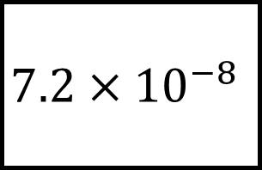
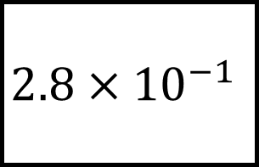









Standard Form Spider 4
$$7.2×{10}^{−8}$$
$$8×{10}^{5}$$
$$8×{10}^{−3}$$
$$2×{10}^{3}$$
$$2.8×{10}^{−1}$$
Fill in the blanks…
$$5×{10}^{2}$$
$$4×{10}^{2}$$
$$5×{10}^{−4}$$
$$3×{10}^{4}$$
$$3×{10}^{−2}$$
$$5×{10}^{2}$$
The numbers on the legs multiply to give the number at the end of each leg.
$$2×{10}^{−5}$$

Slide 8






Standard Form Spider 4 – Answers
$$7.2×{10}^{−8}$$
$$8×{10}^{5}$$
$$9×{10}^{−6}$$
$$4×{10}^{2}$$
$$8×{10}^{−3}$$
$$2×{10}^{3}$$
$$2.8×{10}^{−1}$$
Fill in the blanks…
$$5×{10}^{2}$$
$$4×{10}^{2}$$
$$7×{10}^{−4}$$
$$1×{10}^{6}$$
$$5×{10}^{−4}$$
$$3×{10}^{4}$$
$$3×{10}^{−2}$$
$$1.5×{10}^{7}$$
$$6×{10}^{−7}$$
$$5×{10}^{2}$$
The numbers on the legs multiply to give the number at the end of each leg.
$$2×{10}^{−5}$$

Slide 9












Standard Form Spider 5
$$3.61×{10}^{5}$$
$$6×{10}^{2}$$
$$3.2×{10}^{5}$$
$$4×{10}^{3}$$
Fill in the blanks…
$$5.8×{10}^{8}$$
$$3.1×{10}^{2}$$
$$1.6×{10}^{3}$$
$$8×{10}^{7}$$
$$6×{10}^{−6}$$
$$2×{10}^{5}$$
$$9×{10}^{−5}$$
The numbers on the legs add to give the number at the end of each leg.
$$3×{10}^{3}$$

Slide 10






Standard Form Spider 5 – Answers
$$3.61×{10}^{5}$$
$$4.6×{10}^{3}$$
$$4.1×{10}^{4}$$
$$6×{10}^{2}$$
$$3.2×{10}^{5}$$
$$4×{10}^{3}$$
$$1.91×{10}^{3}$$
Fill in the blanks…
$$5.8×{10}^{8}$$
$$3.1×{10}^{2}$$
$$1.6×{10}^{3}$$
$$8×{10}^{7}$$
$$5×{10}^{8}$$
$$6×{10}^{−6}$$
$$2×{10}^{5}$$
$$9.6×{10}^{−5}$$
$$2.03×{10}^{5}$$
$$9×{10}^{−5}$$
The numbers on the legs add to give the number at the end of each leg.
$$3×{10}^{3}$$

Slide 11








Standard Form Spider 6
$$5.06×{10}^{−4}$$
$$5×{10}^{4}$$
$$4×{10}^{3}$$
$$3.08×{10}^{4}$$
Fill in the blanks…
$$7.03×{10}^{6}$$
$$7×{10}^{6}$$
$$9.007×{10}^{8}$$
$$3.1×{10}^{−2}$$
The numbers on the legs add to give the number at the end of each leg.
$$1×{10}^{−3}$$

Slide 12









Standard Form Spider 6 – Answers
$$5.06×{10}^{−4}$$
$$5.4×{10}^{4}$$
$$6×{10}^{−6}$$
$$5×{10}^{4}$$
$$5×{10}^{−4}$$
$$4×{10}^{3}$$
$$3.08×{10}^{4}$$
Fill in the blanks…
$$7.03×{10}^{6}$$
$$8×{10}^{2}$$
$$3×{10}^{4}$$
$$7×{10}^{6}$$
$$3×{10}^{4}$$
$$7×{10}^{5}$$
$$3×{10}^{−2}$$
$$9.007×{10}^{8}$$
$$3.1×{10}^{−2}$$
$$9×{10}^{8}$$
The numbers on the legs add to give the number at the end of each leg.
$$1×{10}^{−3}$$

