Slide 1
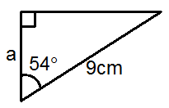
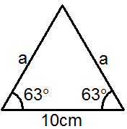
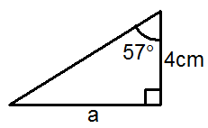
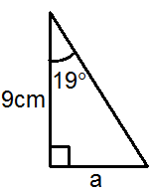
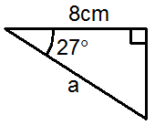
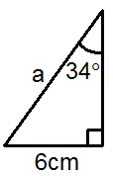
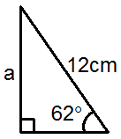
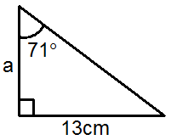
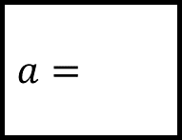
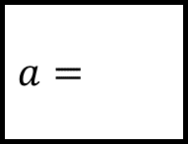

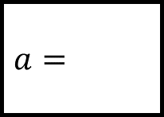




$$a=$$
$$a=$$
$$a=$$
Trigonometry Spider 1
Calculate the missing sides…
$$a=$$
$$a=$$
$$a=$$
$$a=$$
$$a=$$
Please show all your workings
Give your answers to 1dp

Slide 2
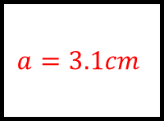
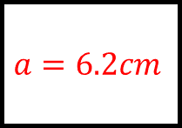
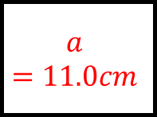
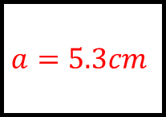
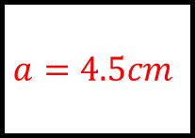
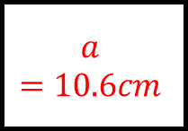
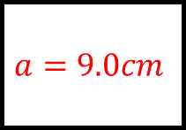
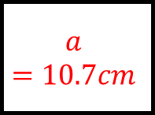
Trigonometry Spider 1 - Answers
$$a=5.3cm$$
$$a=11.0cm$$
$$a=6.2cm$$
Calculate the missing sides…
$$a=3.1cm$$
$$a=9.0cm$$
$$a=10.7cm$$
$$a=10.6cm$$
$$a=4.5cm$$
Please show all your workings
Give your answers to 1dp

Slide 3
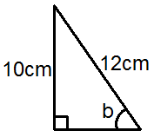
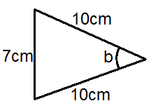
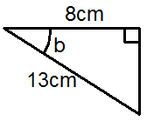
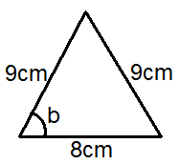
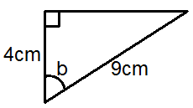
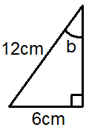
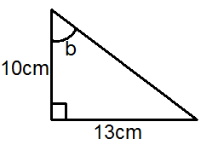
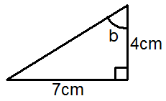
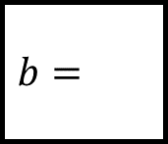
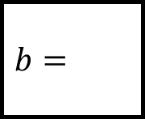
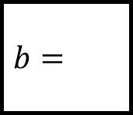
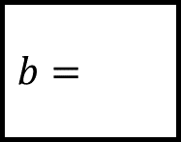


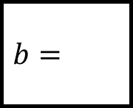
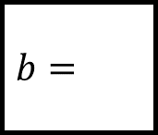
$$b=$$
$$b=$$
$$b=$$
Trigonometry Spider 2
Calculate the missing angles…
$$b=$$
$$b=$$
$$b=$$
$$b=$$
$$b=$$
Please show all your workings
Give your answers to 1dp

Slide 4
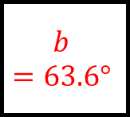
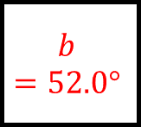
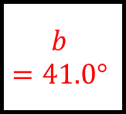

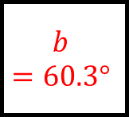
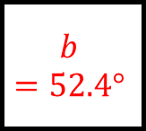
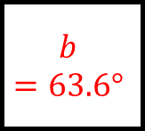
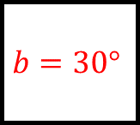
Trigonometry Spider 2 - Answers
$$b=56.4°$$
$$b=41.0°$$
$$b=52.0°$$
Calculate the missing angles…
$$b=63.6°$$
$$b=63.6°$$
$$b=30°$$
$$b=52.4°$$
$$b=60.3°$$
Please show all your workings
Give your answers to 1dp

Slide 5
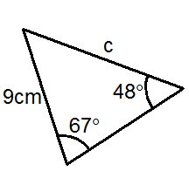
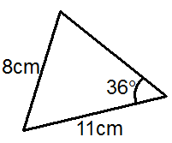
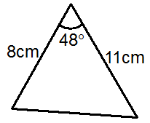
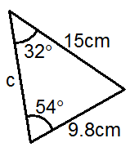
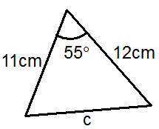
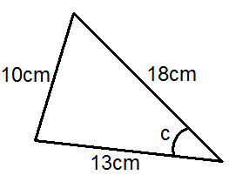
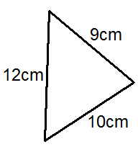
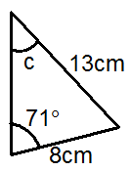
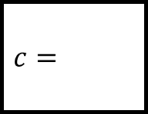

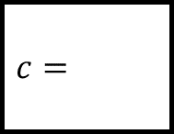


$$c=$$
Area:
Area:
Trigonometry Spider 3
Answer the questions on each leg…
$$c=$$
$$c=$$
$$c=$$
Area:
$$c=$$
Please show all your workings
Give your answers to 1dp

Slide 6








Trigonometry Spider 3 - Answers
$$c=11.1cm$$
Area:
$$44.0{cm}^{2}$$
Area:
$$32.7{cm}^{2}$$
Answer the questions on each leg…
$$c=18.5cm$$
$$c=10.7cm$$
$$c=32.9°$$
Area:
$$44.0{cm}^{2}$$
$$c=35.6°$$
Please show all your workings
Give your answers to 1dp

Slide 7








Please show all your workings
$$STU=$$
$$CAG=$$
Trigonometry Spider 4 - Answers
Answer the questions on each leg…
$$VXZ=$$
$$PRT=$$
Give your answers to 1dp

Slide 8




Please show all your workings
$$STU=57.8°$$
$$CAG=26.6°$$
Trigonometry Spider 4 - Answers
Answer the questions on each leg…
$$VXZ=58.0°$$
$$PRT=14.9°$$
Give your answers to 1dp

