Slide 1
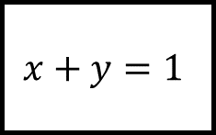
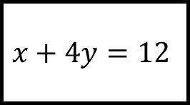
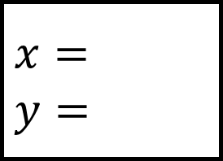
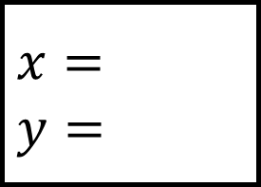
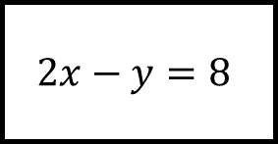
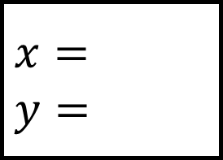
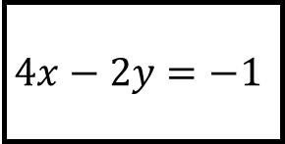
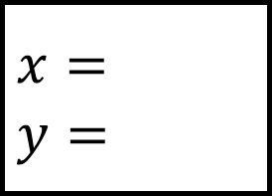
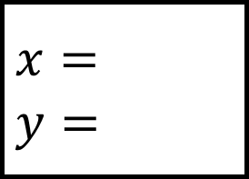
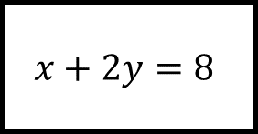
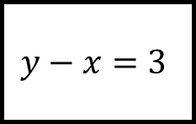
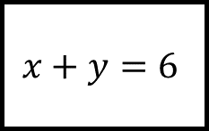
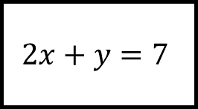
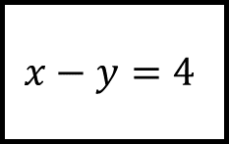
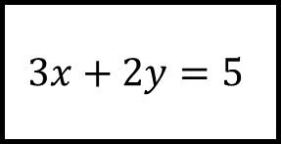
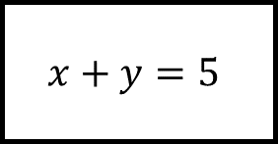
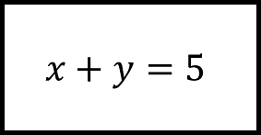
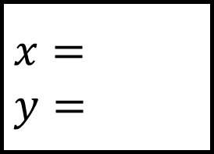
$$x=$$
$$y=$$
Simultaneous Equations Spider 1
$$x=$$
$$y=$$
$$3x+2y=5$$
$$2x+y=7$$
$$2x−y=8$$
$$x+y=5$$
Solve each pair of simultaneous equations
$$x=$$
$$y=$$
$$x=$$
$$y=$$
$$y−x=3$$
$$x+y=1$$
$$x+y=6$$
$$x−y=4$$
$$x+y=5$$
$$x+2y=8$$
$$x=$$
$$y=$$
Show your method in each case
$$x=$$
$$y=$$
$$4x−2y=−1$$
$$x+4y=12$$

Slide 2
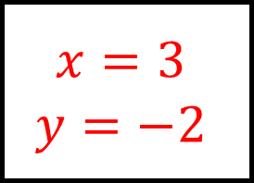
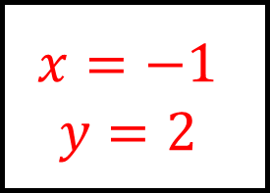
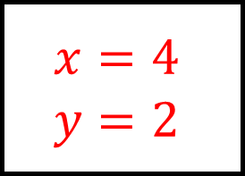
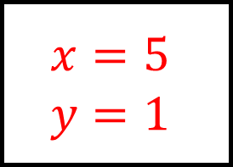
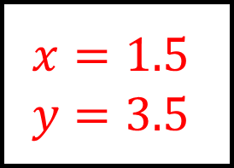
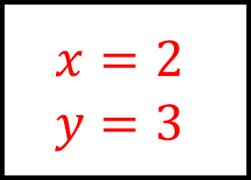
$$x=3$$
$$y=−2$$
Simultaneous Equations Spider 1 – Answers
$$x=2$$
$$y=3$$
$$3x+2y=5$$
$$2x+y=7$$
$$2x−y=8$$
$$x+y=5$$
Solve each pair of simultaneous equations
$$x=5$$
$$y=1$$
$$x=−1$$
$$y=2$$
$$y−x=3$$
$$x+y=1$$
$$x+y=6$$
$$x−y=4$$
$$x+y=5$$
$$x+2y=8$$
$$x=1.5$$
$$y=3.5$$
Show your method in each case
$$x=4$$
$$y=2$$
$$4x−2y=−1$$
$$x+4y=12$$

Slide 3
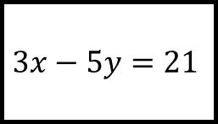
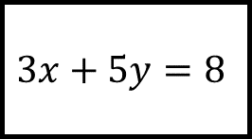
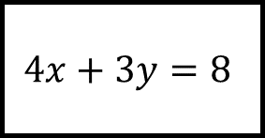
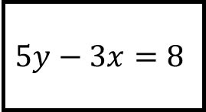
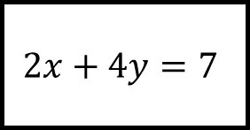
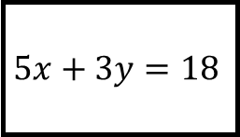
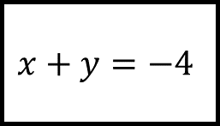
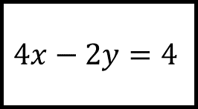
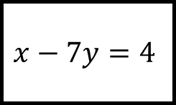
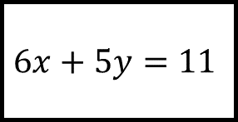
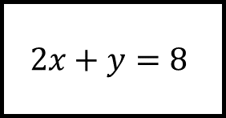
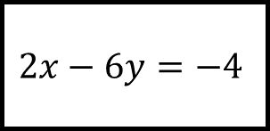
$$x=$$
$$y=$$
Simultaneous Equations Spider 2
$$x=$$
$$y=$$
$$6x+5y=11$$
$$4x−2y=4$$
$$4x+3y=8$$
$$2x+y=8$$
Solve each pair of simultaneous equations
$$x=$$
$$y=$$
$$x=$$
$$y=$$
$$5x+3y=18$$
$$3x−5y=21$$
$$x+y=−4$$
$$x−7y=4$$
$$2x−6y=−4$$
$$2x+4y=7$$
$$x=$$
$$y=$$
Show your method in each case
$$x=$$
$$y=$$
$$5y−3x=8$$
$$3x+5y=8$$

Slide 4
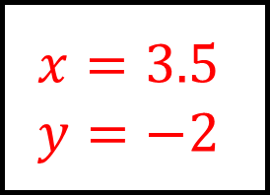
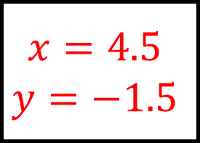
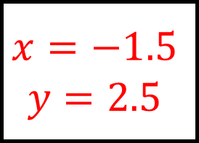
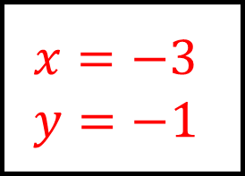
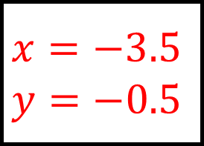
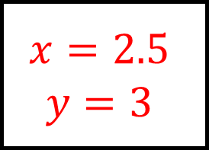
$$x=3.5$$
$$y=−2$$
Simultaneous Equations Spider 2 – Answers
$$x=2.5$$
$$y=3$$
$$6x+5y=11$$
$$4x−2y=4$$
$$4x+3y=8$$
$$2x+y=8$$
Solve each pair of simultaneous equations
$$x=−3$$
$$y=−1$$
$$x=4.5$$
$$y=−1.5$$
$$5x+3y=18$$
$$3x−5y=21$$
$$x+y=−4$$
$$x−7y=4$$
$$2x−6y=−4$$
$$2x+4y=7$$
$$x=−3.5$$
$$y=−0.5$$
Show your method in each case
$$x=−1.5$$
$$y=2.5$$
$$5y−3x=8$$
$$3x+5y=8$$

Slide 5
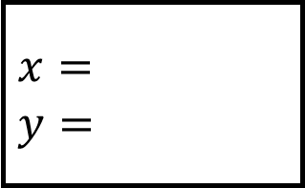
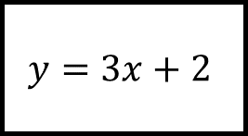
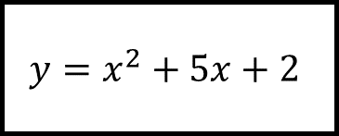
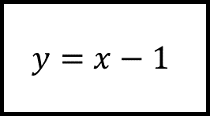
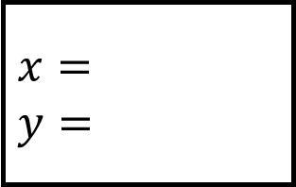
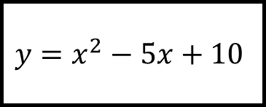
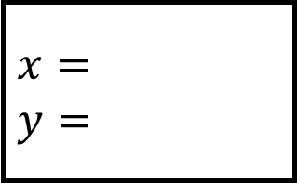
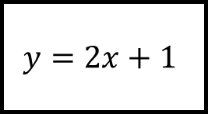




$$x=$$
$$y=$$
Simultaneous Equations Spider 3
$$x=$$
$$y=$$
$$y=3x+2$$
$$y=x+2$$
$$y=x^{2}+2x−4$$
$$y=x^{2}−5x+10$$
Solve each pair of simultaneous equations
$$y=x^{2}+x−1$$
$$y=x^{2}+5x+2$$
$$x=$$
$$y=$$
Show your method in each case
$$x=$$
$$y=$$
$$y=2x+1$$
$$y=x−1$$

Slide 6




$$x=−2 \& 3$$
$$y=−4 \& 11$$
Simultaneous Equations Spider 3 – Answers
$$x=2 \& 4$$
$$y=4 \& 6$$
$$y=3x+2$$
$$y=x+2$$
$$y=x^{2}+2x−4$$
$$y=x^{2}−5x+10$$
Solve each pair of simultaneous equations
$$y=x^{2}+x−1$$
$$y=x^{2}+5x+2$$
$$x=−1 \& 2$$
$$y=−1 \& 5$$
Show your method in each case
$$x=−1 \& −3$$
$$y=−2 \& −4$$
$$y=2x+1$$
$$y=x−1$$

Slide 7











$$x=$$
$$y=$$
Simultaneous Equations Spider 4 – Answers
$$x=$$
$$y=$$
$$x+3y=1$$
$$y=x−1$$
$$x^{2}+y^{2}=5$$
$$x^{2}−y^{2}=5$$
Solve each pair of simultaneous equations
$$x^{2}+y^{2}=2$$
$$x^{2}+y^{2}=17$$
$$x=$$
$$y=$$
Show your method in each case
$$x=$$
$$y=$$
$$y=2x+1$$
$$y=x+3$$

Slide 8




$$x={11}/5 \& −2$$
$$y=−2/5 \& 1$$
Simultaneous Equations Spider 4 – Answers
$$x=3$$
$$y=2$$
$$x+3y=1$$
$$y=x−1$$
$$x^{2}+y^{2}=5$$
$$x^{2}−y^{2}=5$$
Solve each pair of simultaneous equations
$$x^{2}+y^{2}=2$$
$$x^{2}+y^{2}=17$$
$$x=1/5 \& −1$$
$$y=7/5 \& −1$$
Show your method in each case
$$x=−4 \& 1$$
$$y=−1 \& 4$$
$$y=2x+1$$
$$y=x+3$$

Slide 9


















$$x=$$
$$y=$$
Simultaneous Equations Spider – Answers
$$x=$$
$$y=$$
Solve each pair of simultaneous equations
$$x=$$
$$y=$$
$$x=$$
$$y=$$
$$x=$$
$$y=$$
Show your method in each case
$$x=$$
$$y=$$

