Slide 1
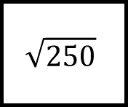
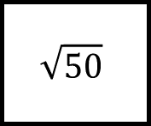
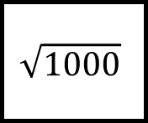
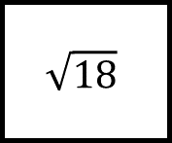
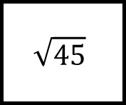
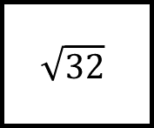
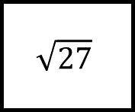
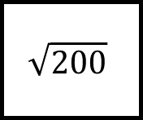
Surds Spider 1
$$\sqrt{18}$$
$$\sqrt{1000}$$
$$\sqrt{50}$$
Fill in the blanks…
$$\sqrt{250}$$
$$\sqrt{27}$$
$$\sqrt{200}$$
$$\sqrt{45}$$
$$\sqrt{32}$$
Simplify the surds on each leg fully
You must show all your workings

Slide 2
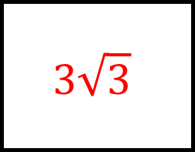
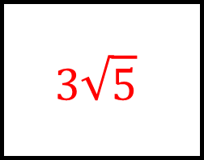
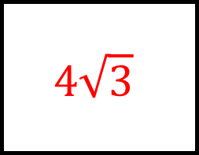
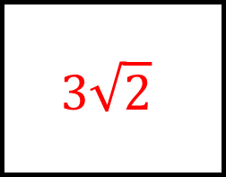
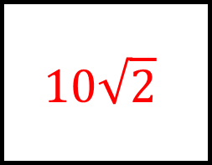
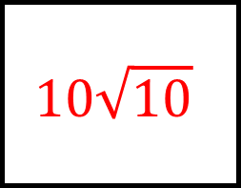
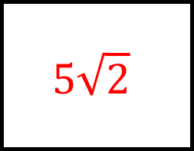
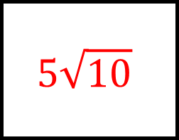
$$3\sqrt{2}$$
$$10\sqrt{10}$$
$$5\sqrt{2}$$
Surds Spider 1
Answers
$$\sqrt{18}$$
$$\sqrt{1000}$$
$$\sqrt{50}$$
$$5\sqrt{10}$$
Fill in the blanks…
$$3\sqrt{3}$$
$$\sqrt{250}$$
$$\sqrt{27}$$
$$\sqrt{200}$$
$$\sqrt{45}$$
$$\sqrt{32}$$
Simplify the surds on each leg fully
You must show all your workings
$$10\sqrt{2}$$
$$4\sqrt{3}$$
$$3\sqrt{5}$$

Slide 3
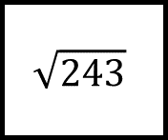
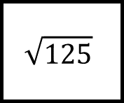
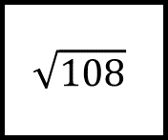
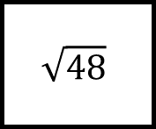

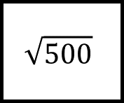
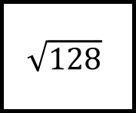
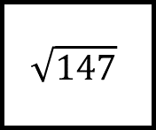
Surds Spider 2
$$\sqrt{48}$$
$$\sqrt{108}$$
$$\sqrt{125}$$
Fill in the blanks…
$$\sqrt{243}$$
$$\sqrt{128}$$
$$\sqrt{147}$$
$$\sqrt{242}$$
$$\sqrt{500}$$
Simplify the surds on each leg fully
You must show all your workings

Slide 4
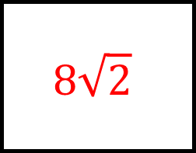
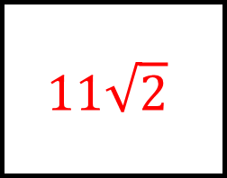
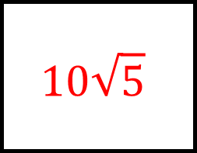

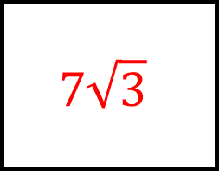
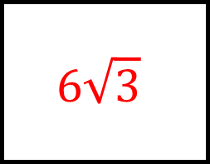
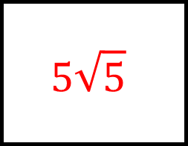
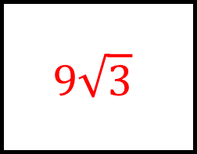
$$4\sqrt{3}$$
$$6\sqrt{3}$$
$$5\sqrt{5}$$
Surds Spider 2
Answers
$$\sqrt{48}$$
$$\sqrt{108}$$
$$\sqrt{125}$$
$$9\sqrt{3}$$
Fill in the blanks…
$$8\sqrt{2}$$
$$\sqrt{243}$$
$$\sqrt{128}$$
$$\sqrt{147}$$
$$\sqrt{242}$$
$$\sqrt{500}$$
Simplify the surds on each leg fully
You must show all your workings
$$7\sqrt{3}$$
$$10\sqrt{5}$$
$$11\sqrt{2}$$

Slide 5
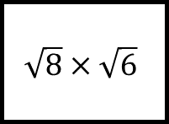
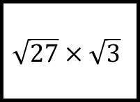
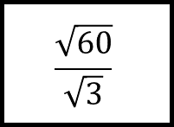
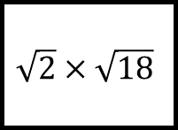
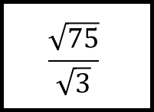
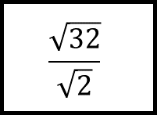
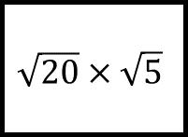
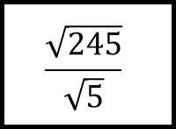
Surds Spider 3
$$\sqrt{2}×\sqrt{18}$$
$$\frac{\sqrt{60}}{\sqrt{3}}$$
$$\sqrt{27}×\sqrt{3}$$
Fill in the blanks…
$$\sqrt{8}×\sqrt{6}$$
$$\sqrt{20}×\sqrt{5}$$
$$\frac{\sqrt{245}}{\sqrt{5}}$$
$$\frac{\sqrt{75}}{\sqrt{3}}$$
$$\frac{\sqrt{32}}{\sqrt{2}}$$
Simplify the surd calculations on each leg fully
You must show all your workings

Slide 6
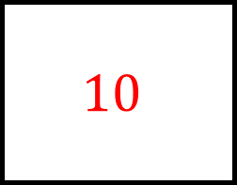
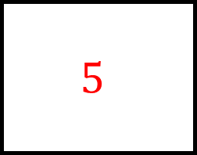


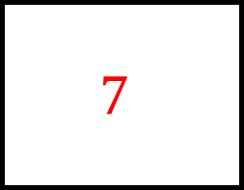
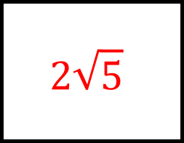
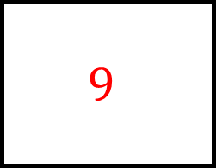
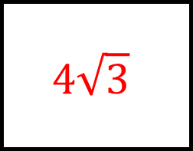
$$6$$
$$2\sqrt{5}$$
$$9$$
Surds Spider 3
Answers
$$\sqrt{2}×\sqrt{18}$$
$$\frac{\sqrt{60}}{\sqrt{3}}$$
$$\sqrt{27}×\sqrt{3}$$
$$4\sqrt{3}$$
Fill in the blanks…
$$10$$
$$\sqrt{8}×\sqrt{6}$$
$$\sqrt{20}×\sqrt{5}$$
$$\frac{\sqrt{245}}{\sqrt{5}}$$
$$\frac{\sqrt{75}}{\sqrt{3}}$$
$$\frac{\sqrt{32}}{\sqrt{2}}$$
Simplify the surd calculations on each leg fully
You must show all your workings
$$7$$
$$4$$
$$5$$

Slide 7
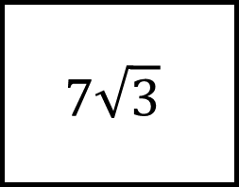
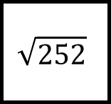
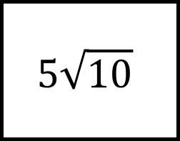
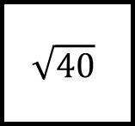
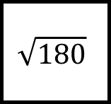
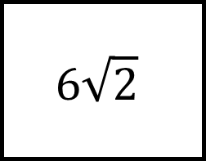






Surds Spider 4
$$\sqrt{252}$$
$$\sqrt{18}$$
$$\sqrt{112}$$
$$\sqrt{8}$$
You must show all your workings
$$5\sqrt{10}$$
Fill in the blanks…
$$6\sqrt{2}$$
$$\sqrt{40}$$
$$\sqrt{32}$$
$$9\sqrt{5}$$
The surds on each leg add to the surd on the end of the leg
$$7\sqrt{3}$$
$$\sqrt{180}$$
$$\sqrt{27}$$

Slide 8






Surds Spider 4
Answers
$$10\sqrt{7}$$
$$5\sqrt{2}$$
$$\sqrt{252}$$
$$\sqrt{18}$$
$$\sqrt{112}$$
$$\sqrt{8}$$
You must show all your workings
$$5\sqrt{10}$$
Fill in the blanks…
$$6\sqrt{2}$$
$$\sqrt{90}$$
$$\sqrt{40}$$
$$\sqrt{32}$$
$$\sqrt{8}$$
$$\sqrt{45}$$
$$\sqrt{48}$$
$$9\sqrt{5}$$
The surds on each leg add to the surd on the end of the leg
$$7\sqrt{3}$$
$$\sqrt{180}$$
$$\sqrt{27}$$

Slide 9








Surds Spider 5
$$\frac{7}{\sqrt{3}}$$
$$\frac{25}{\sqrt{15}}$$
$$\frac{8}{\sqrt{5}}$$
Fill in the blanks…
$$\frac{15}{\sqrt{10}}$$
$$\frac{11}{\sqrt{2}}$$
$$\frac{21}{\sqrt{7}}$$
$$\frac{30}{\sqrt{5}}$$
$$\frac{12}{\sqrt{3}}$$
Rationalise the denominators and simplify fully
You must show all your workings

Slide 10








$$\frac{7\sqrt{3}}{3}$$
$$\frac{5\sqrt{15}}{3}$$
$$\frac{8\sqrt{5}}{5}$$
Surds Spider 5
Answers
$$\frac{7}{\sqrt{3}}$$
$$\frac{25}{\sqrt{15}}$$
$$\frac{8}{\sqrt{5}}$$
$$\frac{3\sqrt{10}}{2}$$
Fill in the blanks…
$$\frac{11\sqrt{2}}{2}$$
$$\frac{15}{\sqrt{10}}$$
$$\frac{11}{\sqrt{2}}$$
$$\frac{21}{\sqrt{7}}$$
$$\frac{30}{\sqrt{5}}$$
$$\frac{12}{\sqrt{3}}$$
Rationalise the denominators and simplify fully
You must show all your workings
$$3\sqrt{7}$$
$$4\sqrt{3}$$
$$6\sqrt{5}$$

Slide 11












Surds Spider 6
$$(4+\sqrt{7})$$
$$(5+\sqrt{3})$$
$$(4+\sqrt{7})$$
$$(1+\sqrt{3})$$
Fill in the blanks…
$$(6+\sqrt{5})$$
$$(6−\sqrt{5})$$
$$(\sqrt{2}+3)$$
$$(\sqrt{2}−5)$$
$$(2+\sqrt{3})$$
$$(7−\sqrt{5})$$
$$(2−\sqrt{3})$$
Multiply the surds on each leg to give the surd on the end of the leg
$$(4−\sqrt{5})$$

Slide 12






Surds Spider 6
Answers
$$23+8\sqrt{7}$$
$$8+6\sqrt{3}$$
$$(4+\sqrt{7})$$
$$(5+\sqrt{3})$$
$$(4+\sqrt{7})$$
$$(1+\sqrt{3})$$
$$31$$
Fill in the blanks…
$$−13−2\sqrt{2}$$
$$(6+\sqrt{5})$$
$$(6−\sqrt{5})$$
$$(\sqrt{2}+3)$$
$$(\sqrt{2}−5)$$
$$(2+\sqrt{3})$$
$$(7−\sqrt{5})$$
$$1$$
$$33−11\sqrt{5}$$
$$(2−\sqrt{3})$$
Multiply the surds on each leg to give the surd on the end of the leg
$$(4−\sqrt{5})$$

Slide 13








Surds Spider 7
$$\frac{3}{4+\sqrt{2}}$$
$$\frac{\sqrt{2}−1}{5+\sqrt{2}}$$
$$\frac{5}{2−\sqrt{3}}$$
Fill in the blanks…
$$\frac{7+\sqrt{3}}{\sqrt{3}−1}$$
$$\frac{1}{4+\sqrt{7}}$$
$$\frac{\sqrt{5}}{\sqrt{5}−2}$$
$$\frac{\sqrt{10}}{2+\sqrt{10}}$$
$$\frac{2}{\sqrt{3}−1}$$
Rationalise the denominators and simplify fully
You must show all your workings

Slide 14








$$\frac{12−3\sqrt{2}}{14}$$
$$\frac{−7+6\sqrt{2}}{23}$$
$$10+5\sqrt{3}$$
Surds Spider 7
Answers
$$\frac{3}{4+\sqrt{2}}$$
$$\frac{\sqrt{2}−1}{5+\sqrt{2}}$$
$$\frac{5}{2−\sqrt{3}}$$
$$5+4\sqrt{3}$$
Fill in the blanks…
$$\frac{4−\sqrt{7}}{9}$$
$$\frac{7+\sqrt{3}}{\sqrt{3}−1}$$
$$\frac{1}{4+\sqrt{7}}$$
$$\frac{\sqrt{5}}{\sqrt{5}−2}$$
$$\frac{\sqrt{10}}{2+\sqrt{10}}$$
$$\frac{2}{\sqrt{3}−1}$$
Rationalise the denominators and simplify fully
You must show all your workings
$$5+2\sqrt{5}$$
$$\sqrt{3}+1$$
$$\frac{5−\sqrt{10}}{3}$$

