Slide 1
Inequalities Matching
Part 1:
Match one group to the other.
There will be a “spare” one – what answer should be there?

Slide 2
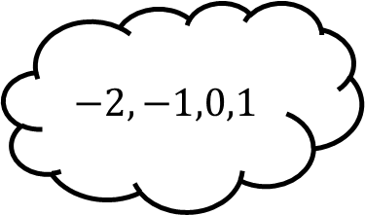
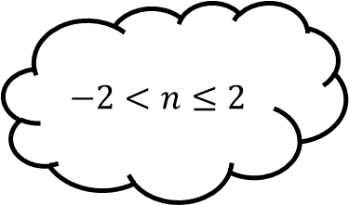
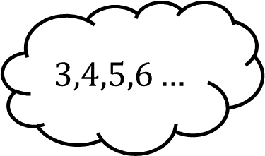
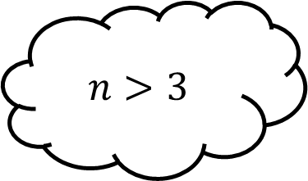
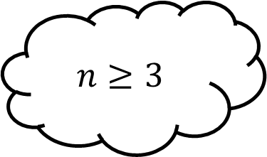
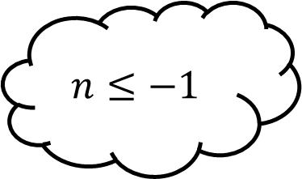
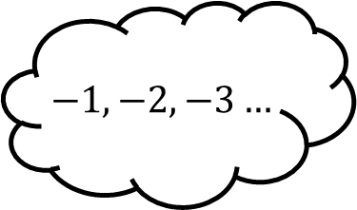
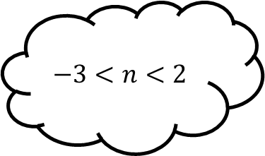
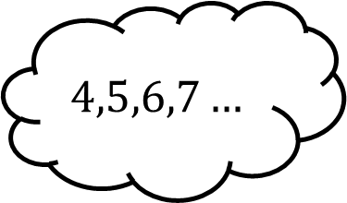
Matching 1
$$3,4,5,6…$$
$$n>3$$
$$n≤−1$$
$$−2,−1,0,1$$
$$−2<n≤2$$
$$4,5,6,7…$$
$$n≥3$$
$$−3<n<2$$
$$−1,−2,−3…$$

Slide 3
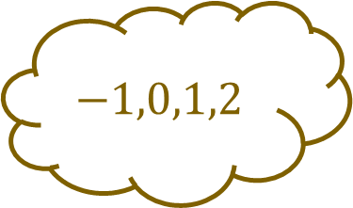
Matching 1 - Answers
$$3,4,5,6…$$
$$n>3$$
$$n≤−1$$
$$−2,−1,0,1$$
$$−2<n≤2$$
$$4,5,6,7…$$
$$n≥3$$
$$−3<n<2$$
$$−1,0,1,2$$
$$−1,−2,−3…$$

Slide 4
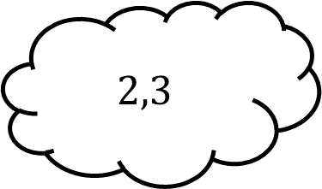
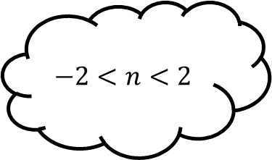
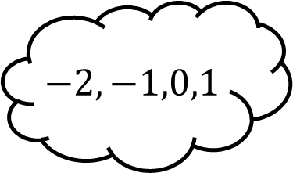
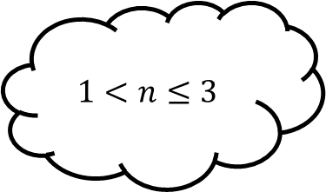
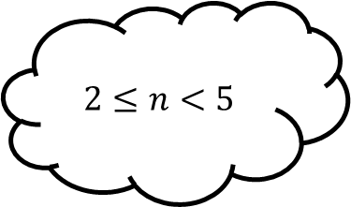
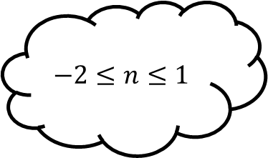
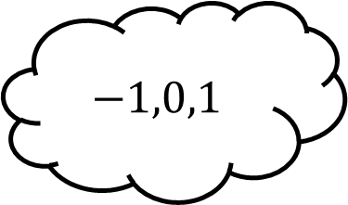
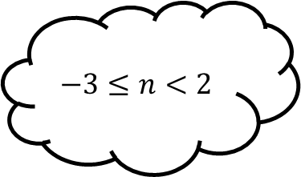
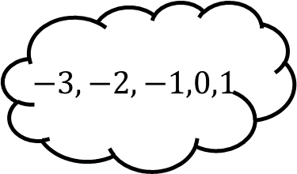
Matching 2
$$−2,−1,0,1$$
$$1<n≤3$$
$$−2≤n≤1$$
$$2,3$$
$$−2<n<2$$
$$−3,−2,−1,0,1$$
$$2≤n<5$$
$$−3≤n<2$$
$$−1,0,1$$

Slide 5
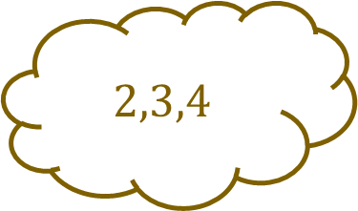
Matching 2 - Answers
$$−2,−1,0,1$$
$$1<n≤3$$
$$−2≤n≤1$$
$$2,3$$
$$−2<n<2$$
$$2,3,4$$
$$−3,−2,−1,0,1$$
$$2≤n<5$$
$$−3≤n<2$$
$$−1,0,1$$

Slide 6
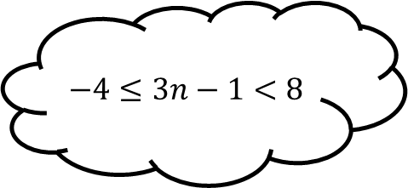
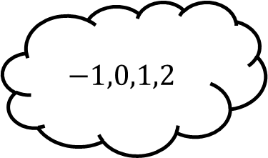
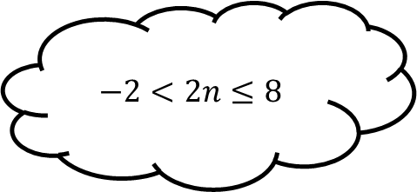
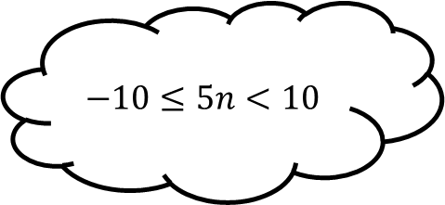
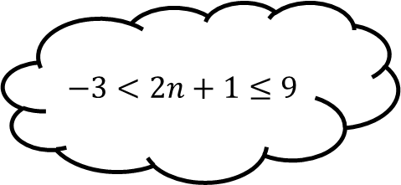
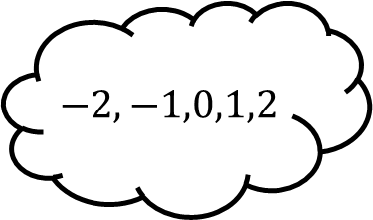
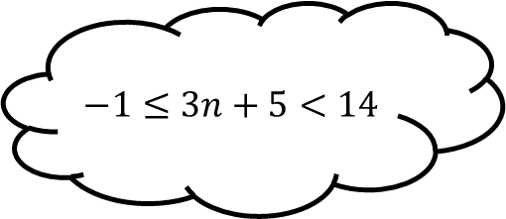
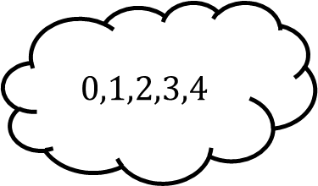
Matching 3
$$−1,0,1,2$$
$$−2<2n≤8$$
$$−3<2n+1≤9$$
$$−2,−1,0,1$$
$$−4≤3n−1<8$$
$$0,1,2,3,4$$
$$−10≤5n<10$$
$$−1≤3n+5<14$$
$$−2,−1,0,1,2$$

Slide 7
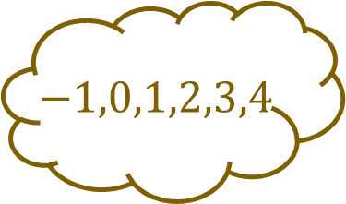
Matching 3 - Answers
$$−1,0,1,2,3,4$$
$$−1,0,1,2$$
$$−2<2n≤8$$
$$−3<2n+1≤9$$
$$−2,−1,0,1$$
$$−4≤3n−1<8$$
$$0,1,2,3,4$$
$$−10≤5n<10$$
$$−1≤3n+5<14$$
$$−2,−1,0,1,2$$

Slide 8
Inequalities Matching
Part 2:
Match all the inequalities that solve to the central inequality.
There are “spares” – what do they solve to?

Slide 9
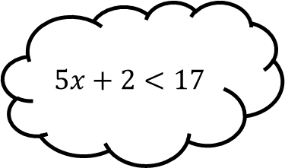
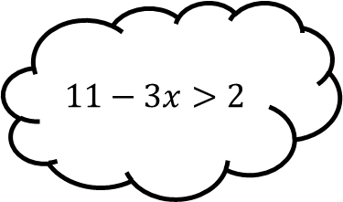
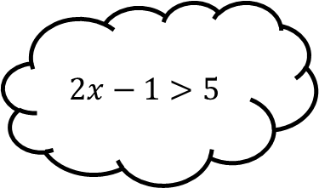
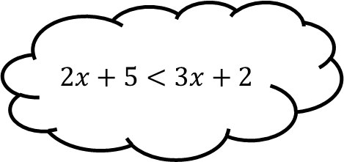
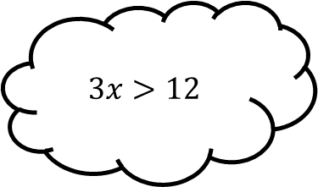
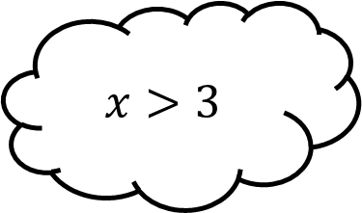
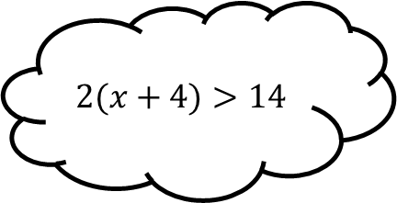
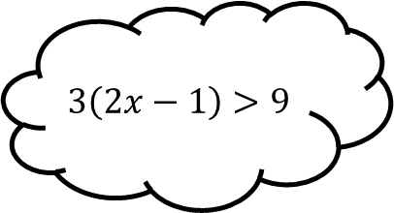
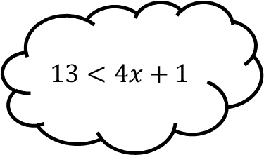
Matching 4
$$3x>12$$
$$2x+5<3x+2$$
$$2x−1>5$$
$$11−3x>2$$
$$x>3$$
$$5x+2<17$$
$$3\left(2x−1\right)>9$$
$$13<4x+1$$
$$2(x+4)>14$$

Slide 10




Matching 4 - Answer
$$3x>12$$
$$2x+5<3x+2$$
$$2x−1>5$$
$$x>4$$
$$11−3x>2$$
$$x>3$$
$$5x+2<17$$
$$x<3$$
$$x<3$$
$$3\left(2x−1\right)>9$$
$$13<4x+1$$
$$2(x+4)>14$$
$$x>2$$

Slide 11
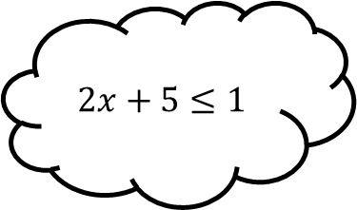
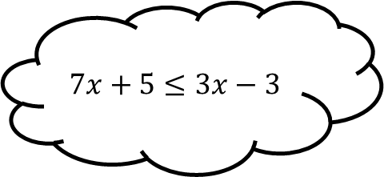
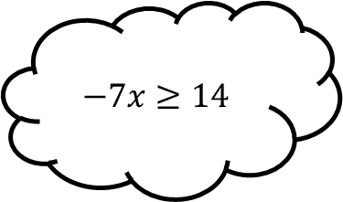
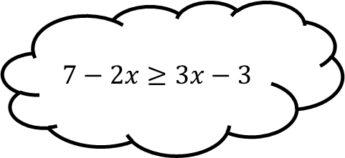
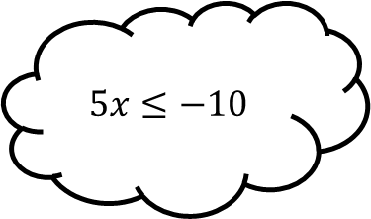
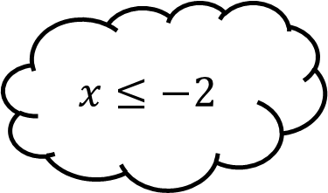
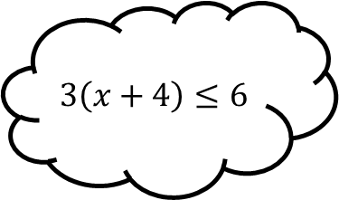
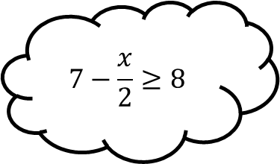
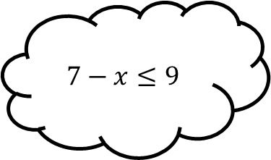
Matching 5
$$5x≤−10$$
$$7−2x≥3x−3$$
$$−7x≥14$$
$$7x+5≤3x−3$$
$$x≤−2$$
$$2x+5≤1$$
$$7−\frac{x}{2}≥8$$
$$7−x≤9$$
$$3\left(x+4\right)≤6$$

Slide 12

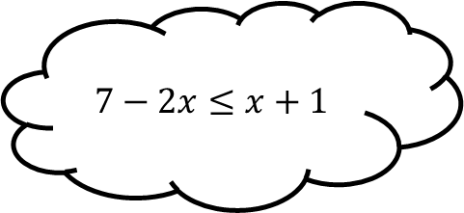

Matching 5 - Answers
$$5x≤−10$$
$$7−2x≤x+1$$
$$−7x≥14$$
$$x≥2$$
$$7x+5≤3x−3$$
$$x≤−2$$
$$2x+5≤1$$
$$7−\frac{x}{2}≥8$$
$$7−x≤9$$
$$3\left(x+4\right)≤6$$
$$x≥−2$$

Slide 13
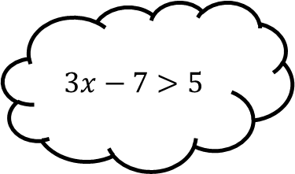
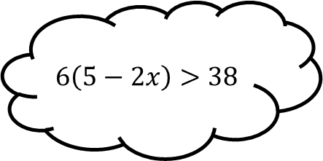







Matching 6
$$−3x<−2$$
$$5x+7>1−4x$$
$$6<−4x$$
$$6\left(5−2x\right)>38$$
$$x>−\frac{2}{3}$$
$$3x−7>5$$
$$7−3x<9$$
$$15x+2>−8$$
$$9x−2>−8$$

Slide 14




Matching 6 - Answers
$$−3x<−2$$
$$5x+7>1−4x$$
$$6<−4x$$
$$x<\frac{2}{3}$$
$$6\left(5−2x\right)>38$$
$$x>−\frac{2}{3}$$
$$3x−7>5$$
$$x<4$$
$$7+3x<9$$
$$15x+2>−8$$
$$9x−2>−8$$
$$x<\frac{2}{3}$$

Slide 15
Inequalities Matching
Part 3:
Match one group to the other.
There will be a “spare” one – what answer should be there?

Slide 16









Matching 7
$x<2$ and
$x>3$
$$x^{2}+5x+6<0$$
$$x^{2}−5x+6>0$$
$x<−5$ and $x>−2$
$$x^{2}−7x+6<0$$
$$−3<x<−2$$
$$x^{2}−4x<0$$
$$x^{2}+7x+10>0$$
$$1<x<6$$

Slide 17

Matching 7 - Answers
$x<2$ and
$x>3$
$$x^{2}+5x+6<0$$
$$x^{2}−5x+6>0$$
$x<−5$ and $x>−2$
$$x^{2}−7x+6<0$$
$$−3<x<−2$$
$$x^{2}−4x<0$$
$$x^{2}+7x+10>0$$
$$0<x<4$$
$$1<x<6$$

Slide 18









Matching 8
$x≤−4$ and $x≥2$
$$x^{2}−6x+8≥0$$
$$x^{2}+3x−10≤0$$
$$−5≤x≤2$$
$$x^{2}−x−2≤0$$
$x≤2$ and $x≥4$
$$x^{2}+2x−8≥0$$
$$x^{2}−3x+5≥3$$
$x≤1$ and $x≥2$

Slide 19

Matching 8 - Answers
$x≤−4$ and $x≥2$
$$x^{2}−6x+8≥0$$
$$x^{2}+3x−10≤0$$
$$−5≤x≤2$$
$$x^{2}−x−2≤0$$
$x≤2$ and $x≥4$
$$x^{2}+2x−8≥0$$
$$−1≤x≤2$$
$$x^{2}−3x+5≥3$$
$x≤1$ and $x≥2$

Slide 20









Matching 9
$$−3<x<\frac{1}{2}$$
$$x^{2}+7x−4>5x−1$$
$$2x^{2}−3x−5<2x−8$$
$$−2<x<\frac{1}{2}$$
$$3x^{2}+7x−3<x^{2}+2x$$
$x<−3$ and $x>1$
$$3x^{2}−6x+1>2x−3$$
$$2x^{2}+4x−1<x+1$$
$x<\frac{2}{3}$ and
$$x>2$$

Slide 21

Matching 9 - Answers
$$1<x<\frac{3}{2}$$
$$−3<x<\frac{1}{2}$$
$$x^{2}+7x−4>5x−1$$
$$2x^{2}−3x−5<2x−8$$
$$−2<x<\frac{1}{2}$$
$$3x^{2}+7x−3<x^{2}+2x$$
$x<−3$ and $x>1$
$$3x^{2}−6x+1>2x−3$$
$$2x^{2}+4x−1<x+1$$
$x<\frac{2}{3}$ and
$$x>2$$

