Slide 1
Ratio Matching
Match all the ratios that simplify to the central ratio.
There are “spares” – what do they simplify to?

Slide 2
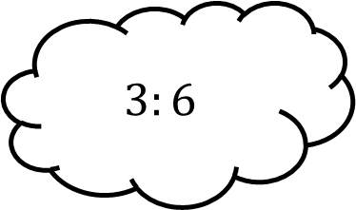
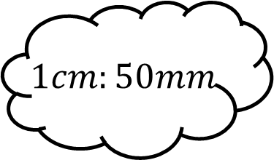
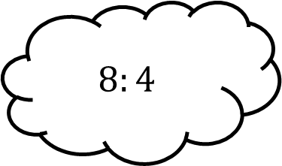
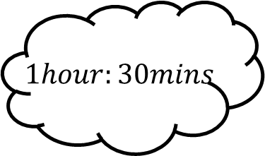
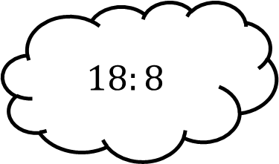
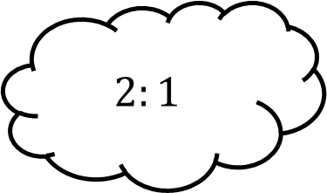
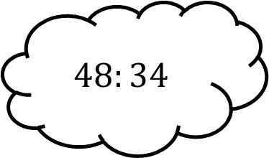
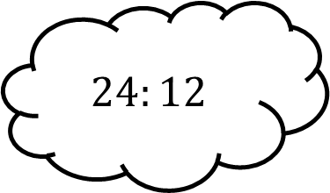
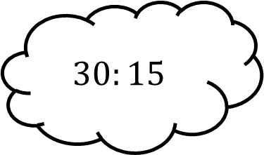
Matching 1
$$8:4$$
$$1hour:30mins$$
$$3:6$$
$$1cm:50mm$$
$$30:15$$
$$2:1$$
$$24:12$$
$$48:34$$
$$18:8$$

Slide 3




Matching 1 - Answers
$$8:4$$
$$1hour:30mins$$
$$3:6$$
$$1:2$$
$$1cm:50mm$$
$$30:15$$
$$2:1$$
$$1:5$$
$$24:12$$
$$48:34$$
$$18:8$$
$$24:17$$
$$9:4$$

Slide 4
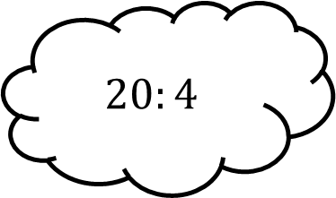
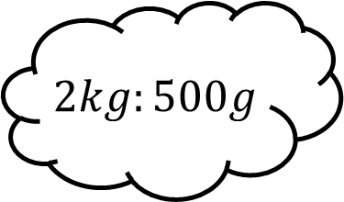

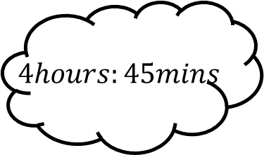
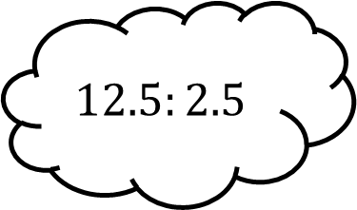
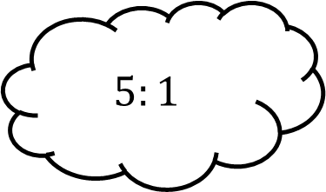
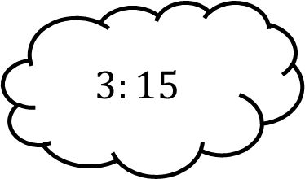
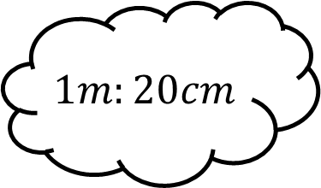
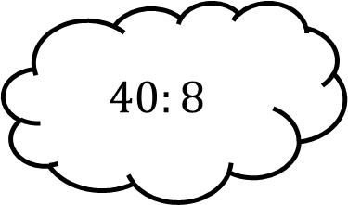
Matching 2
$$10:5$$
$$4hours:45mins$$
$$20:4$$
$$2kg:500g$$
$$40:8$$
$$5:1$$
$$1m:20cm$$
$$3:15$$
$$12.5:2.5$$

Slide 5




Matching 2 - Answers
$$10:5$$
$$4hours:45mins$$
$$20:4$$
$$2:1$$
$$16:3$$
$$2kg:500g$$
$$40:8$$
$$5:1$$
$$4:1$$
$$1m:20cm$$
$$3:15$$
$$12.5:2.5$$
$$1:5$$

Slide 6
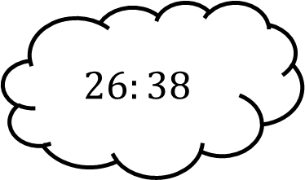
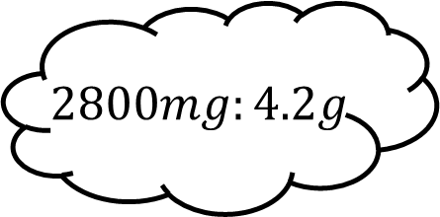
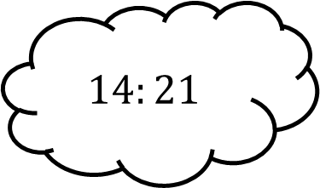
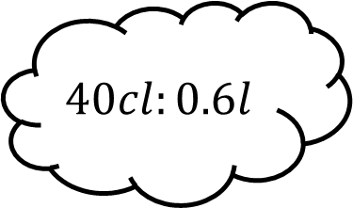
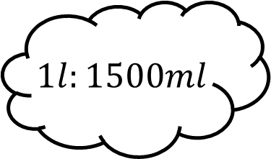

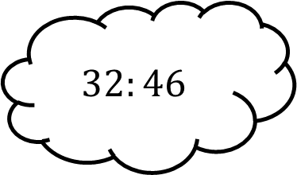
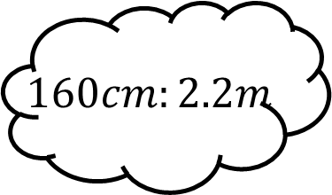
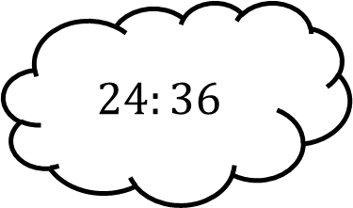
Matching 3
$$14:21$$
$$40cl:0.6l$$
$$26:38$$
$$2800mg:4.2g$$
$$24:36$$
$$2:3$$
$$160cm:2.2m$$
$$32:46$$
$$1l:1500ml$$

Slide 7



Matching 3 - Answers
$$14:21$$
$$40cl:0.6l$$
$$26:38$$
$$13:19$$
$$2800mg:4.2g$$
$$24:36$$
$$2:3$$
$$160cm:2.2m$$
$$32:46$$
$$1l:1500ml$$
$$8:11$$
$$16:23$$

Slide 8
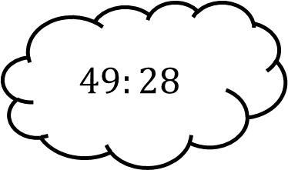
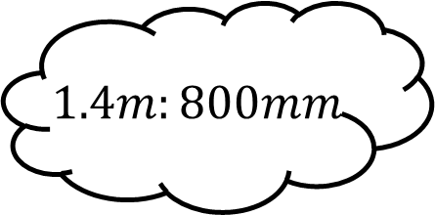
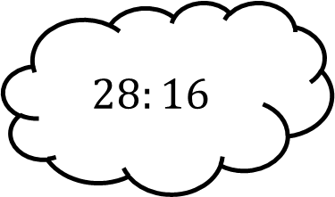
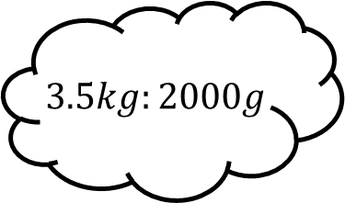
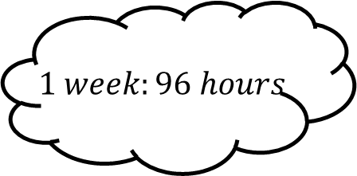
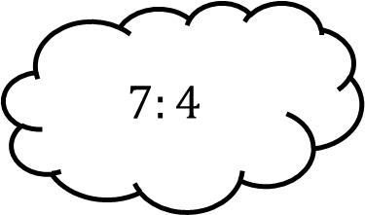
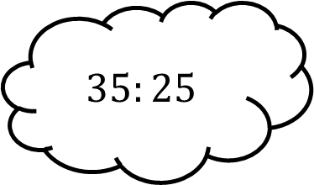
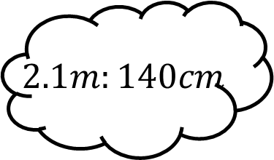
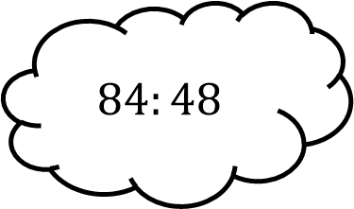
Matching 4
$$28:16$$
$$3.5kg:2000g$$
$$49:28$$
$$1.4m:800mm$$
$$84:48$$
$$7:4$$
$$2.1m:140cm$$
$$35:25$$
$$1 week:96 hours$$

Slide 9


Matching 4 - Answers
$$28:16$$
$$3.5kg:2000g$$
$$49:28$$
$$1.4m:800mm$$
$$84:48$$
$$7:4$$
$$2.1m:140cm$$
$$35:25$$
$$1 week:96 hours$$
$$3:2$$
$$7:5$$

Slide 10









Matching n

